Slide 2
It’s no secret that mental health affects employees just as much–in some cases even more–than physical health. Poor mental health results in less productivity, more absenteeism and low job satisfaction.
- Forbes 2017
Notes:
Earlier this year, Forbes released an article with this quote. It really speaks to how much an employees health, in the case mental health, how an employees health matters. And how if you take care of your employees, your employees will take care of you. Really what it’s saying is.

Slide 3
Corporate Wellness Matters
Notes:
Corporate wellness matters. Hi my name is Andrew, this is Natalie, Tianyi and Al, and we are four computer scientists with experience in building large enterprise systems, to conducting advanced research and even running a computer science conference, and we are here to tackle the corporate wellness space.
Natalie: So what is corporate wellness. [SHORT BLURB 1-2 SENTENCES]. It is a huge industry.

Slide 4
$45.34 Billion
Technavio, 2017
Notes:
Valued at 45.34 Billion this year. And it’s only getting bigger.

Slide 5
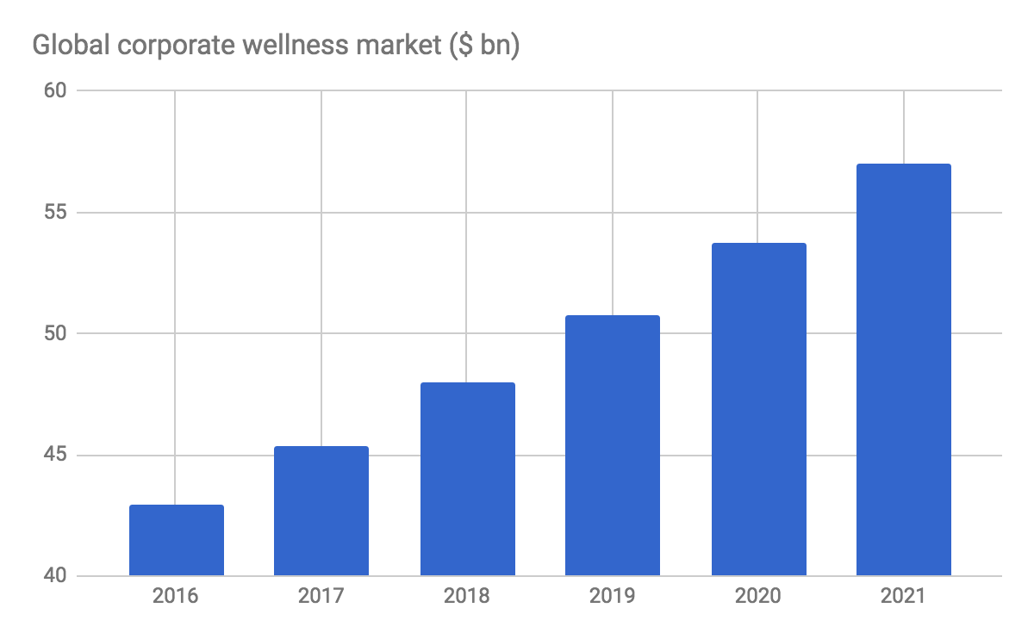
Technavio, 2017
Notes:
Projected to grow to over 55 Billion in 2021.

Slide 6
$6.4 Billion
40% Industry Revenue
3.3%
United States Industry Revenue
Generated by large private sector businesses
Industry annual growth (2016 – 2021)
Notes:
In the US alone, 6.4 billion of revenue is generated every year, with 40% of revenue generated by large private sector businesses which we chose to be our target market. And everything grows at 3.3% annualy.

Slide 7



Market Trends
Rising Government Cooperation
Increased Usage
of Technology
Growing
Program Adoption
Notes:
What’s happening in this space? We are seeing rising government cooperation and support [1-2 SENTENCES] and increased usage of technology [1-2 SENTENCES]

Slide 8
Market Factors
Favorable
Regulatory Landscape
Increase in human lifespan
and longer work hours
Growing Awareness
Notes:
Some driving factors are…

Slide 9
23% Industry Revenue
Accounted for by top four companies
Notes:
Now what is interesting is 23% of industry revenue comes from top four companies in the space.

Slide 10
Major Players
ComPsych
7.4% Market Share
$475.4 Million Revenue
Provides various health programs
Beacon Health Options
5% Market Share
$198.97 Million Revenue
Expertise in workplace health and performance
Notes:
Let’s take a look at two of them, compsych… and beacon health…

Slide 11
Minor Players
Peerfit
Raised $4.36 Million over seven rounds from nine investors.
help insurance carriers, brokers and employers redefine corporate wellness programs.
YouEarnedIt
Raised $8.0 Million over two rounds from six investors.
improving employee experience through integrating wellness incentives with other employee engagement activities.
Notes:
It is also a space being disrupted, here are two examples…

Slide 12

Key Technologies
Mobile Health (mHealth)
Telehealth
Big Data Solutions
Notes:
Whether dominating or starting up, all successful companies recognize the importance of leveraging technology. Some key ones are …

Slide 13

Unsolved Territory
Surface Level Solutions
Intrusiveness
Notes:
Even with advanced technologies, there are still problems left unsolved…

Slide 14
Work Without Worry
Notes:
Work without worry, to allow employers to delegate tasks without worry and to empower employees to be productive without worry.

Slide 15



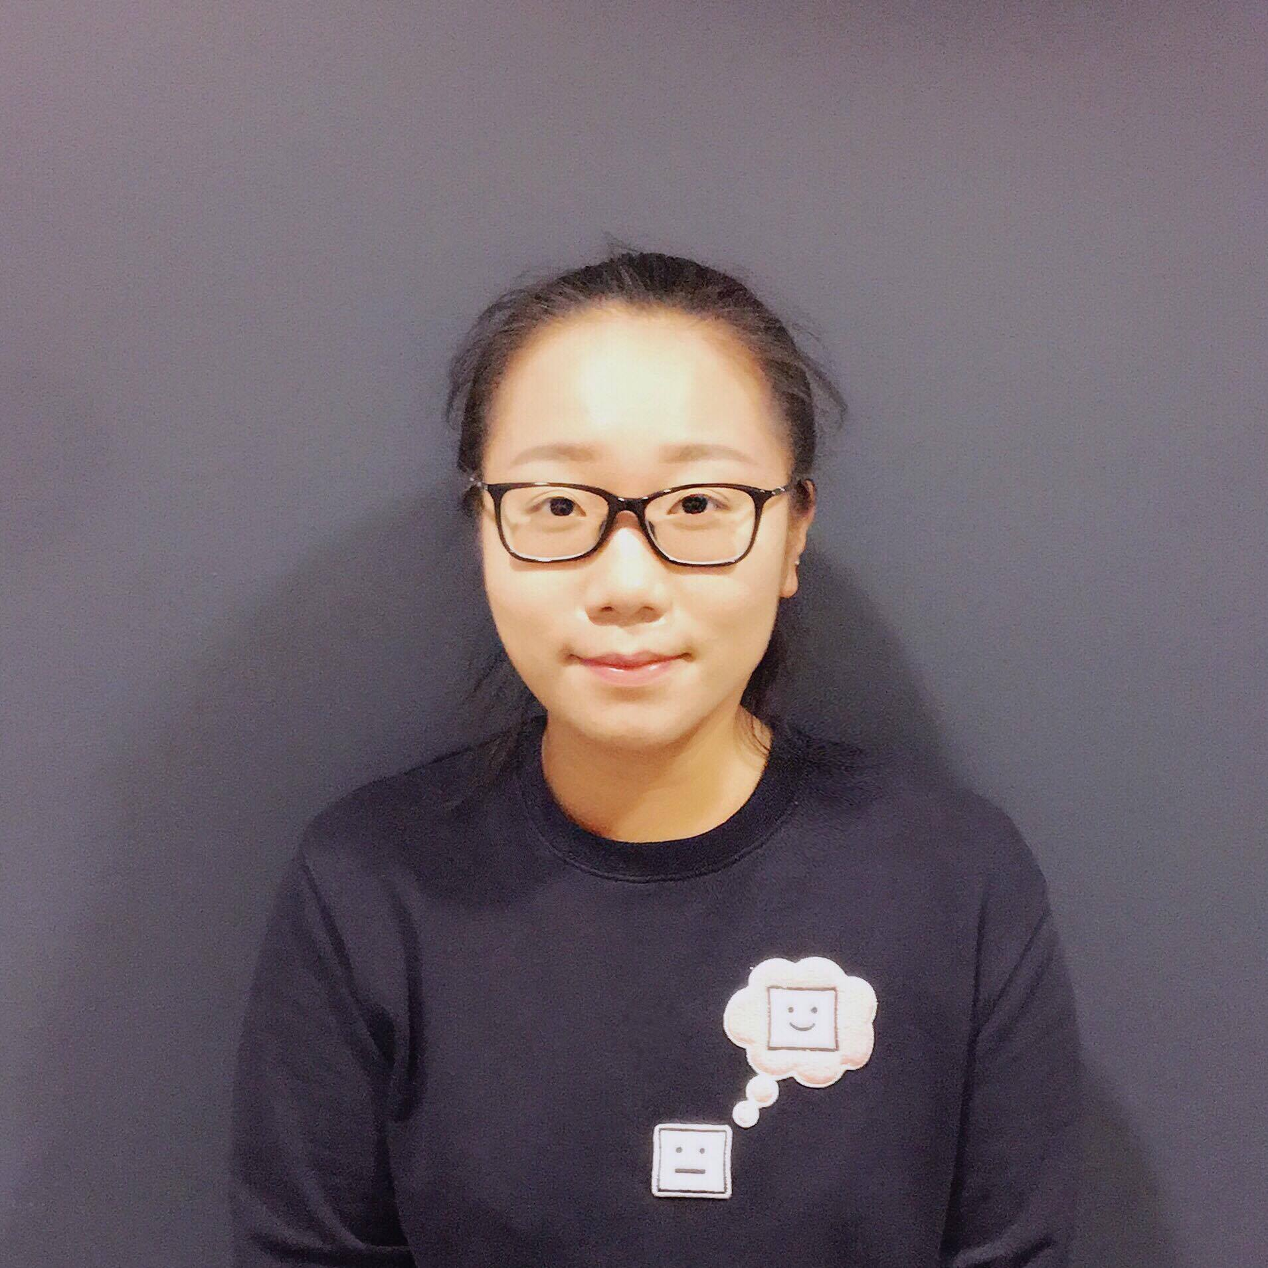
Thanks!
Andrew Xia
Computer Scientist
Natalie Chiang
Computer Scientist
Allahverdi Suleymanov
Computer Scientist
Tianyi Li
Computer Scientist
Notes:
We hope you are as excited about this as we are, thank you and we’d love to take any questions.

Slide 17
SlidesCarnival icons are editable shapes.
This means that you can:
Resize them without losing quality.
Change fill color and opacity.
Change line color, width and style.
Isn’t that nice? :)
Examples:

Slide 18
😉
Now you can use any emoji as an icon!
And of course it resizes without losing quality and you can change the color.
How? Follow Google instructions https://twitter.com/googledocs/status/730087240156643328
✋👆👉👍👤👦👧👨👩👪💃🏃💑❤😂😉😋😒😭👶😸🐟🍒🍔💣📌📖🔨🎃🎈🎨🏈🏰🌏🔌🔑 and many more...

