Slide 1

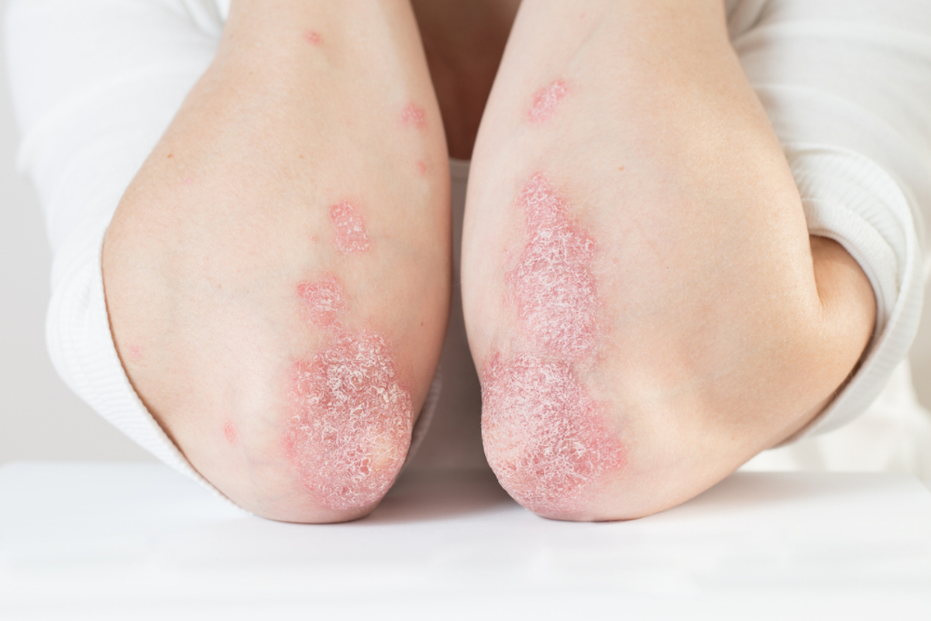

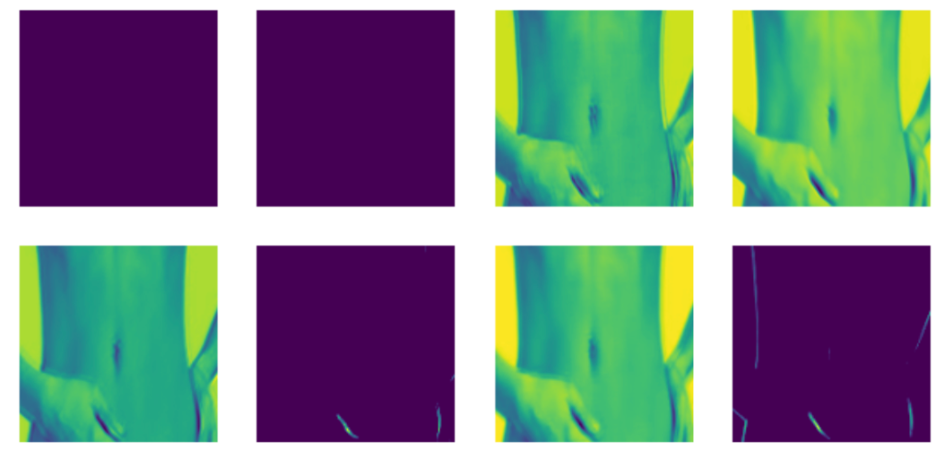
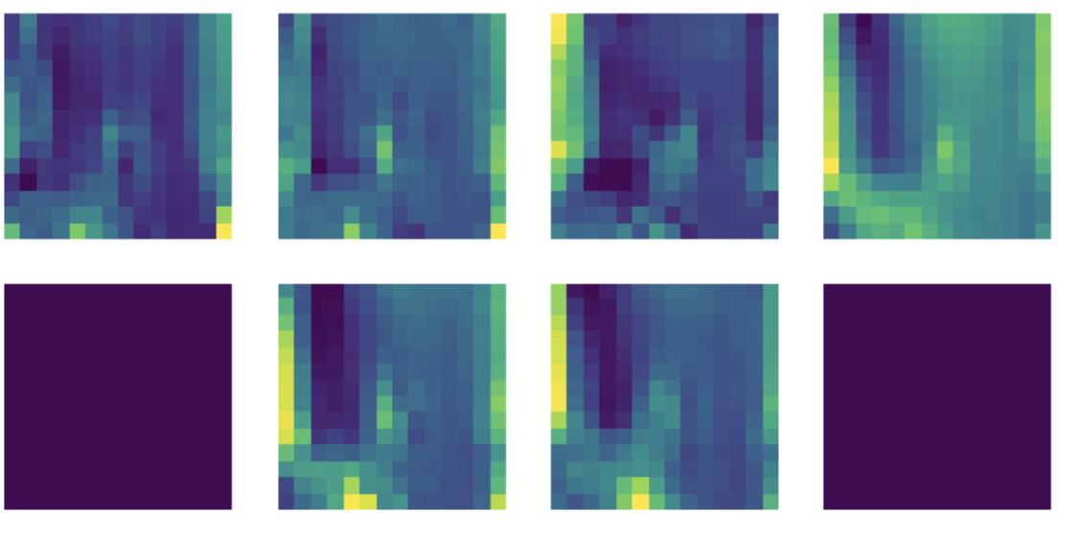
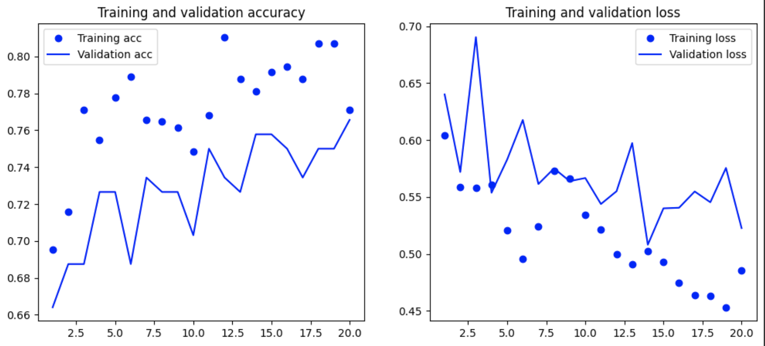
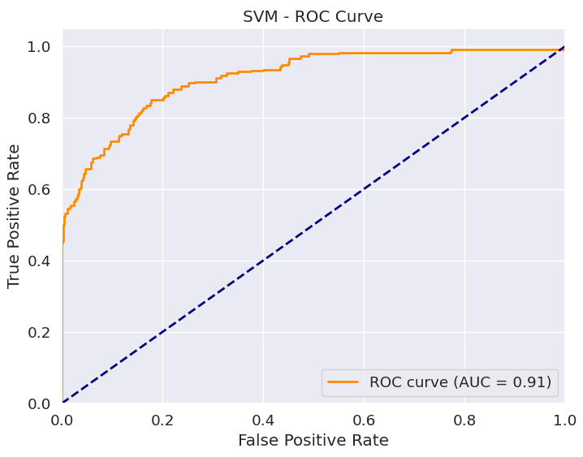
Explore the National Health and Nutrition Examination Survey - Identifying Psoriasis
Authors: Xinran Chen, Tianyu Han, Ying Hong,
Siyu Shen, Shiyuan Xu
Industry Mentors: Prem Sreenivasan
Faculty Mentors: Vivian Zhang
Data Science Capstone Project
with Unilever
Identifying psoriasis
Psoriasis is a chronic autoimmune skin disorder that presents a complex interplay of genetic and environmental factors. While the precise cause of this disease is unclear, several potential influencing factors such as vitamin intake and dietary intake have been identified in past research. Thus, we explored the NHANES dataset with the goal of discovering any insights associated with psoriasis. In addition, we explored image classification on identifying psoriasis.
Model Interpretation
As indicated below, the most important features identified by SVM and Random forest includes age, smoking habits, gender, Vitamin D, BMI, etc. These features aligns with prior domain knowledge, which also strengthen our findings.
Feature maps of the image classifier shows how the model shifts focus from high-level concept to details of the images
Most Important Features (Random Forest):
BMXHT: Standing Height (cm)
RIDAGEEX: Exam Age in Months
BMXBMI: Body Mass Index (kg/m**2)
LBDVIDMS: Vitamin D (nmol/L)
Most Important Features (SVM):
RIAGENDR: Gender
SMQ020: Smoked at least 100 cigarettes in life
DEQ038G: In the past yr did you have sunburn?
ALQ150: Ever have 5 or more drinks every day?
First layer of the classifying model
Last layer of the classifying model before flattening
Figure 3. Feature importance
Figure 4. Feature maps of image classifier
Figure 1. skin with psoriasis Nutrition Examination Survey
Model development
We identified and selected 36 most relevant and interpretable features out of various (dietary, demographic, supplements, physical exams etc.) dataset spanning 4 years. To deal with the imbalance and lack of observations, we employed techniques such as oversampling and data augmentation and applied different types of models including xgboost, logistic regression, and random forest. As a result, fine-tuned xgboost model outperformed others with a 0.96 accuracy and 0.9 precision.
Despite facing difficulties in accessing large image datasets, the image classification model achieves over 70% accuracy in distinguishing healthy skin from psoriasis images.
Conclusions and Recommendations
Our model demonstrates success in healthcare, particularly in diagnosing and treating skin conditions like psoriasis. This highlights its vast potential. The continued advancements in computer vision research are instrumental in paving the way for creating highly efficient, non-invasive, and user-friendly tools. These tools are essential for in-depth dermatological evaluations. Embracing these cutting-edge technologies and encouraging interdisciplinary collaboration is crucial in revolutionizing disease diagnosis. Such advancements can substantially improve patient care outcomes. Incorporating these advanced computational methods in medical diagnostics marks a pivotal shift in healthcare, offering new prospects in patient treatment and overall healthcare management.
Acknowledgments
Dr. Eunyoung Cho, Department of Dermatology, Brown University Medical School
Dr. Larisa J. Geskin, Department of Dermatology, Columbia University Medical Center
References
Lim RK, Woo S, El Raheb S, Qureshi A, Cho E. Association of serum vitamin D levels and psoriasis severity: An Analysis of the US National Health and Nutrition Examination Survey. Presented at: Nutrition 2023; July 22-25, 2023; Boston, MA. Accessed Thursday, July 27, 2023
Figure 2. Model performance for CNN model
Figure 3. ROC curve for SVM model

