Slide 1
Spotify popular music analysis
Team 50
Guotong Ma and Tianyu Liu

Slide 2
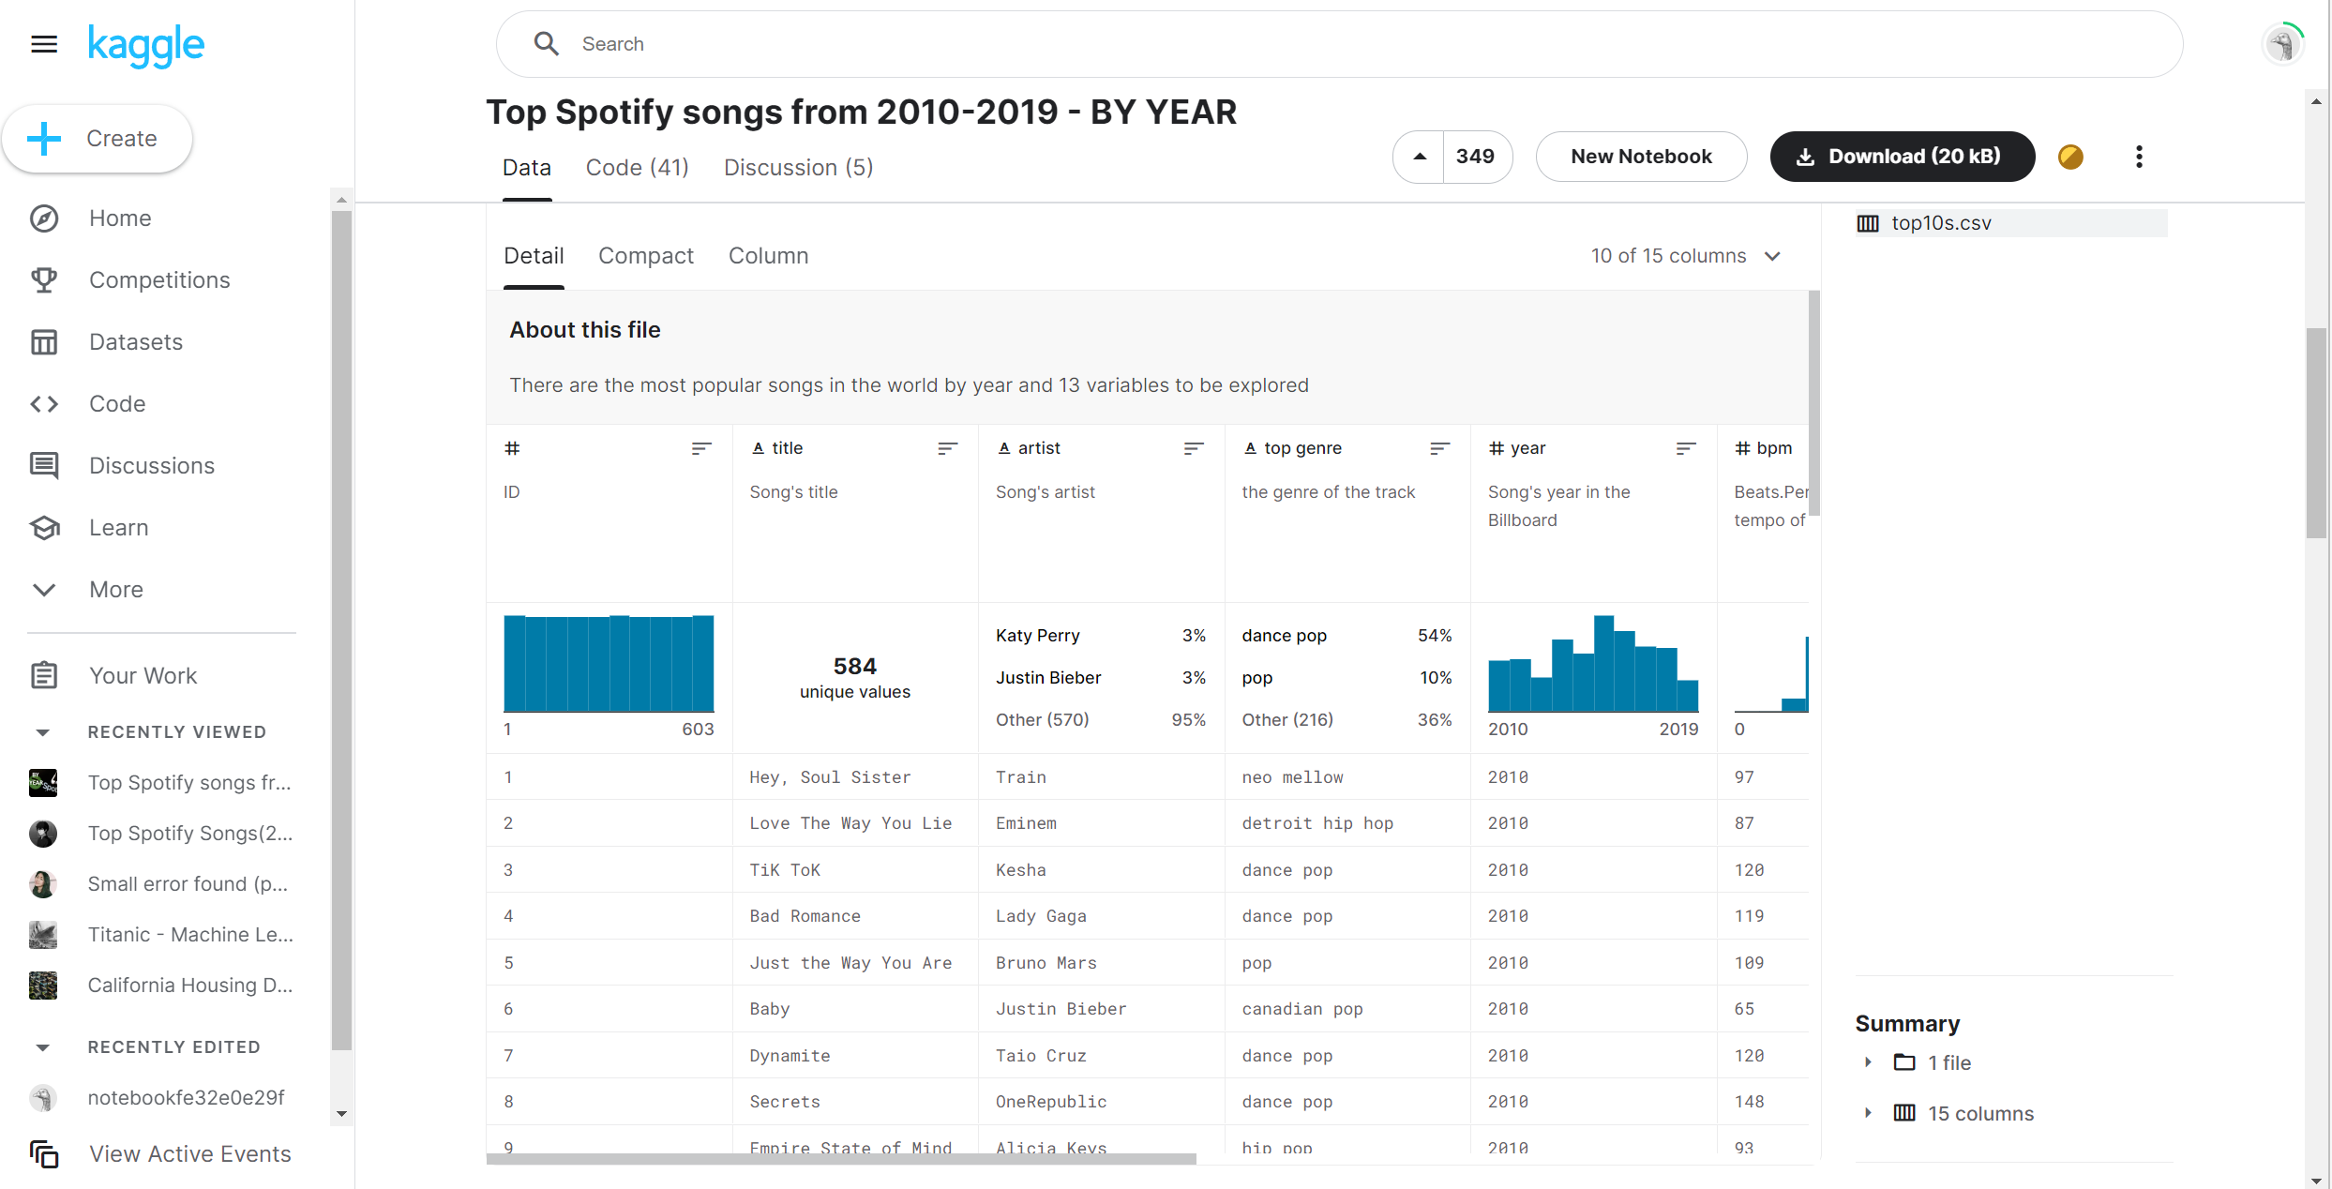
DATASET
Top Spotify songs from 2010-2019 - BY YEAR

Slide 3
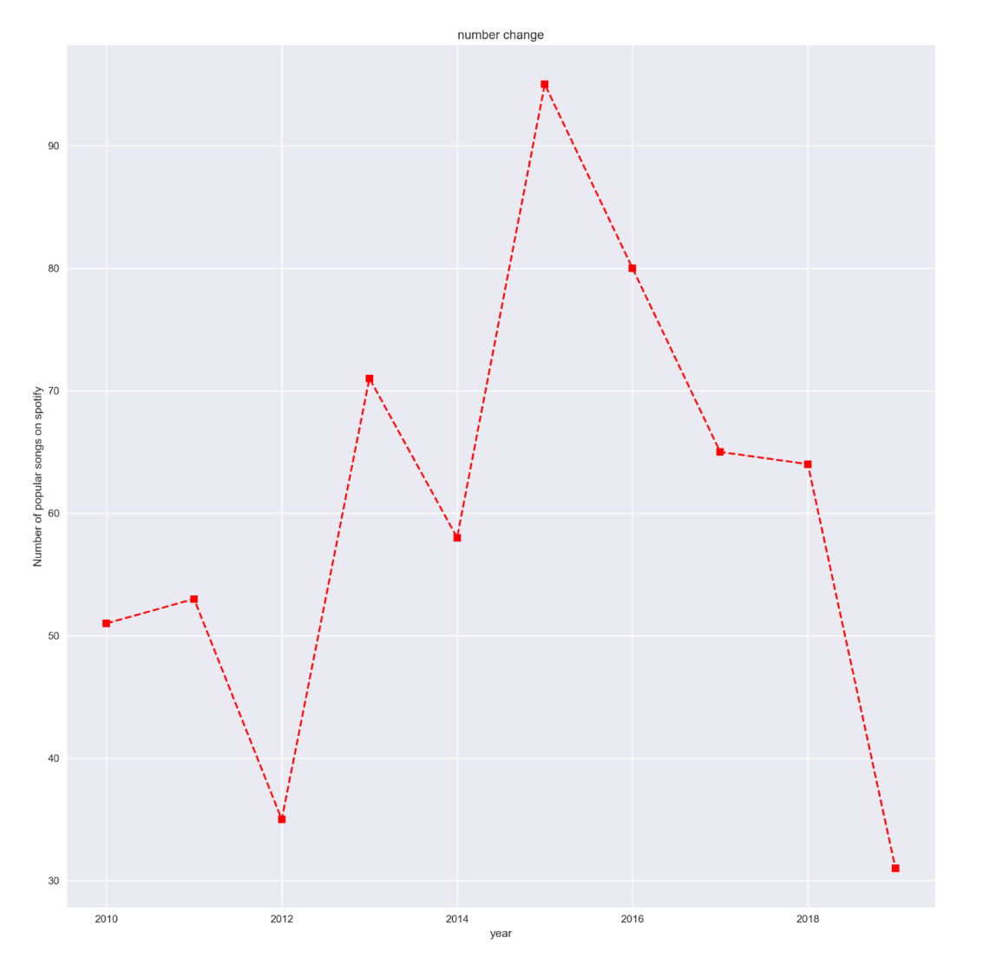
analysis
Q1:Current situation of song industry on spotify
As shown in the figure above, the number of song creations after the epidemic has declined significantly, which means that the appeal of the song market is not as good as before. Now, it is necessary to be more cautious to join the song industry

Slide 4
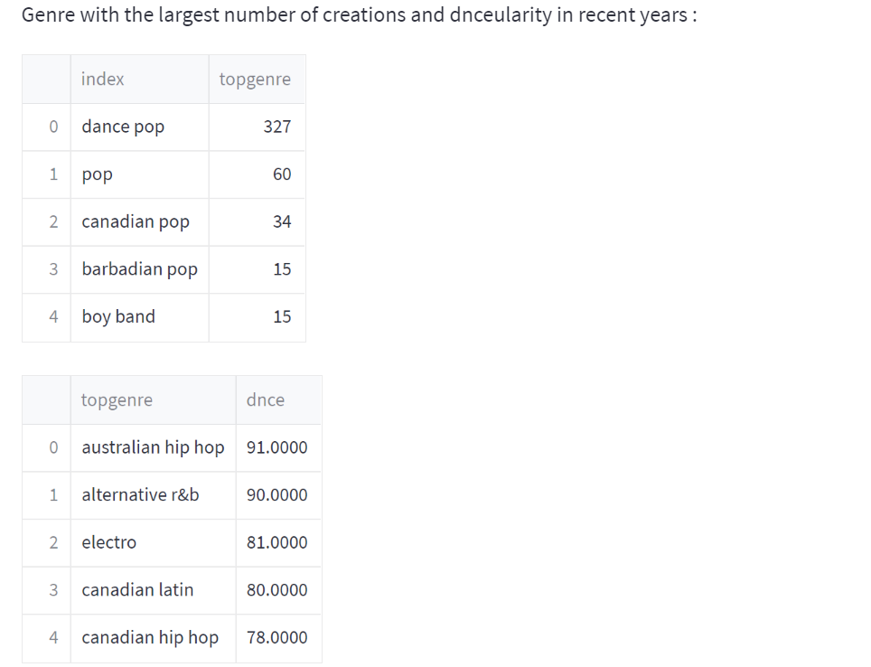

Slide 5
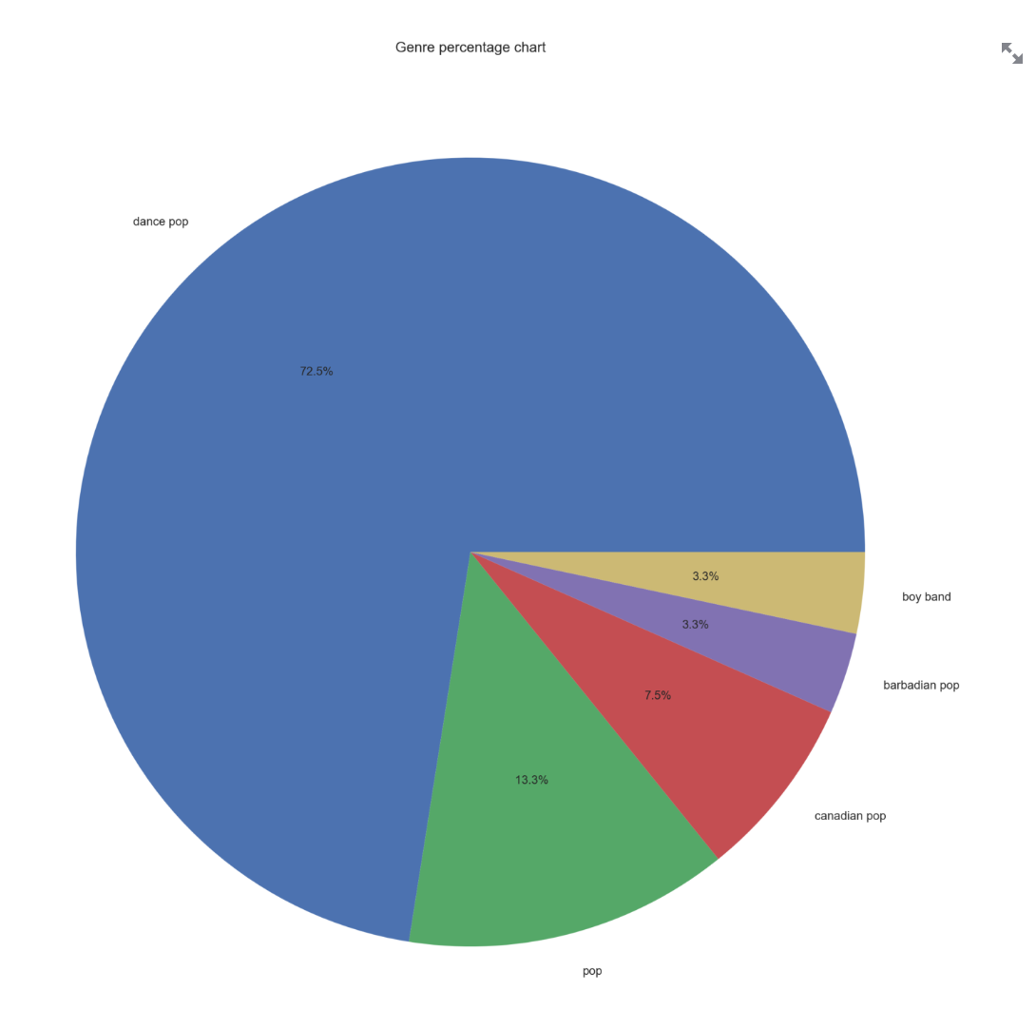
analysis
Q2:Commemorate popular trends of popular song genre
We can find that on Spotify platform the creation of genre with the largest number does not coincide with the most dnceular genre among audience, instead some niche song is more dnceular

Slide 6
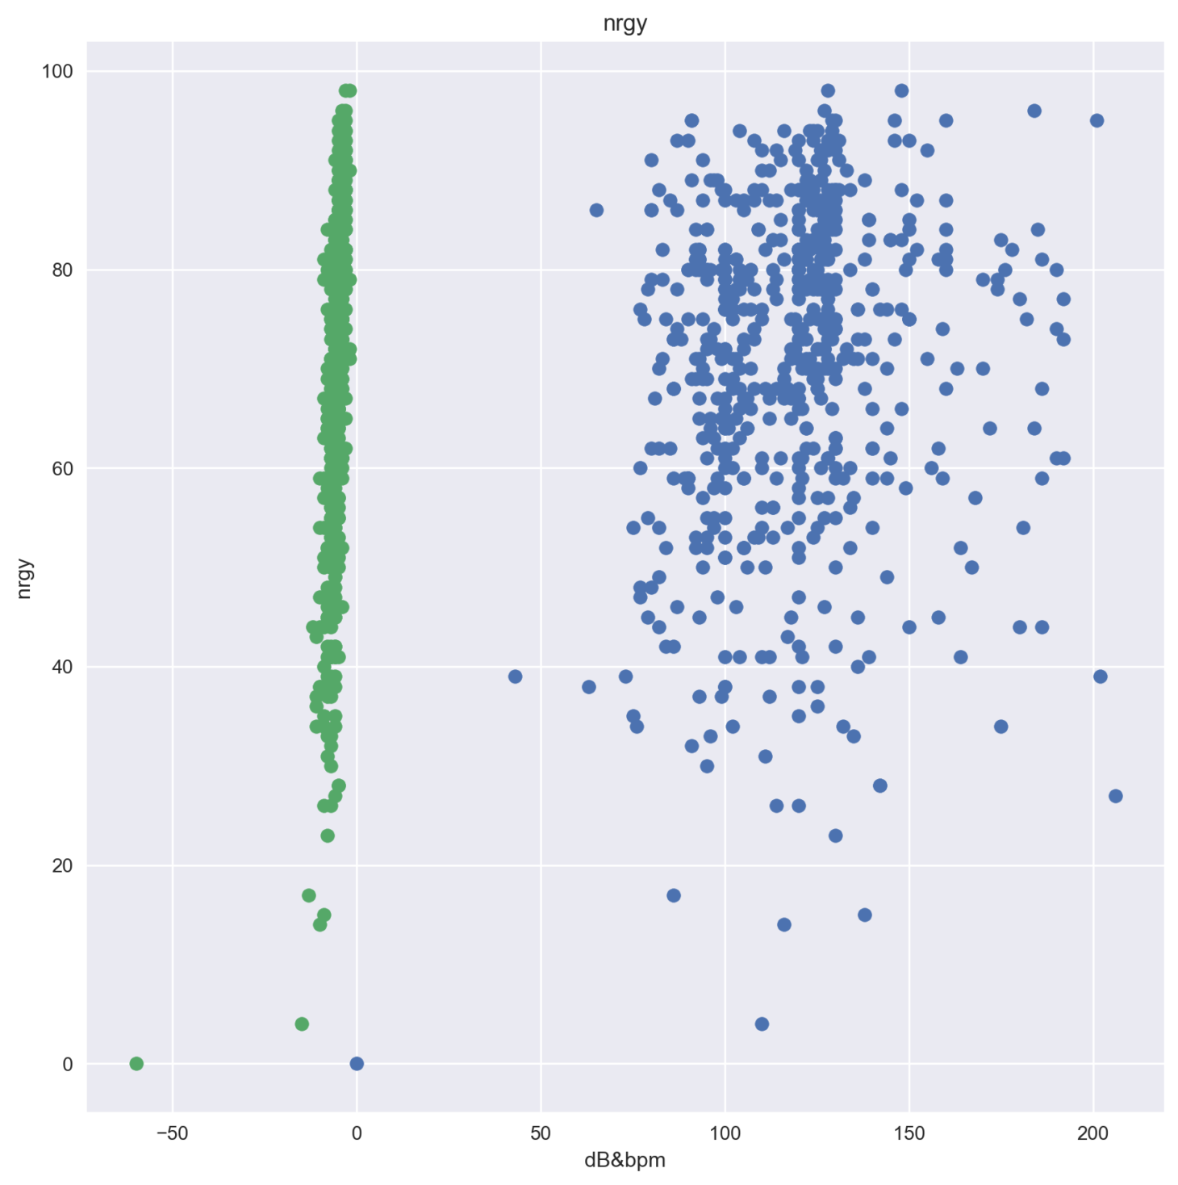
analysis
Q3:The impact of beat and volume on song experience
According to the density of data distribution, most music decibels are the same size. There is no great relationship between rhythm and song energy. Songs with different rhythms can have great energy.

Slide 7
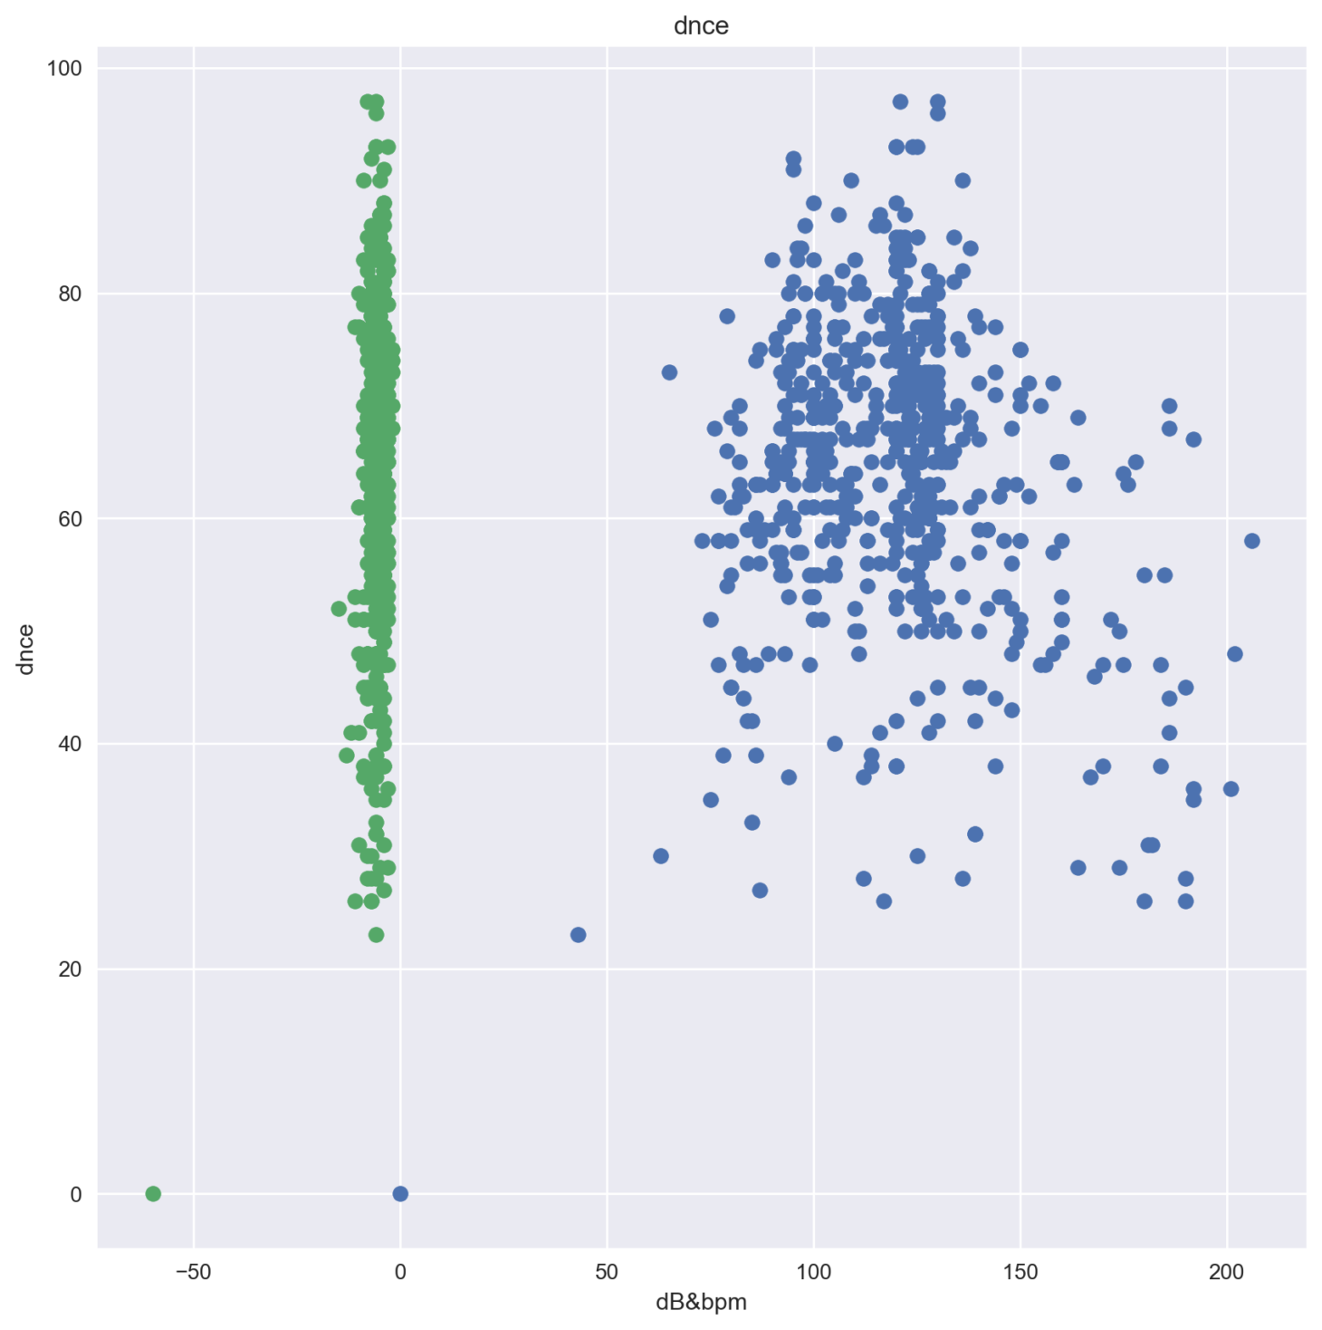
analysis
Q3:The impact of beat and volume on song experience
However, there are some obvious relationships between the beat and the dance ability. Most of the songs with the highest dance ability are between 100-140

