Slide 1
Predict NBA Winner
Yunke Tian
109929662

Slide 2
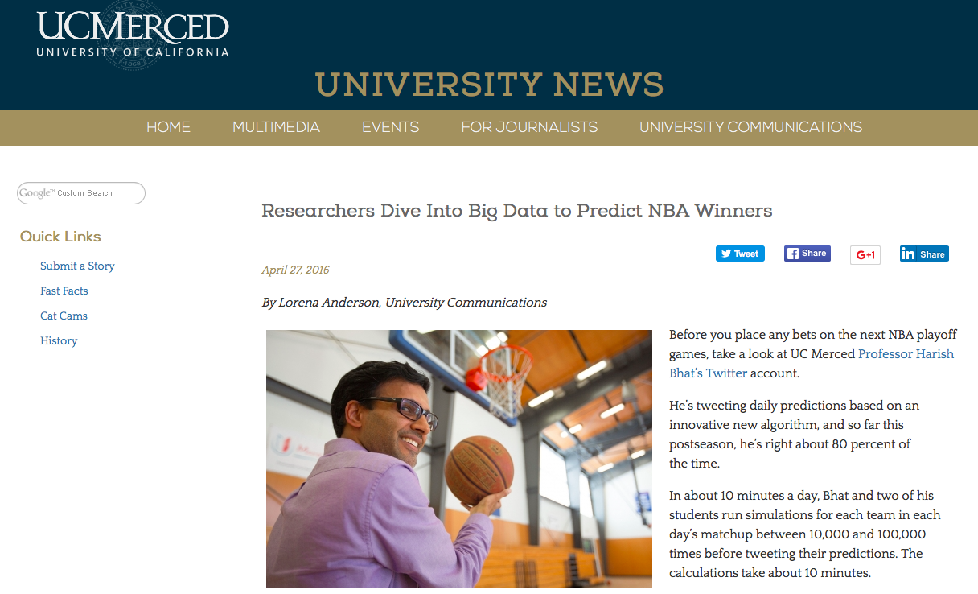
In the NEWS!
Paper referenced: Harish S. Bhat. Learning Stochastic Models for Basketball Substitutions from Play-by-Play Data
News Link: http://www.ucmerced.edu/news/2016/researchers-dive-big-data-predict-nba-winners

Slide 3
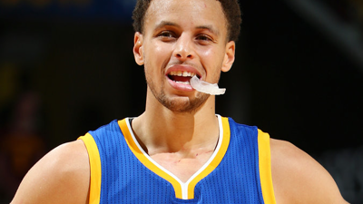
How Amazing?
1. Currently around 80% accuracy rate!
2. Accounts for lineup changes
3. Intelligent: What if Stephen Curry cannot play because of injury? What if a coach uses different lineup strategies towards a given opponent?

Slide 4
Key Concept
Scoring unit: A basketball player
Score differential = (A(i) – B(i)) – (A(i – 1) – B(i – 1))
Scoring rate: Score differential gains for unit time
Team Lineup: A collection of 5 different scoring units
Lineup Change: Player substitution
Continuous-time Markov Chain: A continuous time stochastic process to simulate lineup substitution

Slide 5
Model Structure
Substitution Model (Continuous-time Markov Chain)
Two Models
Basic Scoring Model
Scoring Model
Ridge Regression Model

Slide 6

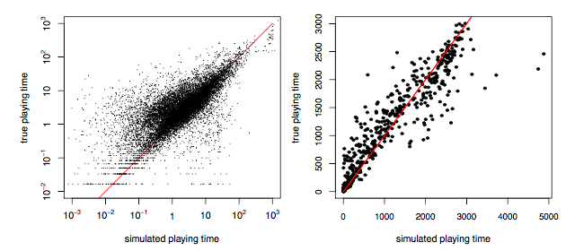
Continuous-time Markov Chain Model
Continuous-time Markov Chain Model: A continuous time stochastic process with Markov property (probability of next moment’s states only related to current state)
Transition rate matrix:
Use 2014-15 regular season play by play data to train
Pearson Correlation:
Left: 0.834
Right: 0.915

Slide 7

Scoring Model (Basic Scoring Model)
Scoring rate = Total score differential / Total time played (across entire training set – 2014-15 regular season)
Use these score rates (together with Markov Chain Model) to simulate 2014-15 games 100 times and compute average to predict:
Use 2014-15 Playoffs to test:
Correctly predicted 11 out of 15 playoff series winners
Two erroneous predictions were series that were decided in the seventh game
67% Accuracy

Slide 8

Scoring Model (Ridge Regression)
For each team:
X: 82 x Ni Matrix recording play time of Ni players in each of 82 games in regular season
Y: 82 x 1 Vector of the margin of victory (margin = 2) or defeat (margin = -2)
Ridge Regression to get β so that: X β = Y
Performance on training data:
Other scoring models:
Support Vector Regression
Nearest Neighbor Regression
68.2% Accuracy
Correctly predicted 12 out of 15

Slide 9
Discussion
What’s good:
Continuous-time Markov Chain. Better reflect the real condition.
Tried different scoring models to find the optimal
Could be improved:
For continuous time Markov Chain Model, the exponentially distribution doesn’t yield satisfying prediction. Could be improved
Model relatively simple: foul times, last minutes

Slide 10
THANK YOU!

