Slide 1
Linear Regression
Tianhang Zheng
https://tianzheng4.github.io

Slide 2
Course Website
https://tianzheng4.github.io/umkc-teaching/2023-fall-teaching-1/
What are on the course website:
Lecture slides
Lab material
Contact Information
If you are interested in my research, feel free to contact me.

Slide 3



Bias and Variance (Corrections)
$$E_{D}\left[ {\left(Y −g\left(X\right)\right)}^{2}\right]=bias^{2}+variance+σ^{2}$$
Bias:
$$E_{D}\left[g\left(X;D\right)\right] −f(X)$$
Depends on
model complexity
Variance:
$${E_{D}[(E}_{D}{\left[g\left(X;D\right)\right] −g(X;D))}^{2}]$$
Irreducible error:
$$σ$$

Slide 4
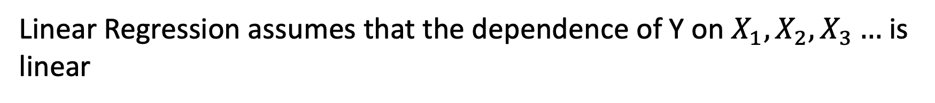
Linear Regression
Linear Regression (LR) is one of the simplest methods for modeling
Linear Regression assumes that the dependence of Y on $X_{1}, X_{2},X_{3}…$ is linear
In most cases, regression function is not linear (but interpretable)

Slide 5
Simple Linear Regression
Linear Regression with a single predictor (Assume the ideal model is a linear function)
$$Y=β_{0}+β_{1}X+ε$$
$β_{0}$ is called intercept and $β_{1}$ is called slope, which are two parameters.
$ε$ is the error term: $ε∼N(0, σ^{2})$

Slide 6
Simple Linear Regression
The objective is to learn (estimate) $β_{0}$ and $β_{1}$
The estimates of $β_{0}$ and $β_{1}$ are denoted by ${\hat{β}}_{0}$ and ${\hat{β}}_{1}$
$$\hat{y}={\hat{β}}_{0}+{\hat{β}}_{1}x$$
$\hat{y}$ is an estimate (prediction) of $Y$ given $X=x$

Slide 7
Simple Linear Regression
The objective is to learn (estimate) $β_{0}$ and $β_{1}$
The estimates of $β_{0}$ and $β_{1}$ are denoted by ${\hat{β}}_{0}$ and ${\hat{β}}_{1}$
$$\hat{y}={\hat{β}}_{0}+{\hat{β}}_{1}x$$
$\hat{y}$ is an estimate (prediction) of outcome given $X=x$
$e=y−\hat{y}$ is the residual

Slide 8
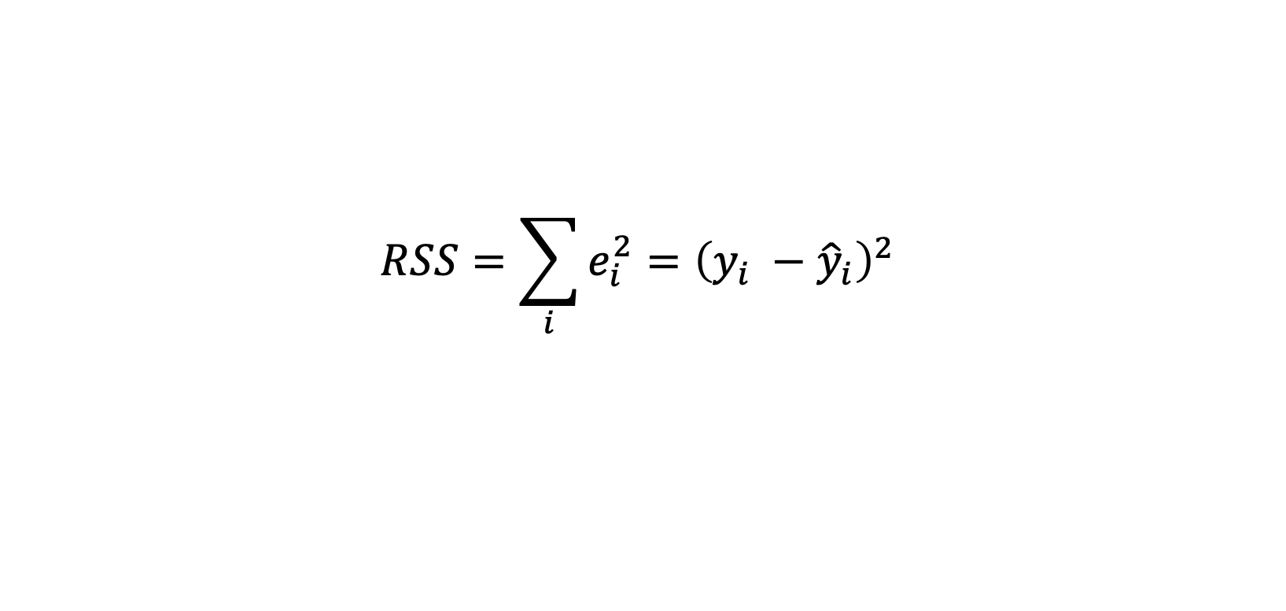

Least Squares Method
The least squares method is commonly used for estimating $β_{0}$ and $β_{1}$
Given a training dataset $D_{tr}={\left\{\left(x_{i}, y_{i}\right)\right\}}_{i=1}^{N}$, the residual sum of squares (RSS) can be defined as
$$RSS=\sum_{i}{e_{i}^{2}={\left(y_{i} −{\hat{y}}_{i}\right)}^{2} }$$

Slide 9
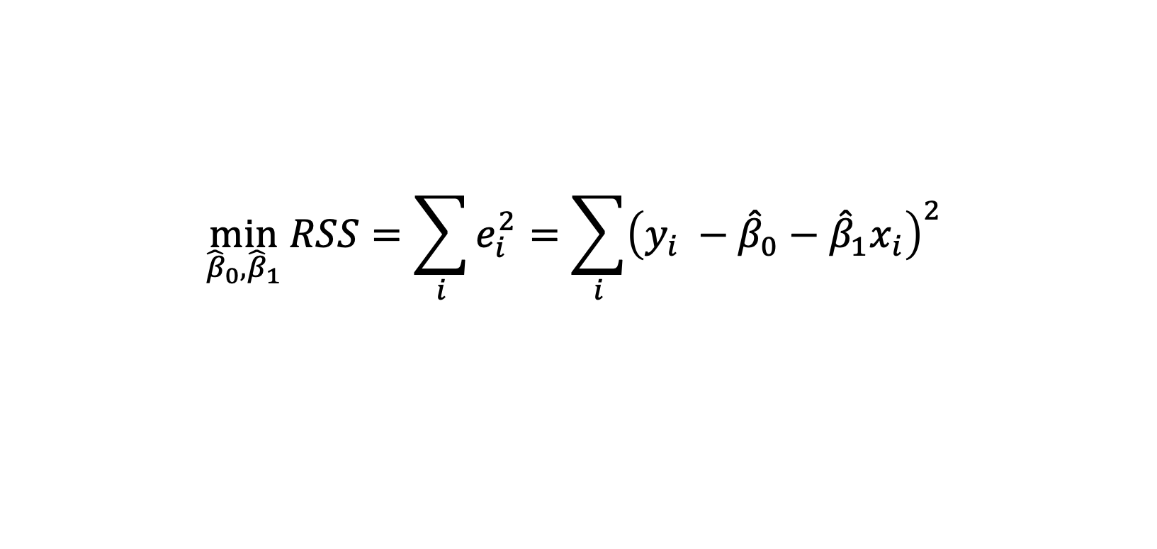

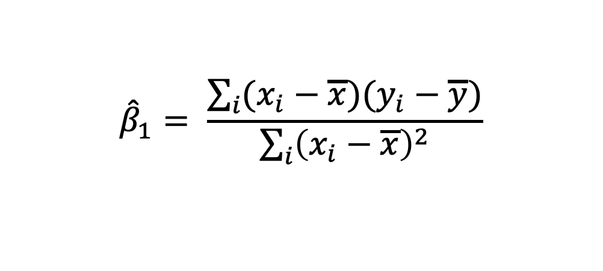
Least Squares Method
$$\min_{{\hat{β}}_{0},{\hat{β}}_{1}}{RSS=\sum_{i}{e_{i}^{2}=\sum_{i}{{\left(y_{i} −{\hat{β}}_{0}−{\hat{β}}_{1}x_{i}\right)}^{2}} }}$$
Take the derivative and set the derivative as 0
$${\hat{β}}_{1}= \frac{\sum_{i}{(x_{i}−\overline{x})(y_{i}−\overline{y})}}{\sum_{i}{{\left(x_{i}−\overline{x}\right)}^{2}}}$$
$${\hat{β}}_{0}=\overline{y}−{\hat{β}}_{1}\overline{x}$$

Slide 10

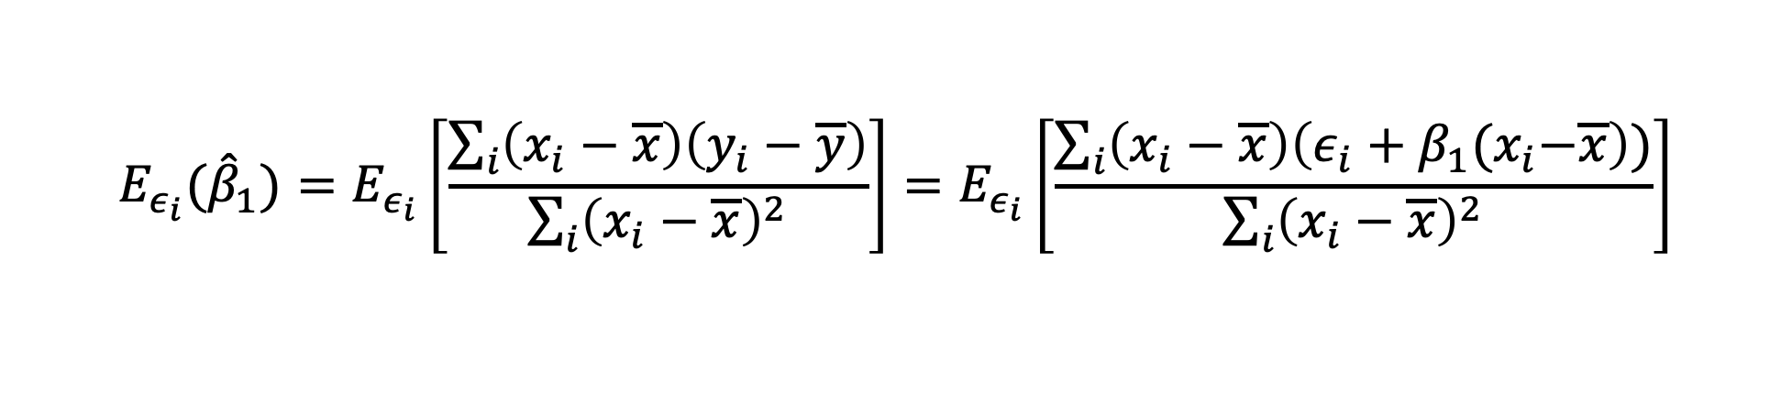
Analyzing Least Squares Method
Under the assumption of linear regression model (ideal model)
$$y_{i}∼N(β_{0}+β_{1}x_{i}, σ^{2})$$
$${E_{ε_{i}}(\hat{β}}_{1})=E_{ε_{i}}\left[\frac{\sum_{i}{\left(x_{i}−\overline{x}\right)\left(y_{i}−\overline{y}\right)}}{\sum_{i}{{\left(x_{i}−\overline{x}\right)}^{2}}}\right]=E_{ε_{i}}\left[\frac{\sum_{i}{\left(x_{i}−\overline{x}\right)\left(ε_{i}+β_{1}{(x}_{i}−\overline{x}\right))}}{\sum_{i}{{\left(x_{i}−\overline{x}\right)}^{2}}}\right]$$

Slide 11
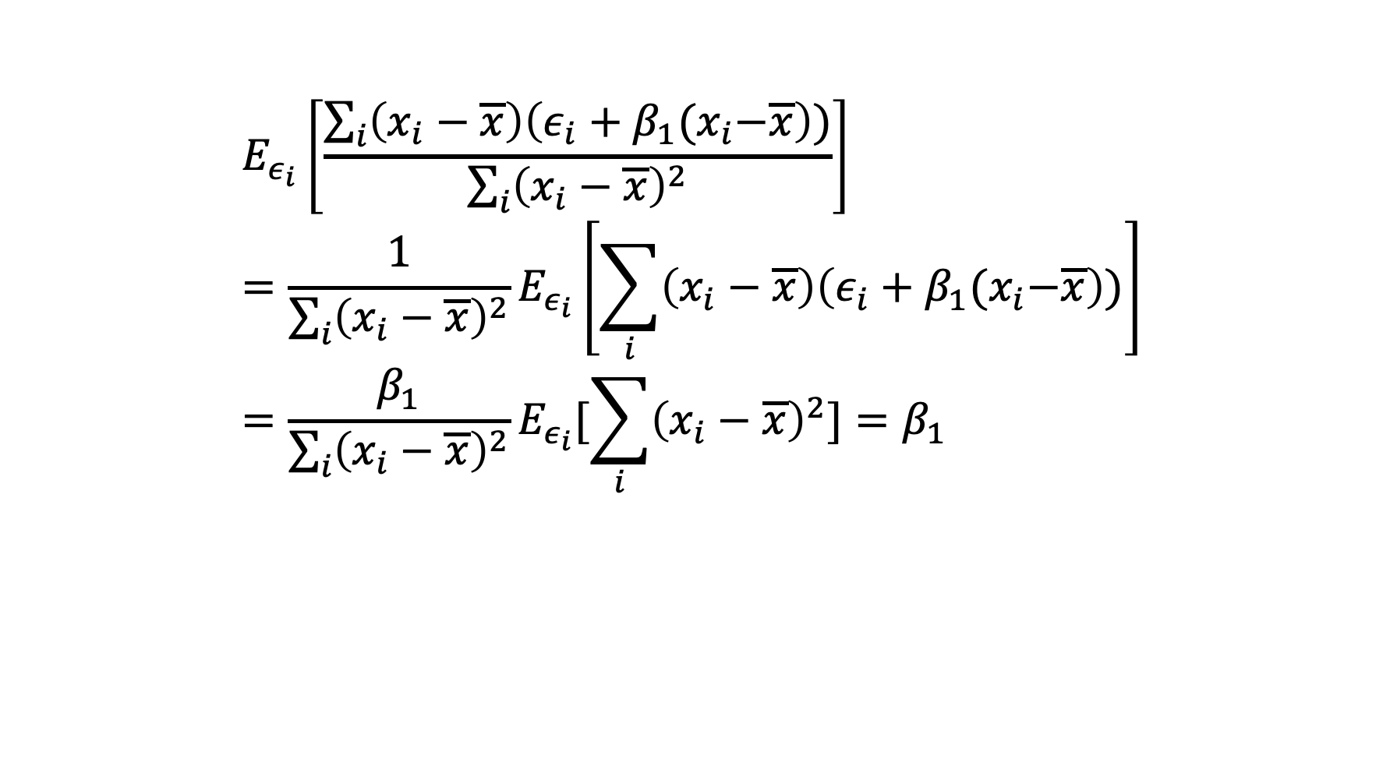
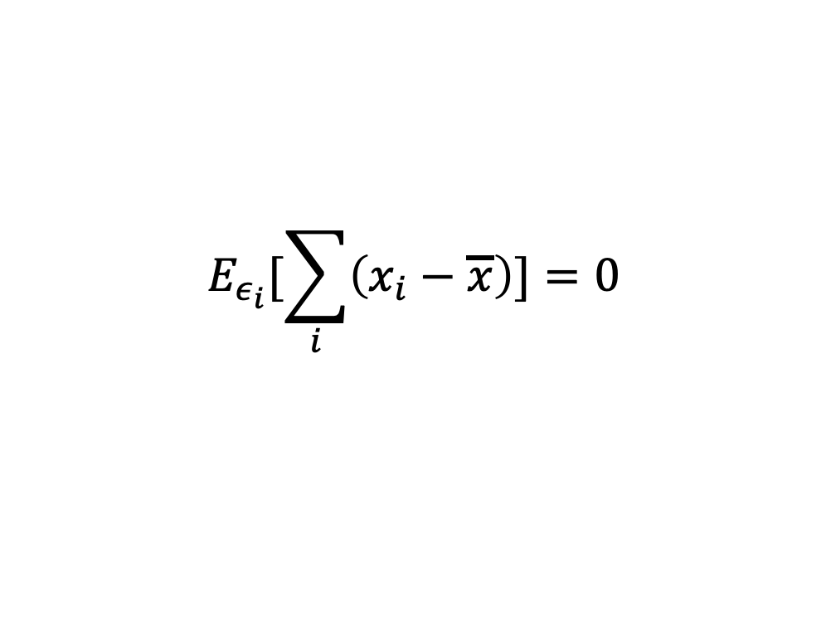
Analyzing Least Squares Method (Unbiased)
$$E_{ε_{i}}[\sum_{i}{\left(x_{i}−\overline{x}\right)]=0}$$
$$E_{ε_{i}}\left[\frac{\sum_{i}{\left(x_{i}−\overline{x}\right)\left(ε_{i}+β_{1}{(x}_{i}−\overline{x}\right))}}{\sum_{i}{{\left(x_{i}−\overline{x}\right)}^{2}}}\right]={\frac{1}{\sum_{i}{{\left(x_{i}−\overline{x}\right)}^{2}}}E}_{ε_{i}}\left[\sum_{i}{\left(x_{i}−\overline{x}\right)\left(ε_{i}+β_{1}{(x}_{i}−\overline{x}\right))}\right]=\frac{β_{1}}{\sum_{i}{{\left(x_{i}−\overline{x}\right)}^{2}}}E_{ε_{i}}[\sum_{i}{{\left(x_{i}−\overline{x}\right)}^{2}]}=β_{1}$$
Why unbiased?

Slide 12

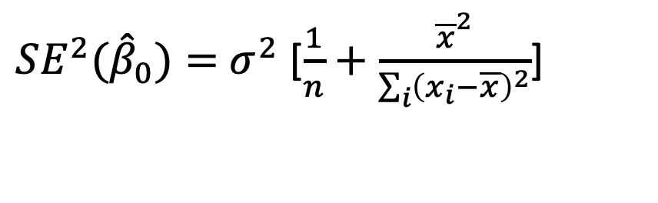
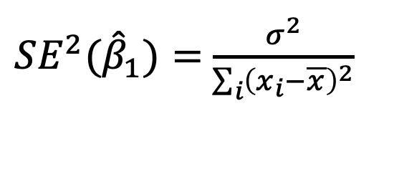
Analyzing Least Squares Method
The variance of ${\hat{β}}_{0}$and ${\hat{β}}_{1}$ are
${SE^{2}(\hat{β}}_{1})=$ $\frac{σ^{2}}{\sum_{i}{{\left(x_{i}−\overline{x}\right)}^{2}}}$
${SE^{2}(\hat{β}}_{0})=$ $σ^{2}$ [$\frac{1}{n}+\frac{{\overline{x}}^{2}}{\sum_{i}{{\left(x_{i}−\overline{x}\right)}^{2}}}$]
$$σ^{2}=Var(ε)$$
$\hat{β}∼N(β, SE^{2}\left(\hat{β}\right))$ Why Gaussian distribution?

Slide 13
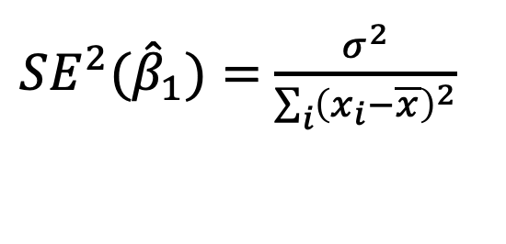

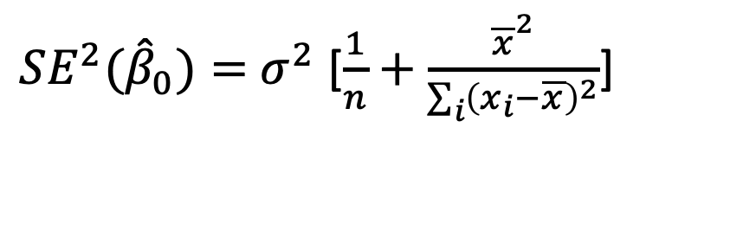
Analyzing Least Squares Method
If we have a lot of training samples
${SE^{2}(\hat{β}}_{1})=$ $\frac{σ^{2}}{\sum_{i}{{\left(x_{i}−\overline{x}\right)}^{2}}}$
${SE^{2}(\hat{β}}_{0})=$ $σ^{2}$ [$\frac{1}{n}+\frac{{\overline{x}}^{2}}{\sum_{i}{{\left(x_{i}−\overline{x}\right)}^{2}}}$]
$$σ^{2}=Var(ε)$$
$\hat{β}∼N(β, SE^{2}\left(\hat{β}\right))$ Why Gaussian distribution?

Slide 14

Confidence Level
$\hat{β}∼N(β, SE^{2}\left(\hat{β}\right))$ means that$β∼N(\hat{β}, SE^{2}\left(\hat{β}\right))$
A 95% confidence interval is defined as a range of values with 95% probability, and the interval for the least square method is
$$[\hat{β}−2SE\left(\hat{β}\right),\hat{β}+2SE(\hat{β})]$$
There is 95% probability that this interval contains the true $β$

Slide 15

Hypothesis Testing
$H_{0}$: There is no relationship between $X$ and $Y$?
$H_{1}$: There is some relationship between $X$ and $Y$?
$$H_{0}:β_{1}=0 { H}_{1}:β_{1}≠0$$

Slide 16

Hypothesis Testing
For the hypothesis testing, we need a t-statistic (not z-statistic)
Because we do not know the true $σ$!
We can only estimate $σ$ by ${\hat{σ}}^{2}=\frac{1}{|D|}\sum_{i}{{\left(y_{i}−{\hat{β}}_{0}−{\hat{β}}_{1}x_{i}\right)}^{2}}$

Slide 17
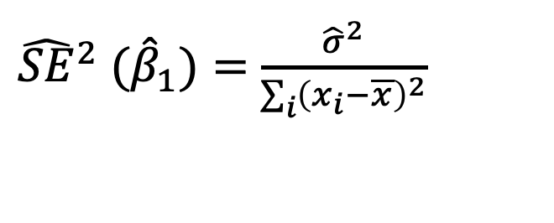
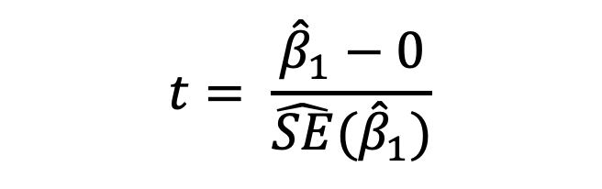
Hypothesis Testing
${{\hat{SE}}^{2} (\hat{β}}_{1})=$ $\frac{{\hat{σ}}^{2}}{\sum_{i}{{\left(x_{i}−\overline{x}\right)}^{2}}}$
$$t= \frac{{\hat{β}}_{1}−0}{\hat{SE}({\hat{β}}_{1})}$$
We could compute a t-statistics by
This variable should satisfy t-distribution with n-2 degrees

Slide 18
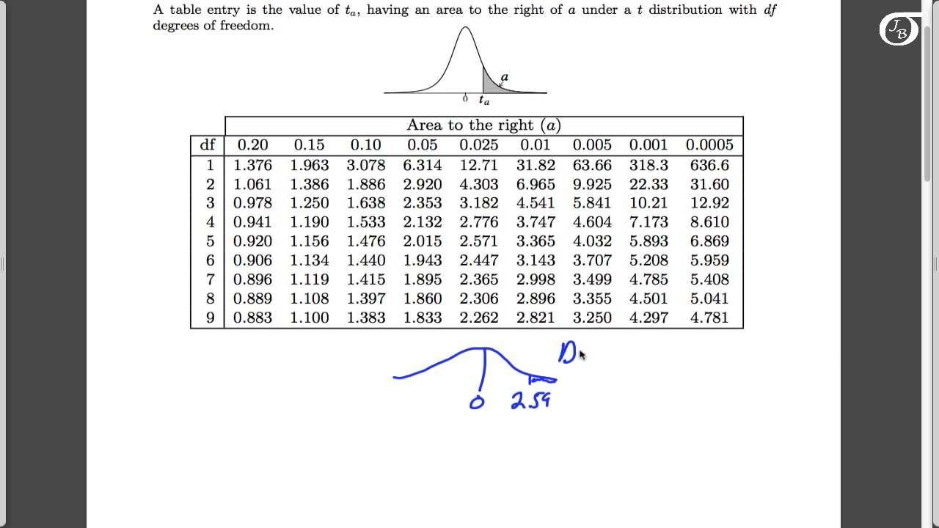
Hypothesis Testing

Slide 19
Hypothesis Testing
If $\left|t\right|$ is very large, which means $α$ is very small
Then we could reject $H_{0}$
This means there is some relationship between $X$ and $Y$

Slide 20
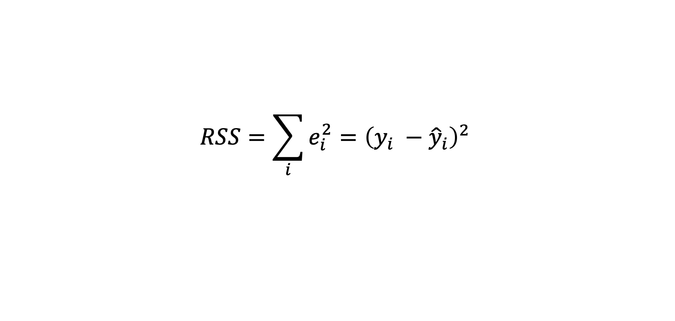
Prediction Error
The residual sum of squares (RSS)
$$RSS=\sum_{i}{e_{i}^{2}={\left(y_{i} −{\hat{y}}_{i}\right)}^{2} }$$
The residual standard error (RSE)
$$RSE= \frac{1}{n−2}\sqrt{RSS}$$

Slide 21
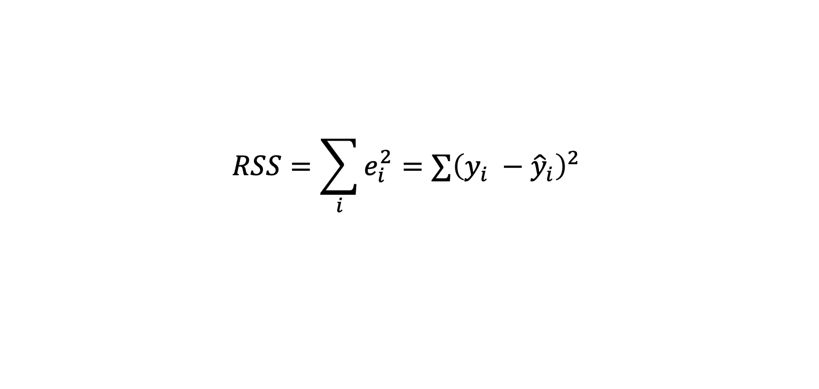

Prediction Error
The residual sum of squares (RSS)
$$RSS=\sum_{i}{e_{i}^{2}={∑\left(y_{i} −{\hat{y}}_{i}\right)}^{2} }$$
The residual standard error (RSE)
$$RSE= \sqrt{\frac{1}{n−2}RSS}$$

Slide 22
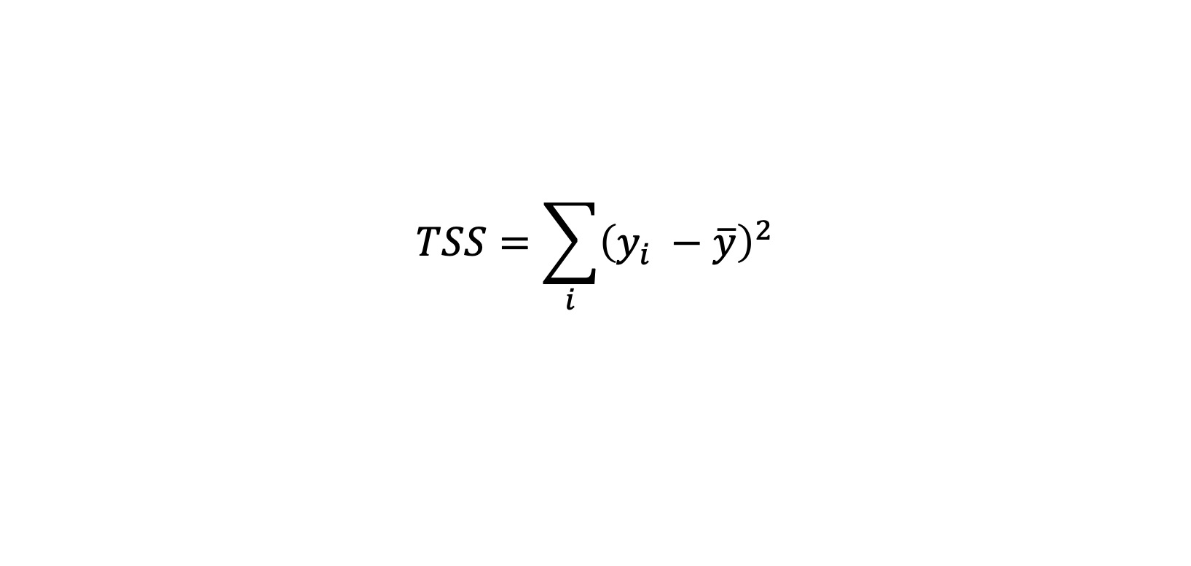
R-Squared
The proportion of the variance that can be explained by a model
$$R^{2}=1 − \frac{RSS}{TSS}$$
TSS is the total sum of squares (total variance of y)
$$TSS=\sum_{i}{{\left(y_{i} −\overline{y}\right)}^{2}}$$

Slide 23
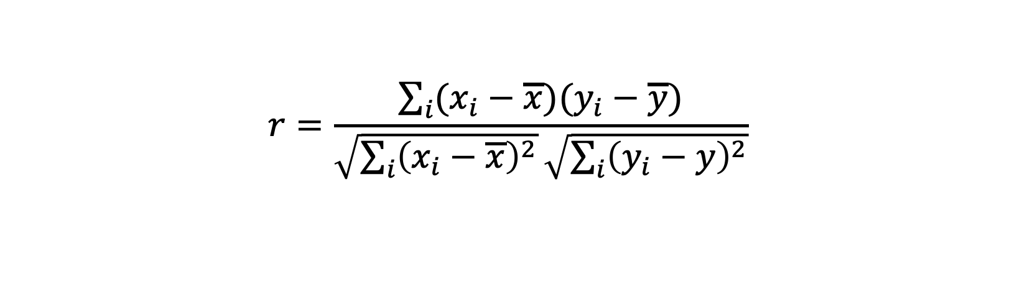
R-Squared
For linear regression, R-squared is the square of the correlation
$$R^{2}=r^{2}$$
$r$ is the correlation between $X$ and $Y$
$$r=\frac{\sum_{i}{(x_{i}−\overline{x})(y_{i}−\overline{y})}}{\sqrt{\sum_{i}{{\left(x_{i}−\overline{x}\right)}^{2}}}\sqrt{\sum_{i}{{\left(y_{i}−y\right)}^{2}}}}$$

Slide 24
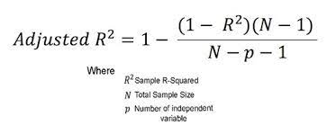
Adjusted R-Squared

Slide 25
Q & A

