Slide 1
Support Vector Machine
Tianhang Zheng
https://tianzheng4.github.io

Slide 2
Intuition
Try and find a plane that separates the classes in feature space.
If we cannot:
Not perfect separation?
Enrich and enlarge the feature space?

Slide 3

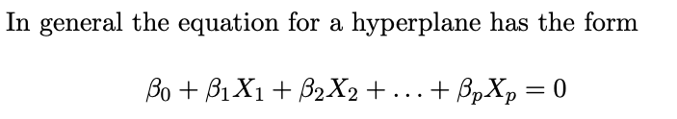
How to separate a feature space

Slide 4
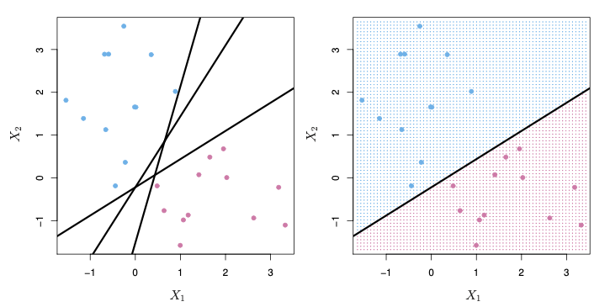
Separation by A Hyperplane

Slide 5
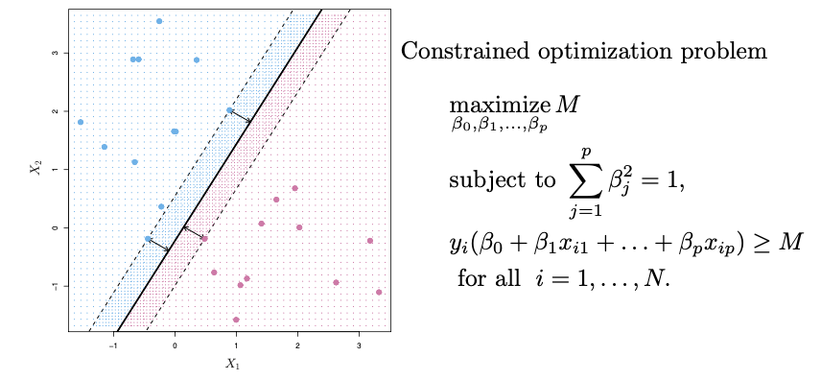
Best Hyperplane: Maximal Margin Classifier

Slide 6
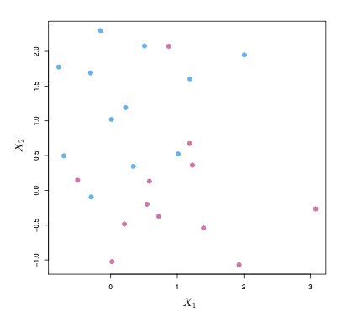
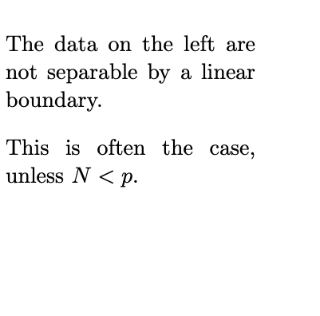
Non-separable Data

Slide 7
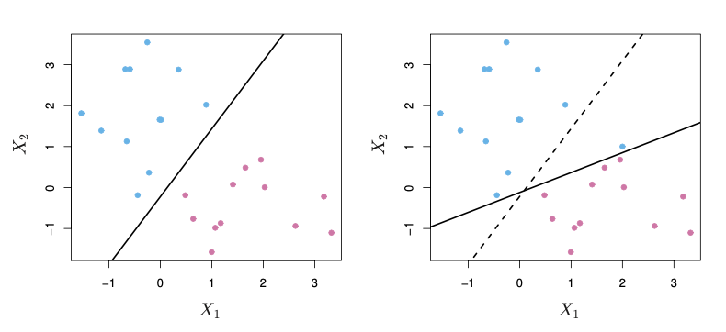
Noisy Data

Slide 8
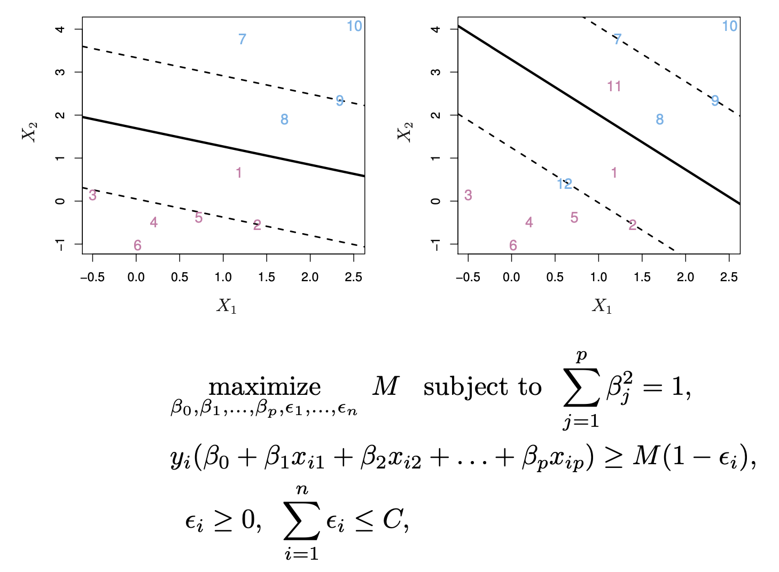
Soft Margin: Support Vector Classifier

Slide 9
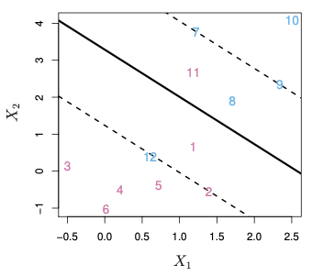
Soft Margin: Support Vector Classifier

Slide 10
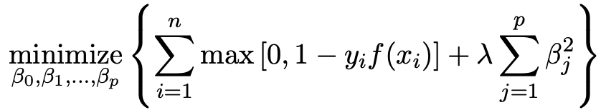
Solver for Support Vector Classifier
It is intractable to solve the constraint problem, so we need to formulate an unconstrainted problem as a solver.

Slide 11
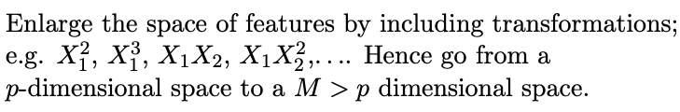

Feature Expansion

Slide 12
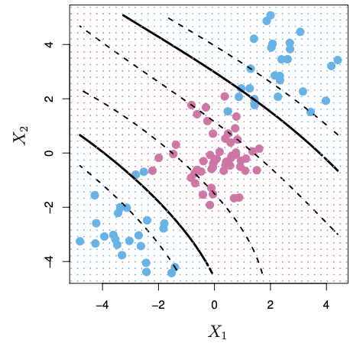
Cubic Polynomials
A basis expansion of cubic polynomials increases the number of variables from 2 to 9

Slide 13
Nonlinearities and Kernels
There is a more elegant and controlled way to introduce nonlinearities in support-vector classifiers — through the use of kernels.
Kernels: Linear Kernels; Polynomial Kernels; Gaussian Kernels

Slide 14
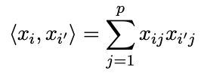
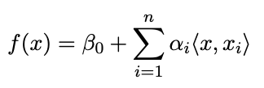
Inner products and support vectors
Inner product:
The linear support vector classifier can be represented as

Slide 15
Nonlinearities and Kernels
There is a more elegant and controlled way to introduce nonlinearities in support-vector classifiers — through the use of kernels.
Kernels: Linear Kernels; Polynomial Kernels; Gaussian Kernels

Slide 16
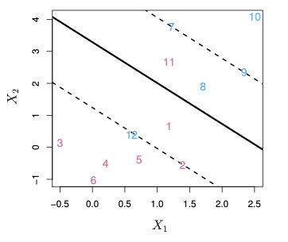

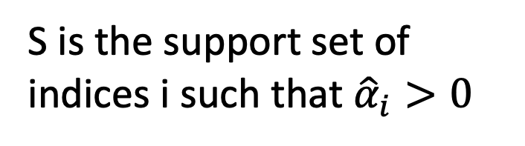
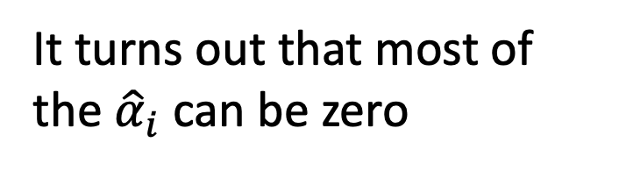
Nonlinearities and Kernels
It turns out that most of the ${\hat{α}}_{i}$ can be zero
S is the support set of indices i such that ${\hat{α}}_{i}>0$

Slide 17
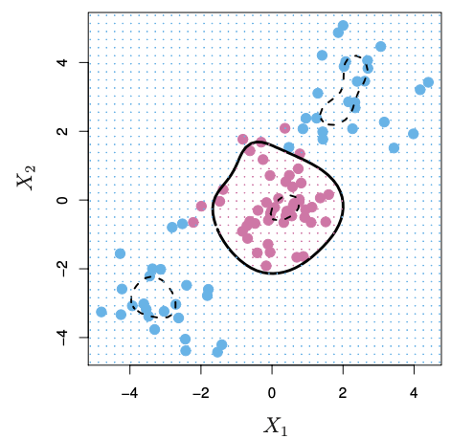

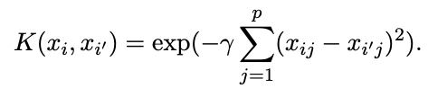
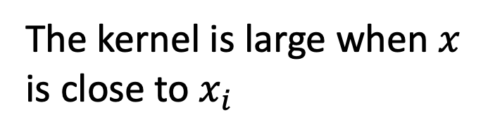
Radial Kernel
The kernel is large when $x$ is close to $x_{i}$

Slide 18

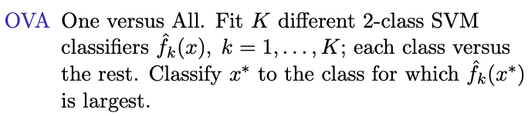
Multi-Class SVM

Slide 19
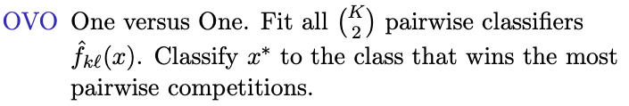
Multi-Class SVM

Slide 20
Support Vector vs Logistic Regression
When classes are (nearly) separable, SVM does better than LR. So does LDA.
When not, LR (with ridge penalty) and SVM very similar.
If you wish to estimate probabilities, LR is the choice.
For nonlinear boundaries, kernel SVMs are popular. Can use kernels with LR and LDA as well, but computations are more expensive.

Slide 21
Q & A

