Slide 1
Tree-based Methods
Tianhang Zheng
https://tianzheng4.github.io

Slide 2
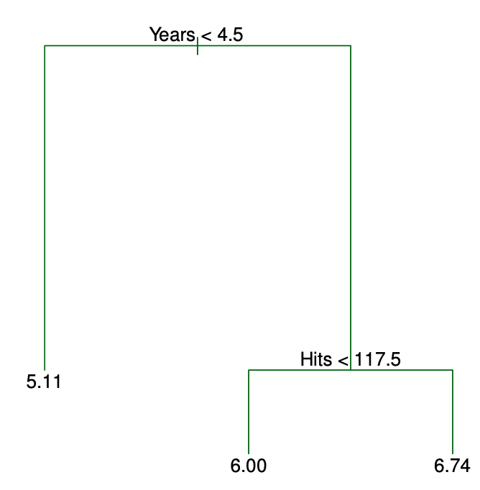
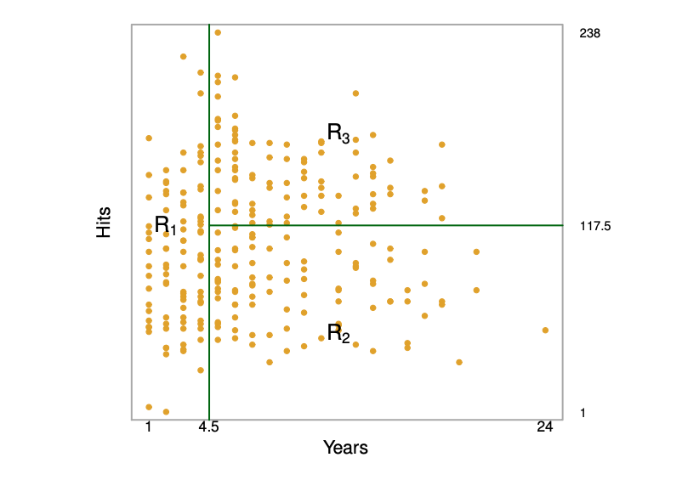
Tree-Building Process

Slide 3
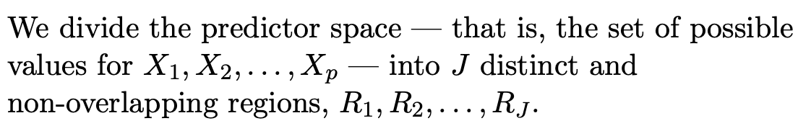
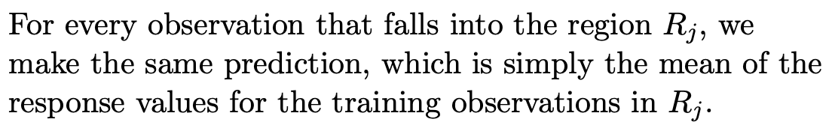
Tree-Building Process

Slide 4
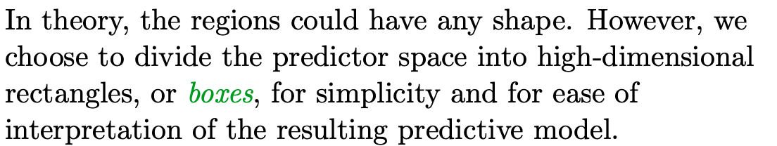
Tree-Building Process

Slide 5
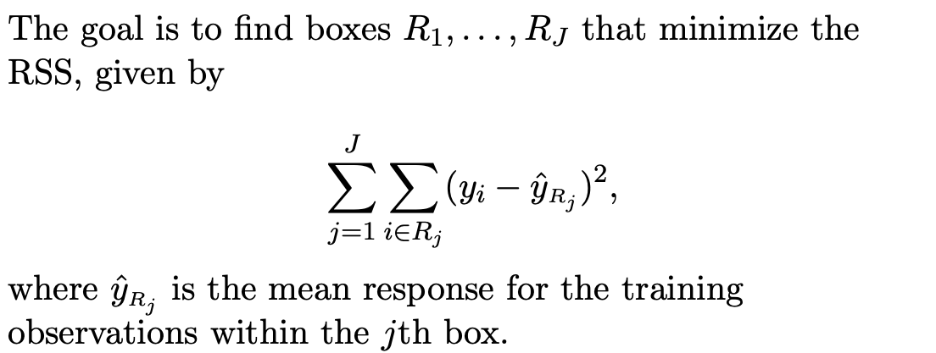
Tree-Building Process

Slide 6
Tree-Building Process

Slide 7
Tree-Building Process

Slide 8
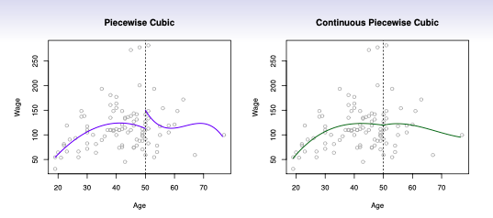
Piecewise Polynomials

Slide 9
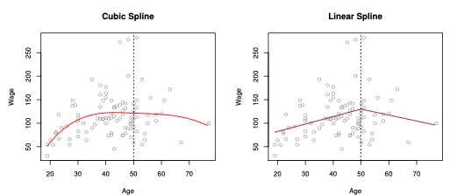
Piecewise Polynomials

Slide 10


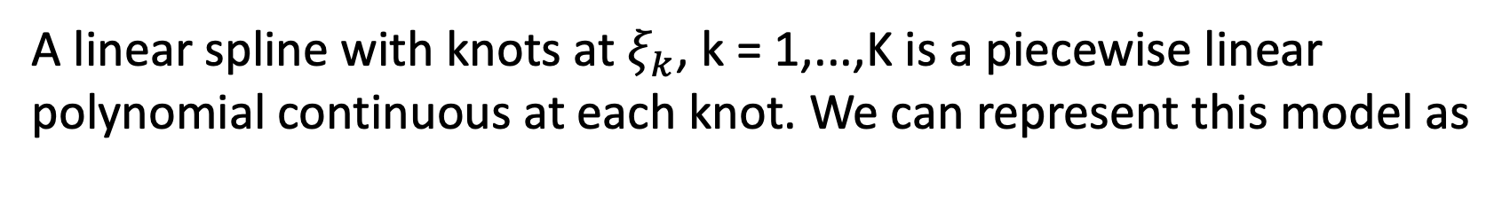
Linear Splines
A linear spline with knots at $ξ_{k}$, k = 1,...,K is a piecewise linear polynomial continuous at each knot. We can represent this model as

Slide 11
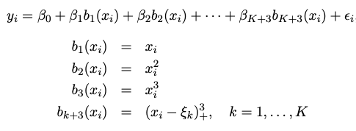

Cubic Splines

Slide 12
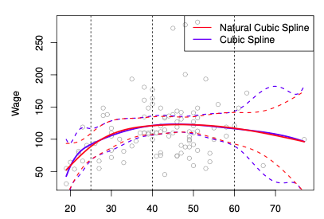
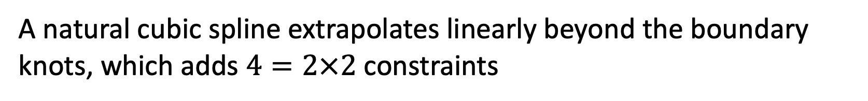
Natural Cubic Splines
A natural cubic spline extrapolates linearly beyond the boundary knots, which adds $4=2×2$ constraints

Slide 13

Smoothing Splines
Objective for smoothing splines
The second term is a roughness penalty and controls how wiggly g(x) is. It is modulated by the tuning parameter.

Slide 14
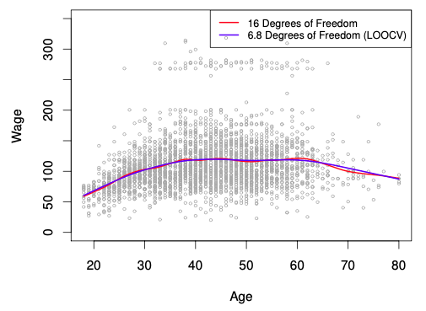
Smoothing Splines

Slide 15
Generalized Additive Models (GAM)
Allows for flexible nonlinearities in several variables, but retains the additive structure of linear models.

Slide 16

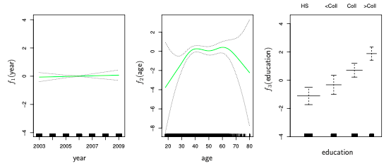
GAMs for classification

Slide 17
Tree-based Methods
Tree-based methods can be used for regression and classification
Stratifying or segmenting the predictor space into a number of simple regions.
Since the set of splitting rules used to segment the predictor space can be summarized in a tree, these types of approaches are known as decision-tree methods.

Slide 18
Pros and Cons
Tree-based methods are simple and useful for interpretation.
We will also discuss methods that can grow multiple trees which are then combined to yield a single consensus prediction
Combining a large number of trees can often result in dramatic improvements in prediction accuracy, at the expense of some loss interpretation.

Slide 19
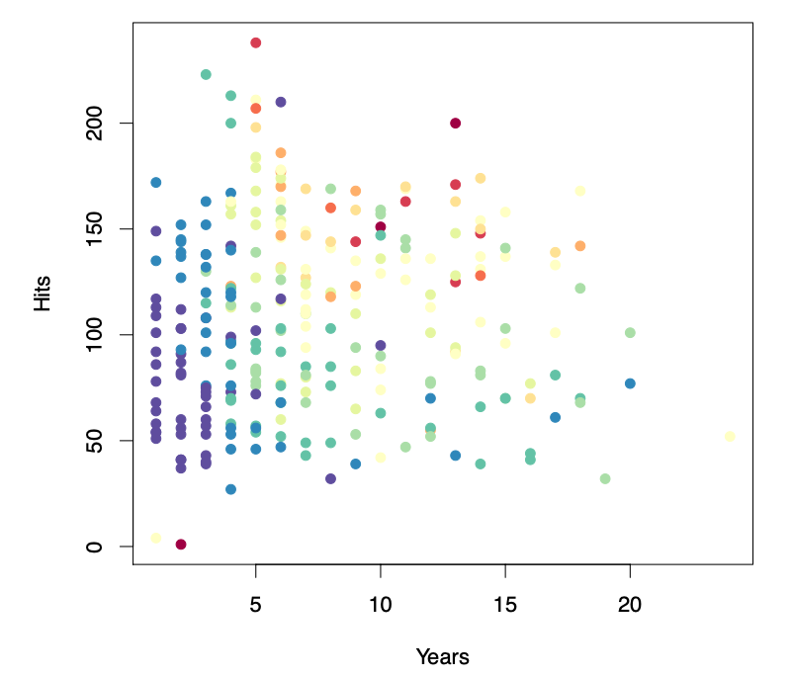
Decision Tree Example

Slide 20
Decision Tree Example

Slide 21
Decision Tree Example

Slide 22
Q & A

