Slide 1
Survival Analysis
Tianhang Zheng
https://tianzheng4.github.io

Slide 2
Survival Analysis
Survival analysis concerns a special kind of outcome variable: the time until an event occurs.
For example, suppose that we have conducted a five-year medical study, in which patients have been treated for cancer.
We would like to fit a model to predict patient survival time, using features such as baseline health measurements or type of treatment.

Slide 3
An Example
The applications of survival analysis extend far beyond medicine. For example, consider a company that wishes to model churn, the event when customers cancel subscription to a service.
The company might collect data on customers over some time period, in order to predict each customer's time to cancellation.
However, presumably not all customers will have cancelled their subscription by the end of this time period; for such customers, the time to cancellation is censored.

Slide 4
Survival and Censoring Times
For each individual, we suppose that there is a true failure or event time T, as well as a true censoring time C.
The survival time represents the time at which the event of interest occurs (such as death).
By contrast, the censoring is the time at which censoring occurs: for example, the time at which the patient drops out of the study or the study ends.

Slide 5

Survival and Censoring Times
We observe either the survival time T or else the censoring time C. Specifically, we observe the random variable
If the event occurs before censoring (i.e. T < C) then we observe the true survival time T; if censoring occurs before the event (T > C) then we observe the censoring time.

Slide 6
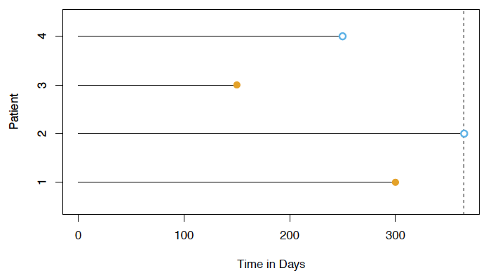
An Illustration
For patients 1 and 3, the event was observed. Patient 2 was alive when the study ended. Patient 4 dropped out of the study.

Slide 7
Censoring
Suppose that a number of patients drop out of a cancer study early because they are very sick.
An analysis that does not take into consideration the reason why the patients dropped out will likely overestimate the true average survival time.

Slide 8
Censoring
Similarly, suppose that males who are very sick are more likely to drop out of the study than females who are very sick.
Then a comparison of male and female survival times may wrongly suggest that males survive longer than females.

Slide 9

The Survival Curve
The survival function (or curve) is defined as
This decreasing function quantifies the probability of surviving past time t.

Slide 10
The Survival Curve
Consider the BrainCancer dataset, which contains the survival times for patients with primary brain tumors undergoing treatment with stereotactic radiation methods.
The predictors are gtv (gross tumor volume, in cubic centimeters); sex (male or female); diagnosis (meningioma, LG glioma, HG glioma, or other); loc (the tumor location: either infratentorial or supratentorial); ki (Karnofsky index); and stereo (stereotactic method).

Slide 11
The Survival Curve
Only 53 of the 88 patients were still alive at the end of the study.
Suppose we'd like to estimate S(20) = Pr(T > 20), the probability that a patient survives for at least 20 months
We can simply compute the proportion of patients who are known to have survived past 20 months.

Slide 12
The Survival Curve
But is it a right estimation?
17 of the 40 patients who did not survive to 20 months were actually censored
We cannot simply assume that they died, which may lead to an underestimation

Slide 13
The Kaplan-Meier Estimate
But is it a right estimation?
17 of the 40 patients who did not survive to 20 months were actually censored
We cannot simply assume that they died, which may lead to an underestimation

Slide 14
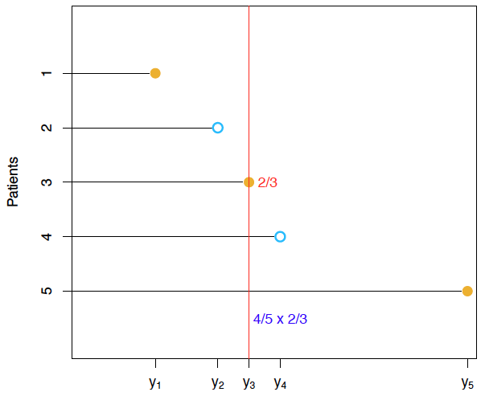

The Kaplan-Meier Estimate

Slide 15
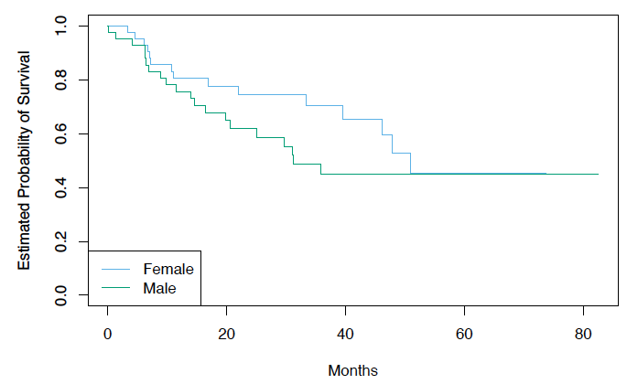
Log-Rank Test
We wish to compare the survival of males to that of females.
Shown are the Kaplan-Meier survival curves for the two groups.

Slide 16
Log-Rank Test
A two-sample t-test seems like an obvious choice: but the presence of censoring again creates a complication.
Therefore, we use log-rank test here

Slide 17
Log-Rank Test
d1 < d2 < …… < dK are the unique death times among the non-censored patients, rk is the number of patients at risk at time dk, and qk is the number of patients who died at time dk.
We further define r1k and r2k to be the number of patients in groups 1 and 2, respectively, who are at risk at time dk.
Similarly, we define q1k and q2k to be the number of
patients in groups 1 and 2, respectively, who died at time
dk. Note that r1k + r2k = rk and q1k + q2k = qk.

Slide 18
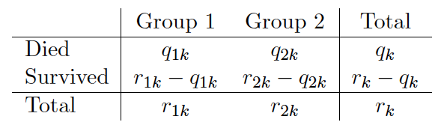
Log-Rank Test
At each death time dk, we construct a 2x2 table of counts of
the form shown above.

Slide 19
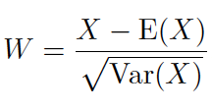
Log Rank Test: the Main Idea
To test H0 : E(X) = 0 for some random variable X, one approach is to construct a test statistic of the form
where E(X) and Var(X) are the expectation and variance, respectively, of X under H0.

Slide 20
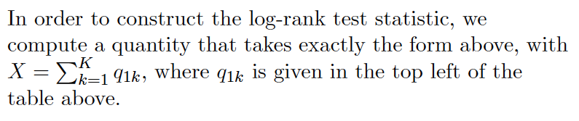
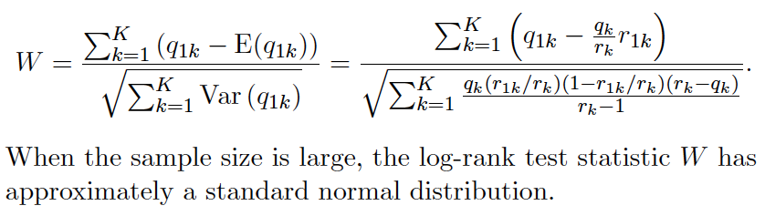
Log Rank Test: the Main Idea

Slide 21
Regression Models with a Survival Response
We wish to predict the true survival time T. Since the observed quantity Y = min(T;C) is positive and may have a long right tail, we might be tempted to fit a linear regression of log(Y ) on X. But censoring again creates a problem.
To overcome this difficulty, we instead make use of a sequential construction, similar to the idea used for the Kaplan-Meier survival curve.

Slide 22

Hazard Function
The hazard function or hazard rate, also known as the force of
mortality is formally defined as
where T is the (true) survival time.
It is the death rate in the instant after time t, given survival up to that time.

Slide 23

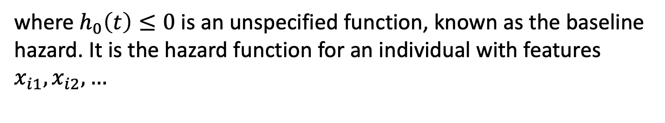
The Proportional Hazards Model
The proportional hazards assumption states that
where $h_{0}\left(t\right)≤0$ is an unspecified function, known as the baseline hazard. It is the hazard function for an individual with features $x_{i1}, x_{i2},…$

Slide 24
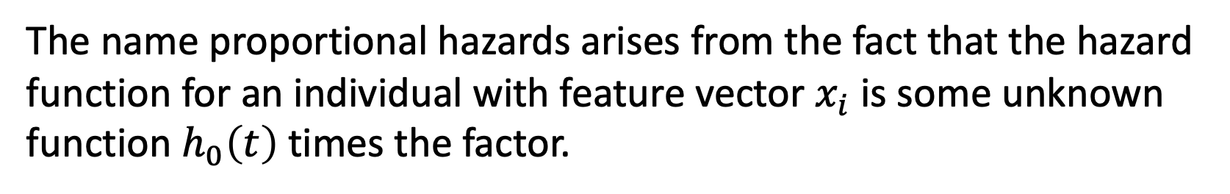
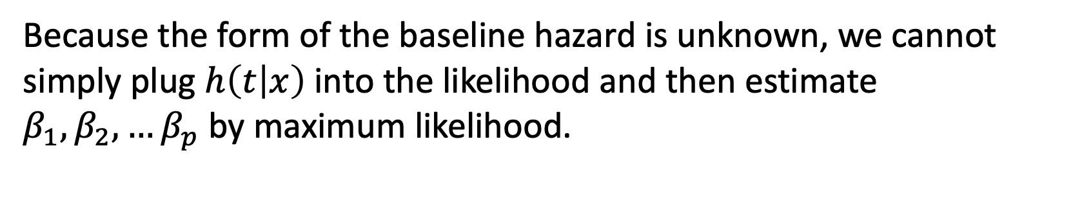
Proportional Hazards Model
The name proportional hazards arises from the fact that the hazard function for an individual with feature vector $x_{i}$ is some unknown function $h_{0}\left(t\right)$times the factor.
Because the form of the baseline hazard is unknown, we cannot simply plug $h\left(t | x\right)$into the likelihood and then estimate $β_{1}, β_{2}, …β_{p}$by maximum likelihood.

Slide 25
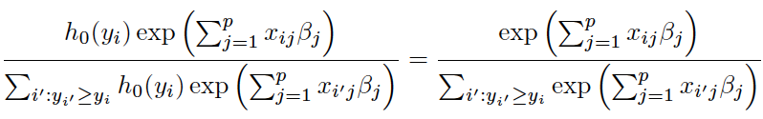
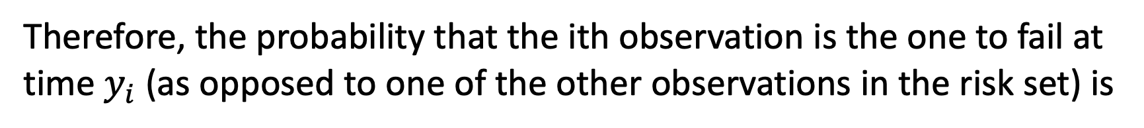
Proportional Hazards Model
Therefore, the probability that the ith observation is the one to fail at time $y_{i}$ (as opposed to one of the other observations in the risk set) is

Slide 26
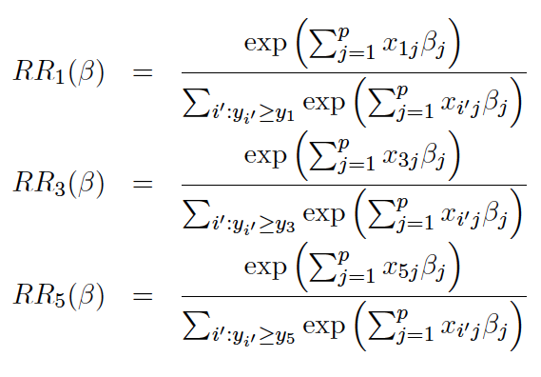
Relative Risk Functions at each Failure Time

Slide 27
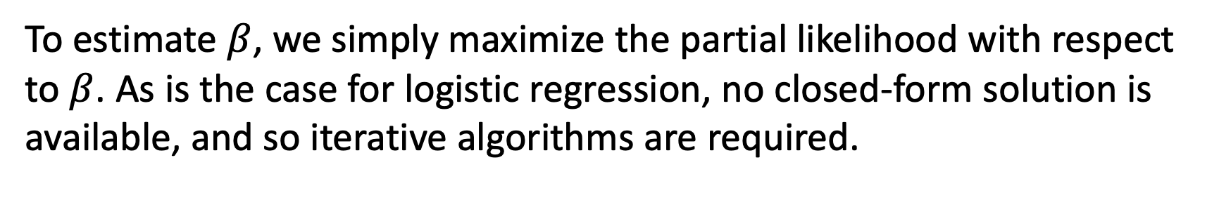
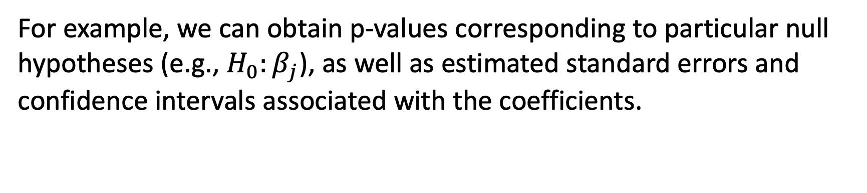
Partial Likelihood
To estimate $β$, we simply maximize the partial likelihood with respect to $β$. As is the case for logistic regression, no closed-form solution is available, and so iterative algorithms are required.
For example, we can obtain p-values corresponding to particular null hypotheses (e.g., $H_{0}:β_{j}$), as well as estimated standard errors and confidence intervals associated with the coefficients.

