Slide 1
Support Vector Machine
Tianhang Zheng
https://tianzheng4.github.io

Slide 2
Intuition
Try and find a plane that separates the classes in feature space.
If we cannot:
Not perfect separation?
Enrich and enlarge the feature space?

Slide 3

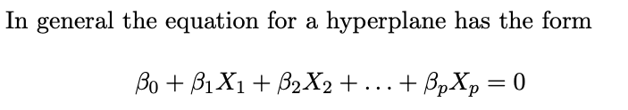
How to separate a feature space

Slide 4
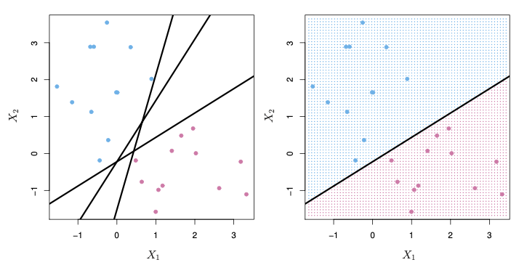
Separation by A Hyperplane

Slide 5
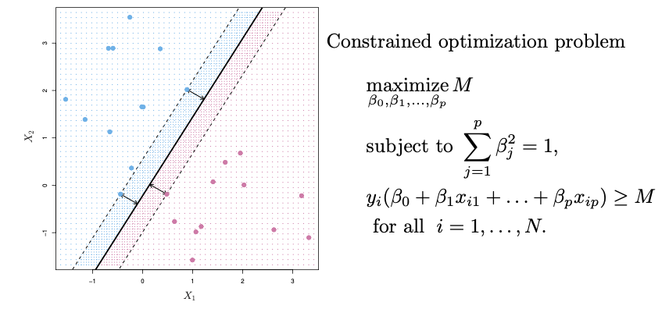
Best Hyperplane: Maximal Margin Classifier

Slide 6
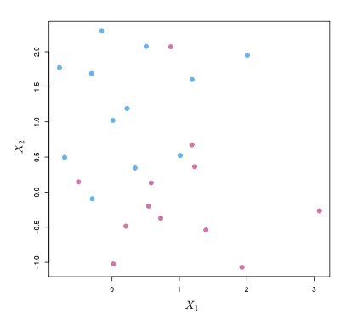
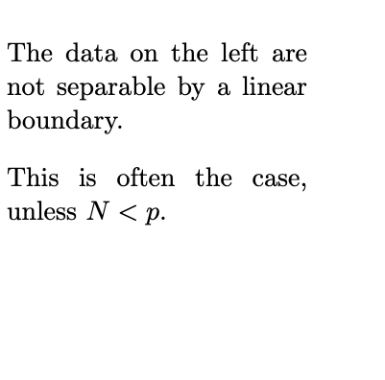
Non-separable Data

Slide 7
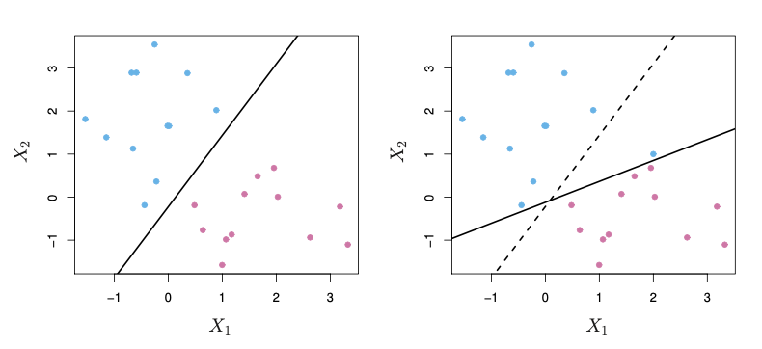
Noisy Data

Slide 8
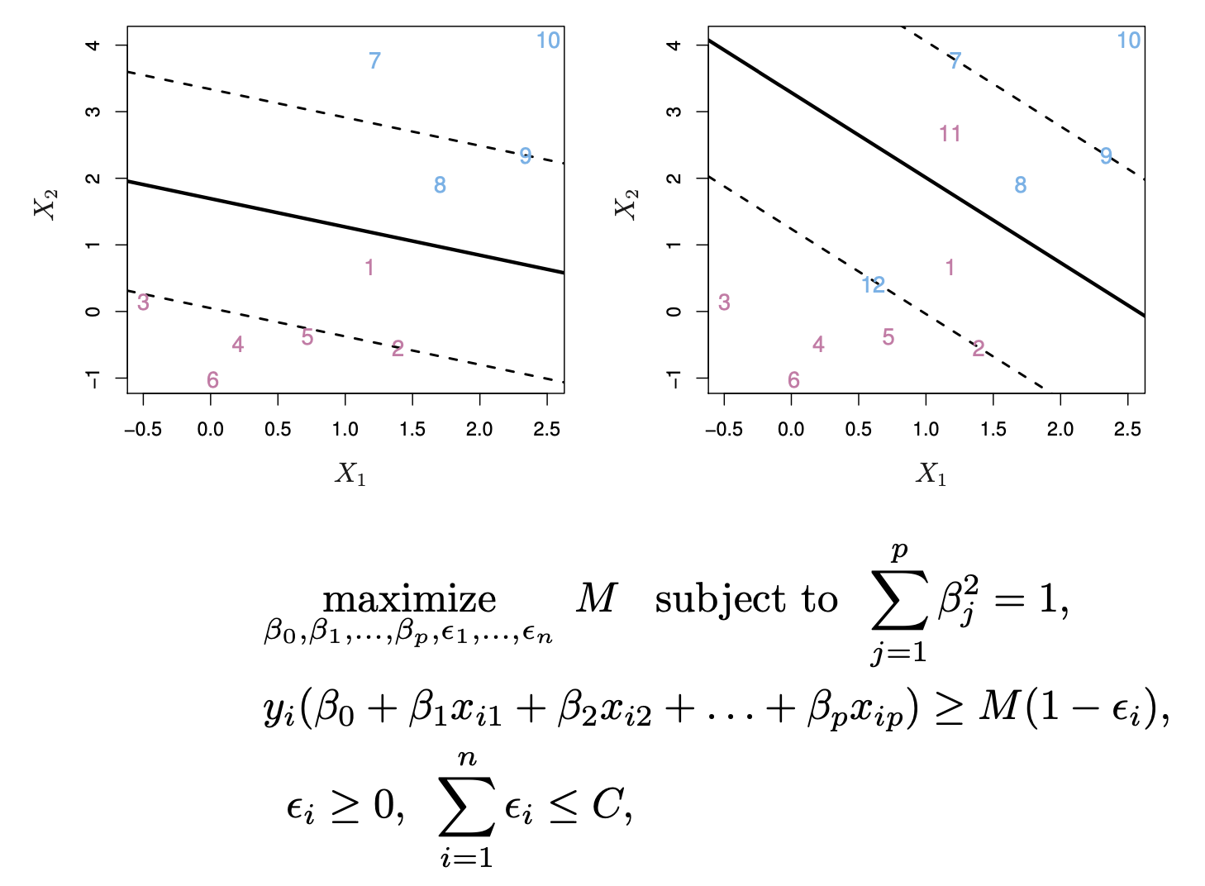
Soft Margin: Support Vector Classifier

Slide 9
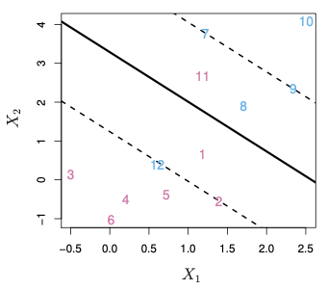
Soft Margin: Support Vector Classifier

Slide 10
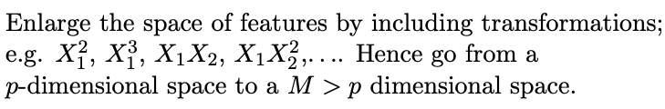

Feature Expansion

Slide 11
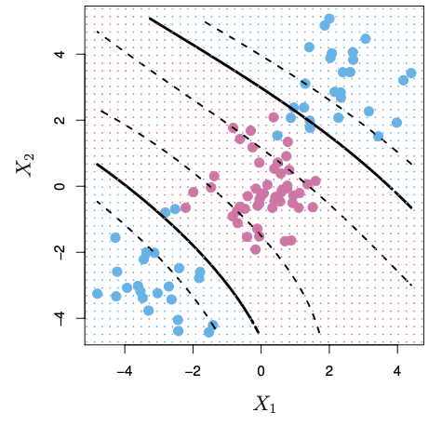
Cubic Polynomials
A basis expansion of cubic polynomials increases the number of variables from 2 to 9

Slide 12
Nonlinearities and Kernels
There is a more elegant and controlled way to introduce nonlinearities in support-vector classifiers — through the use of kernels.
Kernels: Linear Kernels; Polynomial Kernels; Gaussian Kernels

Slide 13
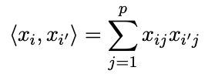
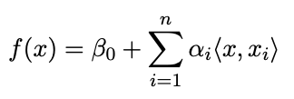
Inner products and support vectors
Inner product:
The linear support vector classifier can be represented as

Slide 14
Nonlinearities and Kernels
There is a more elegant and controlled way to introduce nonlinearities in support-vector classifiers — through the use of kernels.
Kernels: Linear Kernels; Polynomial Kernels; Gaussian Kernels

Slide 15
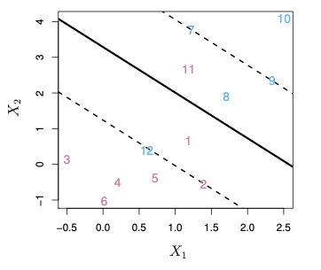

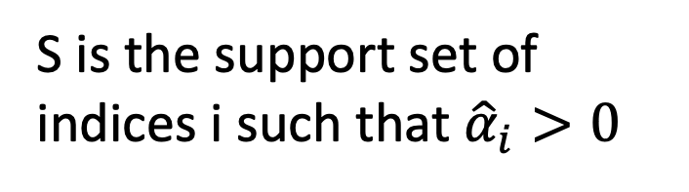
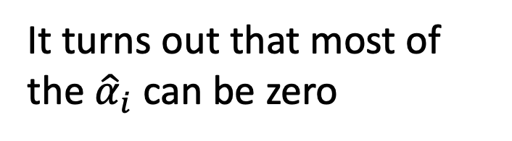
Nonlinearities and Kernels
It turns out that most of the ${\hat{α}}_{i}$ can be zero
S is the support set of indices i such that ${\hat{α}}_{i}>0$

Slide 16
Q & A

