Slide 1
Multiple Hypothesis Testing
Tianhang Zheng
https://tianzheng4.github.io

Slide 2

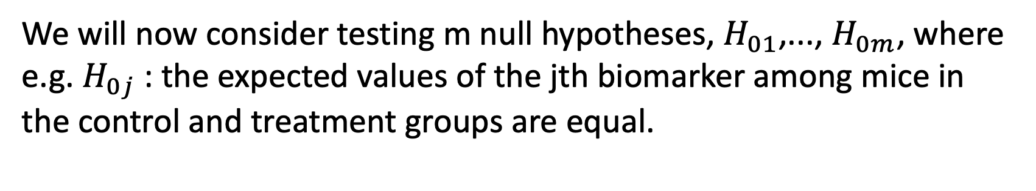
Multiple Hypothesis Testing
A single null hypothesis might look like $H_{0}$: the expected blood pressures of mice in the control and treatment groups are the same.
We will now consider testing m null hypotheses, $H_{01}$,..., $H_{0m}$, where e.g. $H_{0j}$: the expected values of the jth biomarker among mice in the control and treatment groups are equal.

Slide 3
A Quick Review of Hypothesis Testing
Hypothesis tests allow us to answer simple “yes-or-no” questions, such as:
Is the true coefficient in a linear regression equal to zero?
Does the expected blood pressure among mice in the treatment group equal the expected blood pressure among mice in the control group?

Slide 4
Process of Hypothesis Testing
Hypothesis testing proceeds as follows:
1. Define the null and alternative hypotheses
2. Construct the test statistic (t-statistics, F-statistics)
3. Compute the p-value
4. Decide whether to reject the null hypothesis

Slide 5

Define the Null Hypotheses
We divide the world into null and alternative hypotheses.
The null hypothesis, $H_{0}$, is the default state of belief about the world. For instance:
The true coefficient equals zero.
There is no difference in the expected blood pressures.

Slide 6
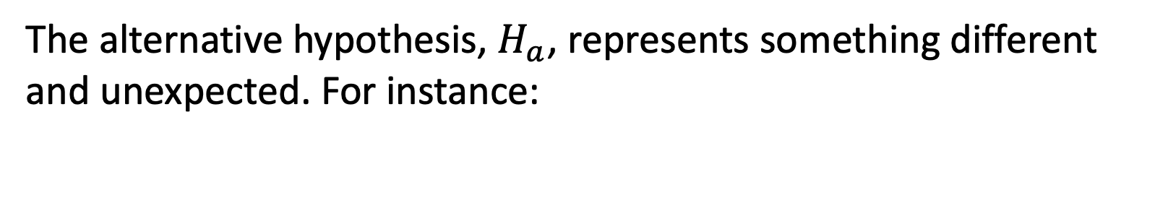
Define the Alternative Hypotheses
The alternative hypothesis, $H_{a}$, represents something different and unexpected. For instance:
The true coefficient is non-zero.
There is a difference in the expected blood pressures.

Slide 7
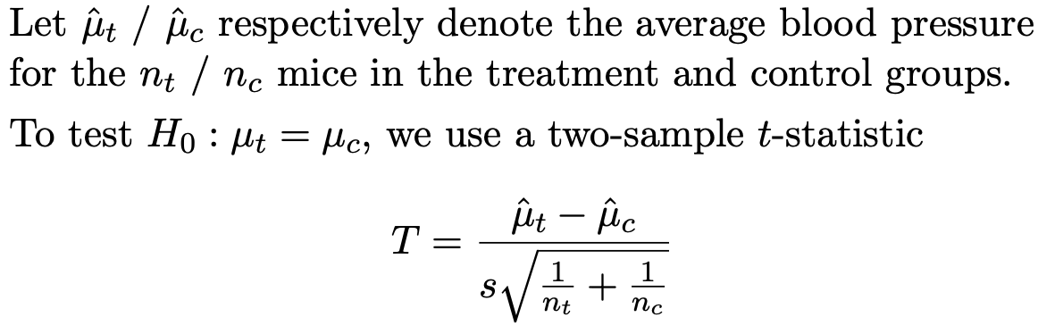
Construct the Test Statistic

Slide 8
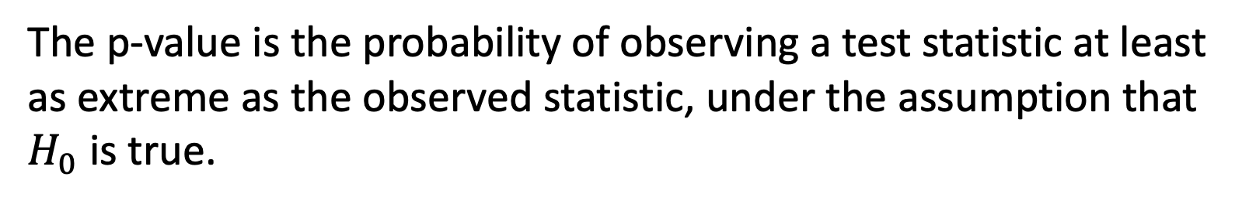


P-Value
The p-value is the probability of observing a test statistic at least as extreme as the observed statistic, under the assumption that $H_{0}$ is true.
A small p-value provides evidence against $H_{0}$ .
A large p-value indicates that $H_{0}$ is likely to be true.

Slide 9

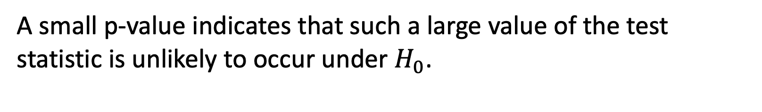
Decide Whether to Reject $H_{0}$
A small p-value indicates that such a large value of the test statistic is unlikely to occur under $H_{0}$.
A small p-value provides evidence against $H_{0}$ .
If the p-value is sufficiently small, then we will want to reject H0 (and, therefore, make a potential “discovery”).

Slide 10
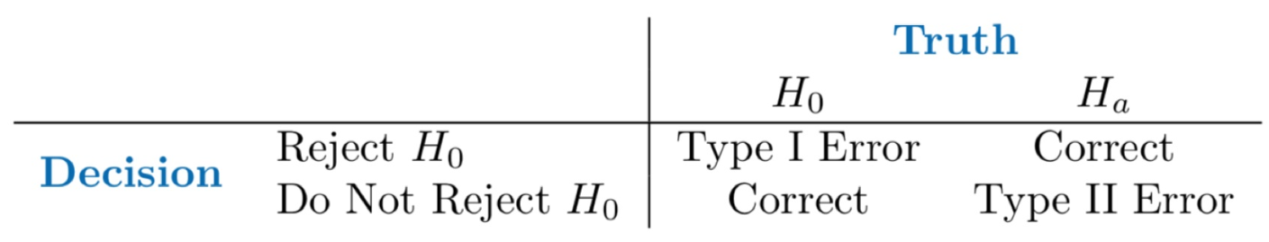
Type I Error and Type II Error

Slide 11


Type I Error Rate
The Type I error rate is the probability of making a Type I error.
We want to ensure a small Type I error rate.
If we only reject $H_{0}$ when the p-value is less than α, then the Type I error rate will be at most α.
So, we reject $H_{0}$ when the p-value falls below some α: often we choose α to equal 0.05 or 0.01 or 0.001.

Slide 12
Multiple Testing
Now suppose that we wish to test m null hypotheses
Can we simply reject all null hypotheses for which the corresponding p-value falls below (say) 0.01?
If we reject all null hypotheses for which the p-value falls below 0.01, then how many Type I errors will we make?

Slide 13
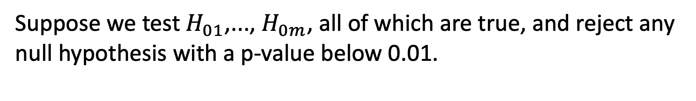
The Challenge of Multiple Testing
Suppose we test $H_{01}$,..., $H_{0m}$, all of which are true, and reject any null hypothesis with a p-value below 0.01.
Then we expect to falsely reject approximately 0.01 × m null hypotheses.
If m = 10,000, then we expect to falsely reject 100 null hypotheses by chance!

Slide 14
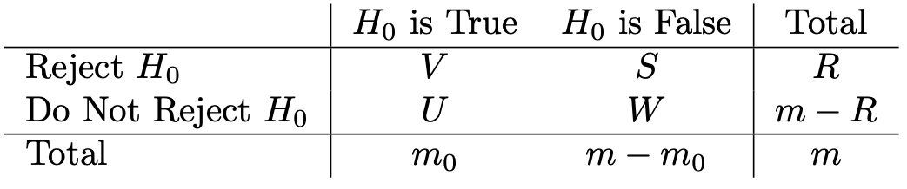
The Family-Wise Error Rate
The family-wise error rate (FWER) is the probability of making at least one Type I error when conducting m hypothesis tests.
FWER=Pr(V ≥1)

Slide 15
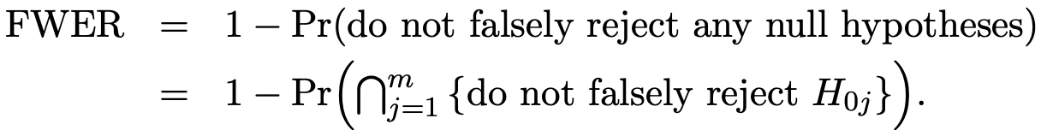
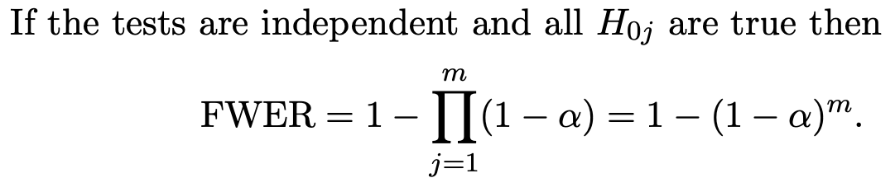
The Family-Wise Error Rate

Slide 16
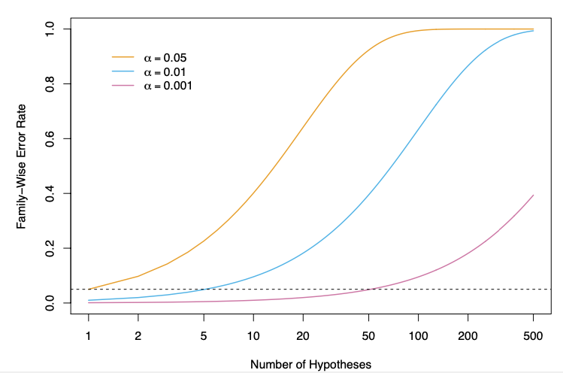
The Family-Wise Error Rate

Slide 17
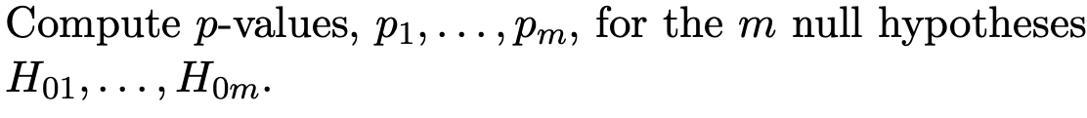
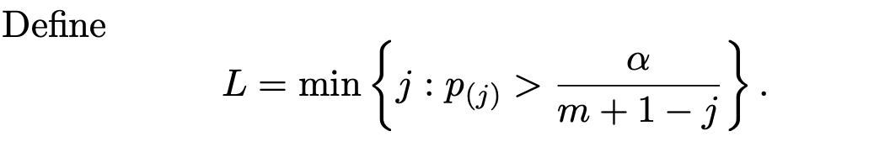
Holm’s Method

Slide 18
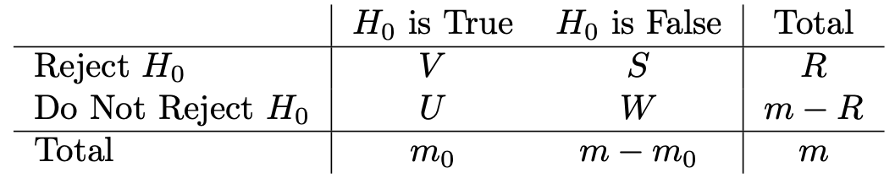
False Discovery Rate

Slide 19
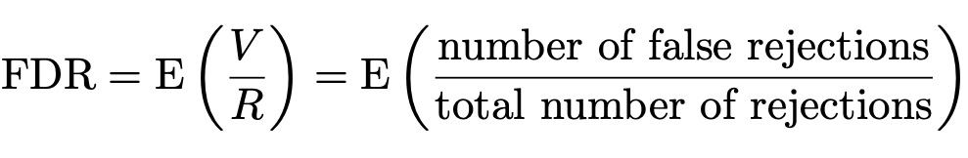
False Discovery Rate

Slide 20
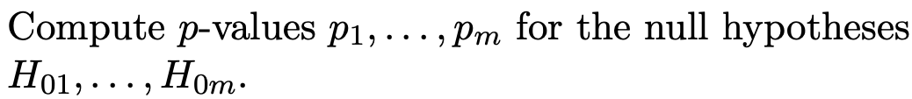
Benjamini-Hochberg Procedure to Control FDR

Slide 21
Re-Sampling
So far, we have assumed that we want to test some null hypothesis H0 with some test statistic T, and that we know (or can assume) the distribution of T under H0.
This allows us to compute the p-value.
What if this theoretical null distribution is unknown?

Slide 22
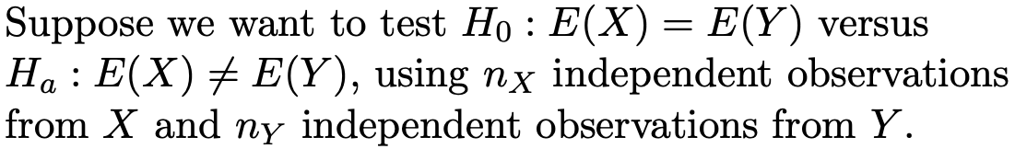
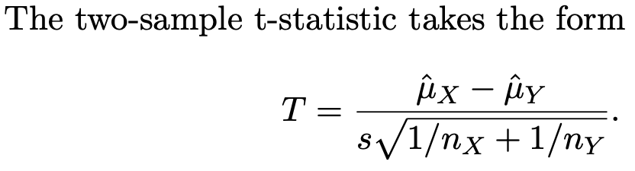
Two-Sample t-Test

Slide 23
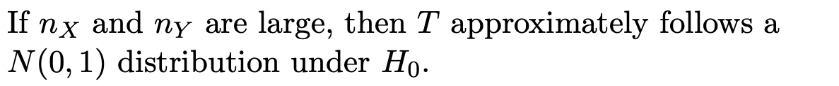
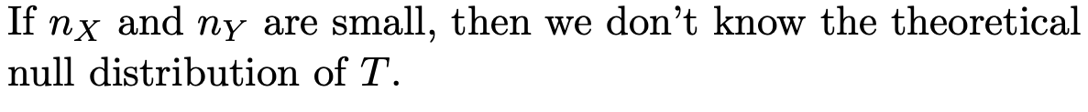
Two-Sample t-Test

Slide 24
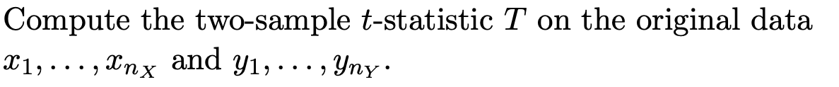
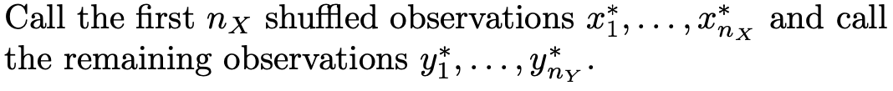
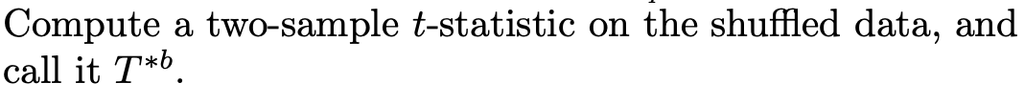
Resampling

Slide 25
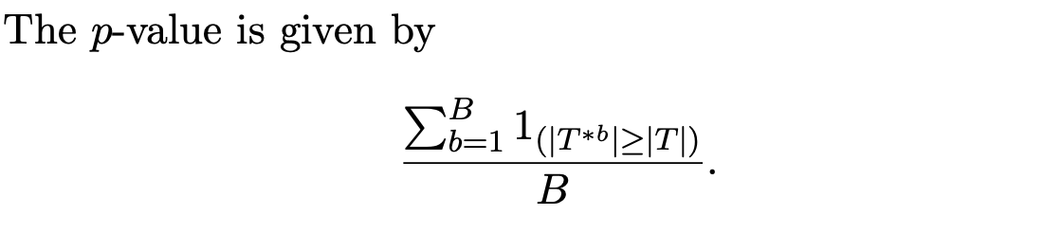
P-Value
Re-sampling approaches are useful if the theoretical null distribution is unavailable, or requires stringent assumptions.

