Slide 1
Introduction to Statistical Learning
Tianhang Zheng
https://tianzheng4.github.io

Slide 2
Course Website
https://tianzheng4.github.io/umkc-teaching/2023-fall-teaching-1/
What are on the course website:
Lecture slides
Lab material
Contact Information
If you are interested in my research, feel free to contact me.

Slide 3
Notations (Supervised Learning)
Vector/Matrix/Tensor predictor X (also called inputs, regressors, covariates, features, independent variables)
Outcome Y (also called dependent variable, response, target)
Objectives:
Accurately predict the outcomes of unseen test cases
Understand which inputs affect the outcome, and how
Assess the quality of our predictions and inferences

Slide 4
Notations (Supervised Learning)
Task: Predict the income based on years of education, years of work, etc.
Outcome Y is Income
Predictors are years of education, years of work, etc. (Denoted by X)
Modeling: $Y=f\left(X\right)+ε$

Slide 5
How to assess a model
Prediction Error (regression problems)
Prediction Accuracy (classification problems)
Model Variance
Interpretability

Slide 6

Prediction Error
Given a training dataset $D$, and a prediction function learned on $D$ (i.e., $g(X;D)$), the prediction error on $X$ can be defined as
$$E_{D}[ {\left(Y −g\left(X;D\right)\right)}^{2}]$$
$f\left(X\right)=E\left(Y | X\right)$ is the function that minimizes the prediction error.
$Y=f\left(X\right)+ε$, where $ε$ is irreducible error (because minimization)

Slide 7


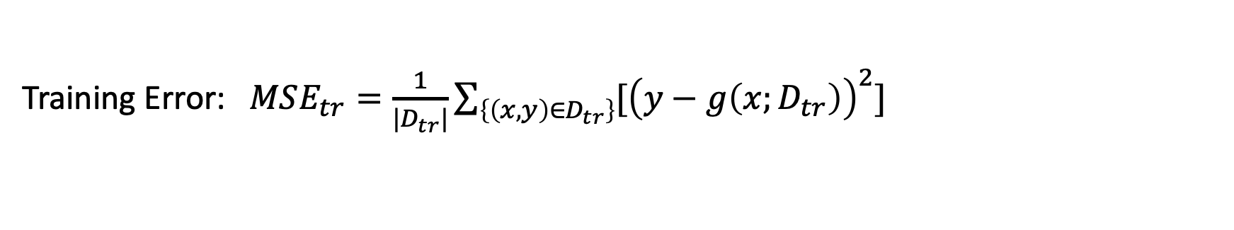
Prediction Error
Given a training dataset $D_{tr}$ and a testing dataset $D_{te}$, and a prediction function learned on $D_{tr}$ (i.e., $g(X;D_{tr})$), the prediction error can be defined as
$$E_{D}[ {\left(Y −g\left(X;D_{tr}\right)\right)}^{2}]$$
Training Error: $MSE_{tr}=\frac{1}{|D_{tr}|}\sum_{\left\{\left(x, y\right)∈D_{tr}\right\}}{[{\left(y−g\left(x;D_{tr}\right)\right)}^{2}]}$
Testing Error: $MSE_{te}=\frac{1}{|D_{te}|}\sum_{\left\{\left(x, y\right)∈D_{te}\right\}}{[{\left(y−g\left(x;D_{tr}\right)\right)}^{2}]}$

Slide 8
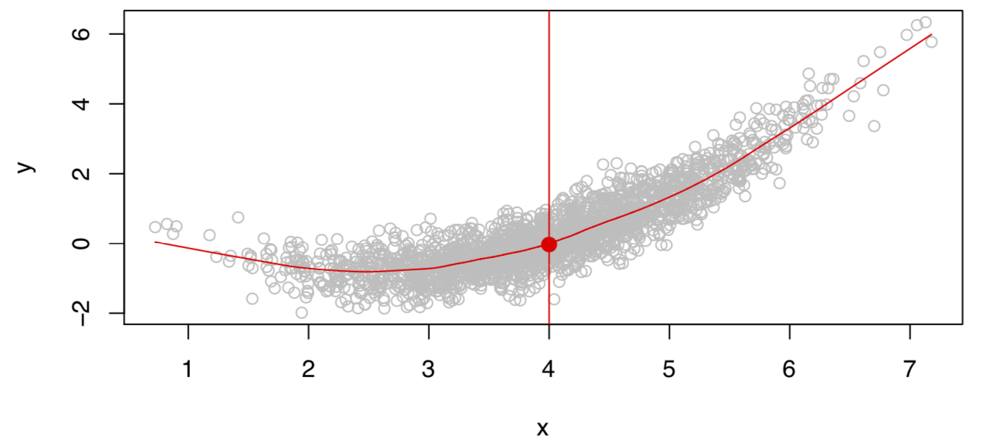
What is an ideal model?
Given X, there may be multiple outcomes Y due to different $ε$.

Slide 9
What is an ideal model?
The ideal model characterizes the expectation of the outcome.
$$f\left(X\right)=E(Y|X)$$
The ideal model here is also called the regression function.
If $X$ is a vector, $X=[X_{1}, X_{2}]$
$$f\left(x\right)=E(Y|X_{1}=x_{1}, { X}_{2}=x_{2})$$

Slide 10
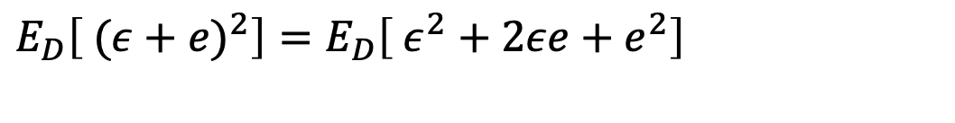


Decompose the Prediction Error
$$E_{D}\left[ {\left(Y −g\left(X\right)\right)}^{2}\right]=E_{D}\left[ {(\left(Y −f(X))+(f(X) −g\left(X;D\right)\right))}^{2}\right]$$
$$ε$$
$$e$$
$E_{D}\left[ {(ε+e)}^{2}\right]=E_{D}\left[ {ε^{2}+2εe+e}^{2}\right]$
$$E_{D}\left[ {(ε+e)}^{2}\right]=E_{D}\left[ {ε^{2}]+E_{D}[2εe]+E_{D}[e}^{2}\right]=ε^{2}+2εE_{D}\left[e\right]+E_{D}[e^{2}]$$
$E_{D}\left[ {(ε+e)}^{2}\right]=ε^{2}+2εE_{D}\left[e\right]+E_{D}[e^{2}]$ irreducible error + reducible error

Slide 11



Decompose the Prediction Error
$$E_{D}\left[ {\left(Y −g\left(X\right)\right)}^{2}\right]=bias^{2}+variance+σ^{2}$$
Bias:
$$E_{D}\left[g\left(X;D\right)\right] −f(X)$$
Depends on
model complexity
Variance:
$${E_{D}[(E}_{D}{\left[g\left(X;D\right)\right] −g(X;D))}^{2}]$$
Irreducible error:
$$ε or σ$$

Slide 12
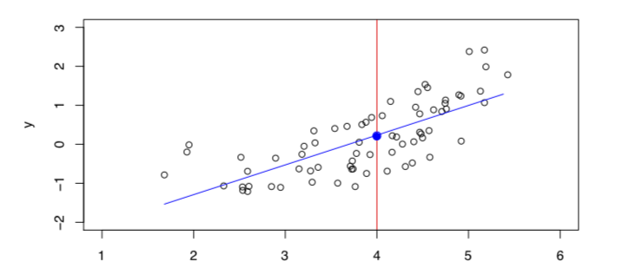
Regression Models (to Estimate g(X))
Linear Models:
$g\left(X\right)=β_{0}+β_{1}X_{1}+ …+β_{p}X_{p} (X=[X_{1},…., X_{p}]$)

Slide 13
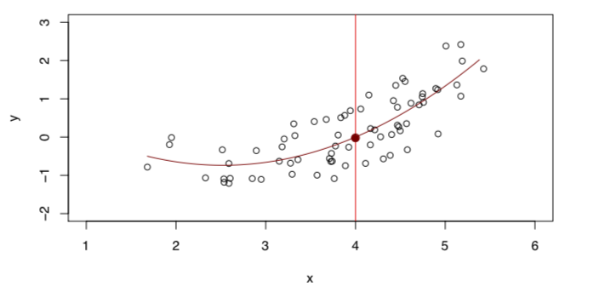
Regression Models (to Estimate g(X))
Quadratic Models:
$g\left(X\right)=β_{0}+β_{1}X_{1}+β_{2}X_{1}^{2} (X=[X_{1}]$)

Slide 14
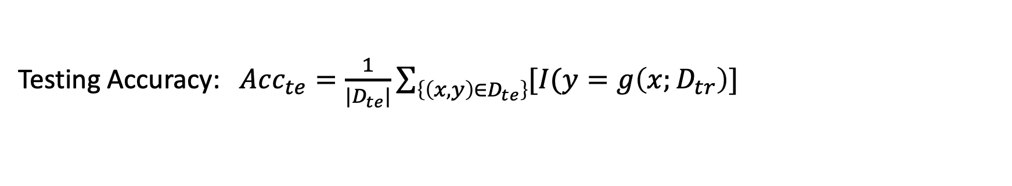
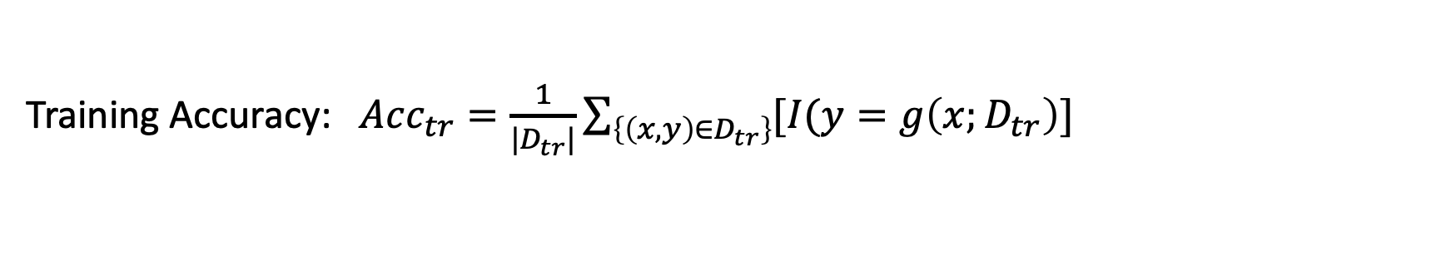
Prediction Accuracy
Given a training dataset $D_{tr}$ and a testing dataset $D_{te}$, and a prediction function learned on $D_{tr}$ (i.e., $g(X;D_{tr})$), the prediction accuracy can be defined as
$$Acc=E_{D}[I(Y=g\left(X;D_{tr}\right)]$$
Training Accuracy: $Acc_{tr}=\frac{1}{|D_{tr}|}\sum_{\left\{\left(x, y\right)∈D_{tr}\right\}}{[I(y=g\left(x;D_{tr}\right)]}$
Testing Accuracy: $Acc_{te}=\frac{1}{|D_{te}|}\sum_{\left\{\left(x, y\right)∈D_{te}\right\}}{[I(y=g\left(x;D_{tr}\right)]}$

Slide 15
Classification Models
The output of classification models are labels
Logistic Regression Models
Support Vector Machine
K-Nearest Neighbors

Slide 16

Model Bias and Variance
$$E_{D}\left[g\left(X;D\right)\right] −f(X)$$
Model Bias
Model Variance: The variance of parameters (but what is the standard?)
Better metric: ${E_{D}[(E}_{D}{\left[g\left(X;D\right)\right] −g(X;D))}^{2}]$

Slide 17
Bias and Variance Trade-off
If a model is more complicated (e.g., with more parameters):
The bias is expected to be smaller
The variance is expected to be larger

Slide 18
Interpretability
The importance of each predictor?
Why a model makes a particular decision?
Example: Linear Model
$$Income=5×Year of work+4×Year of Edu+0.1×Height$$

Slide 19
Accuracy and Interpretability Trade-off
If a model is more complicated (e.g., with more parameters):
The accuracy may be higher (but may suffer from overfitting)
The interpretability may be worse (It is easy to interpret linear models)

Slide 20
Other Metrics (Binary Classification)
A + B: B is the prediction, and A means the correctness of the prediction
True Positive: TP
False Positive: FP
TP + FP = 1
True Negative: TN
False Negative: FN
TN + FN = 1

Slide 21
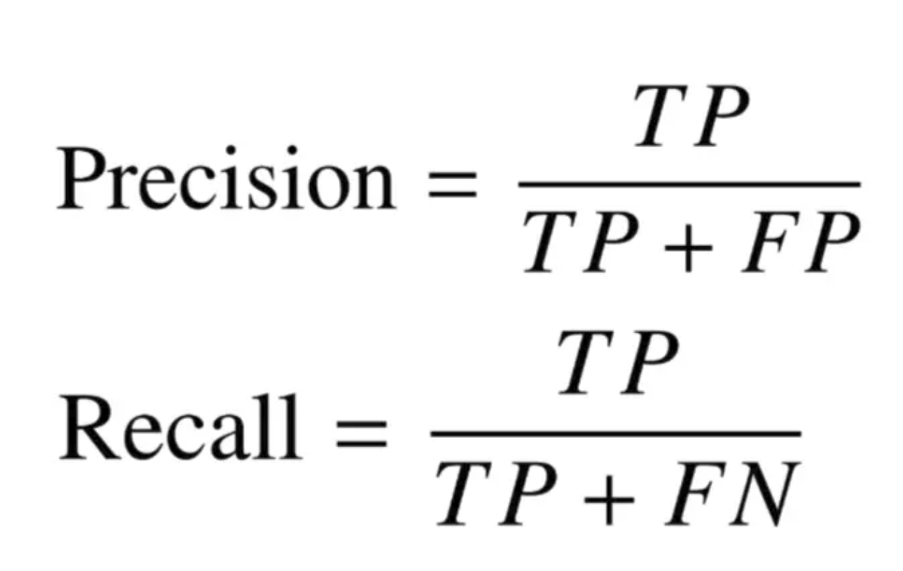
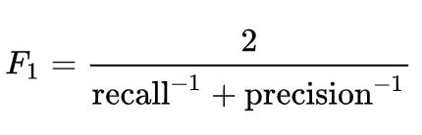
Other Metrics (Binary Classification)
How many positive predictions are correct?
How many positive cases are correctly predicted?

Slide 22
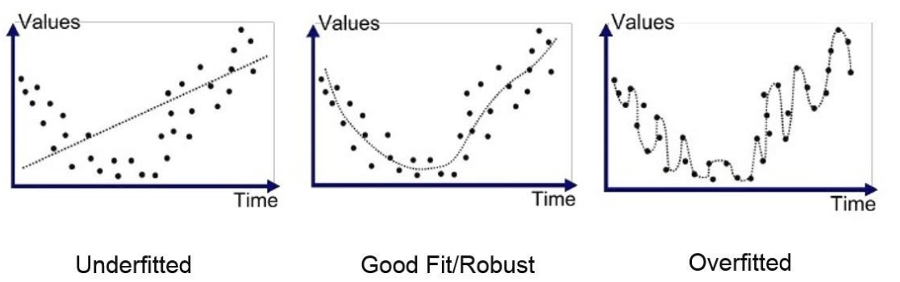
Goodfit, Underfit and Overfit
High bias
High variance

Slide 23
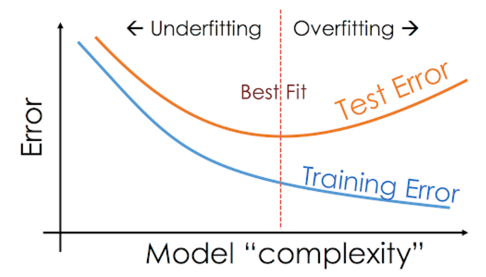
Underfit and Overfit

Slide 24
Q & A

