Slide 1
Multi-Variable Linear Regression
Tianhang Zheng
https://tianzheng4.github.io

Slide 2
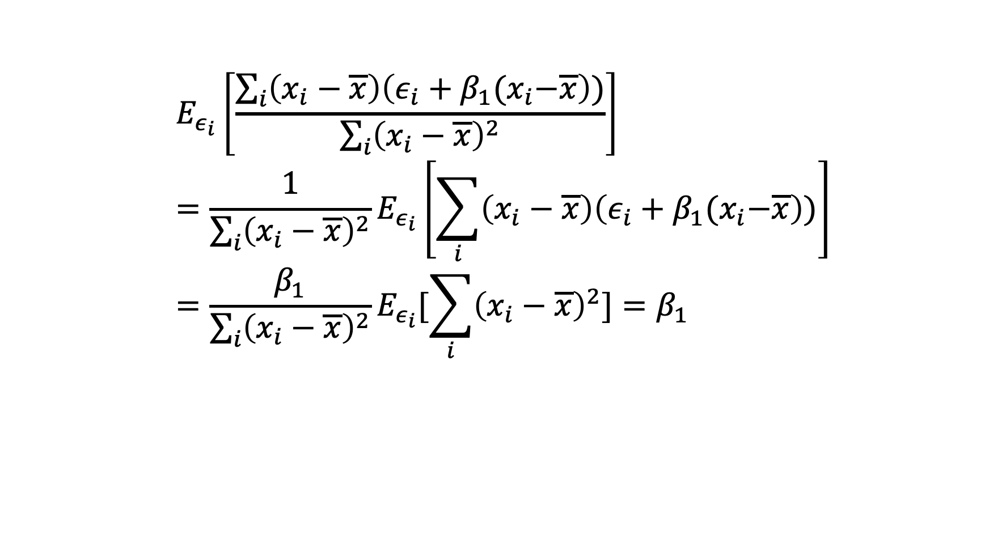
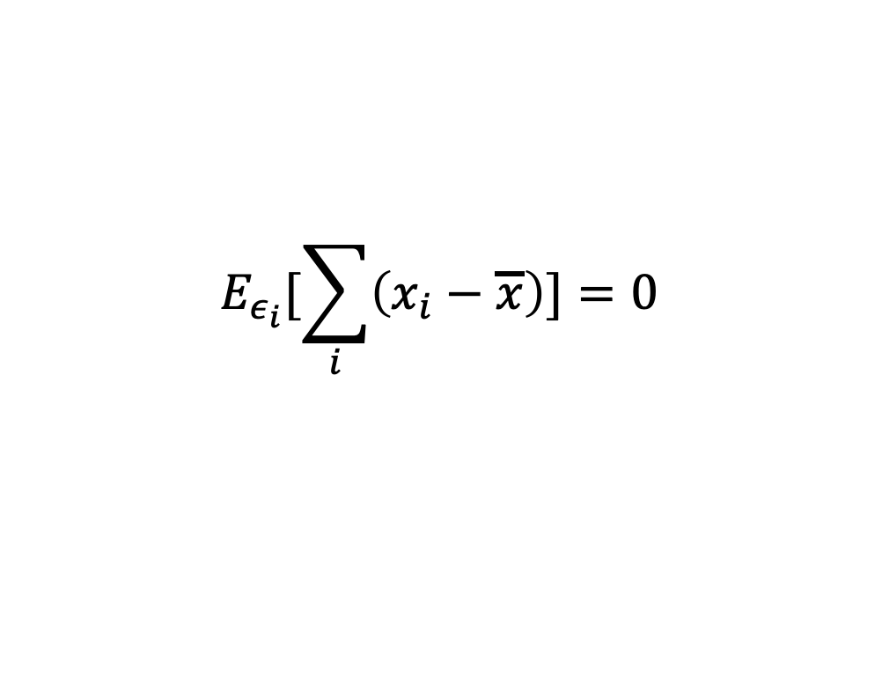
Analyzing Least Squares Method (Unbiased)
$$E_{ε_{i}}[\sum_{i}{\left(x_{i}−\overline{x}\right)]=0}$$
$$E_{ε_{i}}\left[\frac{\sum_{i}{\left(x_{i}−\overline{x}\right)\left(ε_{i}+β_{1}{(x}_{i}−\overline{x}\right))}}{\sum_{i}{{\left(x_{i}−\overline{x}\right)}^{2}}}\right]={\frac{1}{\sum_{i}{{\left(x_{i}−\overline{x}\right)}^{2}}}E}_{ε_{i}}\left[\sum_{i}{\left(x_{i}−\overline{x}\right)\left(ε_{i}+β_{1}{(x}_{i}−\overline{x}\right))}\right]=\frac{β_{1}}{\sum_{i}{{\left(x_{i}−\overline{x}\right)}^{2}}}E_{ε_{i}}[\sum_{i}{{\left(x_{i}−\overline{x}\right)}^{2}]}=β_{1}$$
Why unbiased?

Slide 3

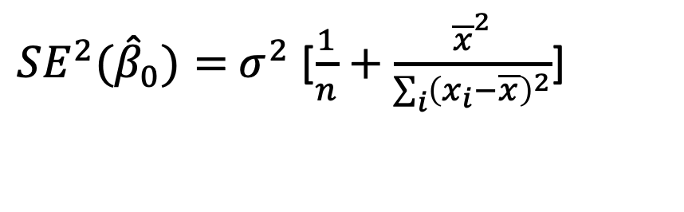
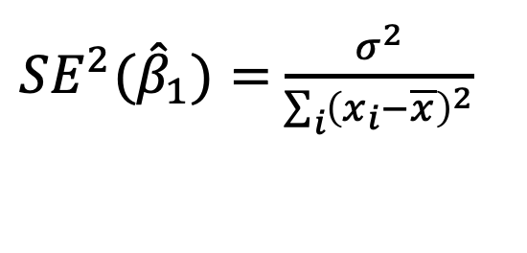
Analyzing Least Squares Method
The variance of ${\hat{β}}_{0}$and ${\hat{β}}_{1}$ are
${SE^{2}(\hat{β}}_{1})=$ $\frac{σ^{2}}{\sum_{i}{{\left(x_{i}−\overline{x}\right)}^{2}}}$
${SE^{2}(\hat{β}}_{0})=$ $σ^{2}$ [$\frac{1}{n}+\frac{{\overline{x}}^{2}}{\sum_{i}{{\left(x_{i}−\overline{x}\right)}^{2}}}$]
$$σ^{2}=Var(ε)$$
$\hat{β}∼N(β, SE^{2}\left(\hat{β}\right))$ Why Gaussian distribution?

Slide 4

Confidence Level
$\hat{β}∼N(β, SE^{2}\left(\hat{β}\right))$ means that$β∼N(\hat{β}, SE^{2}\left(\hat{β}\right))$
A 95% confidence interval is defined as a range of values with 95% probability, and the interval for the least square method is
$$[\hat{β}−2SE\left(\hat{β}\right),\hat{β}+2SE(\hat{β})]$$
There is 95% probability that this interval contains the true $β$

Slide 5
Multiple Linear Regression
Linear Regression with multiple predictors (Assume the ideal model is a linear function)
$$Y=β_{0}+β_{1}X_{1}+β_{2}X_{2}+…+β_{p}X_{p}+ε$$
$β_{0}$ is interpreted as the average effect of one unit increase in $X_{i}$ on Y

Slide 6
Parameter Estimation
The objective is to learn (estimate) $β_{0}, β_{1}…, β_{p}$
The estimates of $β_{0}, β_{1}…, β_{p}$are denoted by ${\hat{β}}_{0}, {\hat{β}}_{1}…,{\hat{β}}_{p}$
$$\hat{y}={\hat{β}}_{0}+{\hat{β}}_{1}x_{1}+…+{\hat{β}}_{1}x_{p}$$
$e=y−\hat{y}$ is the residual

Slide 7
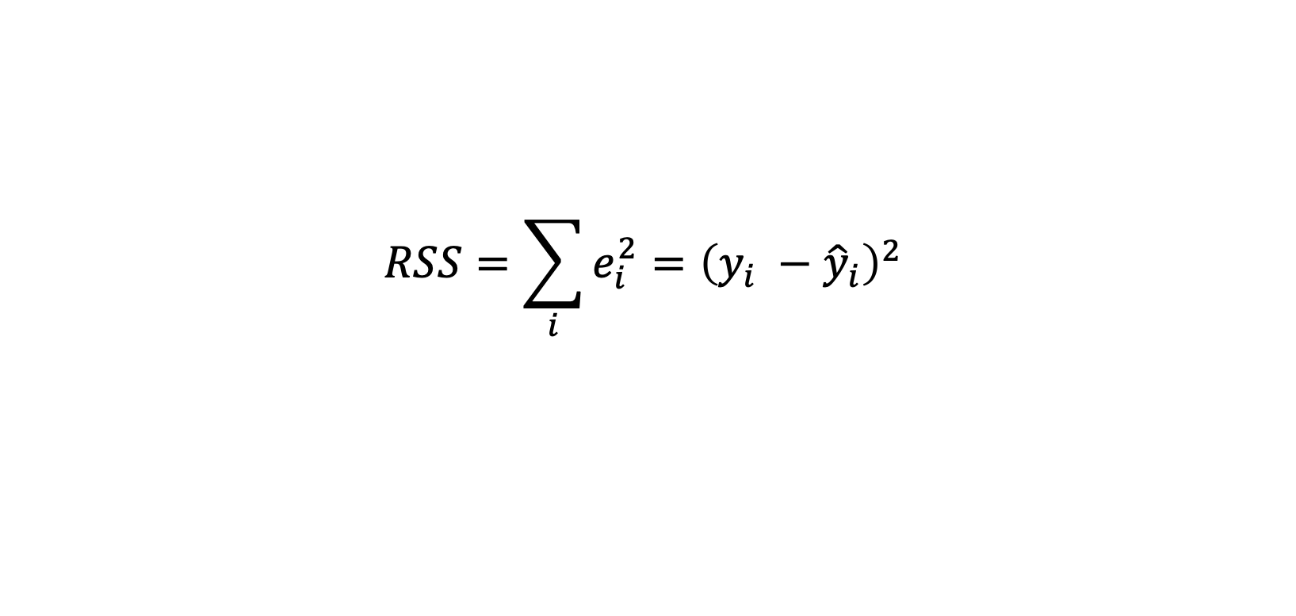
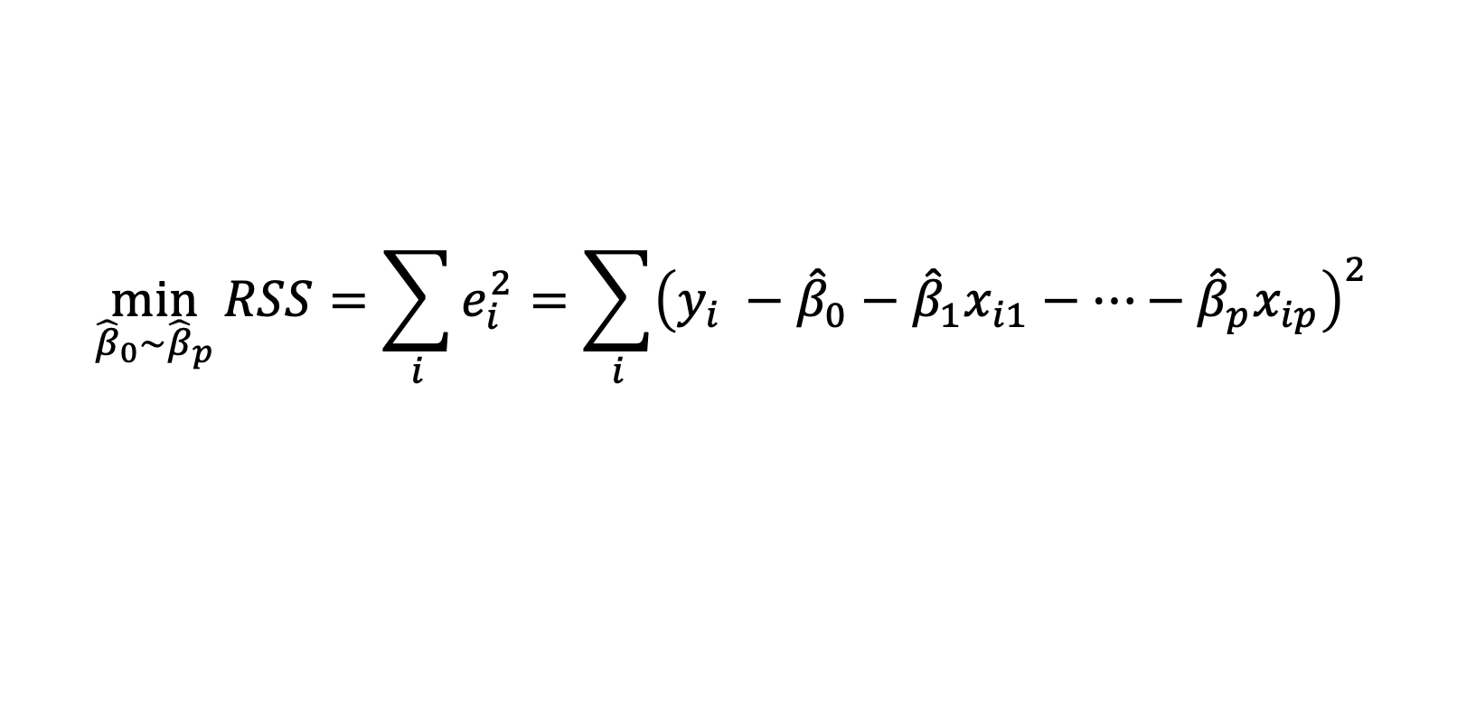
Least Square Method (Solved by Software)
$$RSS=\sum_{i}{e_{i}^{2}={\left(y_{i} −{\hat{y}}_{i}\right)}^{2} }$$
$$\min_{{\hat{β}}_{0}∼{\hat{β}}_{p}}{RSS=\sum_{i}{e_{i}^{2}=\sum_{i}{{\left(y_{i} −{\hat{β}}_{0}−{\hat{β}}_{1}x_{i1}−…−{\hat{β}}_{p}x_{ip}\right)}^{2}} }}$$
Take the derivative and set it as 0 to estimate $\hat{β}$

Slide 8
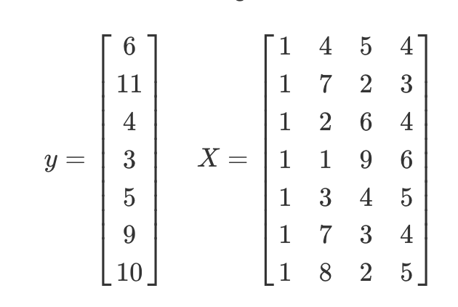


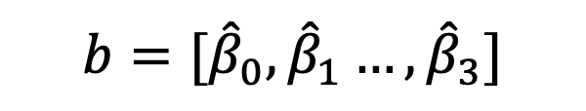
Least Square Method (Solved by Matrix)
Estimation:
$${b=[\hat{β}}_{0}, {\hat{β}}_{1}…,{\hat{β}}_{3}]$$

Slide 9
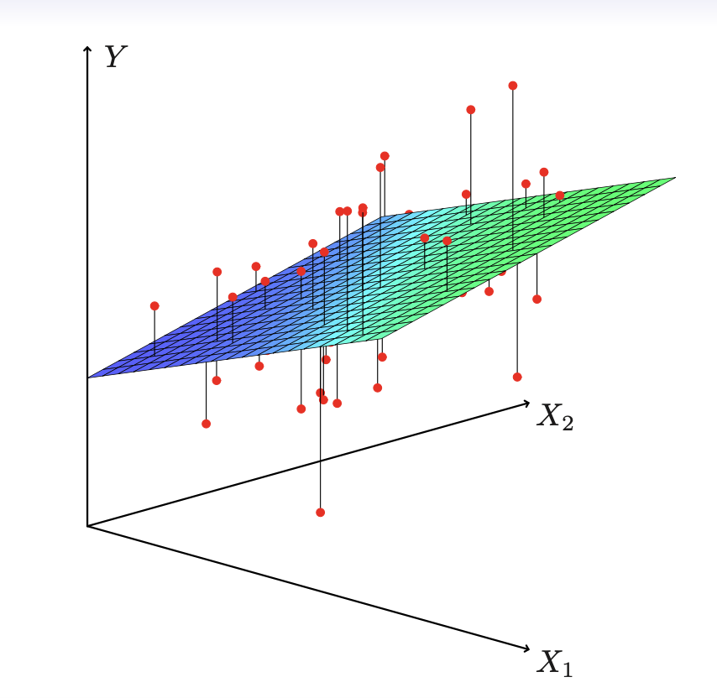
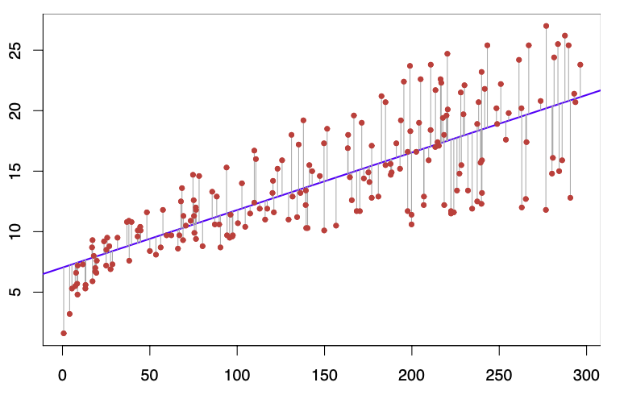
Visualization

Slide 10

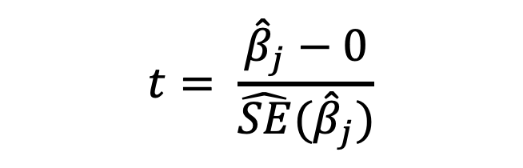
Hypothesis Testing
$$H_{0}:β_{j}= 0$$
$$t= \frac{{\hat{β}}_{j}−0}{\hat{SE}({\hat{β}}_{j})}$$
We can use t-statistics
$$\hat{β}=\left[{\hat{β}}_{0},{\hat{β}}_{1},…,{\hat{β}}_{p}\right]∼N{\left(β, {σ^{2}(X}^{t}X\right)}^{−1})$$

Slide 11

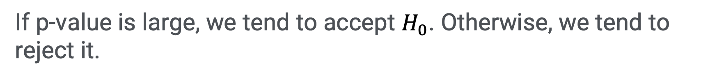
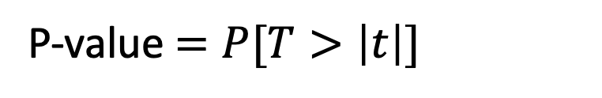
P value
A p-value is the probability of obtaining test results at least as extreme as the result actually observed, under the assumption that the null hypothesis ($H_{0}$) is correct.
P-value $=P[T>\left|t\right|]$
If p-value is large, we tend to accept $H_{0}$. Otherwise, we tend to reject it.

Slide 12
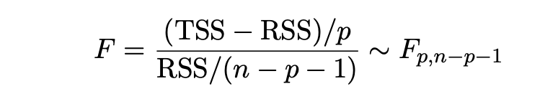

Hypothesis Testing
$$H_{0}:β_{1}=β_{2}=…=β_{p}= 0$$
We need to use F-statistics

Slide 13
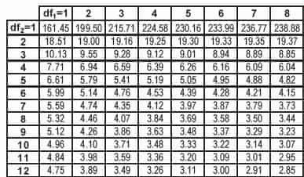
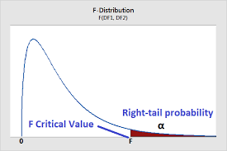
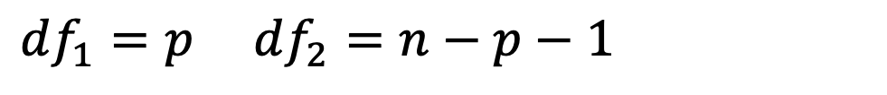
Hypothesis Testing
$df_{1}=p$ $df_{2}=n−p−1$

Slide 14
Variable Selection
Forward Selection
Backward Selection
Colinearity

Slide 15
Forward Selection
Begin with the null model — a model that contains an intercept but no predictors.
Fit p simple linear regressions and add to the null model the variable that results in the lowest RSS.
Add to that model the variable that results in the lowest RSS amongst all two-variable models. (Continue until some stopping rule is satisfied)

Slide 16
Backward Selection
Start with all variables in the model.
Remove the variable with the largest p-value — that is, the
variable that is the least statistically significant.
Continue to fit and remove until a stopping rule is reached

Slide 17
Colinearity
Two or more variables are exactly correlated.
The parameters are not fixed and will be affected by small changes in the training data
Increase the difficulty for interpretation

Slide 18


Variable Interaction / Nonlinear Effects
Consider interaction between $X_{1}$ and $X_{2}$.
$$Y=β_{0}+β_{1}X_{1}+β_{2}X_{2}+β_{3}X_{1}X_{2}+ε$$
Consider nonlinear effects of $X_{1}$
$$Y=β_{0}+β_{1}X_{1}+β_{2}X_{1}^{2}+ε$$

Slide 19
Next
Friday: First Assignment---Linear Regression
Next Week: Classification and Regression

Slide 20
Q & A

