Slide 1
Review
Tianhang Zheng
https://tianzheng4.github.io

Slide 2
Supervised Learning
Vector/Matrix/Tensor predictor X (also called inputs, regressors, covariates, features, independent variables)
Outcome Y (also called dependent variable, response, target)
Objectives:
Accurately predict the outcomes of unseen test cases
Understand which inputs affect the outcome, and how
Assess the quality of our predictions and inferences

Slide 3
Supervised Learning
New Input
Linear Regression
X: Inputs
Machine Learning Algorithm
Model
Y: Outcomes
Logistic Regression
Outcome

Slide 4
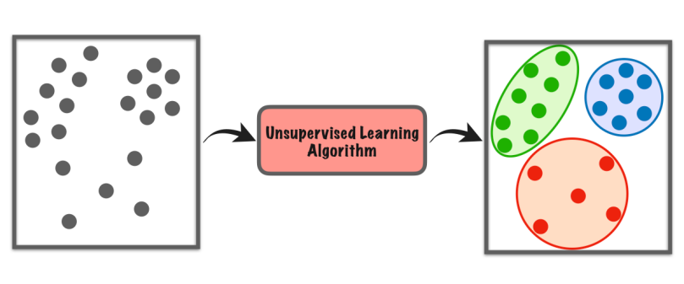
Unsupervised Learning
No outcome variable, just a set of predictors (features) measured on a set of samples.
Objectives:
Find groups of samples that behave similarly
Find the most important sets of features

Slide 5
How to assess a model
Prediction Error (regression problems)
Prediction Accuracy (classification problems)
Model Variance
Interpretability

Slide 6
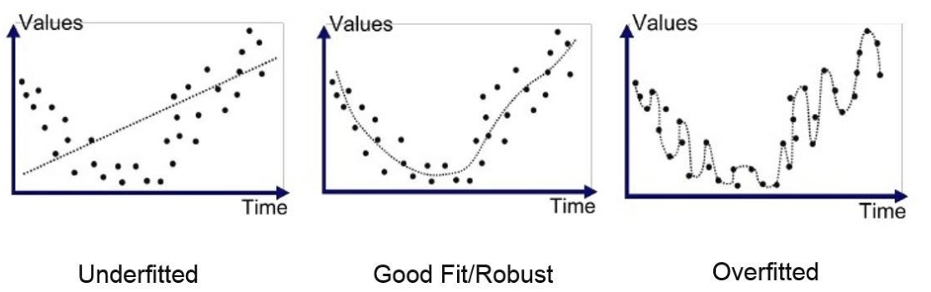
Goodfit, Underfit and Overfit
High bias
High variance

Slide 7
Bias and Variance (Corrections)
$$E_{D}\left[ {\left(Y −g\left(X\right)\right)}^{2}\right]=bias^{2}+variance+σ^{2}$$
Bias:
$$E_{D}\left[g\left(X;D\right)\right] −f(X)$$
Depends on
model complexity
Variance:
$${E_{D}[(E}_{D}{\left[g\left(X;D\right)\right] −g(X;D))}^{2}]$$
Irreducible error:
$$σ$$

Slide 8
Simple Linear Regression
Linear Regression with a single predictor (Assume the ideal model is a linear function)
$$Y=β_{0}+β_{1}X+ε$$
$β_{0}$ is called intercept and $β_{1}$ is called slope, which are two parameters.
$ε$ is the error term: $ε∼N(0, σ^{2})$

Slide 9
Least Squares Method
$$\min_{{\hat{β}}_{0},{\hat{β}}_{1}}{RSS=\sum_{i}{e_{i}^{2}=\sum_{i}{{\left(y_{i} −{\hat{β}}_{0}−{\hat{β}}_{1}x_{i}\right)}^{2}} }}$$
Take the derivative and set the derivative as 0
$${\hat{β}}_{1}= \frac{\sum_{i}{(x_{i}−\overline{x})(y_{i}−\overline{y})}}{\sum_{i}{{\left(x_{i}−\overline{x}\right)}^{2}}}$$
$${\hat{β}}_{0}=\overline{y}−{\hat{β}}_{1}\overline{x}$$

Slide 10
Confidence Level
$\hat{β}∼N(β, SE^{2}\left(\hat{β}\right))$ means that$β∼N(\hat{β}, SE^{2}\left(\hat{β}\right))$
A 95% confidence interval is defined as a range of values with 95% probability, and the interval for the least square method is
$$[\hat{β}−2SE\left(\hat{β}\right),\hat{β}+2SE(\hat{β})]$$
There is 95% probability that this interval contains the true $β$

Slide 11
Prediction Error
The residual sum of squares (RSS)
$$RSS=\sum_{i}{e_{i}^{2}={∑\left(y_{i} −{\hat{y}}_{i}\right)}^{2} }$$
The residual standard error (RSE)
$$RSE= \sqrt{\frac{1}{n−2}RSS}$$

Slide 12
R-Squared
The proportion of the variance that can be explained by a model
$$R^{2}=1 − \frac{RSS}{TSS}$$
TSS is the total sum of squares (total variance of y)
$$TSS=\sum_{i}{{\left(y_{i} −\overline{y}\right)}^{2}}$$

Slide 13
Multiple Linear Regression
Linear Regression with multiple predictors (Assume the ideal model is a linear function)
$$Y=β_{0}+β_{1}X_{1}+β_{2}X_{2}+…+β_{p}X_{p}+ε$$
$β_{0}$ is interpreted as the average effect of one unit increase in $X_{i}$ on Y

Slide 14
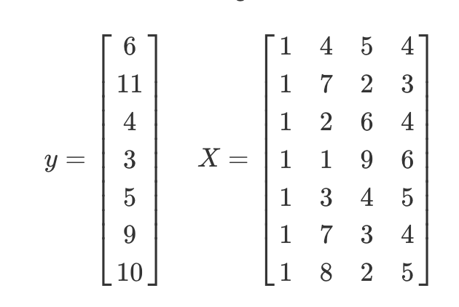


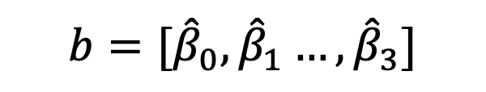
Least Square Method (Solved by Matrix)
Estimation:
$${b=[\hat{β}}_{0}, {\hat{β}}_{1}…,{\hat{β}}_{3}]$$

Slide 15

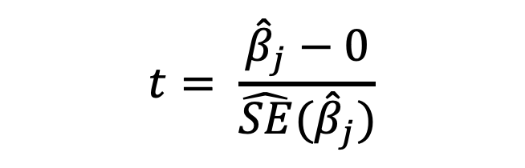
Hypothesis Testing
$$H_{0}:β_{j}= 0$$
$$t= \frac{{\hat{β}}_{j}−0}{\hat{SE}({\hat{β}}_{j})}$$
We can use t-statistics
$$\hat{β}=\left[{\hat{β}}_{0},{\hat{β}}_{1},…,{\hat{β}}_{p}\right]∼N{\left(β, {σ^{2}(X}^{t}X\right)}^{−1})$$

Slide 16
P value
A p-value is the probability of obtaining test results at least as extreme as the result actually observed, under the assumption that the null hypothesis ($H_{0}$) is correct.
P-value $=P[T>\left|t\right|]$
If p-value is large, we tend to accept $H_{0}$. Otherwise, we tend to reject it.

Slide 17


Logistic Regression
$$p(Y=1|X)=\frac{e^{β_{0}+β_{1}X}}{1+e^{β_{0}+β_{1}X}}$$
$p\left(Y=1 | X\right)$ always has values between 0 and 1
$$\log\left(\frac{p}{1−p}\right)=β_{0}+β_{1}X$$

Slide 18

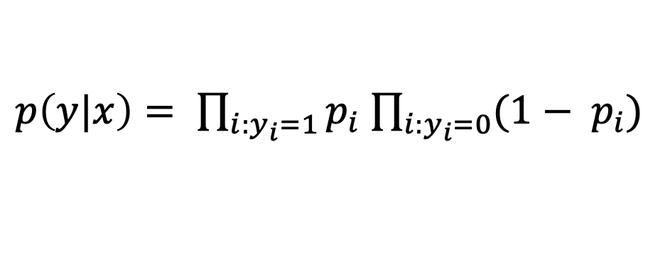
Maximum Likelihood Method
Commonly used for parameter estimation of logistic regression
Assume that the predictors are independent
$p\left(y|x\right)= \prod_{i:y_{i}=1}{p_{i}}$ $\prod_{i:y_{i}=0}{{(1− p}_{i})}$
$$p_{i}= p(y_{i}=1|x_{i})$$
This likelihood characterizes the conditional probability of the observed data

Slide 19
Multi-Class Logistic Regression
A linear function for each class
$$p(Y=k|X)=\frac{e^{β_{0k}+β_{1k}X}}{\sum_{l=1}^{K}{e^{β_{0l}+β_{1l}X}}}$$
Multi-class logistic regression is also called multinomial regression

Slide 20
K Nearest Neighbors
A non-parametric supervised learning algorithm for classification
Assign the label of x based on a majority vote mechanism
Select the k training points that are nearest to the target point x
Assign the majority label for the k training points as the label of x

Slide 21
K-Fold Cross-validation
Randomly divide the data into K equal-sized parts. We leave out part k, fit the model to the other K − 1 parts (combined), and then obtain predictions for the left-out kth part.
This is done in turn for each part k = 1,2,...K, and then the results are combined.

Slide 22
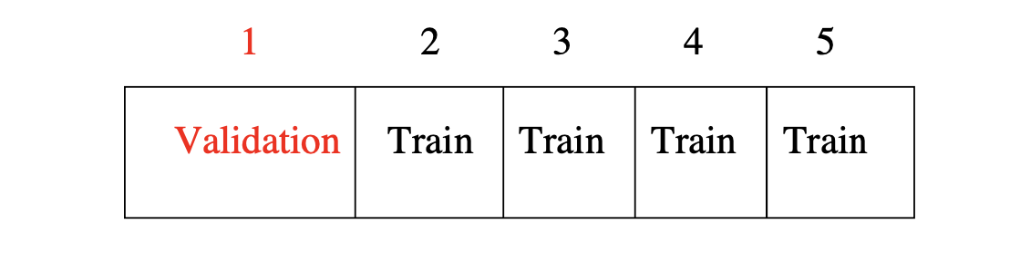
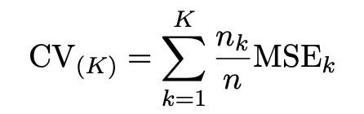


K-Fold Cross-validation
Denote K parts by $C_{1}, C_{2}, C_{3}…, C_{K}$

Slide 23

Leave-One Out Cross-Validation (LOOCV )
K=n K-fold cross validation
LOOCV is sometimes useful, but the estimates are highly correlated, so the average has high variance
A better choice is K=5 or 10

Slide 24
BootStrap
We obtain distinct datasets by repeatedly sampling observations from the original dataset with replacement.
Each “bootstrap dataset” is created by sampling with replacement and is the same size as our original dataset.
Use the bootstrap to get an estimate of a parameter

Slide 25
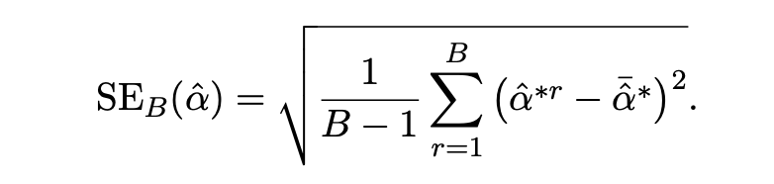
BootStrap
Primarily used to obtain standard errors of an estimate.
Provide approximate confidence intervals for a population parameter.

Slide 26
BootStrap to Estimate Prediction Error?
To estimate prediction error using the bootstrap, we could think about using each bootstrap dataset as our training sample, and the original sample as our validation sample.
But there is large overlap between training and validation set, which will underestimate the error

Slide 27
Final Exam
Three concept questions
Two calculation questions

