Slide 1
Model Selection and Regularization
Tianhang Zheng
https://tianzheng4.github.io

Slide 2
Model Selection and Regularization Methods
Subset Selection. We identify a subset of the p predictors that we believe to be related to the response.
Shrinkage. We fit a model involving all p predictors, but the estimated coefficients are shrunken towards zero relative to the least squares estimates (Regularization)
Dimension Reduction. We project the p predictors into a M-dimensional subspace, where M < p. This is achieved by computing M different linear combinations, or projections.

Slide 3

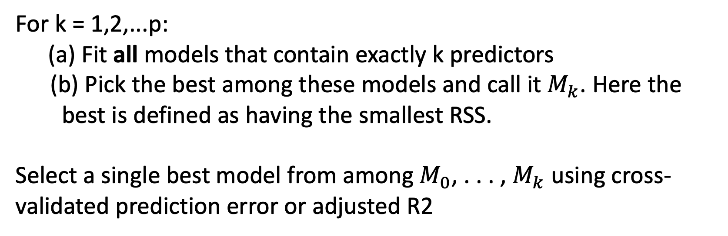
Subset Selection
Let $M_{0}$ denote the null model, which contains no predictors.
For k = 1,2,...p: (a) Fit all models that contain exactly k predictors
(b) Pick the best among these models and call it $M_{k}$. Here the
best is defined as having the smallest RSS.
Select a single best model from among $M_{0}$, . . . , $M_{k}$ using cross-validated prediction error or adjusted R2

Slide 4
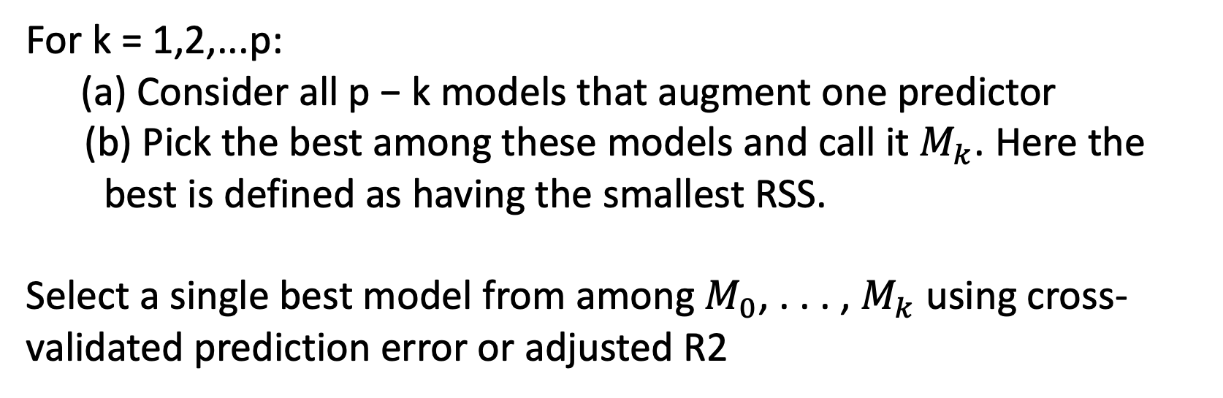
Forward Stepwise Selection
Let $M_{0}$ denote the null model, which contains no predictors.
For k = 1,2,...p: (a) Consider all p − k models that augment one predictor
(b) Pick the best among these models and call it $M_{k}$. Here the
best is defined as having the smallest RSS.
Select a single best model from among $M_{0}$, . . . , $M_{k}$ using cross-validated prediction error or adjusted R2

Slide 5
Forward Stepwise Selection (Greedy)
Let $M_{0}$ denote the null model, which contains no predictors.
For k = 1,2,...p: (a) Consider all p − k models that augment one predictor
(b) Pick the best among these models and call it $M_{k}$. Here the
best is defined as having the smallest RSS.
Select a single best model from among $M_{0}$, . . . , $M_{k}$ using cross-validated prediction error or adjusted R2

Slide 6
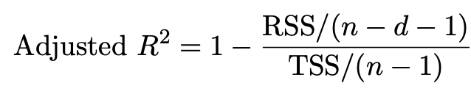
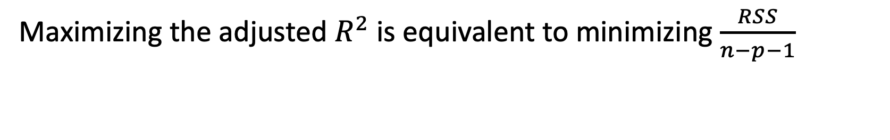
Adjusted R2
Maximizing the adjusted $R^{2}$ is equivalent to minimizing $\frac{RSS}{n−p−1}$

Slide 7
Shrinkage Methods
Ridge regression and Lasso
Fit a model containing all p predictors using a technique that constrains or regularizes the coefficient estimates, or equivalently, that shrinks the coefficient estimates towards zero. (reduce parameter variance)

Slide 8
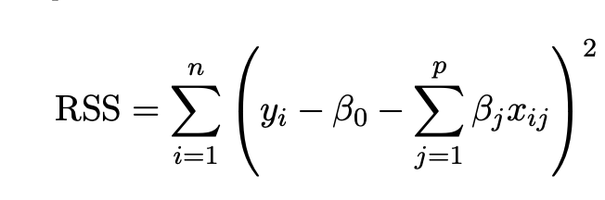
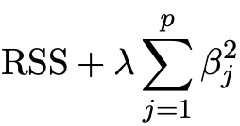
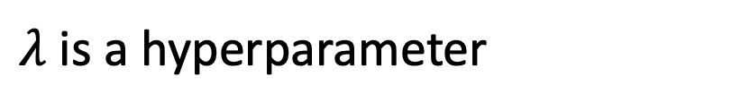
Ridge regression
Ridge regression objective
$λ$ is a hyperparameter

Slide 9
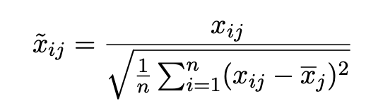
Ridge regression
Before ridge regression, we usually need to standardize the predictors
We usually use cross validation to set $λ$

Slide 10
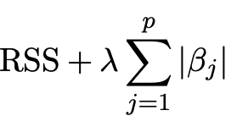
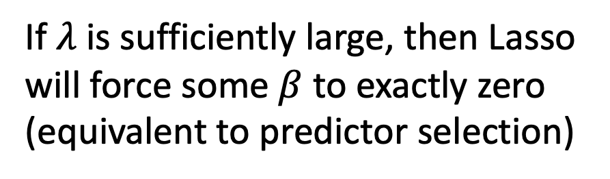
Lasso
Ridge regression will include all p predictors in the final model (Disadvantage: No predictor selection)
Objective of Lasso
If$λ$ is sufficiently large, then Lasso will force some $β$ to exactly zero (equivalent to predictor selection)

Slide 11
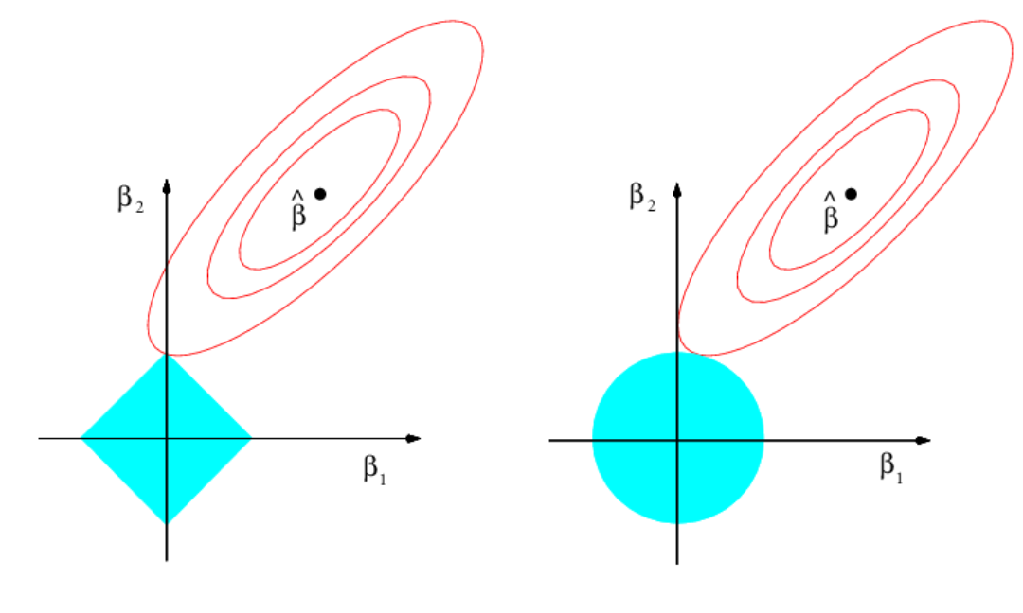

Lasso vs Ridge Regression
Why Lasso can force some $β$ to exactly zero?

Slide 12
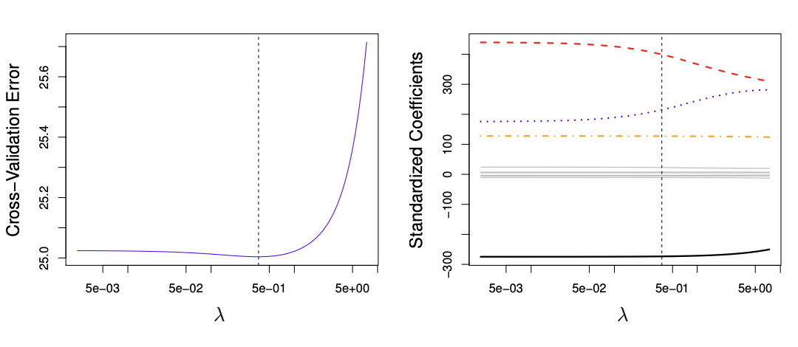
An example

Slide 13
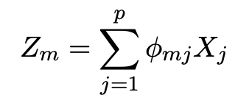
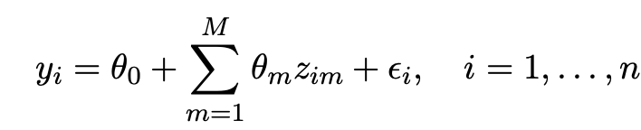
Dimension Reduction
Use linear combinations of the predictors to construct new predictors
We can then fit the linear regression model

Slide 14
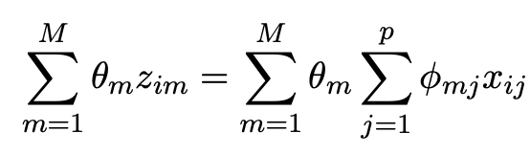
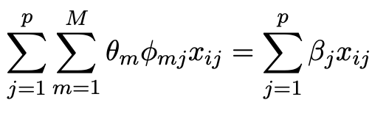
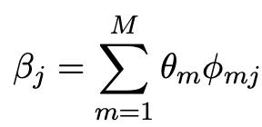
Dimension Reduction
Dimension reduction serves to constrain the estimated coefficients as

Slide 15
Dimension Reduction
Dimension reduction serves to constrain the estimated coefficients as

Slide 16
Principal Components Regression
Dimension reduction by Principal Components Analysis (PCA), and conduct linear regression on new predictors
The first principal component is that (normalized) linear combination of the variables with the largest variance.
The second principal component has largest variance, subject to being uncorrelated with the first.

Slide 17
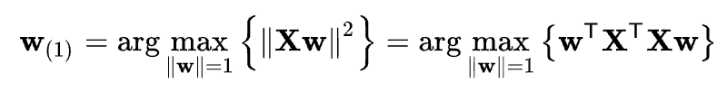
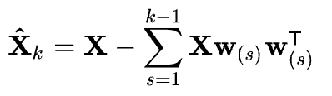
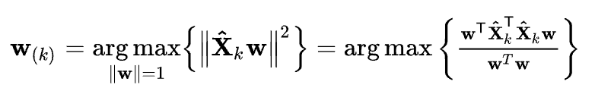
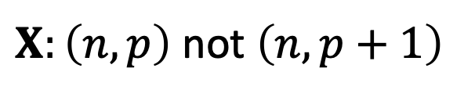
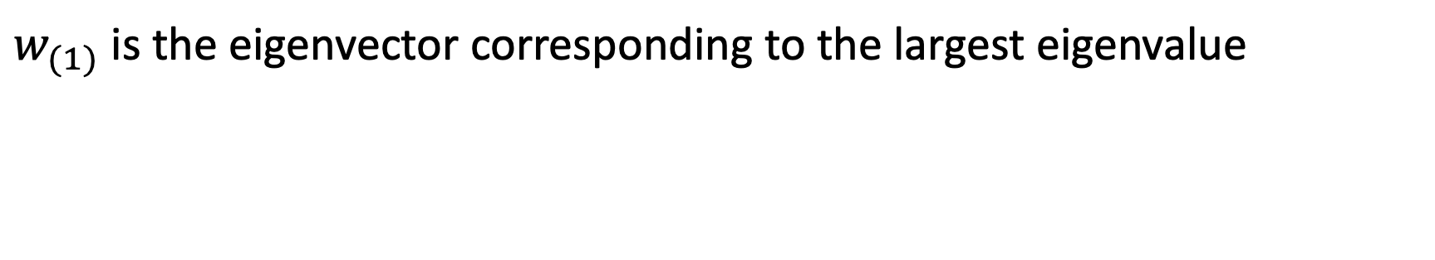
Principal Components Analysis
$X:\left(n,p\right)$ not $\left(n,p+1\right)$
$w_{(1)}$ is the eigenvector corresponding to the largest eigenvalue

Slide 18
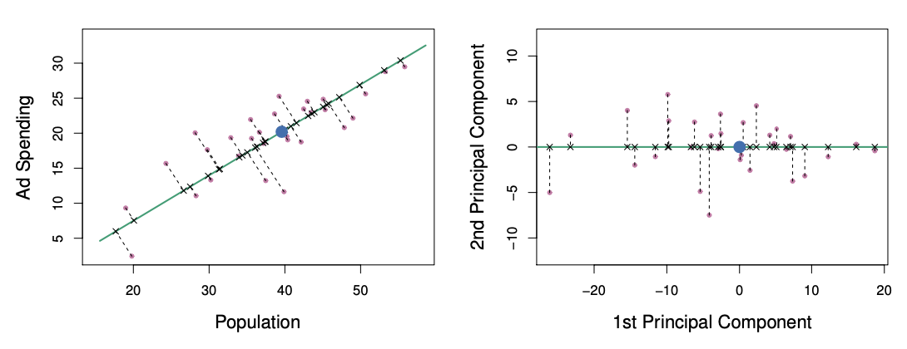
Principal Components Analysis

Slide 19
Principal Components Regression
PCR identifies linear combinations, or directions, that best represent the predictors
These directions are identified in an unsupervised way, since the response Y is not used to determine the principal component directions
Drawback: no guarantee that the directions that best explain the predictors will be the best directions to use for predicting the response.

Slide 20
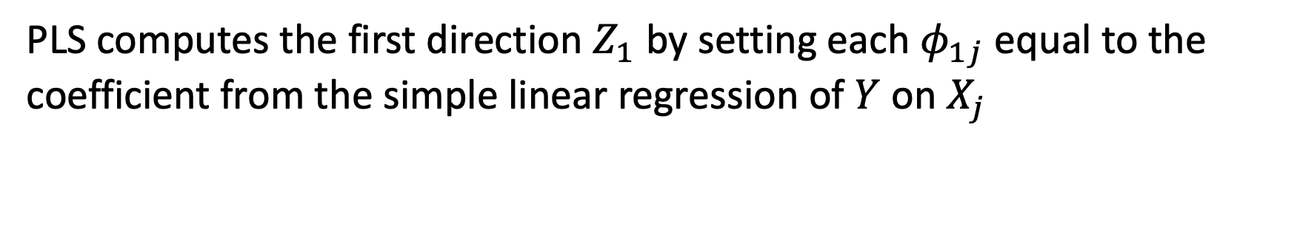
Partial Least Squares
PLS computes the first direction $Z_{1}$ by setting each $φ_{1j}$ equal to the coefficient from the simple linear regression of $Y$ on $X_{j}$
Conduct linear regression and repeat the produce on the residual of $Y$

Slide 21
Q & A

