Slide 1
Tree-based Methods
Tianhang Zheng
https://tianzheng4.github.io

Slide 2
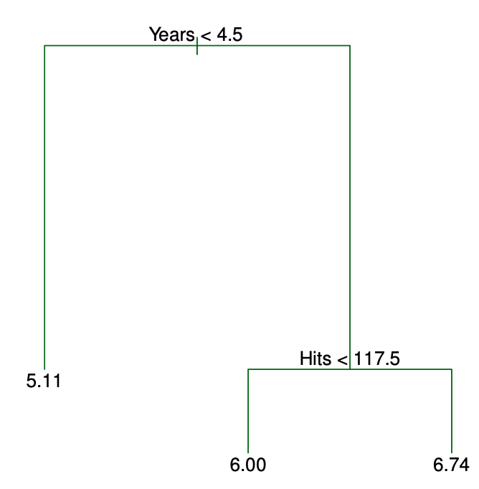
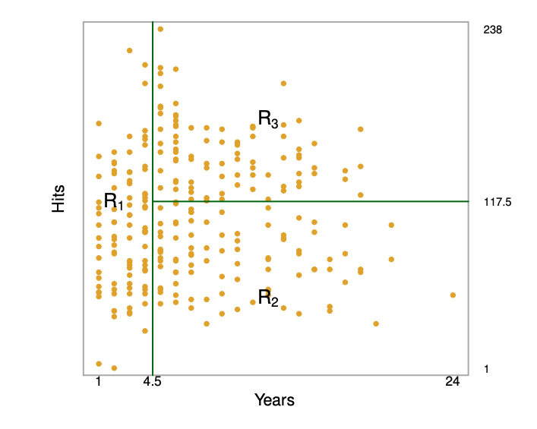
Interpretation of Decision Tree

Slide 3
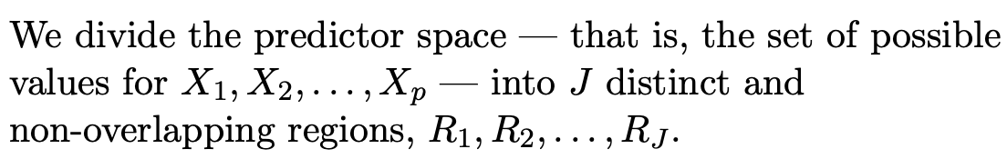
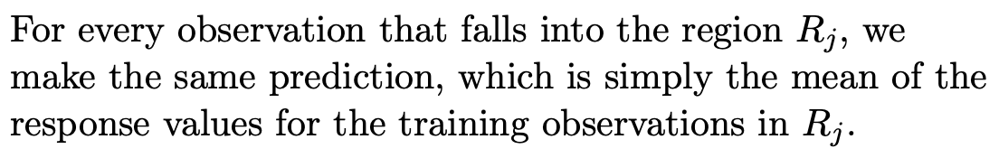
Regression Tree-Building Process

Slide 4
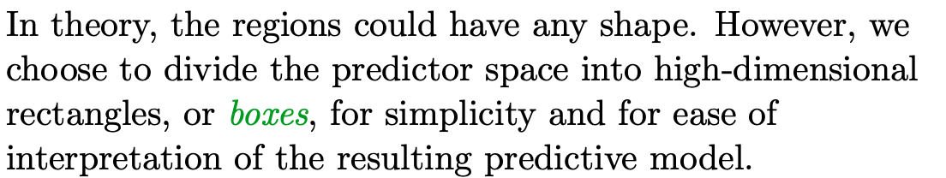
Regression Tree-Building Process

Slide 5
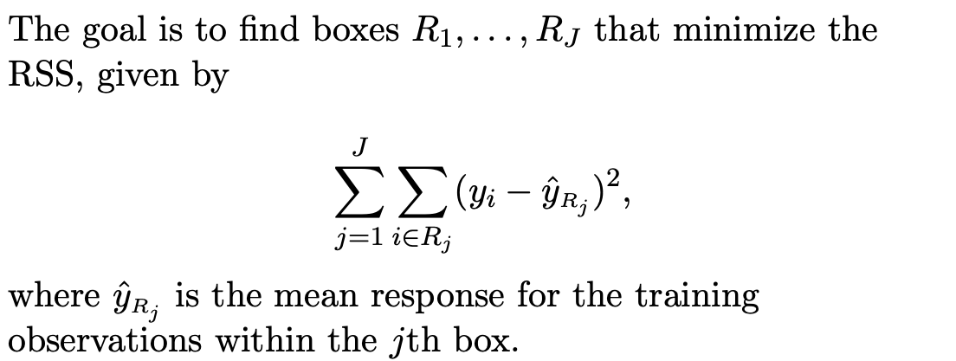
Regression Tree-Building Process

Slide 6
Regression Tree-Building Process

Slide 7
Regression Tree-Building Process

Slide 8
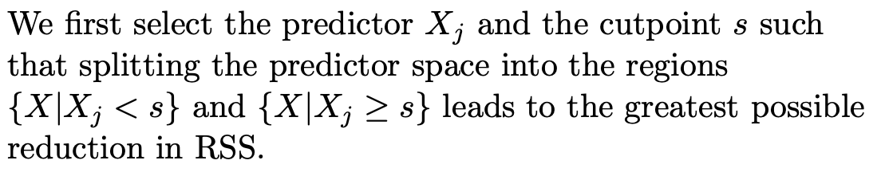
Greedy Method

Slide 9


Beyond RSS
If a target is a classification outcome taking on values 0,1,…,K-1
Log Loss or Entropy:

Slide 10
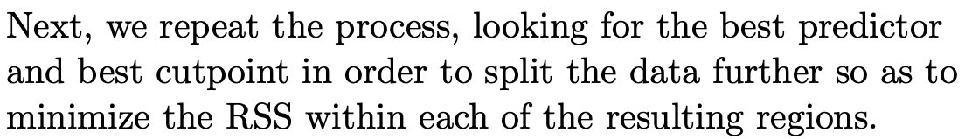
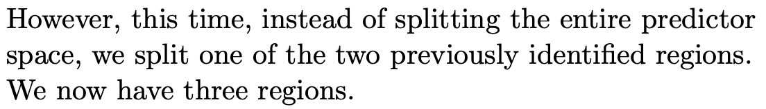
Greedy Method

Slide 11
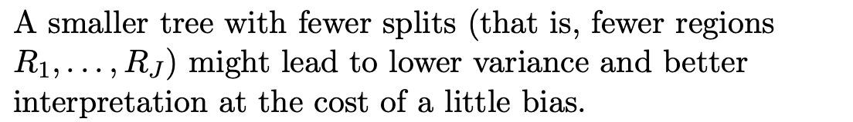
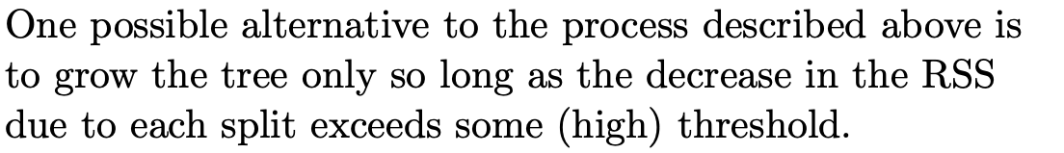
Tree Pruning

Slide 12
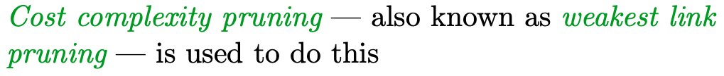
Tree Pruning

Slide 13
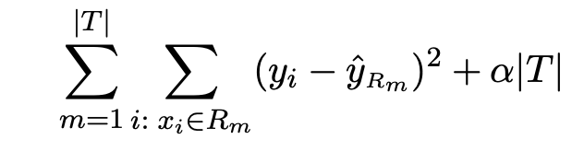
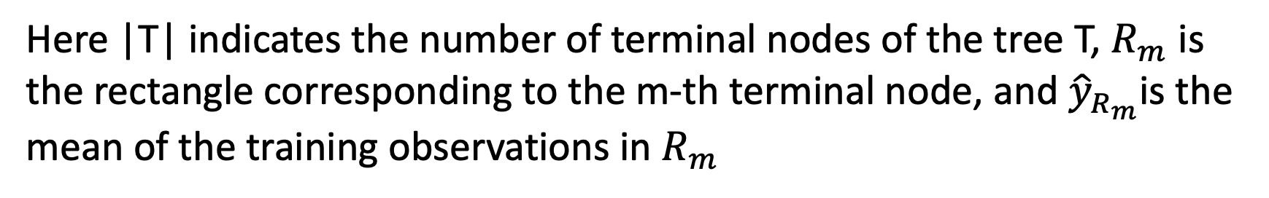
Cost Complexity Pruning
The objective is
Here |T| indicates the number of terminal nodes of the tree T, $R_{m}$ is the rectangle corresponding to the m-th terminal node, and ${\hat{y}}_{R_{m}}$is the mean of the training observations in $R_{m}$

Slide 14
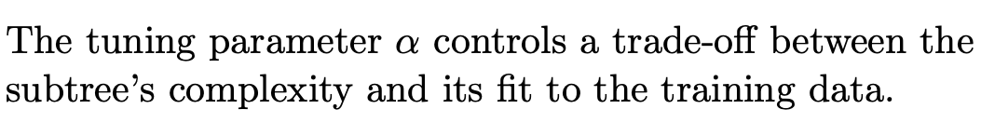
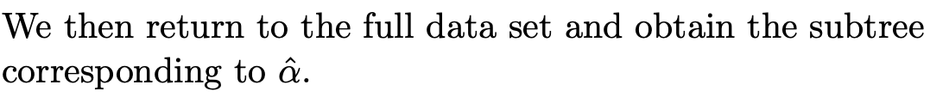
Cost Complexity Pruning

Slide 15
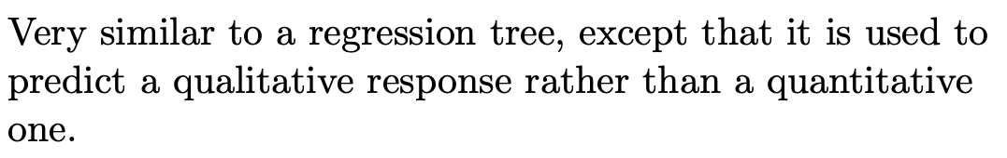
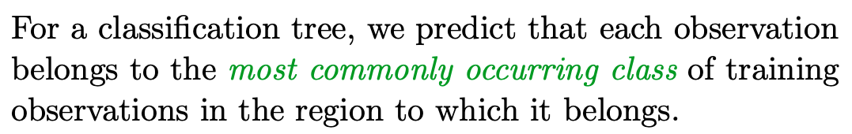
Classification Tree

Slide 16
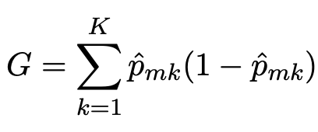
Classification Tree-Building Process
If a target is a classification outcome taking on values 0,1,…,K-1
The Gini index is defined by

Slide 17
Classification Tree-Building Process
If a target is a classification outcome taking on values 0,1,…,K-1
The Gini index is defined by

Slide 18
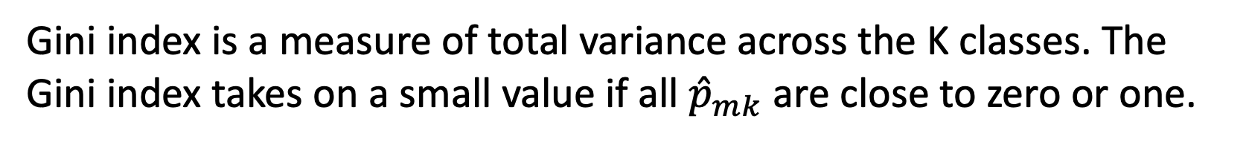
Gini Index
Gini index is a measure of total variance across the K classes. The Gini index takes on a small value if all ${\hat{p}}_{mk}$ are close to zero or one.
For this reason the Gini index is referred to as a measure of node purity — a small value indicates that a node contains predominantly observations from a single class.

Slide 19
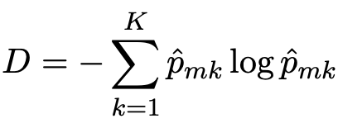
Cross-Entropy
An alternative to the Gini index is cross-entropy, given by
Cross-entropy is also a commonly-used loss function for deep learning

Slide 20
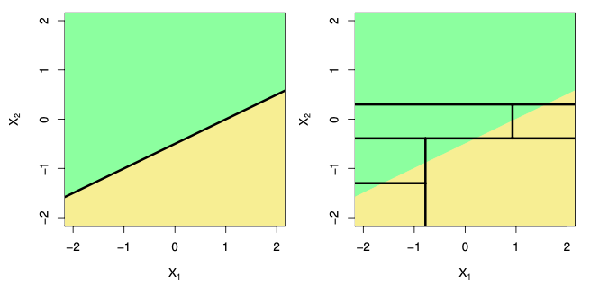
Tree vs Linear Model

Slide 21
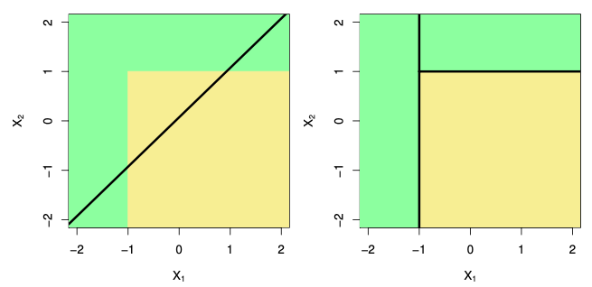
Tree vs Linear Model

Slide 22
Discussion about Tree-based Methods
Trees are very easy to explain to people. In fact, they are even easier to explain than linear regression.
Some people believe that decision trees more closely mirror human decision-making
Trees can easily handle qualitative predictors without the need to create dummy variables.

Slide 23
Bagging
Averaging a set of observations reduces variance. But this is not practical because we do not have access to multiple training sets.
Instead, we can bootstrap, by taking repeated samples from the (single) training data set.
Bootstrap aggregation, or bagging, is a general-purpose procedure for reducing the variance of a statistical learning method.

Slide 24
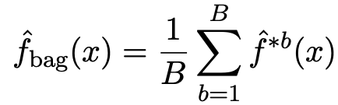
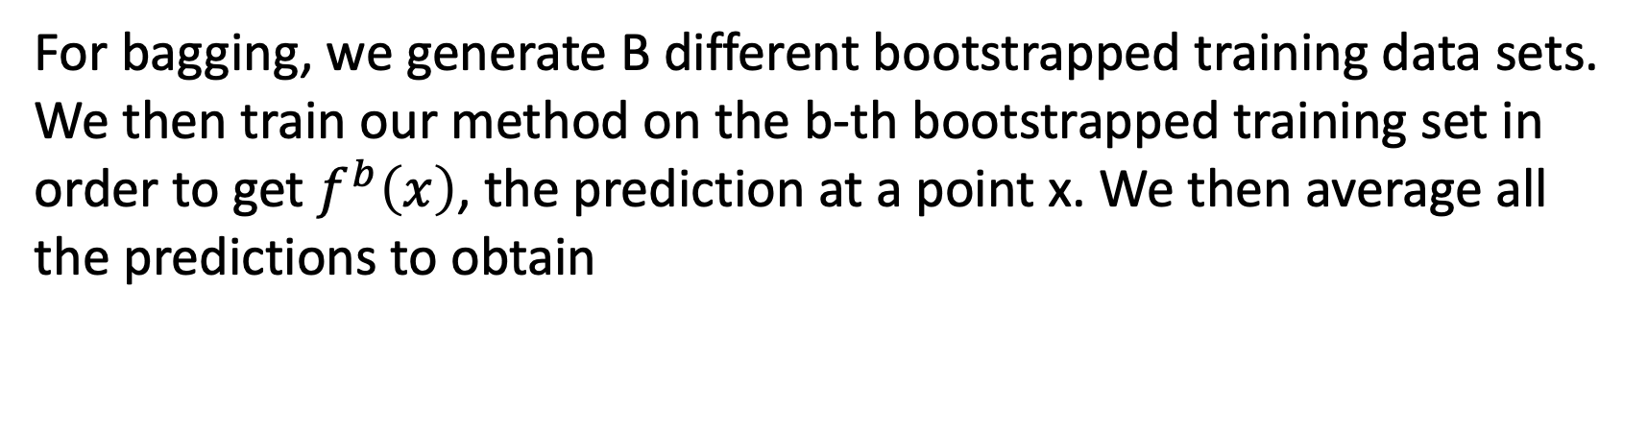
Bagging
For bagging, we generate B different bootstrapped training data sets. We then train our method on the b-th bootstrapped training set in order to get $f^{b}\left(x\right)$, the prediction at a point x. We then average all the predictions to obtain

Slide 25
Bagging Classification Trees
For classification trees: for each test observation, we record the class predicted by each of the B trees
Take a majority vote: the overall prediction is the most commonly occurring class among the B predictions.
But the trees are highly correlated and can increase variance

Slide 26
Random Forests
Random forests provide an improvement over bagged trees by way of a small tweak that decorrelates the trees. This reduces the variance when we average the trees.
Random forests provide an improvement over bagged trees by way of a small tweak that decorrelates the trees. This reduces the variance when we average the trees.

Slide 27
Random Forests
When building these decision trees, each time a split in a tree is considered, a random selection of m predictors is chosen as split candidates from the full set of p predictors. The split is allowed to use only one of those m predictors.
The reason: if one or a few features are very strong predictors for the target output, these features will be selected in many of the B trees, causing them (bagging trees) to become correlated.

Slide 28
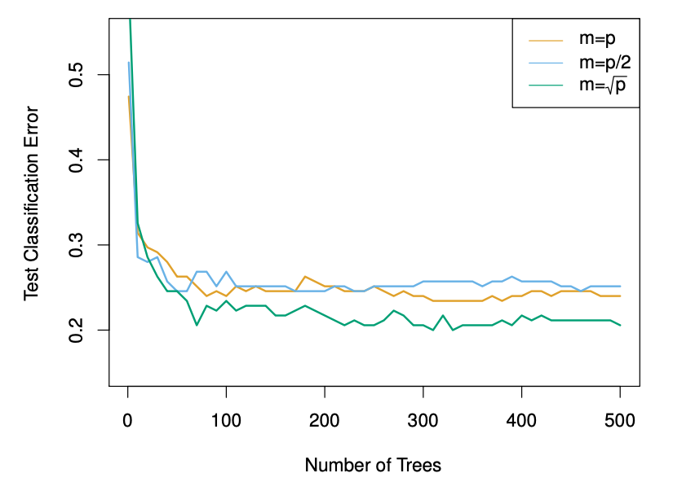
Random Forests (How to Select m)

Slide 29
Boosting Trees
Boosting works in a similar way as bagging, except that the trees are grown sequentially: each tree is grown using information from previously grown trees.
Unlike fitting a single large decision tree to the data, which amounts to fitting the data hard and potentially overfitting, the boosting approach instead learns slowly.

Slide 30
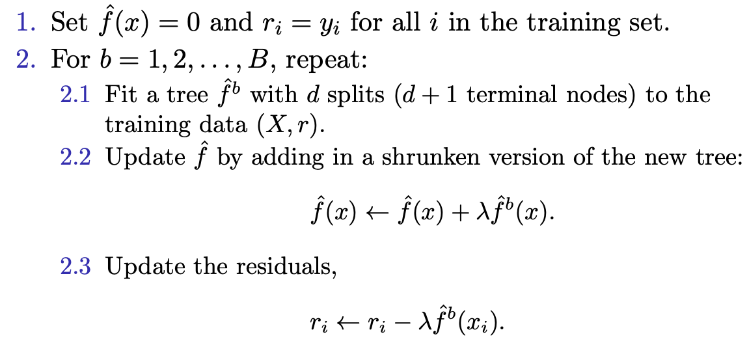
Boosting Regression Trees

Slide 31
Gradient Boosting
A machine learning algorithm used in regression and classification tasks that gives a prediction model in the form of an ensemble of weak prediction models.
Can outperform random forest but more complicated: https://en.wikipedia.org/wiki/Gradient_boosting

Slide 32
Hyperparameters for Boosting
The number of trees B: Too large B leads to overfitting (cross validation)
The shrinkage parameter λ: Typically 0.01 or 0.001
The number of splits d in each tree: Often d = 1 works well, in which case each tree is a stump

Slide 33
Q & A

