Slide 1
Moving Beyond Linearity
Tianhang Zheng
https://tianzheng4.github.io

Slide 2
Moving Beyond Linearity
The truth is usually not linear.
It may be • polynomials, • step functions, • splines, • local regression, and • generalized additive models

Slide 3

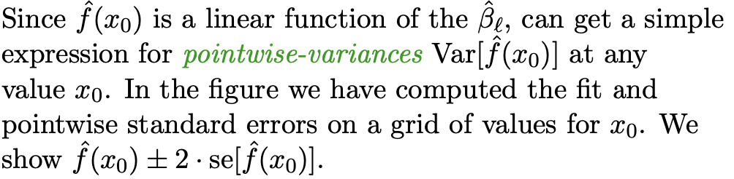
Polynomial Regression

Slide 4
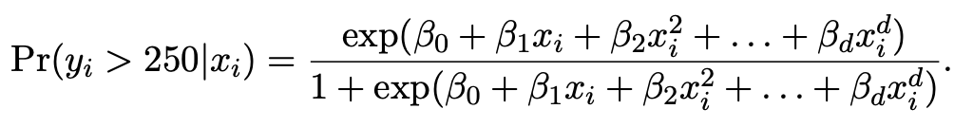
Logistic Regression

Slide 5
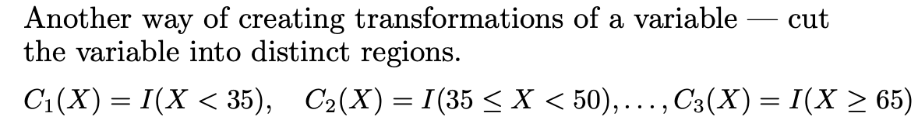
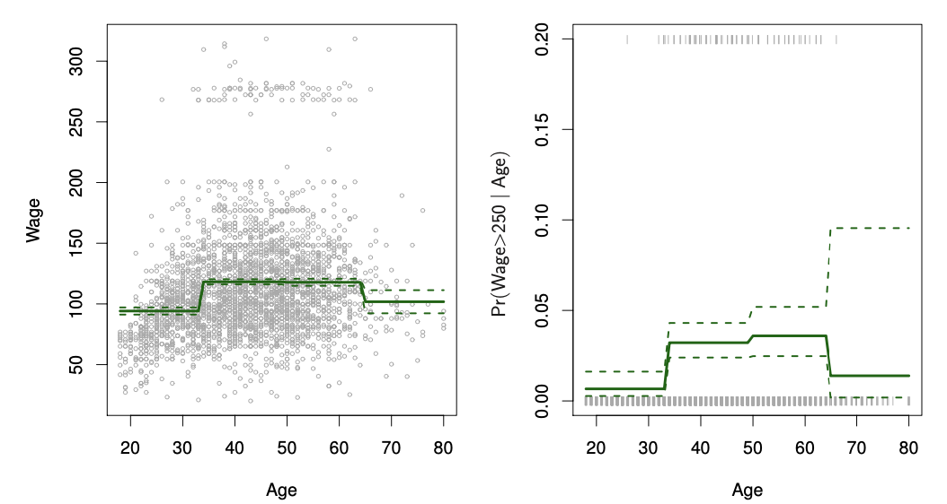
Step Functions

Slide 6
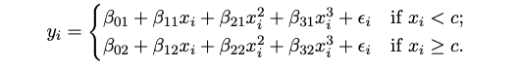
Piecewise Polynomials
Instead of a single polynomial in X over its whole domain, we can rather use different polynomials in regions defined by knots.

Slide 7
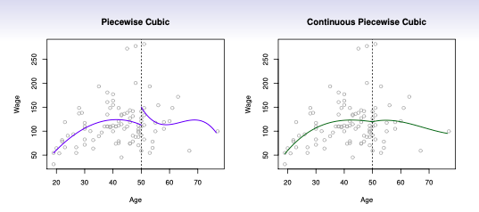
Piecewise Polynomials

Slide 8
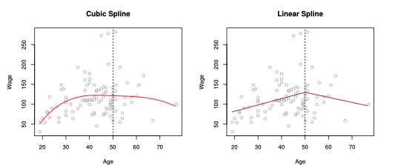
Piecewise Polynomials

Slide 9


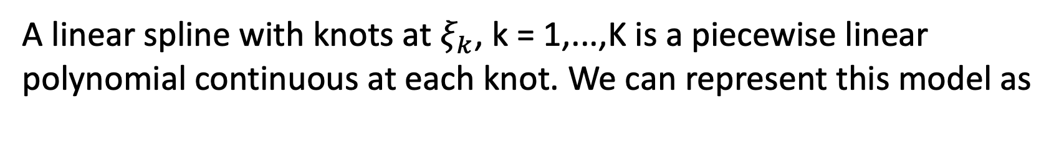
Linear Splines
A linear spline with knots at $ξ_{k}$, k = 1,...,K is a piecewise linear polynomial continuous at each knot. We can represent this model as

Slide 10
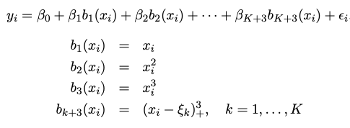

Cubic Splines

Slide 11
Q & A

