Slide 1
Deep Learning
Tianhang Zheng
https://tianzheng4.github.io

Slide 2
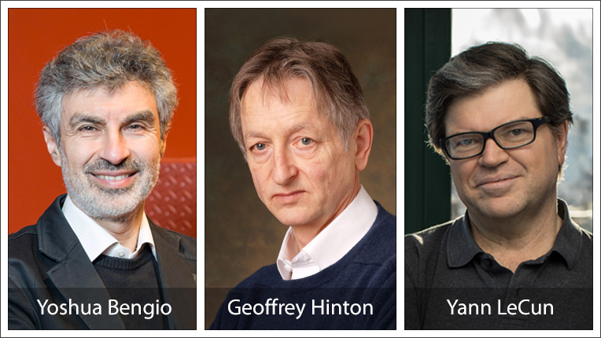
Deep Learning
People begin to study neural networks starting from 1980

Slide 3

Deep Learning
Deep learning becomes very popular starting from 2012
ImageNet classification with deep convolutional neural networks (NeurIPS 2012) shows that deep neural networks can outperform traditional machine learning techniques by a large margin!

Slide 4
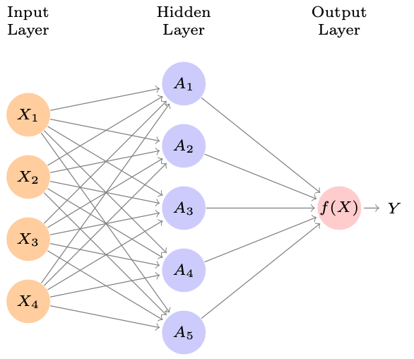




Single Layer Neural Network

Slide 5
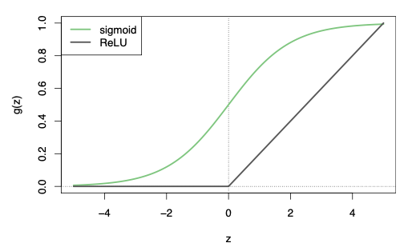

Activation Function
Activation functions in hidden layers are typically nonlinear, otherwise the model collapses to a linear model.

Slide 6
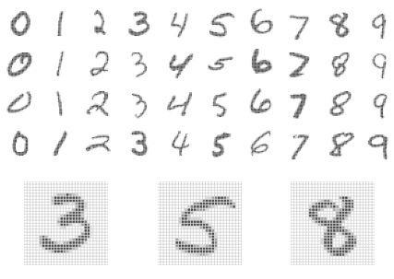
Example: MNIST Digits
Build a two-layer network with 256 units at first layer, 128 units at second layer, and 10 units at output layer.

Slide 7
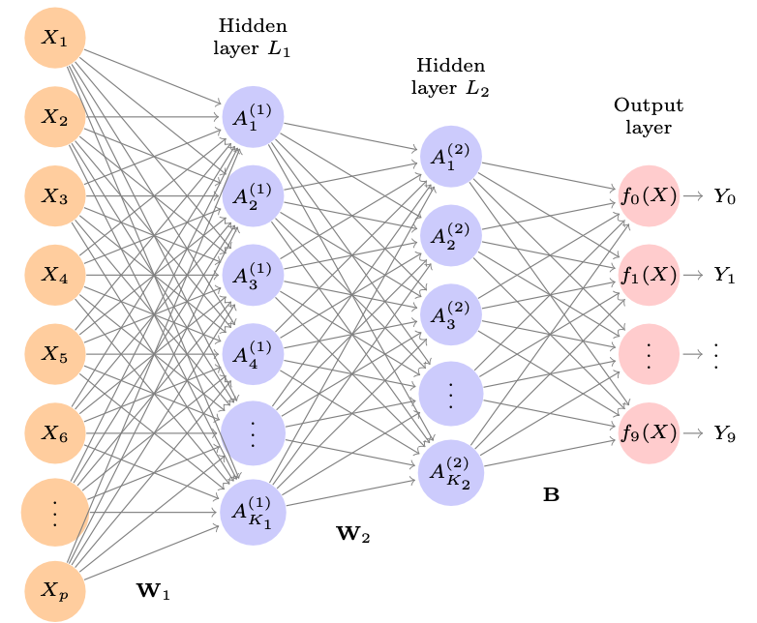

Slide 8

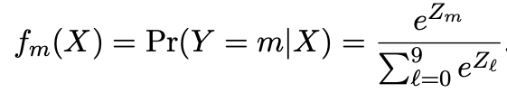
Softmax Output
Softmax output:

Slide 9
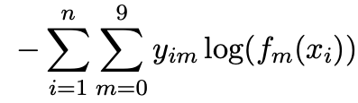
Cross-Entropy Loss
Negative multinomial log-likelihood:

Slide 10
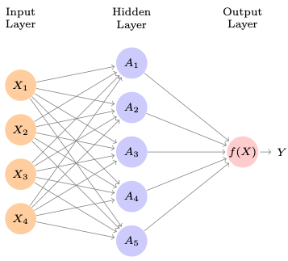


Train Neural Networks
The objective is non-convex

Slide 11

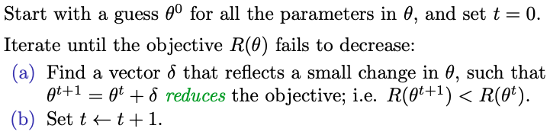
Train Neural Networks

Slide 12


Train Neural Networks

Slide 13
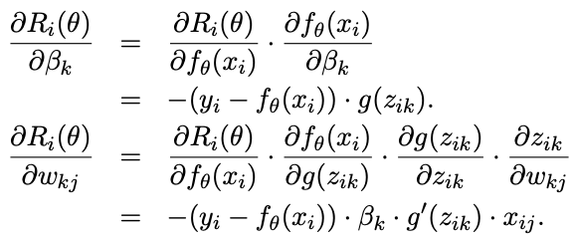
Gradients and Backpropagation
Backpropagation uses the chain rule for differentiation:

Slide 14
Optimizers
Stochastic Gradient Descent (SGD)
Stochastic Gradient Descent with Momentum
Adam Optimizer

Slide 15
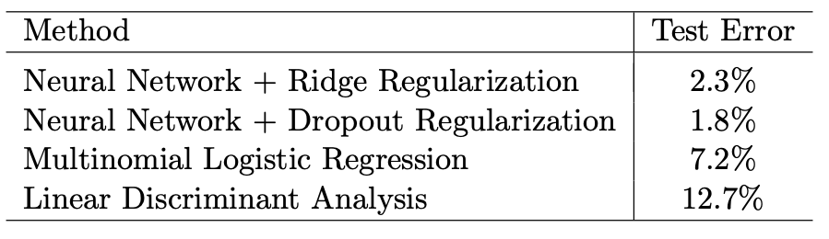
Why Neural Network?

Slide 16
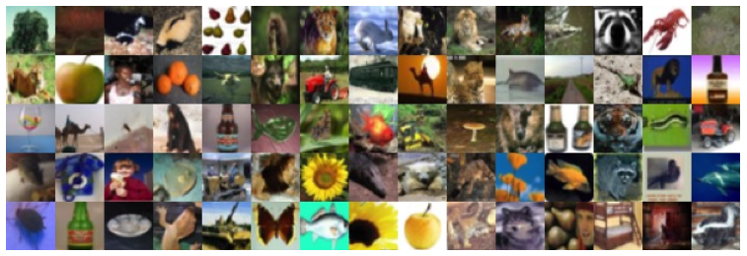
Convolutional Neural Network
A commonly used network architecture for classifying images

Slide 17
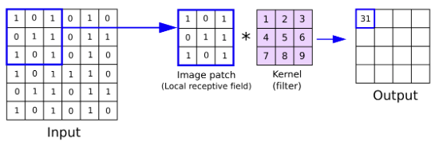
Convolutional Kernel

Slide 18
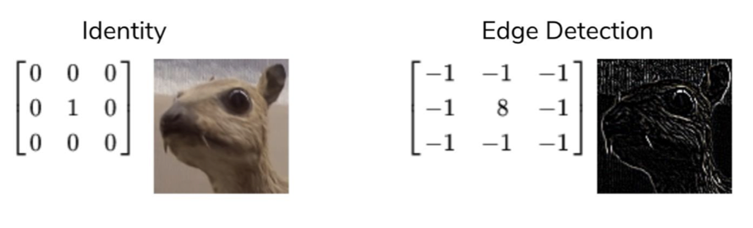
Convolutional Kernel

Slide 19
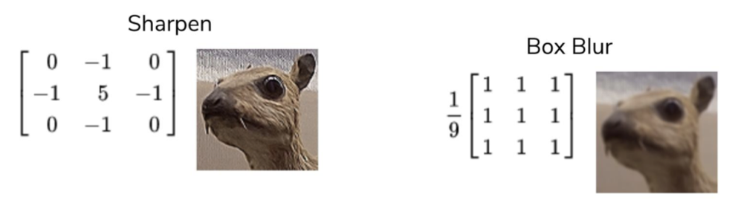
Convolutional Kernel

Slide 20
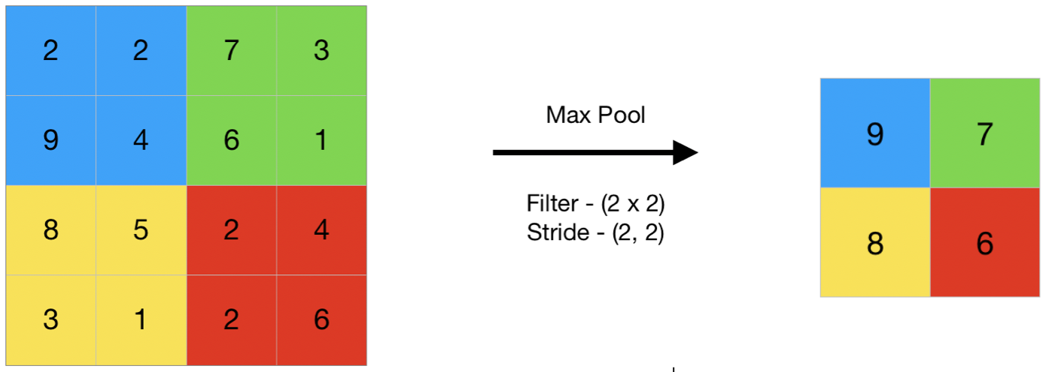
Max Pooling
Max pooling mainly helps in extracting sharp features, and reduce model variance and computation cost

Slide 21
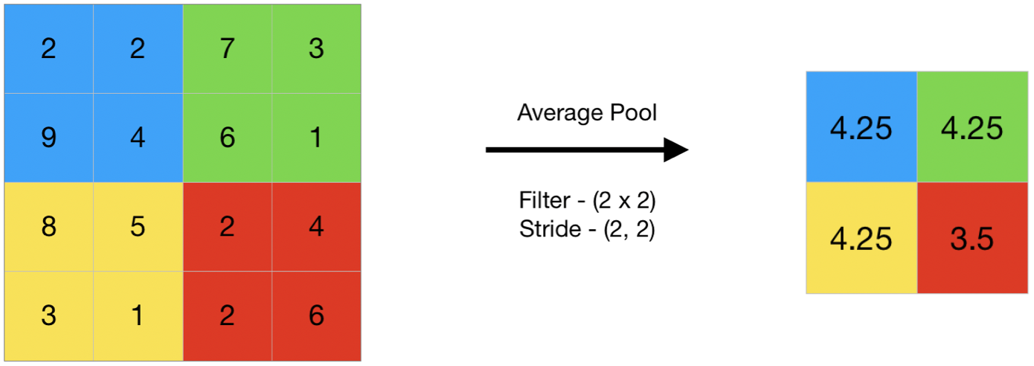
Avg Pooling
Avg pooling mainly helps in extracting smooth features, and reduce model variance and computation cost

Slide 22
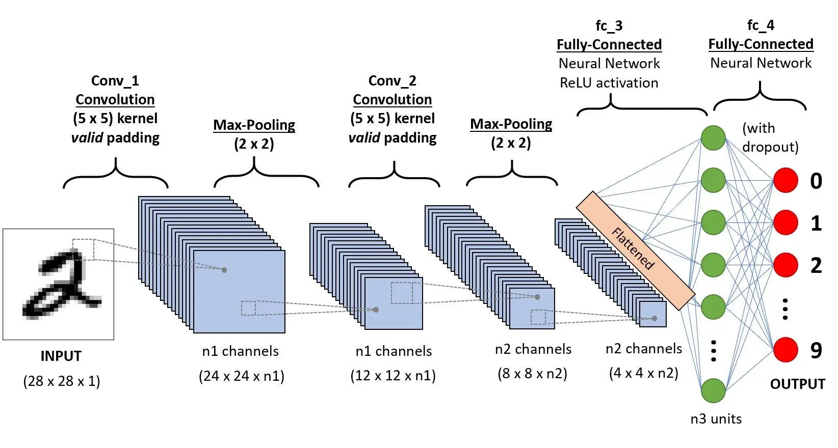
Convolutional Neural Network

Slide 23
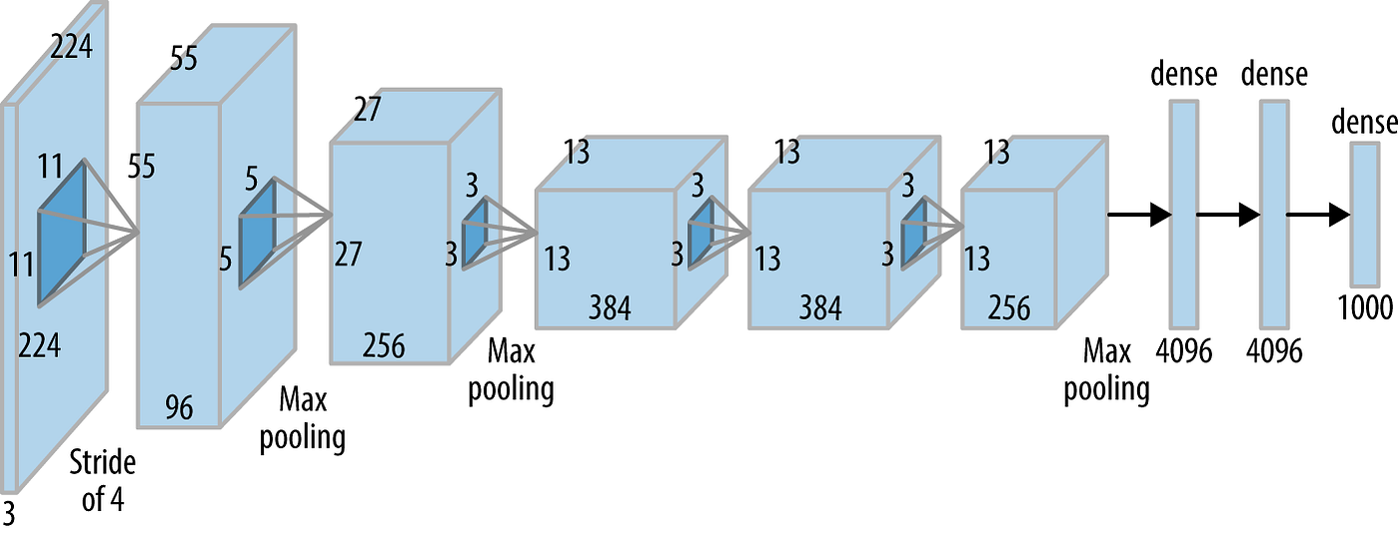
Deep Convolutional Neural Network

Slide 24
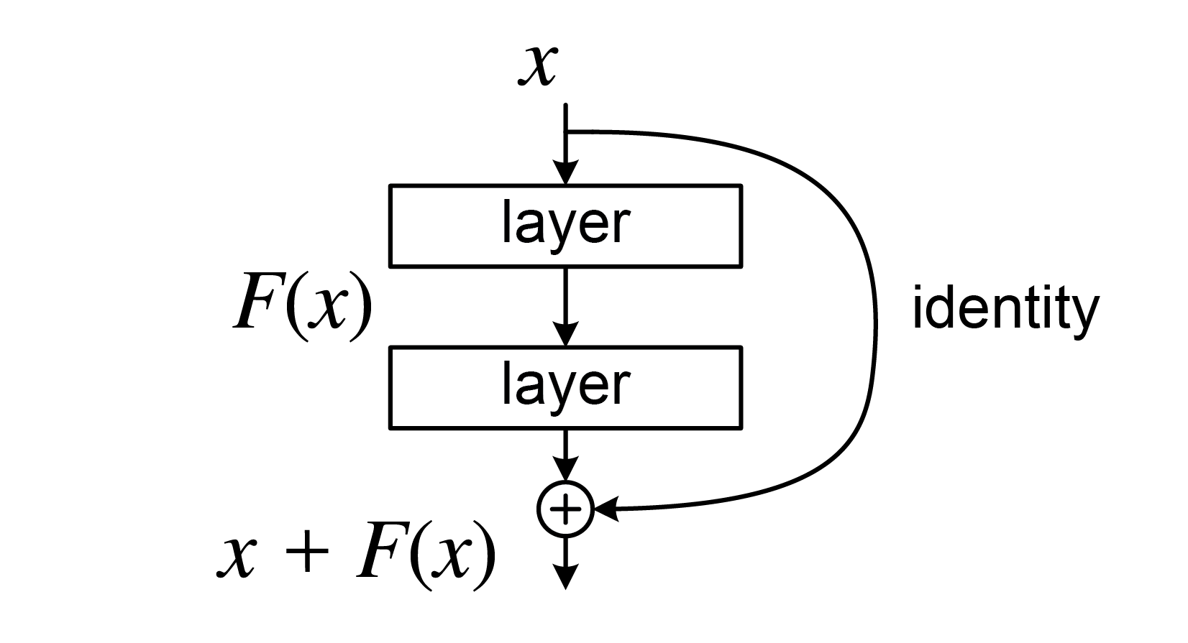
Residual Neural Networks (ResNet)
Address the issue of gradient vanishing
Easy to model identity function

Slide 25
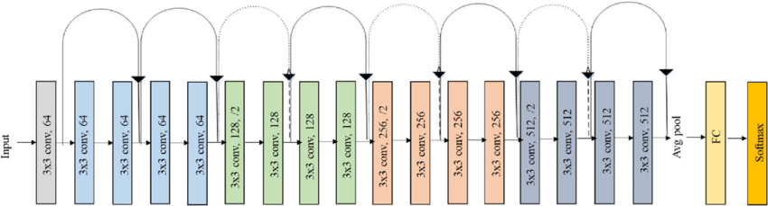
Residual Neural Networks (ResNet)
ResNet-18

Slide 26

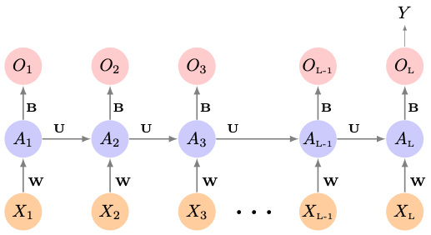
Recurrent Neural Networks

Slide 27
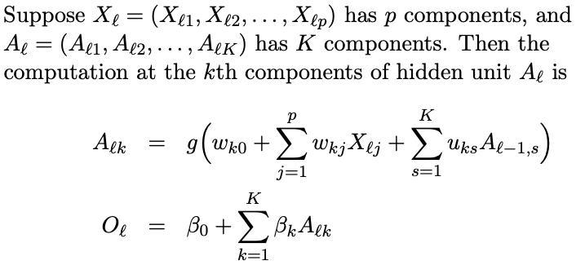
Recurrent Neural Networks

Slide 28
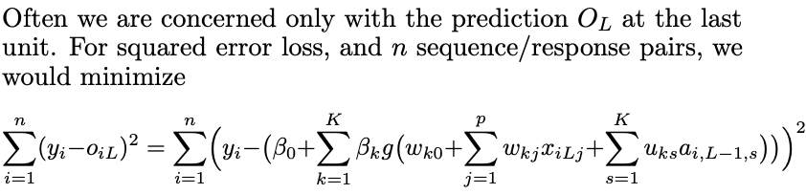
Recurrent Neural Network Loss

Slide 29
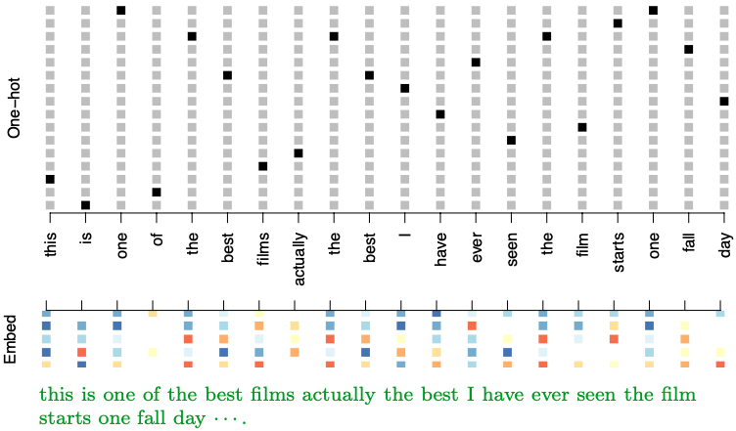
Word Embedding

Slide 30
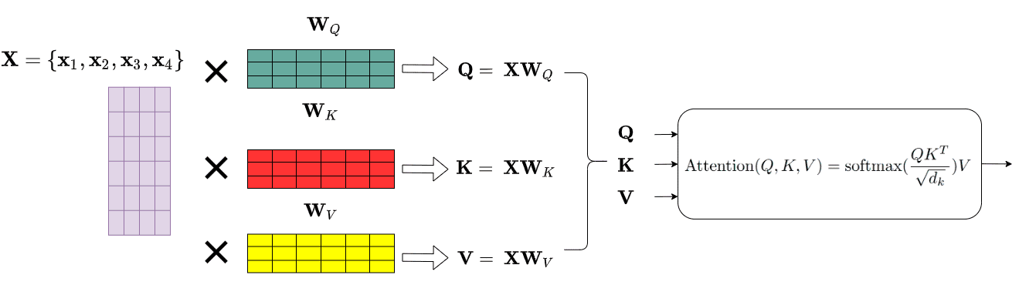
Transformers

Slide 31
Tricks of Deep Learning
Dropout: At each SGD update, randomly remove units with probability
Regularization: Minimize L2 norm of model parameters
Learning Scheduler: Decay or Periodic
Data Augmentation: Randomly crop the images

Slide 32
Schedule of Group Project
Nov. 30: Group 1-6 (10-12 minutes)
Dec. 5: Group 7-12 (10-12 minutes)
Dec. 7: Review + (Remaining groups)

