Slide 1
Moving Beyond Linearity
Tianhang Zheng
https://tianzheng4.github.io

Slide 2
Moving Beyond Linearity
The truth is usually not linear.
It may be • polynomials, • step functions, • splines, • local regression, and • generalized additive models

Slide 3

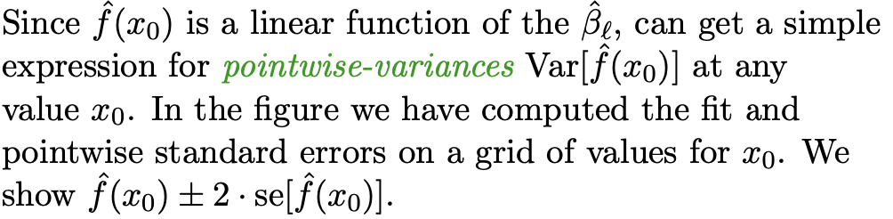
Polynomial Regression

Slide 4
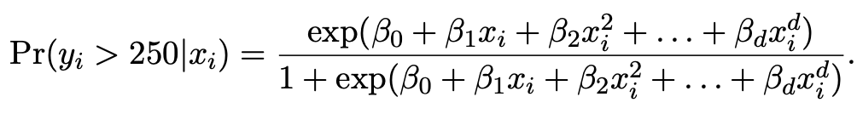
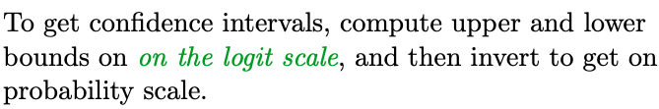
Logistic Regression

Slide 5
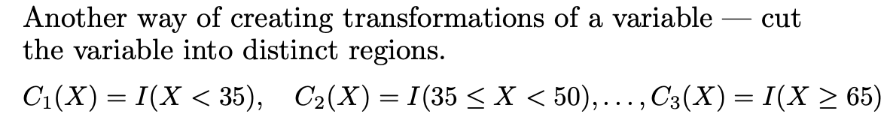
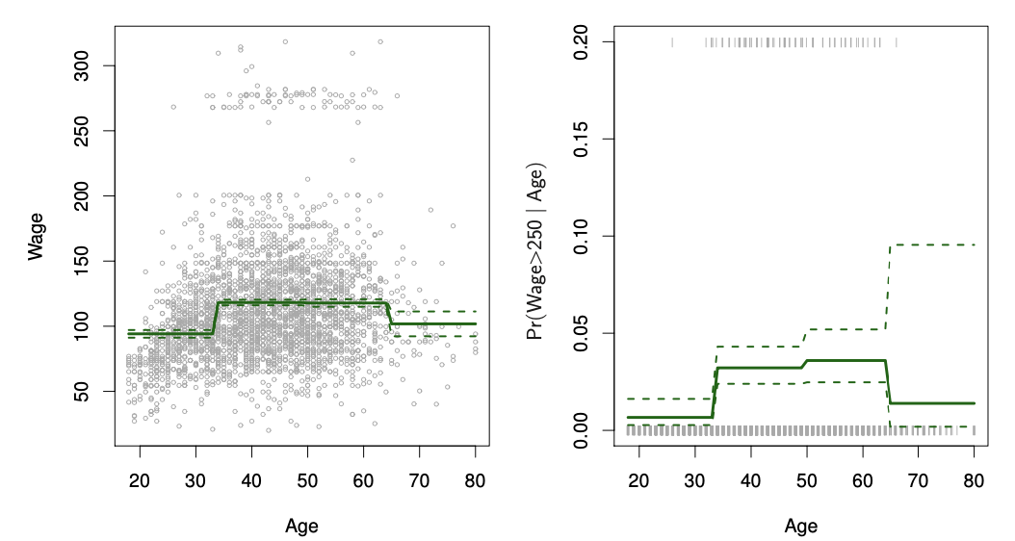
Step Functions

Slide 6
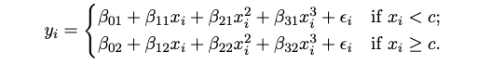
Piecewise Polynomials
Instead of a single polynomial in X over its whole domain, we can rather use different polynomials in regions defined by knots.

Slide 7
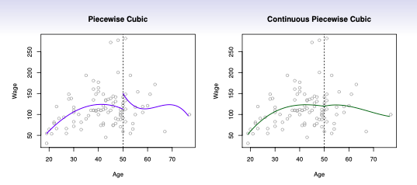
Piecewise Polynomials

Slide 8
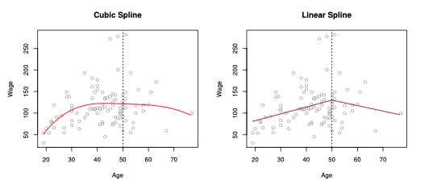
Piecewise Polynomials

Slide 9


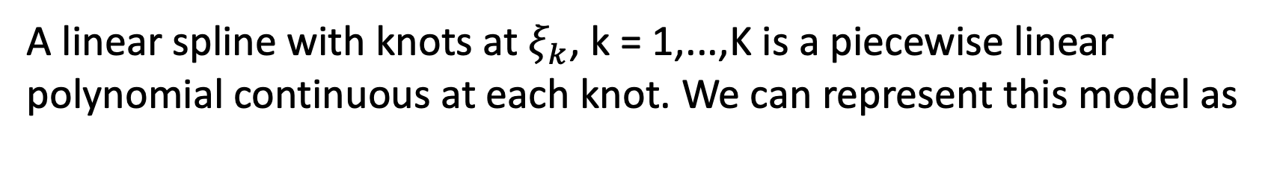
Linear Splines
A linear spline with knots at $ξ_{k}$, k = 1,...,K is a piecewise linear polynomial continuous at each knot. We can represent this model as

Slide 10
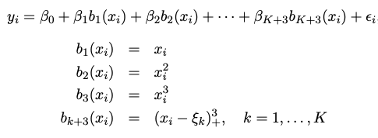

Cubic Splines

Slide 11
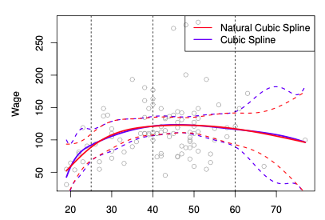

Natural Cubic Splines
A natural cubic spline extrapolates linearly beyond the boundary knots, which adds $4=2×2$ constraints

Slide 12

Smoothing Splines
Objective for smoothing splines
The second term is a roughness penalty and controls how wiggly g(x) is. It is modulated by the tuning parameter.

Slide 13
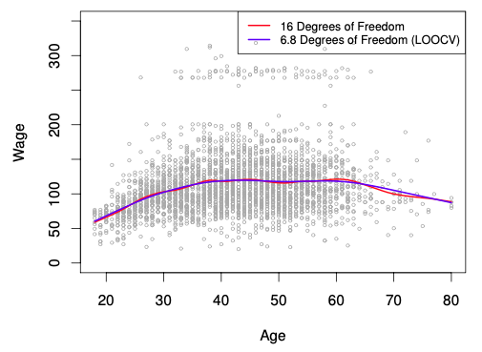
Smoothing Splines

Slide 14
Generalized Additive Models (GAM)
Allows for flexible nonlinearities in several variables, but retains the additive structure of linear models.

Slide 15

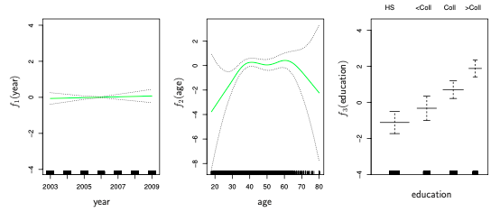
GAMs for classification

Slide 16
Tree-based Methods
Tree-based methods can be used for regression and classification
Stratifying or segmenting the predictor space into a number of simple regions.
Since the set of splitting rules used to segment the predictor space can be summarized in a tree, these types of approaches are known as decision-tree methods.

Slide 17
Pros and Cons
Tree-based methods are simple and useful for interpretation.
We will also discuss methods that can grow multiple trees which are then combined to yield a single consensus prediction
Combining a large number of trees can often result in dramatic improvements in prediction accuracy, at the expense of some loss interpretation.

Slide 18
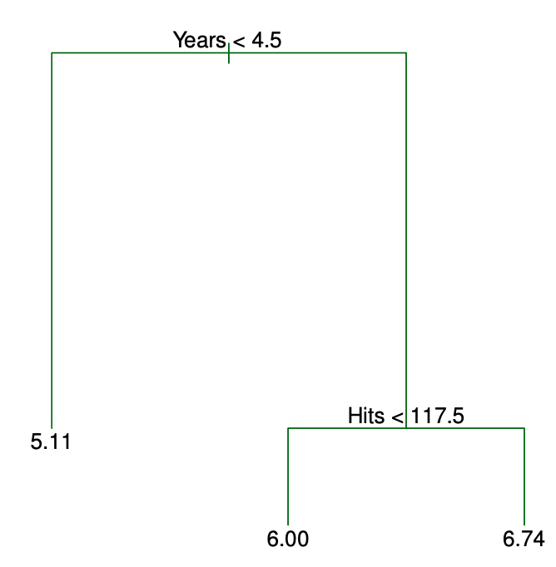
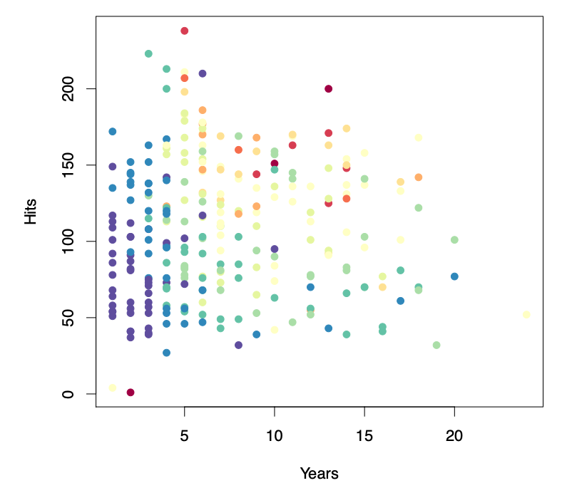
Decision Tree Example

Slide 19
Decision Tree Example

Slide 20
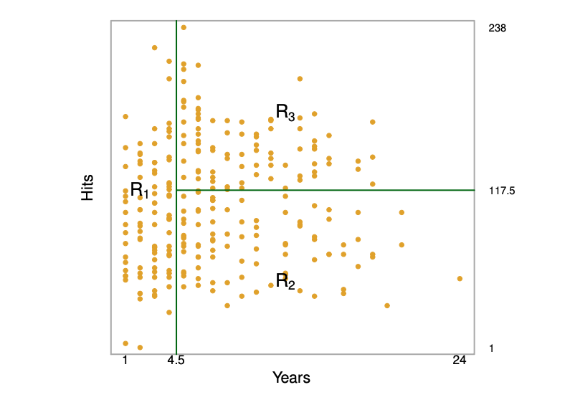
Decision Tree Example

Slide 21
Q & A

