Slide 1
Unsupervised Learning
Tianhang Zheng
https://tianzheng4.github.io

Slide 2
Unsupervised Learning vs Supervised Learning
Unsupervised learning is more subjective than supervised learning, as there is no simple goal for the analysis, such as prediction of a response
It is often easier to obtain unlabeled data — from a lab instrument or a computer — than labeled data, which can require human intervention.

Slide 3
The Goals of Unsupervised Learning
We discuss two methods:
Principal components analysis: a tool used for data visualization or data pre-processing before supervised techniques are applied
Clustering: a broad class of methods for discovering unknown subgroups in data.

Slide 4
The Goals of Unsupervised Learning
We discuss two methods:
Principal components analysis: a tool used for data visualization or data pre-processing before supervised techniques are applied
Clustering: a broad class of methods for discovering unknown subgroups in data.

Slide 5
Principal Components Analysis (PCA)
PCA produces a low-dimensional representation of a dataset. It finds a sequence of linear combinations of the variables that have maximal variance, and are mutually uncorrelated.
Apart from producing derived variables for use in supervised learning problems, PCA also serves as a tool for data visualization.

Slide 6

Principal Components Analysis (PCA)
The first principal component of a set of features is the normalized linear combination of the features
that has the largest variance. By normalized, we mean that

Slide 7

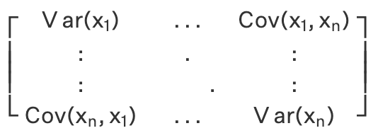

Principal Components Analysis (PCA)
$Φ_{1}$ is the eigenvector corresponding to the largest eigenvalue
Do not forget to normalize $Φ_{1}$

Slide 8
Clustering Methods
K-means clustering, we seek to partition the observations into a pre-specified number of clusters.
Hierarchical clustering, we do not know in advance how many clusters we want; in fact, we end up with a tree-like visual representation of the observations

Slide 9
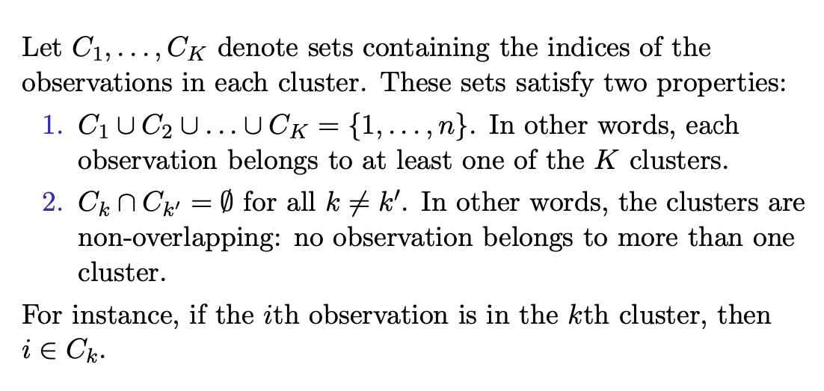
K-Means

Slide 10
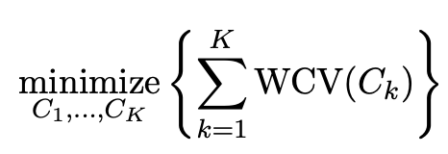
K-Means
The idea behind K-means clustering is that a good clustering is one for which the within-cluster variation is as small as possible.
The problem is formulated as

Slide 11
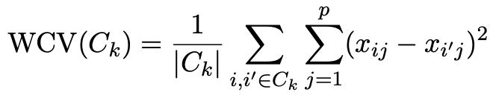
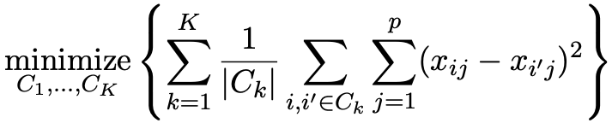
K-Means
Typically use Euclidean distance to measure within-cluster variation
The objective can be reformulated as

Slide 12
K-Means
Typically use Euclidean distance to measure within-cluster variation
The objective can be reformulated as

Slide 13
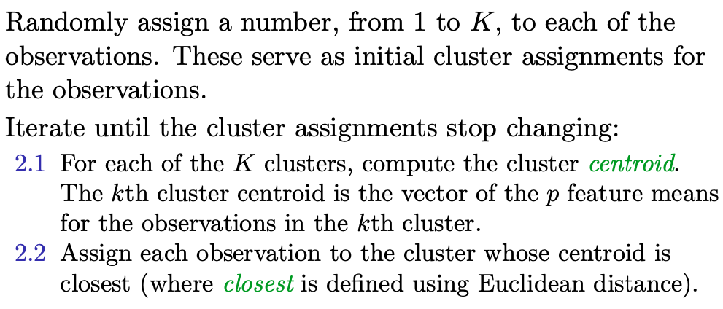
K-Means

Slide 14
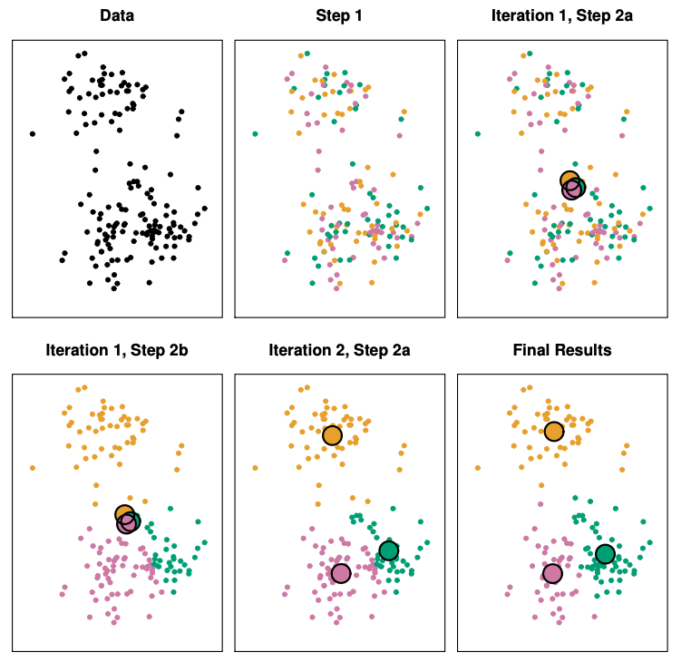
K-Means Example

Slide 15
Hierarchical Clustering
K-means clustering requires us to pre-specify the number of clusters K. This can be a disadvantage
Hierarchical clustering is an alternative approach which does not require that we commit to a particular choice of K.

Slide 16
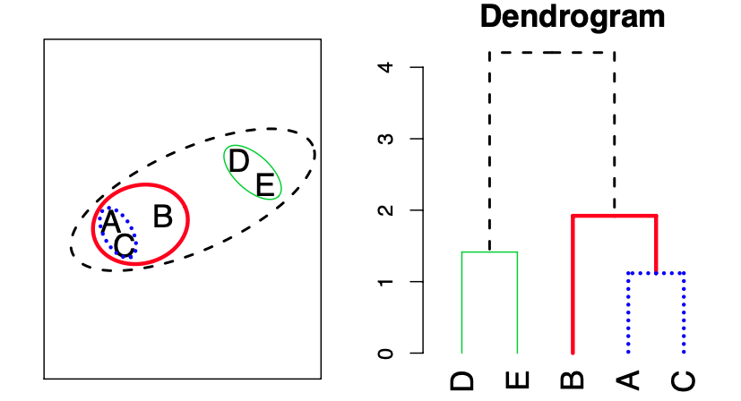
Hierarchical Clustering
Start with each point in its own cluster. Identify the closest two clusters and merge them. Repeat until all points are in a single cluster.

Slide 17
Hierarchical Clustering
How to compute the distance between two clusters?
Minimum distance
Maximum distance
Average distance

Slide 18
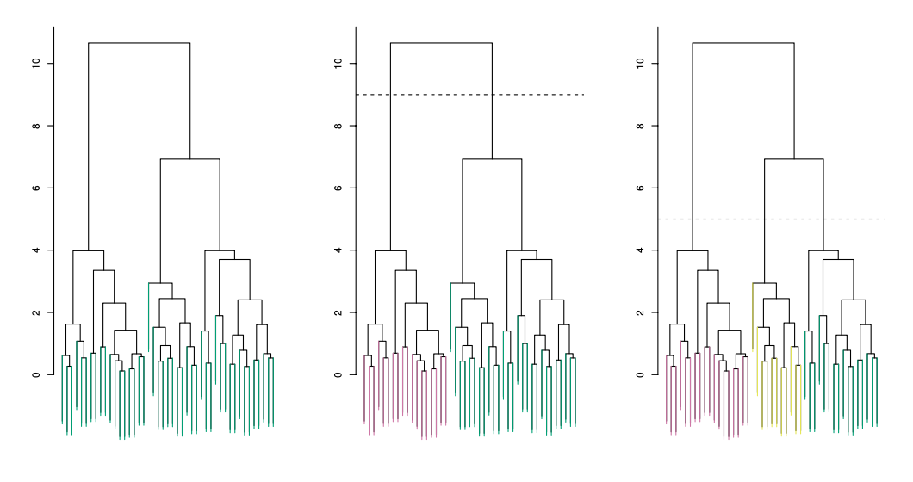
Hierarchical Clustering (Number of Clusters)

