Slide 1
Linear Regression
Tianhang Zheng
https://tianzheng4.github.io

Slide 2
Course Website
https://tianzheng4.github.io/umkc-teaching/2023-fall-teaching-1/
What are on the course website:
Lecture slides
Lab material
Contact Information
If you are interested in my research, feel free to contact me.

Slide 3
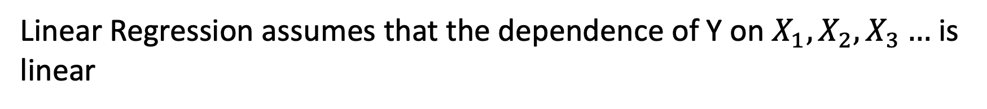
Linear Regression
Linear Regression (LR) is one of the simplest methods for modeling
Linear Regression assumes that the dependence of Y on $X_{1}, X_{2},X_{3}…$ is linear
In most cases, regression function is not linear (but interpretable)

Slide 4

Simple Linear Regression
Linear Regression with a single predictor
$$Y=β_{0}+β_{1}X+ε$$
$β_{0}$ is called intercept and $β_{1}$ is called slope, which are two parameters.
$ε$ is the error term

Slide 5
Simple Linear Regression
The objective is to learn (estimate) $β_{0}$ and $β_{1}$
The estimates of $β_{0}$ and $β_{1}$ are denoted by ${\hat{β}}_{0}$ and ${\hat{β}}_{1}$
$$\hat{y}={\hat{β}}_{0}+{\hat{β}}_{1}x$$
$\hat{y}$ is an estimate (prediction) of $Y$ given $X=x$

Slide 6
Simple Linear Regression
The objective is to learn (estimate) $β_{0}$ and $β_{1}$
The estimates of $β_{0}$ and $β_{1}$ are denoted by ${\hat{β}}_{0}$ and ${\hat{β}}_{1}$
$$\hat{y}={\hat{β}}_{0}+{\hat{β}}_{1}x$$
$\hat{y}$ is an estimate (prediction) of outcome given $X=x$
$e=y−\hat{y}$ is the residual

Slide 7
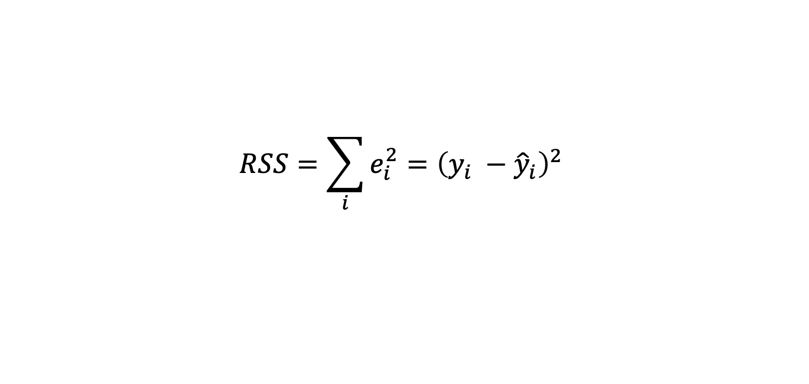

Least Squares Method
The least squares method is commonly used for estimating $β_{0}$ and $β_{1}$
Given a training dataset $D_{tr}={\left\{\left(x_{i}, y_{i}\right)\right\}}_{i=1}^{N}$, the residual sum of squares (RSS) can be defined as
$$RSS=\sum_{i}{e_{i}^{2}={\left(y_{i} −{\hat{y}}_{i}\right)}^{2} }$$

Slide 8
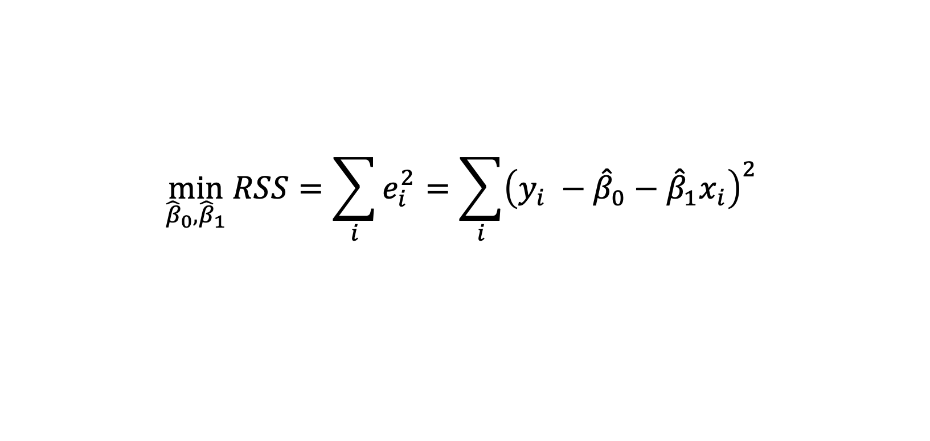

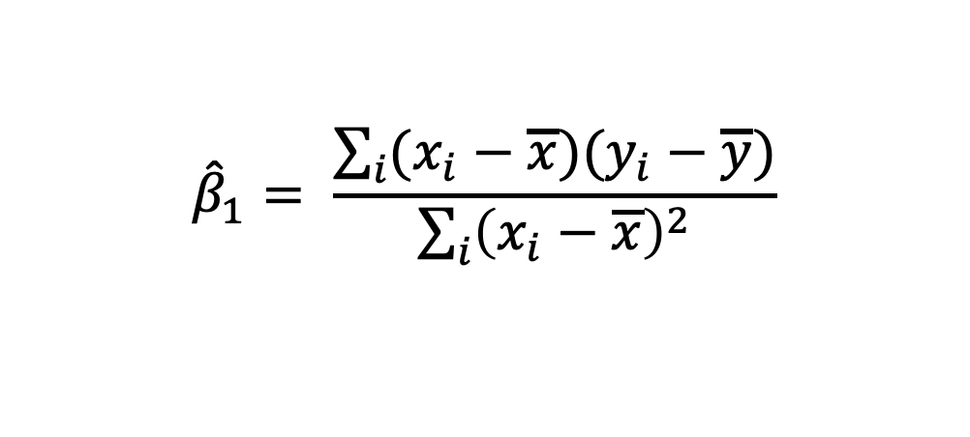
Least Squares Method
$$\min_{{\hat{β}}_{0},{\hat{β}}_{1}}{RSS=\sum_{i}{e_{i}^{2}=\sum_{i}{{\left(y_{i} −{\hat{β}}_{0}−{\hat{β}}_{1}x_{i}\right)}^{2}} }}$$
Take the derivative and set the derivative as 0
$${\hat{β}}_{1}= \frac{\sum_{i}{(x_{i}−\overline{x})(y_{i}−\overline{y})}}{\sum_{i}{{\left(x_{i}−\overline{x}\right)}^{2}}}$$
$${\hat{β}}_{0}=\overline{y}−{\hat{β}}_{1}\overline{x}$$

Slide 9
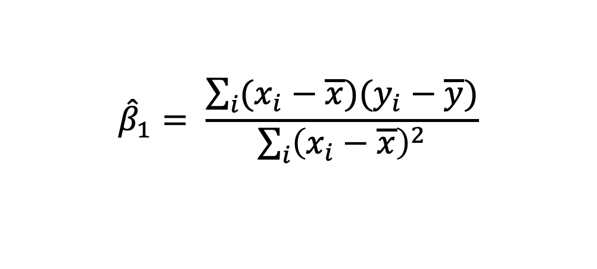

Least Squares Method
Under the assumption of linear regression model
$$y_{i}∼N(β_{0}+β_{1}X, σ^{2})$$
$${\hat{β}}_{1}= \frac{\sum_{i}{(x_{i}−\overline{x})(y_{i}−\overline{y})}}{\sum_{i}{{\left(x_{i}−\overline{x}\right)}^{2}}}$$

Slide 10

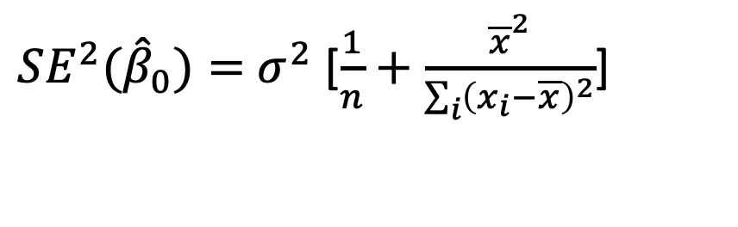
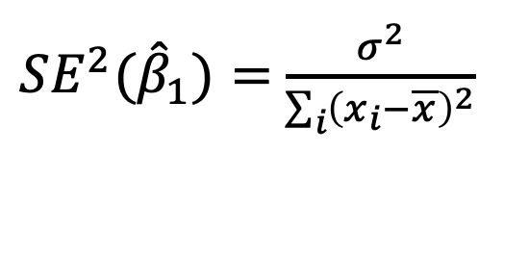
Least Squares Method
The variance of ${\hat{β}}_{0}$and ${\hat{β}}_{1}$ are
${SE^{2}(\hat{β}}_{1})=$ $\frac{σ^{2}}{\sum_{i}{{\left(x_{i}−\overline{x}\right)}^{2}}}$
${SE^{2}(\hat{β}}_{0})=$ $σ^{2}$ [$\frac{1}{n}+\frac{{\overline{x}}^{2}}{\sum_{i}{{\left(x_{i}−\overline{x}\right)}^{2}}}$]
$$σ^{2}=Var(ε)$$

Slide 11

Confidence Level
A 95% confidence interval is defined as a range of values with 95% probability, and the interval for the least square method is
$$[β−2SE\left(β\right), β+2SE(β)]$$
There is 95% probability that this interval contains the true $β$
Why is this interval?

Slide 12
Q & A

