Slide 1
Unsupervised Learning
Tianhang Zheng
https://tianzheng4.github.io

Slide 2
Unsupervised Learning vs Supervised Learning
Unsupervised learning is more subjective than supervised learning, as there is no simple goal for the analysis, such as prediction of a response
It is often easier to obtain unlabeled data — from a lab instrument or a computer — than labeled data, which can require human intervention.

Slide 3
The Goals of Unsupervised Learning
We discuss two methods:
Principal components analysis: a tool used for data visualization or data pre-processing before supervised techniques are applied
Clustering: a broad class of methods for discovering unknown subgroups in data.

Slide 4
The Goals of Unsupervised Learning
We discuss two methods:
Principal components analysis: a tool used for data visualization or data pre-processing before supervised techniques are applied
Clustering: a broad class of methods for discovering unknown subgroups in data.

Slide 5
Principal Components Analysis (PCA)
PCA produces a low-dimensional representation of a dataset. It finds a sequence of linear combinations of the variables that have maximal variance, and are mutually uncorrelated.
Apart from producing derived variables for use in supervised learning problems, PCA also serves as a tool for data visualization.

Slide 6

Principal Components Analysis (PCA)
The first principal component of a set of features is the normalized linear combination of the features
that has the largest variance. By normalized, we mean that

Slide 7

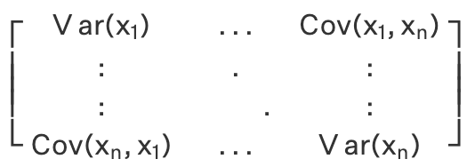

Principal Components Analysis (PCA)
$Φ_{1}$ is the eigenvector corresponding to the largest eigenvalue
Do not forget to normalize $Φ_{1}$

Slide 8
Clustering Methods
K-means clustering, we seek to partition the observations into a pre-specified number of clusters.
Hierarchical clustering, we do not know in advance how many clusters we want; in fact, we end up with a tree-like visual representation of the observations

Slide 9
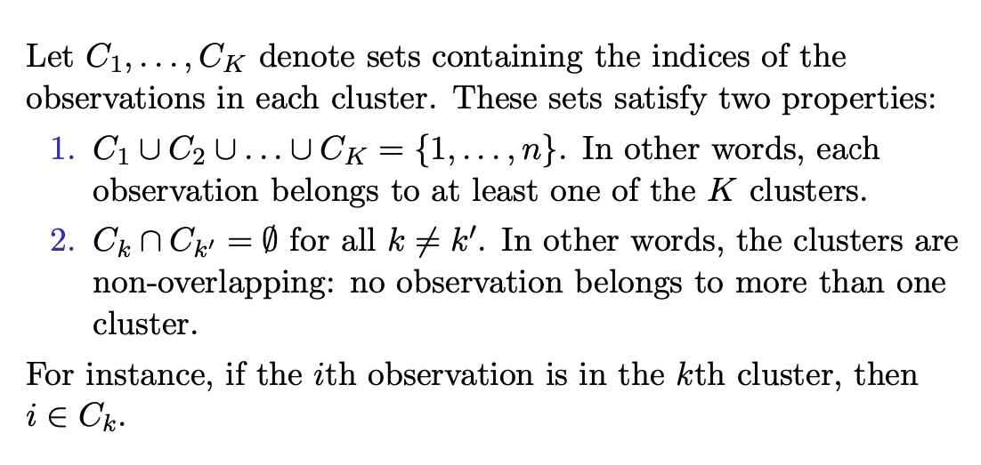
K-Means

Slide 10
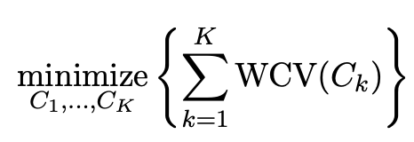
K-Means
The idea behind K-means clustering is that a good clustering is one for which the within-cluster variation is as small as possible.
The problem is formulated as

Slide 11
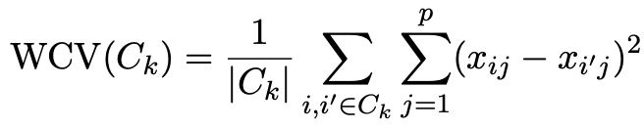
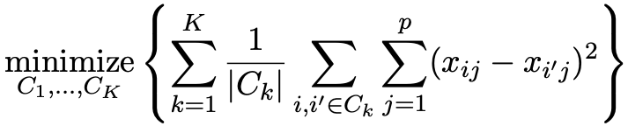
K-Means
Typically use Euclidean distance to measure within-cluster variation
The objective can be reformulated as

Slide 12
K-Means
Typically use Euclidean distance to measure within-cluster variation
The objective can be reformulated as

Slide 13
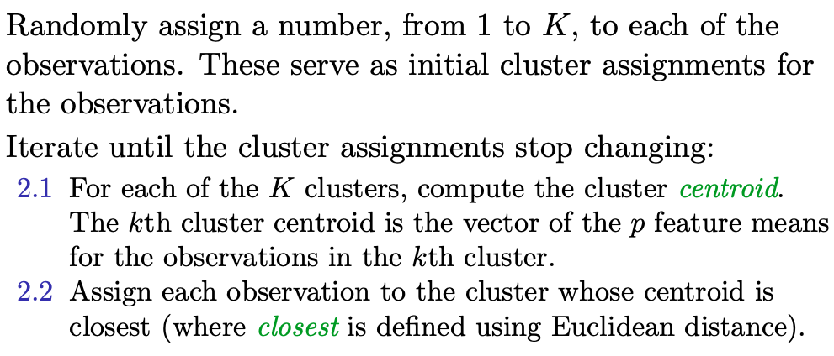
K-Means

Slide 14
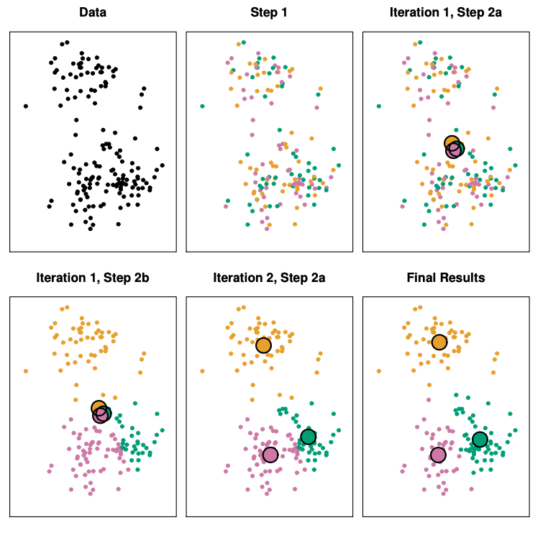
K-Means Example

Slide 15
Hierarchical Clustering
K-means clustering requires us to pre-specify the number of clusters K. This can be a disadvantage
Hierarchical clustering is an alternative approach which does not require that we commit to a particular choice of K.

Slide 16
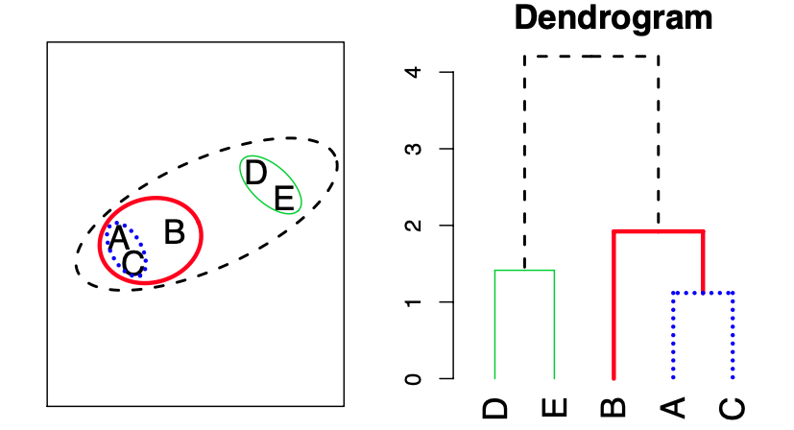
Hierarchical Clustering
Start with each point in its own cluster. Identify the closest two clusters and merge them. Repeat until all points are in a single cluster.

Slide 17
Hierarchical Clustering
How to compute the distance between two clusters?
Minimum distance
Maximum distance
Average distance

Slide 18
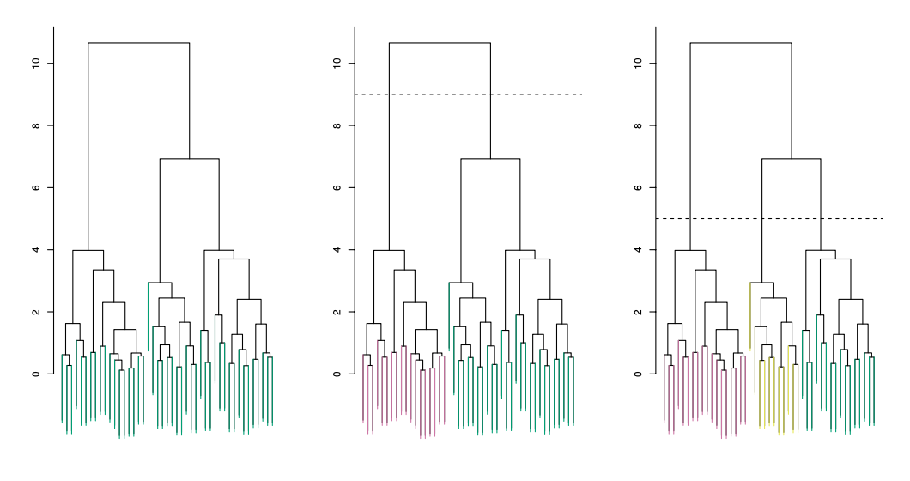
Hierarchical Clustering (Number of Clusters)

Slide 19
NIH NRT GRA Oppotunites
NSF NRT-AI: Interdisciplinary Graduate Training Through Research in Artificial Intelligence and Secure Networked Sensing to Mitigate the Crisis of Alcohol and Drug Abuse
1-2 years of fellowship support (12-month stipend of $34,000 plus tuition remission).
US citizenship or permanent residency.

