Slide 1
Multi-Variable Linear Regression
Tianhang Zheng
https://tianzheng4.github.io

Slide 2
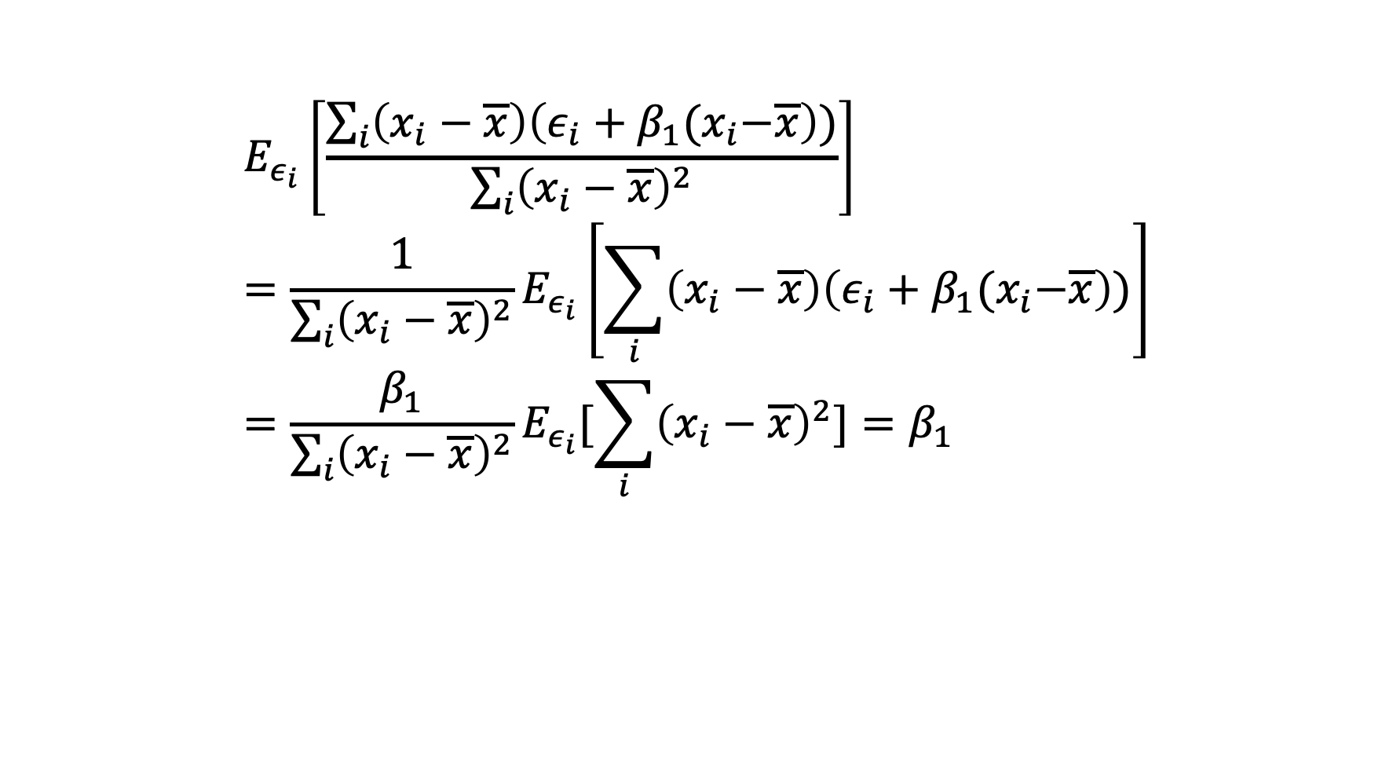
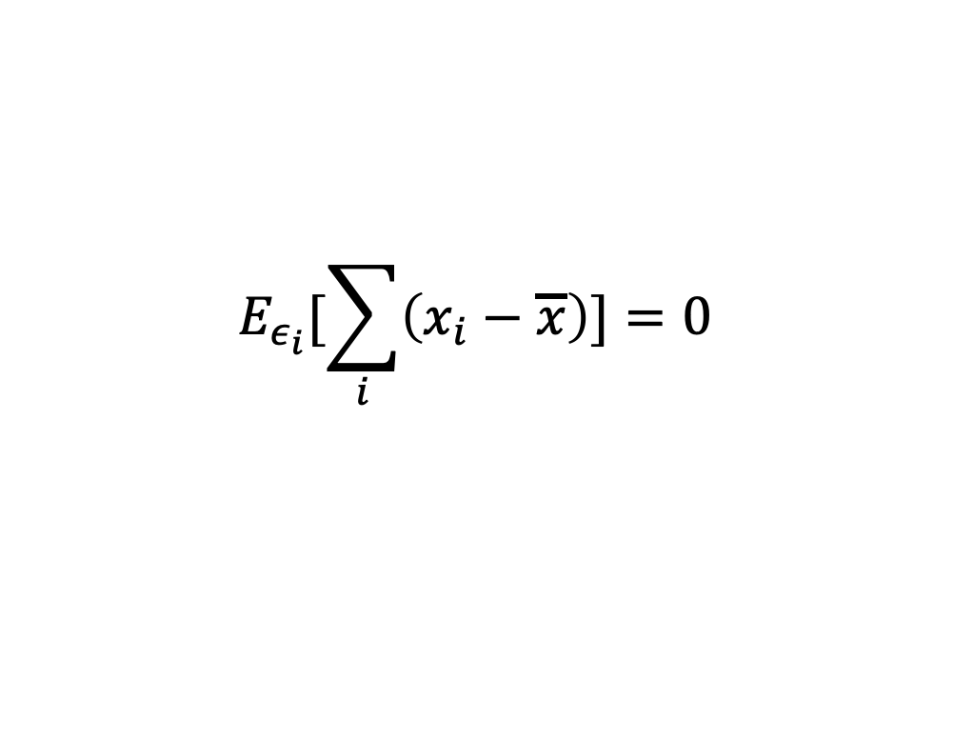
Analyzing Least Squares Method (Unbiased)
$$E_{ε_{i}}[\sum_{i}{\left(x_{i}−\overline{x}\right)]=0}$$
$$E_{ε_{i}}\left[\frac{\sum_{i}{\left(x_{i}−\overline{x}\right)\left(ε_{i}+β_{1}{(x}_{i}−\overline{x}\right))}}{\sum_{i}{{\left(x_{i}−\overline{x}\right)}^{2}}}\right]={\frac{1}{\sum_{i}{{\left(x_{i}−\overline{x}\right)}^{2}}}E}_{ε_{i}}\left[\sum_{i}{\left(x_{i}−\overline{x}\right)\left(ε_{i}+β_{1}{(x}_{i}−\overline{x}\right))}\right]=\frac{β_{1}}{\sum_{i}{{\left(x_{i}−\overline{x}\right)}^{2}}}E_{ε_{i}}[\sum_{i}{{\left(x_{i}−\overline{x}\right)}^{2}]}=β_{1}$$
Why unbiased?

Slide 3

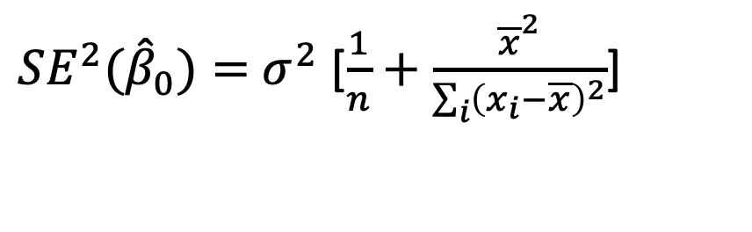
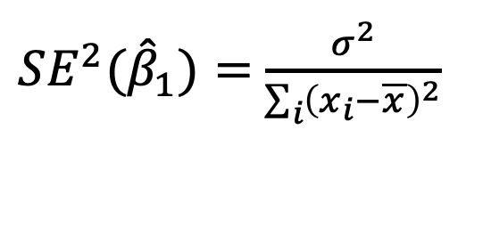
Analyzing Least Squares Method
The variance of ${\hat{β}}_{0}$and ${\hat{β}}_{1}$ are
${SE^{2}(\hat{β}}_{1})=$ $\frac{σ^{2}}{\sum_{i}{{\left(x_{i}−\overline{x}\right)}^{2}}}$
${SE^{2}(\hat{β}}_{0})=$ $σ^{2}$ [$\frac{1}{n}+\frac{{\overline{x}}^{2}}{\sum_{i}{{\left(x_{i}−\overline{x}\right)}^{2}}}$]
$$σ^{2}=Var(ε)$$
$\hat{β}∼N(β, SE^{2}\left(\hat{β}\right))$ Why Gaussian distribution?

Slide 4

Confidence Level
$\hat{β}∼N(β, SE^{2}\left(\hat{β}\right))$ means that$β∼N(\hat{β}, SE^{2}\left(\hat{β}\right))$
A 95% confidence interval is defined as a range of values with 95% probability, and the interval for the least square method is
$$[\hat{β}−2SE\left(\hat{β}\right),\hat{β}+2SE(\hat{β})]$$
There is 95% probability that this interval contains the true $β$

Slide 5
Multiple Linear Regression
Linear Regression with multiple predictors (Assume the ideal model is a linear function)
$$Y=β_{0}+β_{1}X_{1}+β_{2}X_{2}+…+β_{p}X_{p}+ε$$
$β_{0}$ is interpreted as the average effect of one unit increase in $X_{i}$ on Y

Slide 6
Parameter Estimation
The objective is to learn (estimate) $β_{0}, β_{1}…, β_{p}$
The estimates of $β_{0}, β_{1}…, β_{p}$are denoted by ${\hat{β}}_{0}, {\hat{β}}_{1}…,{\hat{β}}_{p}$
$$\hat{y}={\hat{β}}_{0}+{\hat{β}}_{1}x_{1}+…+{\hat{β}}_{1}x_{p}$$
$e=y−\hat{y}$ is the residual

Slide 7
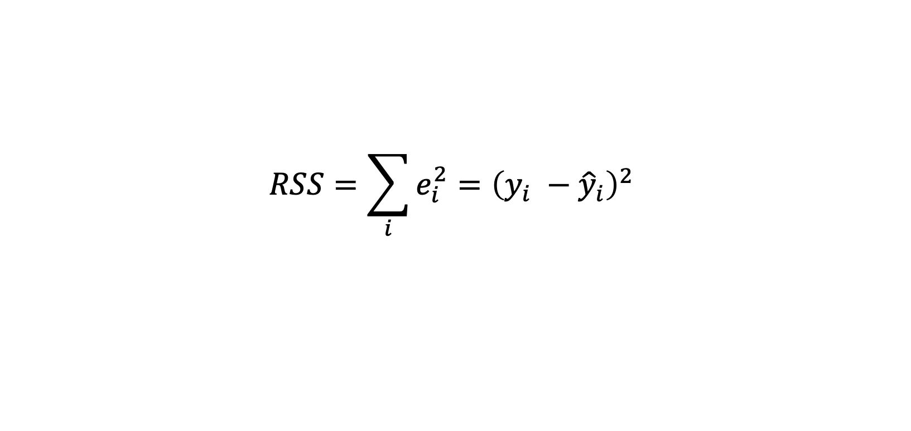
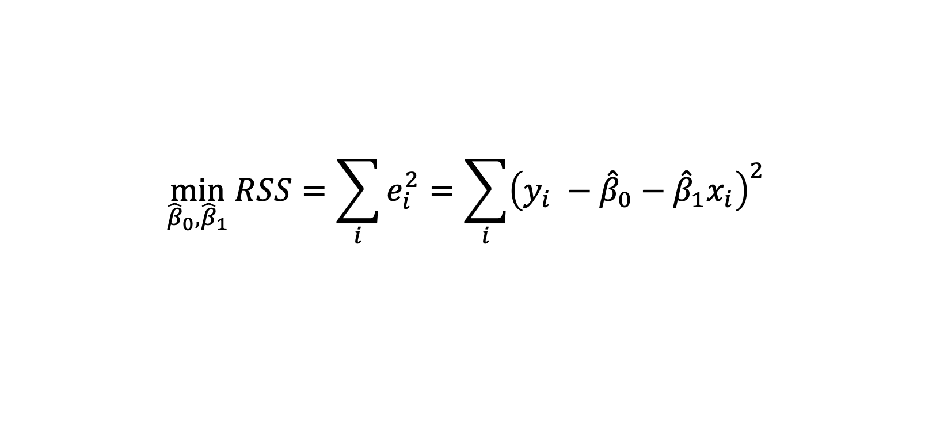
Least Square Method
$$RSS=\sum_{i}{e_{i}^{2}={\left(y_{i} −{\hat{y}}_{i}\right)}^{2} }$$
$$\min_{{\hat{β}}_{0},{\hat{β}}_{1}}{RSS=\sum_{i}{e_{i}^{2}=\sum_{i}{{\left(y_{i} −{\hat{β}}_{0}−{\hat{β}}_{1}x_{i}\right)}^{2}} }}$$

Slide 8
Q & A

