Slide 1
Barcode, QR code and Motion detection with Camera, Python and Opencv
Tianzi Xie

Slide 2
Code is originally developed by Adrian Rosebrock
Original name of it: Real-time barcode detection in video with Python and OpenCV
It can only do barcode detection.
I found it is possible for barcode detection, QR code detection and motion detection, and I did some modifications.

Slide 3
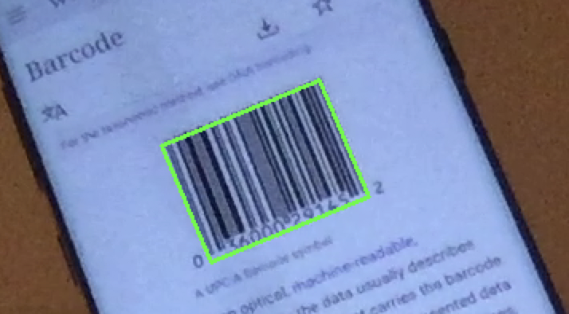
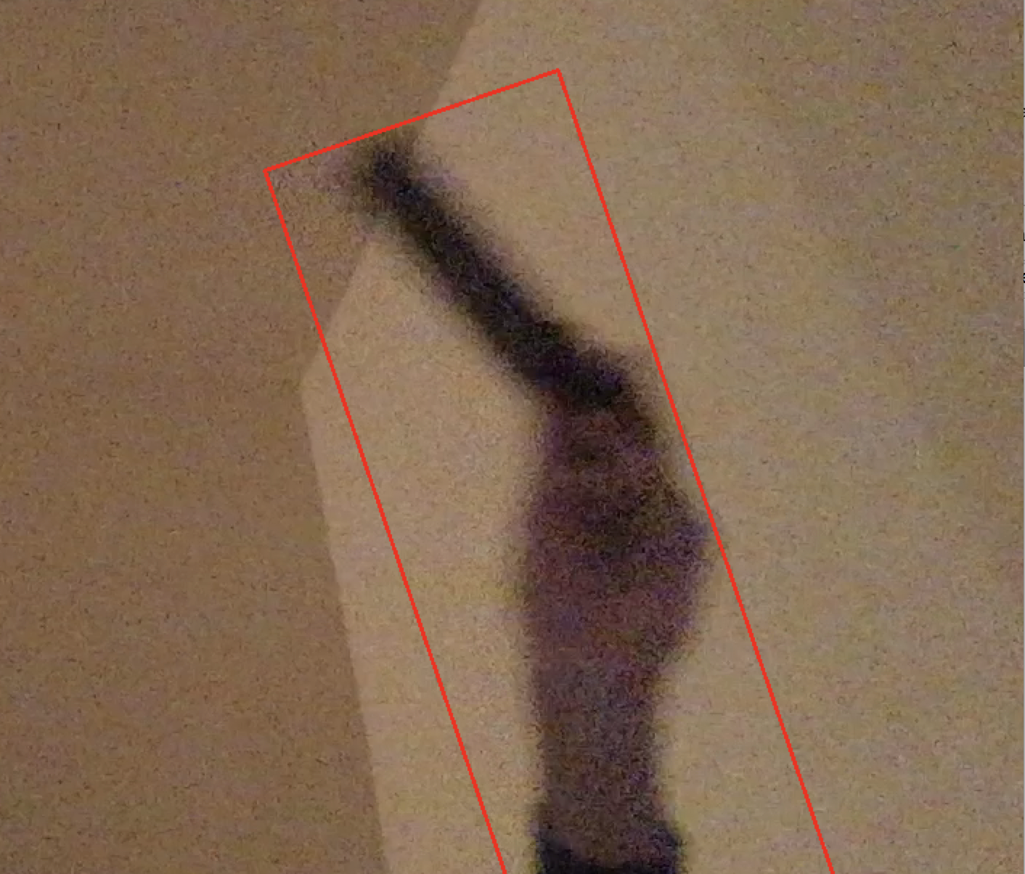
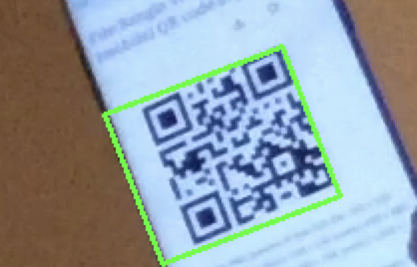
How it work as:
Green lined box for barcode and QR code detection.
Red lined box for single object motion detection.

Slide 4
Functions used in function: detect(image,th) to provide 4 points of green/red lined boxes.
cv2.cvtColor, convert to grayscale
cv2.Sobel, calculate gradient magnitude
cv2.Subtract, subtract from gradX and gradY to gradient
cv2.convertScaleAbs, calculates absolute values, and converts the result to 8-bit
cv2.GaussianBlur, do gaussian blur
cv2.threshold, Binary Threshold
cv2.getStructuringElement, define a kernel with RECT Structuring Element

Slide 5
Functions used in function: detect(image,th) to provide 4 points of green/red lined boxes.
cv2.morphologyEx, dilation followed by erosion
cv2.erode, erosion(s)
cv2.dilate, dilation(s)
cv2.findContours, finds the contours
cv2.minAreaRec, draws a minimum rectangle around that area
cv2.cv.BoxPoints, get four points for box

Slide 6
Functions to show the results
cv2.VideoCapture, it can load local video
camera.read, open and load video from camera
cv2.drawContours, draw by four points of box on to captured frame of video from camera
cv2.imshow, show result frames in a window

Slide 7
I use these functions to draw red lined box to show detected motion.
a = detect(frame,160)
box1 = detect(frame,160)
abs(np.sum(box1-a))
cv2.drawContours(frame, [box1], -1, (0, 0, 255), 2)

Slide 8
And these functions to draw green lined box to show detected barcode and QR code.
box = detect(frame,215)
cv2.drawContours(frame, [box], -1, (0, 255, 0), 2)

Slide 9
Modified parameters
RECT = cv2.getStructuringElement(cv2.MORPH_RECT, (20, 20))
blurred = cv2.GaussianBlur(gradient, (9, 9),5)
a = detect(frame,160)
box1 = detect(frame,160)
box = detect(frame,215)
abs(np.sum(box1-a))>60 and abs(np.sum(box1-a))<500

Slide 10
code modified from: https://www.pyimagesearch.com/2014/12/15/real-time-barcode-detection-video-python-opencv
Reference : https://www.pyimagesearch.com/2014/12/15/real-time-barcode-detection-video-python-opencv

