Slide 1
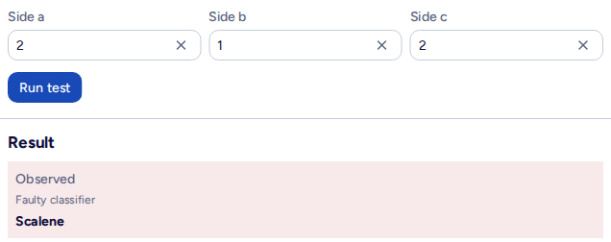
TRIANGLE TEST LAB / DEMONSTRATION
Catch two defects
with four test cases
Set up Qase, run the cases manually, then report automated checks.
2 passed
2 failed
Expected in the manual run
and each automated suite.
Open lab
Open Qase
Open GitHub
Qase project TR | 28 Oct 2026
01 / 10
Notes:
Purpose: demonstrate that specification-based tests expose two known classifier defects.
This is a performative testing exercise, not a performance test.
Use the four cases from commit 785557b. The lab shows only the faulty classifier output.
A failed assertion is the desired evidence for a defective case. Keep the expected value correct.
Suggested order: setup before class, register four cases, start GitHub automation, execute the manual run while it works, then inspect the two Qase reports.
Links: https://triangle.theerapakg.moe/ ; https://app.qase.io/project/TR

Slide 2
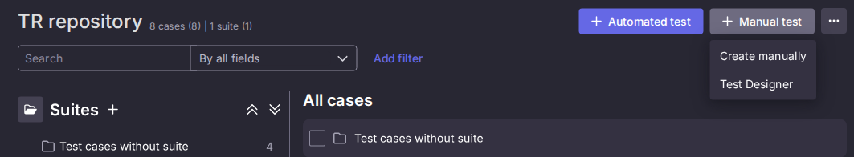
TRIANGLE TEST LAB / SETUP 1 / QASE
Start with a Qase project
Prepare access and the place where the cases will live.
1
Sign in or accept a workspace invitation
Open Projects, then reuse Triangle, code TR, or create your own project.
2
Create a suite in Repository
Use the plus beside Suites. Name it Triangle demo - four cases.
Project > Suite > Case > Run
Qase project TR | 28 Oct 2026
02 / 10
Notes:
Audience prerequisites: a browser, a Qase account or workspace invitation, permission to create cases and runs, and access to Triangle Lab.
In Qase Projects, reuse Triangle with project code TR. For an independent exercise, create a project in your workspace and note its project code. Use that same code in GitHub and .env.local.
Create the suite 'Triangle demo - four cases' from Repository > Suites > plus.
Vocabulary: Project contains the product's tests. Suite groups cases. Case defines steps, data and expected result. Run records an execution and its actual outcomes.
The screenshot is the real TR repository, with the Manual test > Create manually menu open. The case counts can change.
Source: https://docs.qase.io/en/articles/5563688-getting-started

Slide 3
TRIANGLE TEST LAB / SETUP 2 / REPORTING
Connect the two reporters
Configure this once in your Qase workspace and GitHub repository.
Qase Apps > Vitest and Playwright > Activate > Access tokens
Create one token for each app.
GitHub > Settings > Secrets and variables > Actions
Setting name
Where / value
QASE_TESTOPS_PROJECT
Variable / TR
QASE_VITEST_API_TOKEN
Secret / Vitest app token
QASE_PLAYWRIGHT_API_TOKEN
Secret / Playwright app token
The existing workflow installs the reporters and sends both suites to Qase.
Qase project TR | 28 Oct 2026
03 / 10
Notes:
Qase Apps: open Vitest, activate it if needed, open Access tokens, create a token. Repeat for Playwright. The current workspace already has both apps installed.
GitHub: use tiara-stack/triangle with permission, or fork the repo and enable Actions in your fork. Open repository Settings > Secrets and variables > Actions.
On Variables, add repository variable QASE_TESTOPS_PROJECT=TR, or your own Qase project code.
On Secrets, add QASE_VITEST_API_TOKEN with the Vitest app token and QASE_PLAYWRIGHT_API_TOKEN with the Playwright app token.
Alternative: a shared token can use QASE_TESTOPS_API_TOKEN. Separate app tokens are preferable for app attribution. Do not confuse the GitHub setting names with the reporter env name: scripts/performative-test.ts maps each selected token into QASE_TESTOPS_API_TOKEN for its child process.
The workflow and reporter packages are already in this repo. There is no need to install a Qase GitHub integration just to upload these results.
Check the configuration log says 'Qase TestOps reporting is enabled.' Then check four results in each new Qase run.
Never show real tokens on slides or commit them.
Sources: https://developers.qase.io/docs/prerequisites ; https://developers.qase.io/docs/playwright ; https://docs.github.com/en/actions/how-tos/write-workflows/choose-what-workflows-do/use-secrets

Slide 4
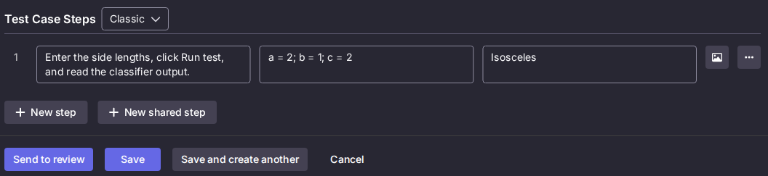
TRIANGLE TEST LAB / QASE REPOSITORY
Register each case with an expected result
Use the specification when writing the case. Record the faulty output during execution.
1
Manual test > Create manually
Choose the suite. Set Automation status to Manual and Type to Functional.
Title
Classifies a = c as Isosceles
Classic step: action, data, expected result
Repeat with the other three inputs and expected results on the next slide.
Qase project TR | 28 Oct 2026
04 / 10
Notes:
Repository > Suites plus: create 'Triangle demo - four cases'.
Manual test > Create manually opens the full case editor.
Title: Classifies a = c as Isosceles. Choose the suite. In this workspace Status is called Actual. Automation status Manual, Type Functional.
Pre-conditions: Triangle Lab open, Enter sides only selected.
Test Case Steps: Classic > New step.
Action: Enter the three side lengths, click Run test, read the classifier output.
Data: a=2; b=1; c=2. Expected result: Isosceles.
Use Save and create another for the remaining cases. Use the next slide as the answer sheet.
Qase assigns real case IDs with the TR prefix. Keep them.
Screenshot: an unsaved draft in the real project. No cases were created for this document.
Source: https://docs.qase.io/en/articles/5563704-test-cases

Slide 5
TRIANGLE TEST LAB / THE ANSWER SHEET
Four inputs, four expected results
These are the four cases in the current demonstration.
Case
a, b, c
Expected
Actual output
Record
01 a and c match
2, 1, 2
Isosceles
Scalene
Failed
02 200 is allowed
1, 200, 200
Isosceles
Value is out of range
Failed
03 Equilateral
3, 3, 3
Equilateral
Equilateral
Passed
04 201 rejected
201, 1, 1
Value is out of
range
Value is out of range
Passed
Whole numbers 1 through 200 are allowed, including 200.
Qase project TR | 28 Oct 2026
05 / 10
Notes:
Case 01: a=2,b=1,c=2. Correct specification Isosceles. Faulty classifier Scalene. Record Failed.
Case 02: a=1,b=200,c=200. Correct specification Isosceles. Faulty classifier Value is out of range. Record Failed.
Case 03: a=3,b=3,c=3. Expected and observed Equilateral. Record Passed.
Case 04: a=201,b=1,c=1. Expected and observed Value is out of range. Record Passed.
The allowed side range is inclusive 1 through 200. The valid-200 case proves an inclusive upper boundary defect. The a=c case proves an omitted equality check.
Use 03,01,02,04 as a convenient manual demonstration order: a passing baseline, the two defects, then a passing out-of-range rejection.
Source: src/lib/triangle.ts, tests/performative/triangle.test.ts, tests/e2e/performative.spec.ts at commit 785557b.
Specification: https://triangle.theerapakg.moe/lesson-3-triangle-problem.pdf

Slide 6
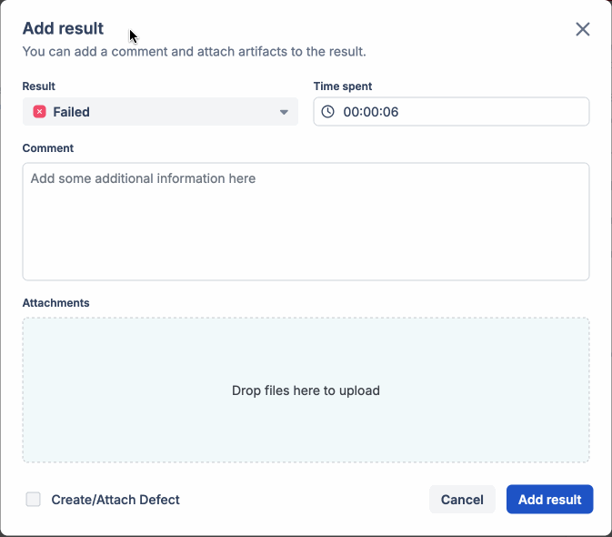
TRIANGLE TEST LAB / MANUAL EXECUTION
Run, compare, record in Qase
The expected result belongs to the case. The actual result comes from Triangle Lab.
1
Select the four manual cases > Run
Name the run Triangle demo - Manual. Open its wizard.
2
Enter sides in the lab > Run test
Read the faulty classifier's output, then compare it with the
case.
3
Save Passed or Failed in Qase
For a failure, add a comment and attach the lab screenshot.
Example Comment
Add result dialog. Official Qase help example.
a=2, b=1, c=2. Expected: Isosceles. Actual: Scalene.
Qase project TR | 28 Oct 2026
06 / 10
Notes:
Select only the four manual cases in the Qase Repository and click Run for an express run. Name the run 'Triangle demo - Manual'. Alternatively use Test Runs > Start new test run and choose the four cases.
Open a case in the run or Open wizard. Keep the lab in another tab.
In Triangle Lab choose Enter sides only, enter a,b,c and click Run test. Read Observed / Faulty classifier output.
Passed means actual equals the case's expected result. Failed means they differ. An HTTP 200 alone does not make the classifier correct.
In Add result, select Failed, add the Comment shown, attach the lab screenshot, and save the result. Do not change the expected result to the faulty output.
After all four cases, verify 2 Passed and 2 Failed, then Complete the manual run.
The Add result image is a clearly labeled official Qase Help Center example because no real manual run or result was created to illustrate this guide.
Sources: https://docs.qase.io/en/articles/5563702-test-runs ; image https://docs.qase.io/en/articles/6417206-github

Slide 7
TRIANGLE TEST LAB / AUTOMATED EXECUTION
Start the existing GitHub workflow
In your repository or fork, run both suites once and inspect Qase.
GitHub Actions
>
Vitest + Playwright
>
Qase project TR
Runs the checked-out tests
Four checks in each suite
Two reports with results
1
Actions > Performative defect detection
Click Run workflow, choose main, then Run workflow again.
2
Check logs, then open Qase Test Runs
Confirm reporting is enabled and that both suites uploaded four results.
Open workflow
Two assertion failures per suite should make the job red.
Qase project TR | 28 Oct 2026
07 / 10
Notes:
GitHub repository > Actions > Performative defect detection.
Click Run workflow, choose main, and click Run workflow again.
Workflow URL: https://github.com/tiara-stack/triangle/actions/workflows/performative.yml
The workflow installs dependencies and Chromium, reports Qase configuration status, then runs pnpm test:performative.
The script runs the direct Effect/Vitest tests and then the Playwright UI tests even when the direct suite fails.
Playwright builds and starts the app from this checkout on a local port. These checks do not depend on a running production deployment.
Inspect failures for the a=c and valid-200 assertions. Look for enabled reporting and upload messages.
A red workflow is intentional for these known defects, but setup/network/authentication failures are not evidence of a classifier defect. Open the test logs and verify the failing assertion.
GitHub requires write access to manually run a workflow; a fork can be used for an independent exercise.
Source: https://docs.github.com/en/actions/how-tos/manage-workflow-runs/manually-run-a-workflow

Slide 8
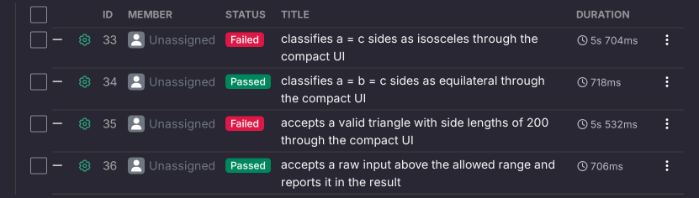
TRIANGLE TEST LAB / AUTOMATED RESULTS
Inspect the uploaded Qase results
Open the newest Direct Effect and Browser UI runs. Each should have four checks.
Example: Browser UI, run 16
2 passed + 2 failed in each suite
Open a Failed case for assertion details.
Qase project TR | 28 Oct 2026
08 / 10
Notes:
Actual screenshot: Qase Browser UI run 16 from GitHub workflow run 40702371101, commit 785557b.
Run 15 is Direct Effect, started by Vitest. Run 16 is Browser UI, started by Playwright.
Each has two Failed and two Passed results, so there are eight results across both runs.
Open a Failed result. The a=c browser result expected an Isosceles heading and reports that it was not found. Direct tests show the expected/observed object mismatch.
Case 01 and case 02 fail in both suites. Case 03 and case 04 pass in both suites.
Qase may show a 100% completion rate, 4 of 4 results, while run status still says In Progress. Use Complete to close the run if needed. Do not treat the lifecycle status as the test outcome.
Traceability: current code has no explicit Qase case IDs. Reporters match title and suite path. The automated repository entries may be separate from the manual cases. To share a case history, add the actual Qase IDs in both test files. Never invent IDs from this slide's 01-04 numbering.
Do not dispatch a new workflow just to view these existing example results.
Links: https://app.qase.io/run/TR/dashboard/15 ; https://app.qase.io/run/TR/dashboard/16
Source: https://developers.qase.io/docs/linking-tests

Slide 9
TRIANGLE TEST LAB / OPTIONAL / LOCAL SETUP
Follow along on your own machine
Use Git, Node.js 22.18 and pnpm 11.9.0 to match the repository workflow.
1 Install from the repository
2 Copy .env.local.example to .env.local
git clone \
https://github.com/tiara-stack/triangle.git
cd triangle
pnpm install --frozen-lockfile
QASE_TESTOPS_PROJECT=TR
QASE_VITEST_API_TOKEN=<Vitest token>
QASE_PLAYWRIGHT_API_TOKEN=<Playwright token>
Install Chromium
node node_modules/@playwright/test/cli.js \
install chromium
Replace the placeholders with your own tokens.
3 pnpm test:performative:qase
Qase project TR | 28 Oct 2026
09 / 10
Notes:
Manual testing needs only a browser and Qase. These local commands are for someone who wants to run the existing automation.
Clone https://github.com/tiara-stack/triangle.git or your fork, cd triangle, pnpm install --frozen-lockfile.
Install Chromium with node node_modules/@playwright/test/cli.js install chromium. On Linux, add --with-deps if system libraries are missing.
Copy .env.local.example to .env.local. Set QASE_TESTOPS_PROJECT, QASE_VITEST_API_TOKEN and QASE_PLAYWRIGHT_API_TOKEN. Leave shared QASE_TESTOPS_API_TOKEN empty when using distinct app tokens.
The file is already gitignored. Keep real token values private.
Run pnpm test:performative:qase to execute both suites and upload. The script loads .env.local via Effect ConfigProvider; shell environment variables take precedence. It maps each app token to its corresponding reporter process.
Run QASE_MODE=off pnpm test:performative for a rehearsal without publishing. Use pnpm test:performative:direct or pnpm test:performative:browser to select one suite. Add --qase to those scripts to publish.
Playwright builds and starts the local app automatically. A nonzero exit due to the two known assertion failures is expected.
Reporters are already installed: vitest-qase-reporter and playwright-qase-reporter. Conditional reporter configuration is in vitest.node.config.ts and playwright.config.ts. The script is scripts/performative-test.ts.

Slide 10
TRIANGLE TEST LAB / DEMO CHECKLIST
Show the evidence, then the conclusion
Use the passing cases to establish a baseline and the failures to demonstrate detection.
1
Before the session
Qase access, four manual cases, GitHub settings and one rehearsal.
2
During the demonstration
Start automation. Run manual cases 03, 01, 02, 04. Complete the manual run.
3
Show the reports
Each run has 2 passed + 2 failed. Open a failed assertion and explain the mismatch.
The classifier is faulty. These tests catch it.
Triangle Lab
Qase repository
GitHub workflow
Qase project TR | 28 Oct 2026
10 / 10
Notes:
Before presenting: verify Qase access, four manual cases, GitHub tokens/variable and workflow permission. Rehearse once and keep the lab plus Qase tabs open.
For speed, start GitHub automation first. While it works, execute the manual cases in order Equilateral, a=c, valid 200, 201 rejected.
Complete the manual run after verifying 2 Passed and 2 Failed.
Open the newest Direct Effect and Browser UI Qase runs. Each should have 4 results, 2 Passed and 2 Failed. Open one failed assertion to show the evidence.
Explain: the classifier is faulty, and correct tests expose it. The expected result must remain the specification, not the observed faulty output.
Case registration and result entry are separate actions. Creating a manual case does not automatically connect it to an automated test. The current code matches titles and suite paths, with no explicit Qase IDs. See the handout for this traceability note.
Primary references: Qase first steps https://docs.qase.io/en/articles/5563688-getting-started ; Qase cases https://docs.qase.io/en/articles/5563704-test-cases ; Qase runs https://docs.qase.io/en/articles/5563702-test-runs ; reporter tokens https://developers.qase.io/docs/prerequisites ; linking https://developers.qase.io/docs/linking-tests ; GitHub manual dispatch https://docs.github.com/en/actions/how-tos/manage-workflow-runs/manually-run-a-workflow
Image sources: real Triangle Lab and Qase project TR captures on 28 Oct 2026. Add result screenshot from official Qase Help Center GitHub article, https://docs.qase.io/en/articles/6417206-github .
The guide and deck did not create any real test case, submit a result, or dispatch a workflow.

