Slide 1
COVID
File created on: 12/03/2021 4:52:07 PM GMT+08:00

Slide 2
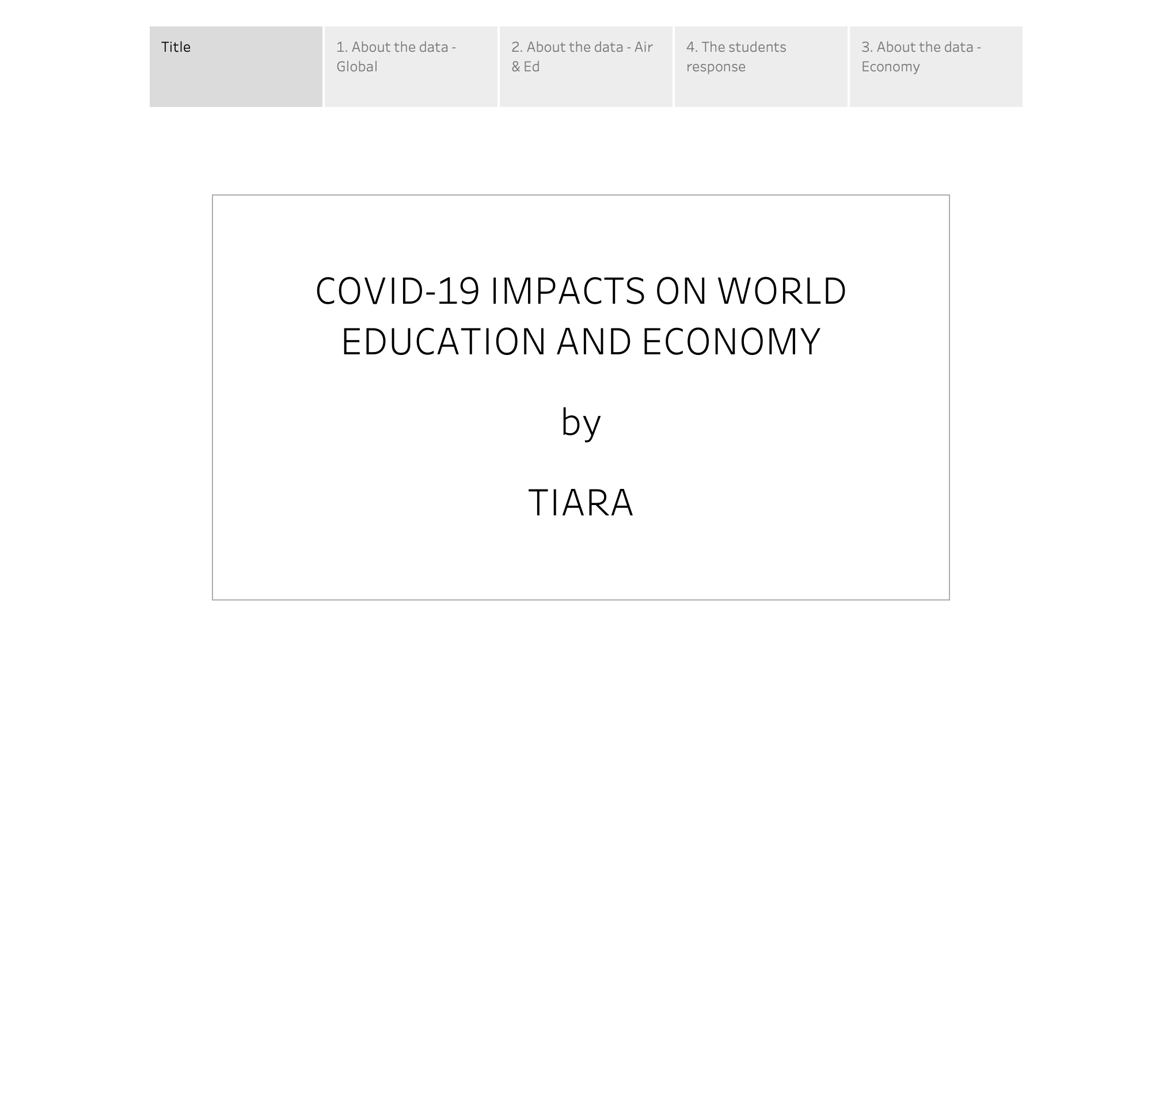

Slide 3
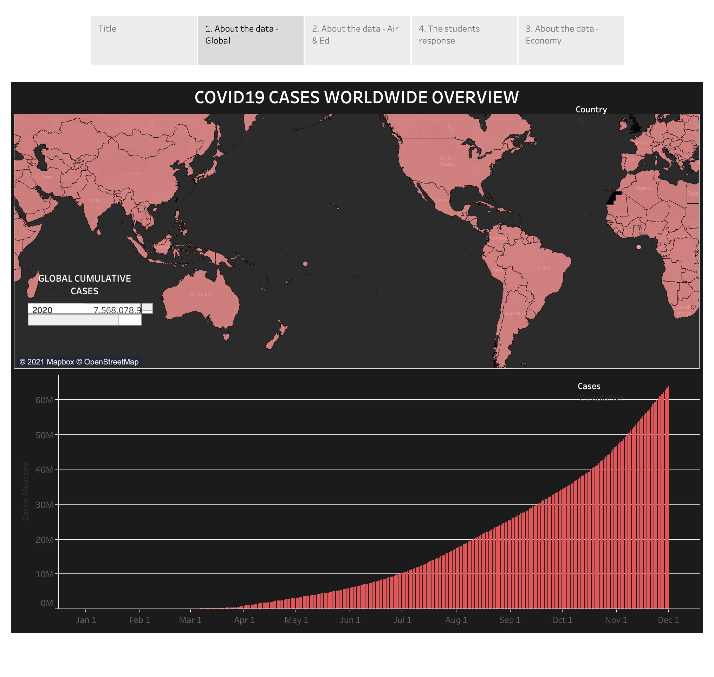

Slide 4
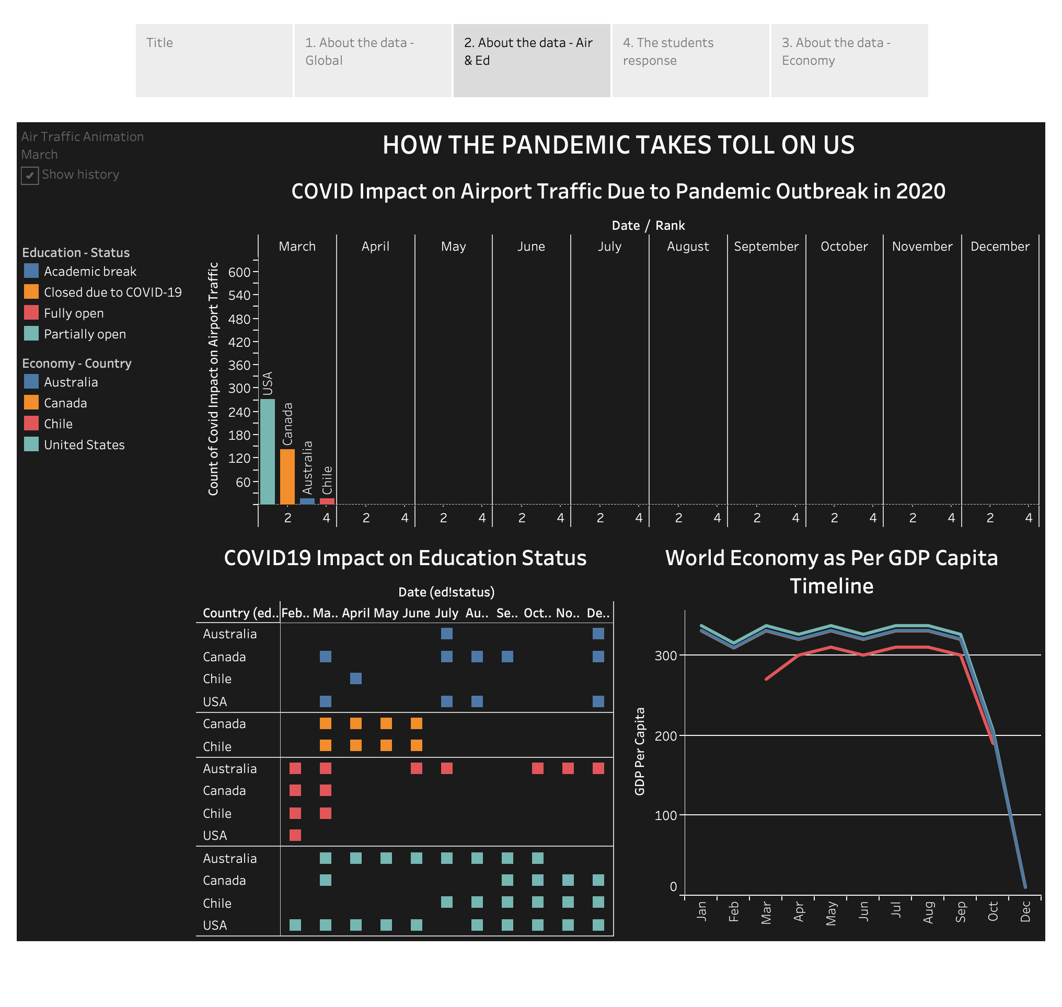

Slide 5
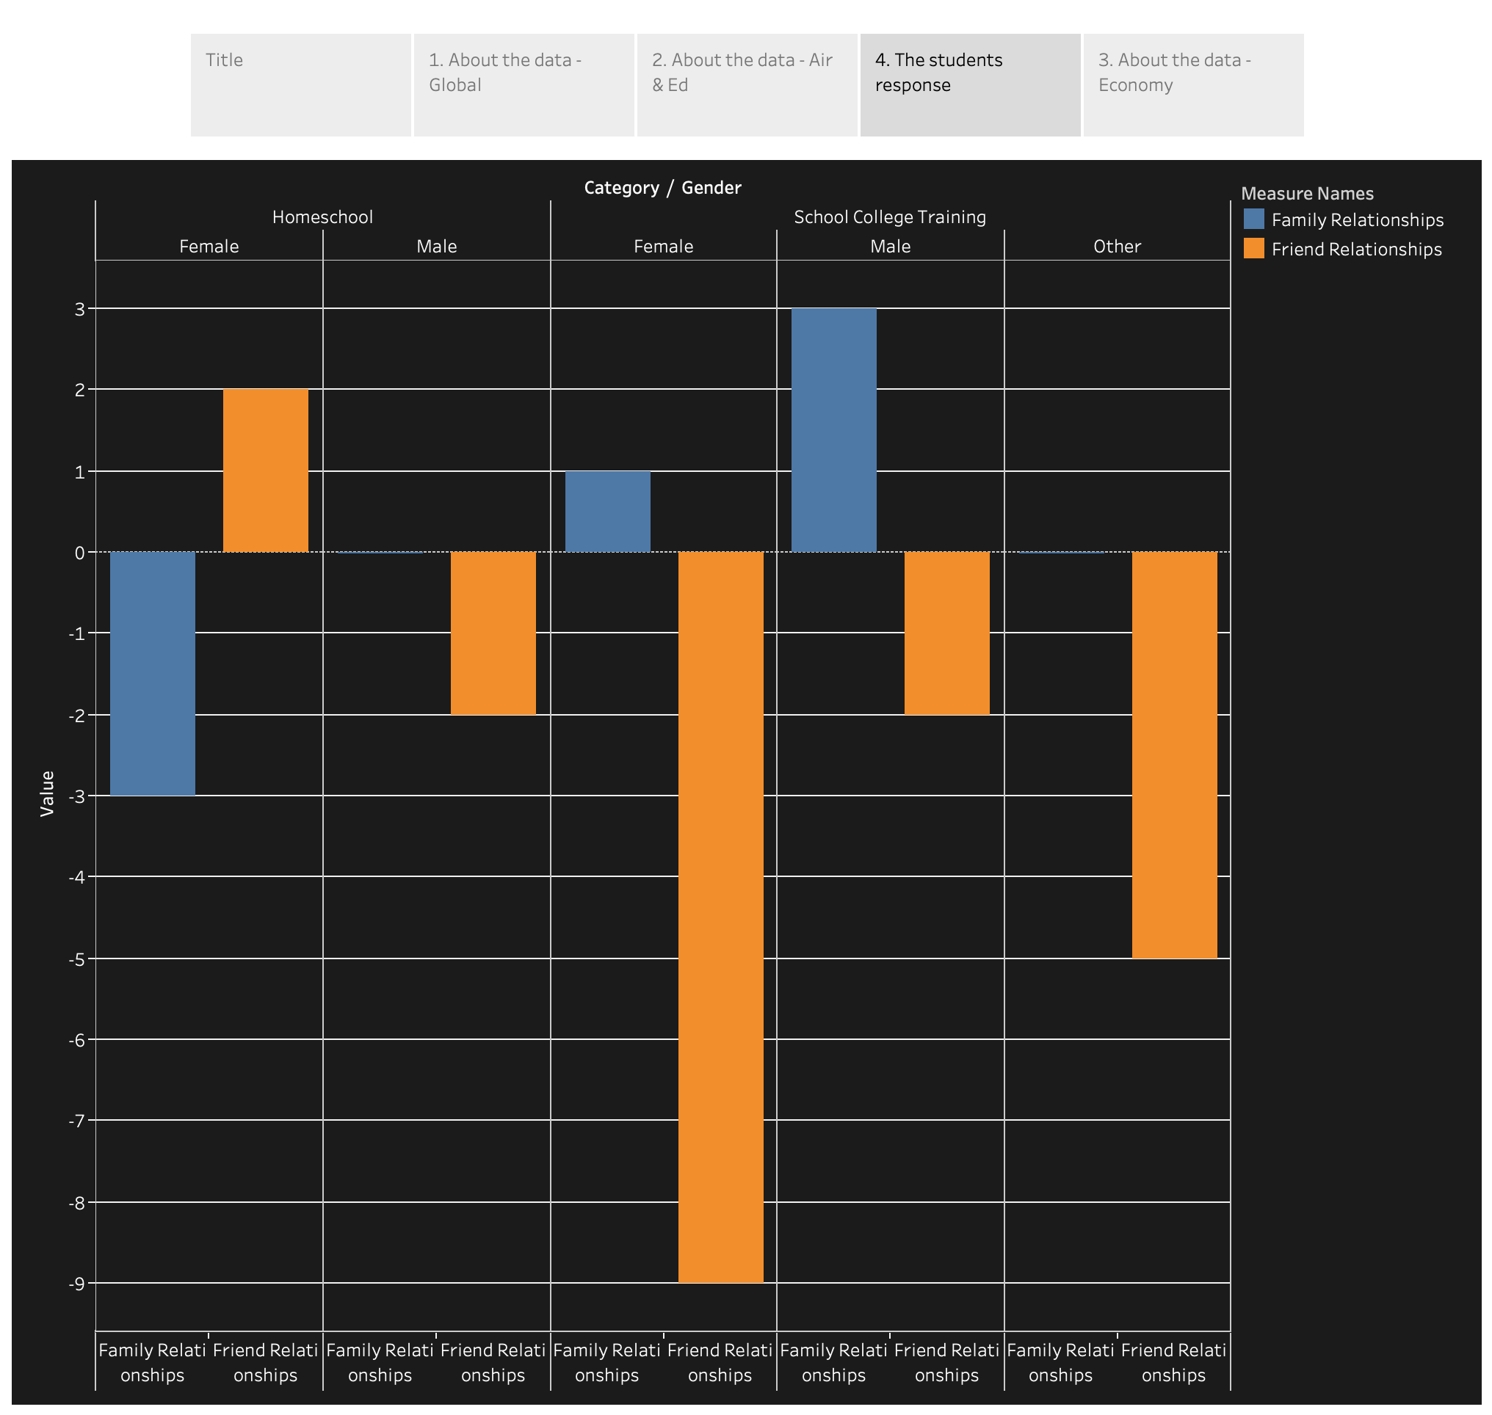

Slide 6
