Slide 1
TREINAMENTO EM CONSCIENTIZAÇÃO EM ERGONOMIA EM ESCRITÓRIO

Slide 2
Objetivos do treinamento em Ergonomia
Objectivos
  Principipios da ergonomia
  Interacões entre você e seu ambiente de trabalho
  Ferramentas para organizar e gerenciar seu ambiente de trabalho
  Ferramenta - Lista visual para escritórios
    Intranet-based programme
  SB Technical Manual - Introduction
  Home Office Ergonomic Guidelines

Slide 3
Benefits of an
Ergonomics Evaluation
Reduce stress and fatigue
Decrease likelihood of injury
Increased comfort
Improved job satisfaction
Improved productivity

Slide 4
SB’s Ergonomic Injury/Illness History
Leading cause of workplace Injuries/Illnesses at SB
Affects almost all SB employees
1998 US WSO/Consumer operations, Franklin Plaza
  55 % of OSHA-recordable injuries
  ergonomically-related
  62 % of LTAs ergonomically-related
  (1040 lost days)
UK data shows an increase of office related ergonomic injuries

Slide 5
Common Health Effects associated with Offices Health Effects
Tendon disorders
  Tendinitis, Tenosynovitis
Nerve Disorders
  Carpal & Cubital Tunnel Syndrome
Back Disorders
  Cervical, Lumbar

Slide 6
Potential for Injury
Force - excessive
Frequency - repetitive and duration
Posture - non-neutral
Example - Data entry
  Force - primitive keyboard
  Frequency - number of data points/shift
  Posture - keyboard distance far away at incorrect height

Slide 7
Evaluating WRMSD in the Office Environment
10 elements of office workstation
TOOL
  ergonomic self assessment
    electronically via intranet
    hardcopy available
Home Office Ergonomic Guidelines

Slide 8
Viewing angle
Document
holder
Elbow
angle
Wrist rest
Height
Keyboard
height
Knee
clearance
Elbow rest
Lower back
support
Seat back
angle
Table
height
Knee
angle

Slide 9
10 Elements of Office Ergonomics
Chair
Monitor
Keyboard
Mouse
Phone
Lighting
Posture
Work Surfaces
Work Habits
Laptop

Slide 10
Chair
Chair height correct when
  foot sole on floor or footrest
Hands & forearms at elbow height
Lumbar support to support lower back
Seat pan concave, rounded or waterfall edge
Comfortable sitting position

Slide 11
Monitor
Distance - 18 in/45 cm to 24 in/60 cm - arm’s length
Top of screen at or slightly below eye level
Screen and document holder same distance
Free of glare and clean
  slight angle down to reduce glare
Adjust brightness and contrast

Slide 12
Keyboard and Mouse
Place the keyboard in front of you at elbow height
Form a 90° angle with upper and lower arms
Wrists straight on soft surfaces
Mouse at same height next to keyboard
Arm not elevated or extended while using mouse

Slide 13
Phone
Locate phone close to main area
Consider use for longer periods:
  speaker phone
  telephone headset
  shoulder rest

Slide 14
Lighting
Aim task lights away from monitor screen
Do not locate the monitor directly under bright lights
Limit the reflection from walls
Lights should not shine directly into eyes when viewing the screen
Window blinds adjusted

Slide 15
Posture
Shoulders - relaxed
Elbows - close to body
Wrists - straight
Feet - fully supported
Forearms & thighs - fully supported
Head - not tilted

Slide 16
Work Surfaces
Work surface elbow height
Room for keyboard in front of monitor
Keep items within easy reach
Place CPU on floor

Slide 17
Work Habits
Take short breaks every 30 - 60 minutes
Alternate your tasks
Vary work position slightly from time to time

Slide 18
LapTop
Home/office
  Full size external keyboard
  Full size external monitor
  Use mouse
Planes/Trains/Hotels
  Use attachable mouse
  Luggage with wheels
  Backpack/Rucksacks
Don’t forget about your family & home PC

Slide 19
TOOL
The Optimal Office List

Slide 20
TOOL
Designed to show you what is required and us how you work
Response will assist you and SB identify improvement opportunities
Programme will be offered globally

Slide 21
TOOL
Intranet
  On CE&S intranet site http://ces.sb.com/ under Training section and Ergo Tool
7 sections + Employee/Job Information
  70 questions
  15 minutes
  Yes/No/NA

Slide 22
TOOL
Each of the areas contain illustrations
Click on highlighted words for definitions
Low Cost Solutions suggested provide ideas

Slide 23
TOOL
New office equipment and furnishing will be provided as needed as approved by appropriate management.
Decisions to purchase supplies will be dependent on your department/site purchasing procedures. See your supervisor or ergonomics program owner as identified in your site Ergonomics Management System

Slide 24
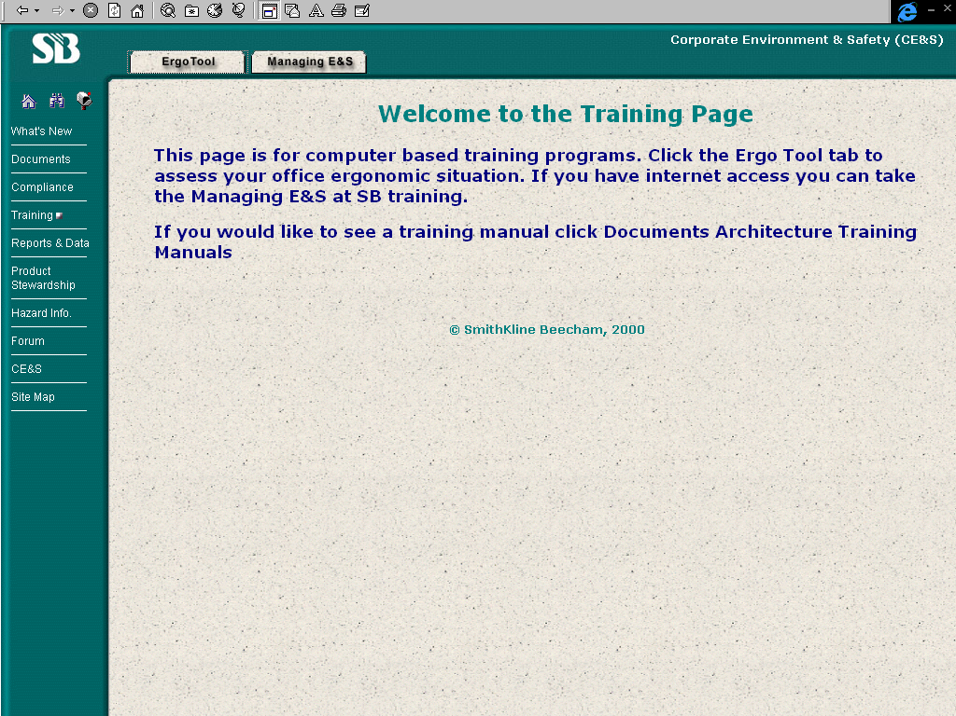

Slide 25
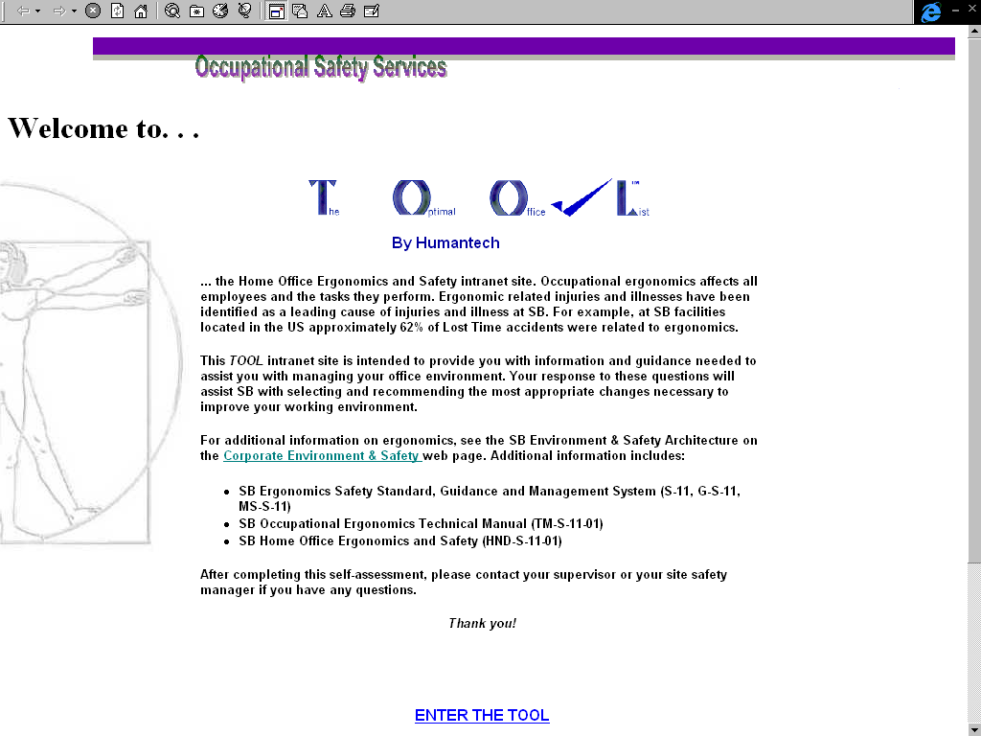

Slide 26
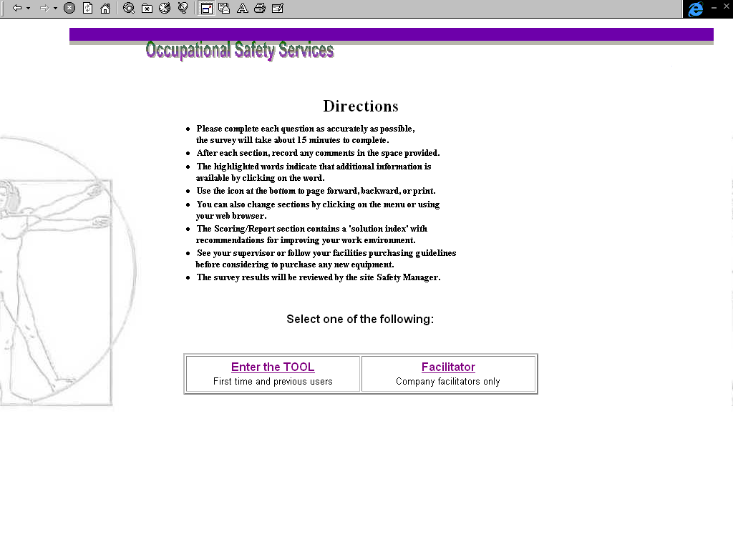

Slide 27
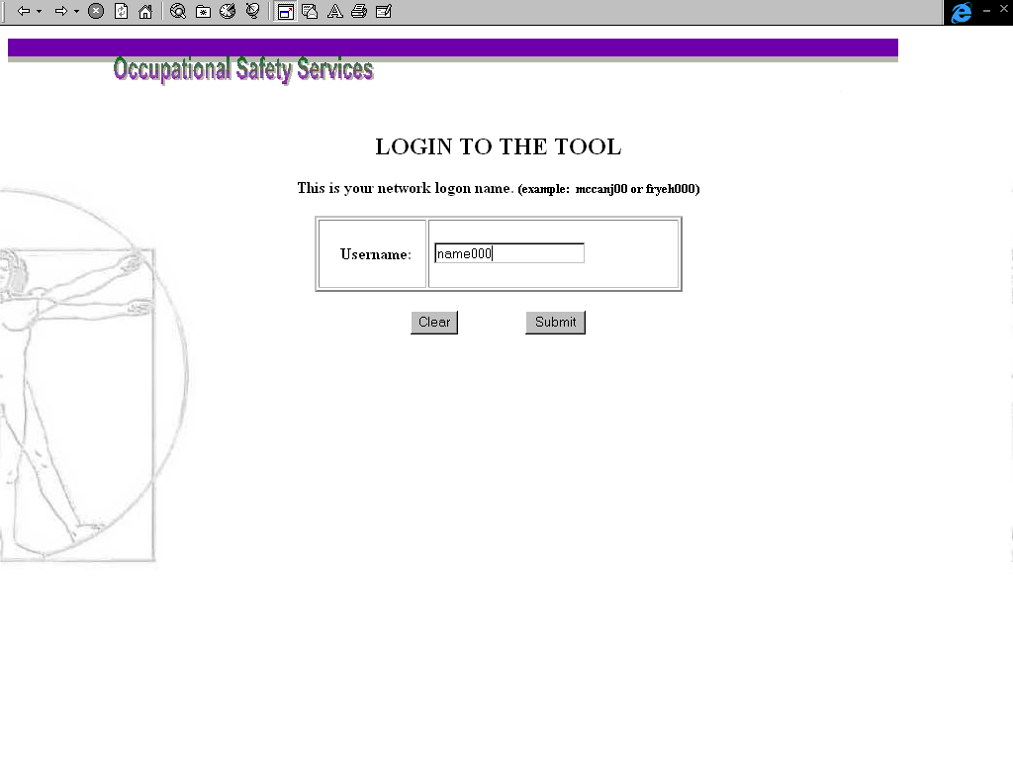

Slide 28
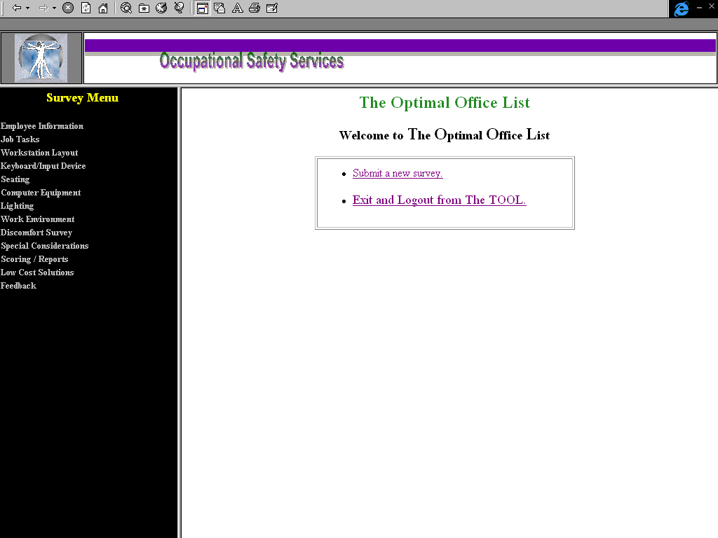

Slide 29
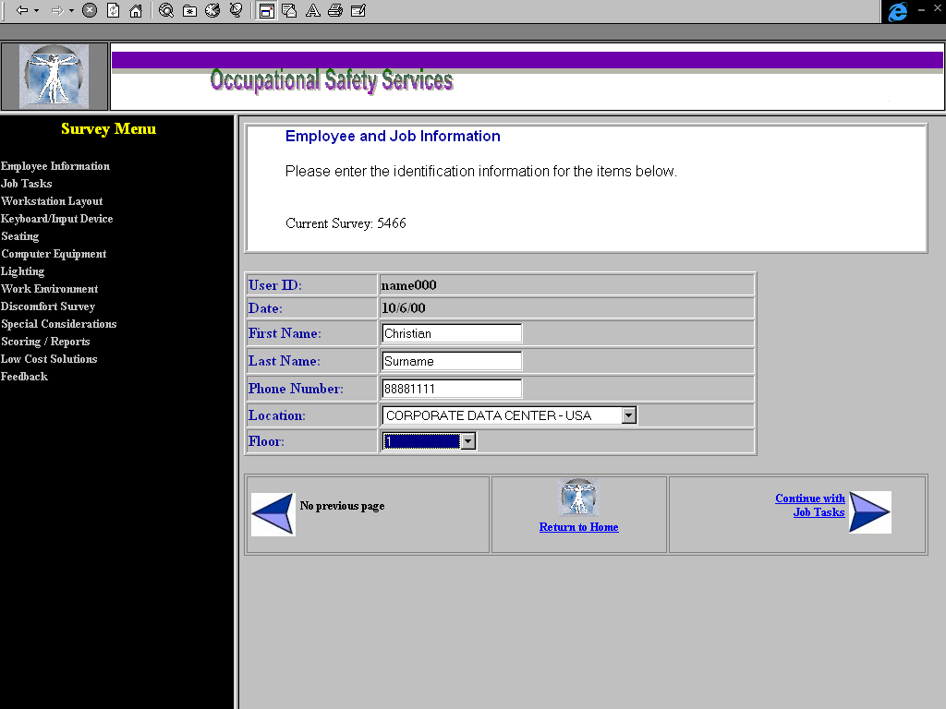

Slide 30
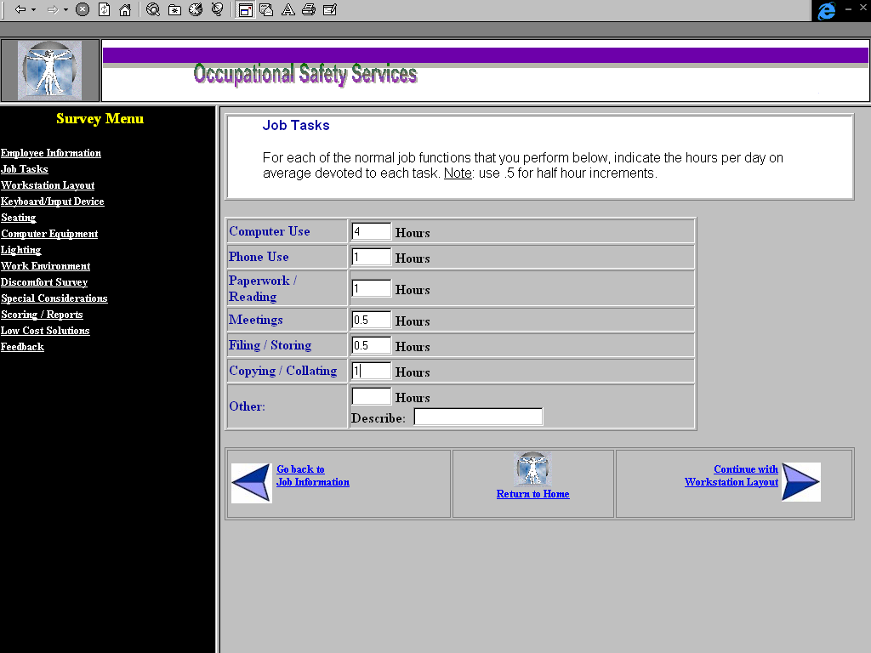

Slide 31
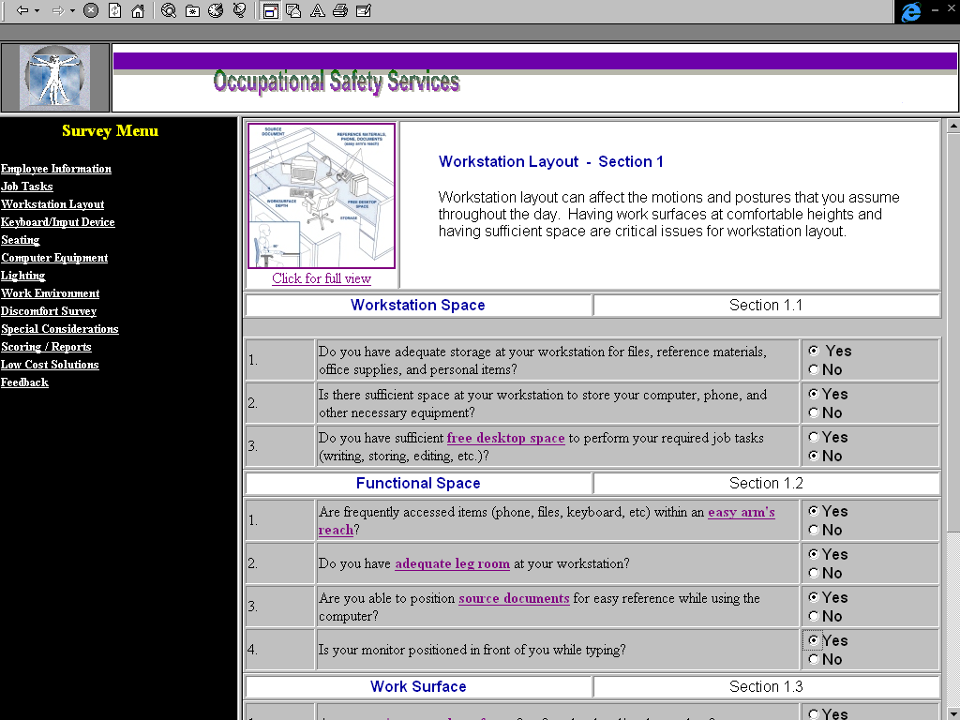

Slide 32
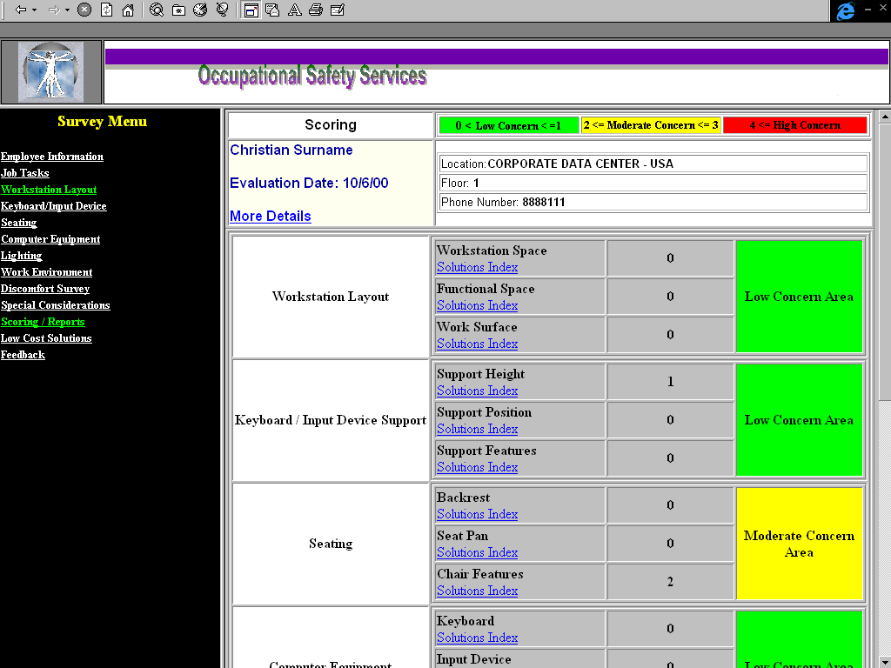

Slide 33
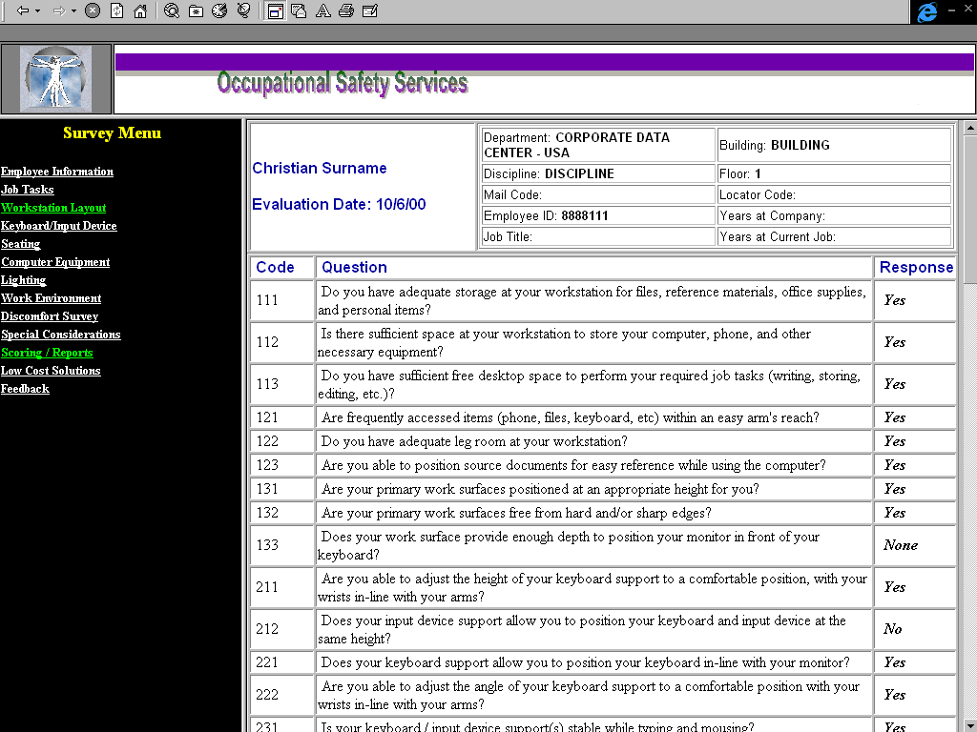

Slide 34
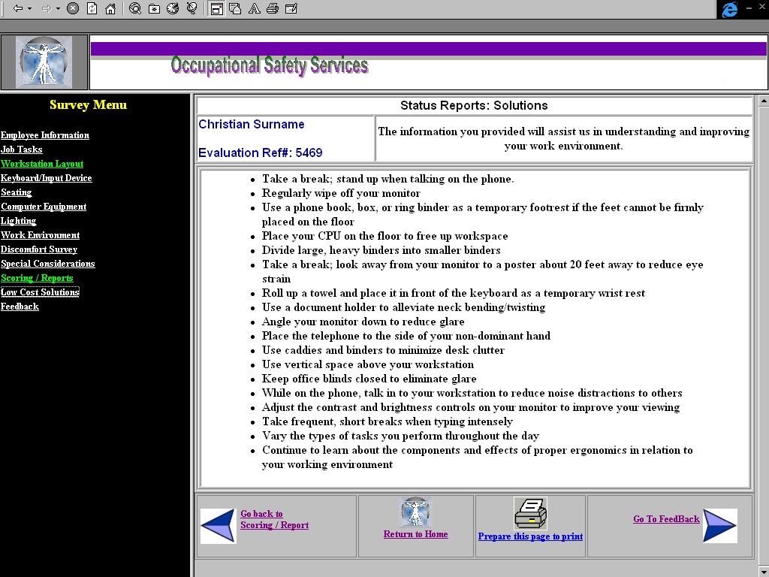

Slide 35
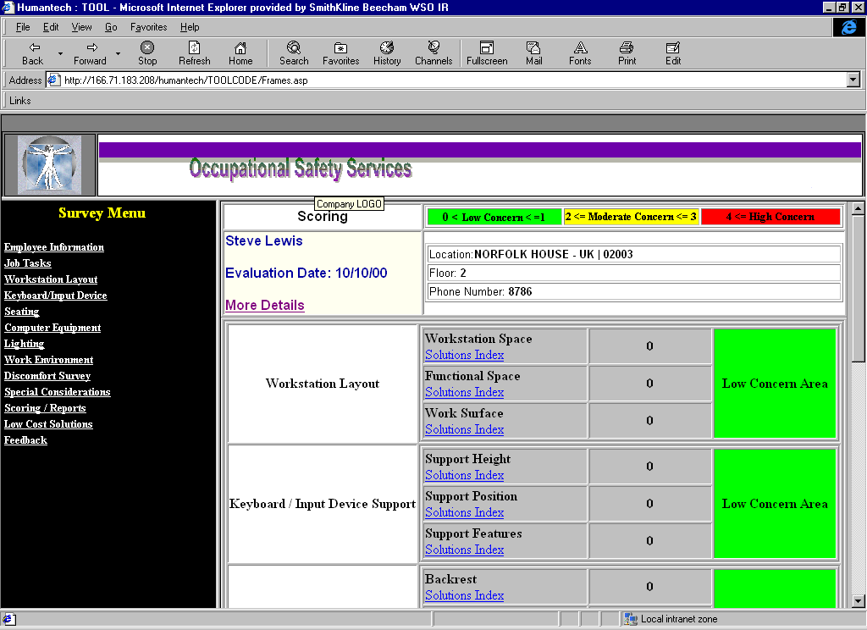
To print out a copy of your input - Select More Details and press File-Print

Slide 36
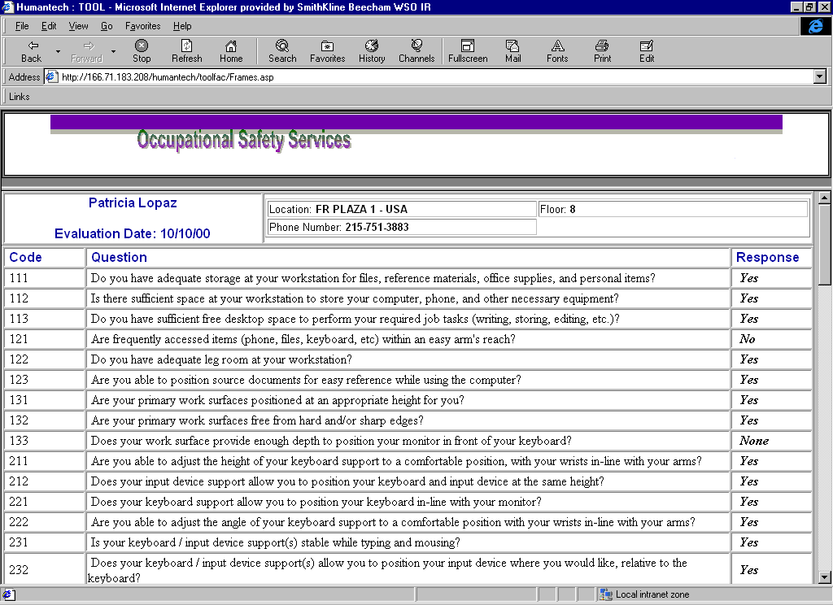
File - Print

Slide 37
Additional Resources - Site Dependent
Sites to complete this slide

Slide 38
Suggested Deployment Process
Conduct Awareness Training
  10 Steps to ergonomics awareness
  Introduce the TOOL
Users complete TOOL
Site Management reviews assessment and develops strategy for improvements

Slide 39
Work Does Not Need to be a Pain!
Thanks

