Slide 1
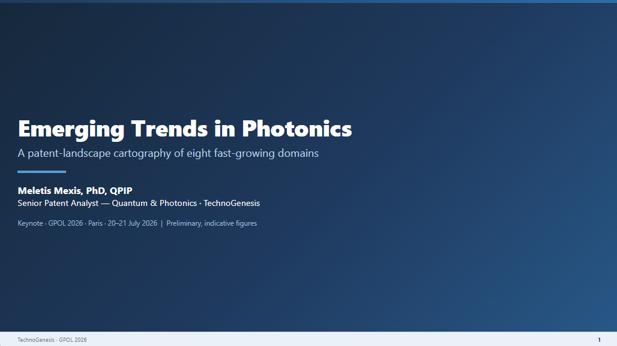
© 2026 TechnoGenesis. All rights reserved

Slide 2
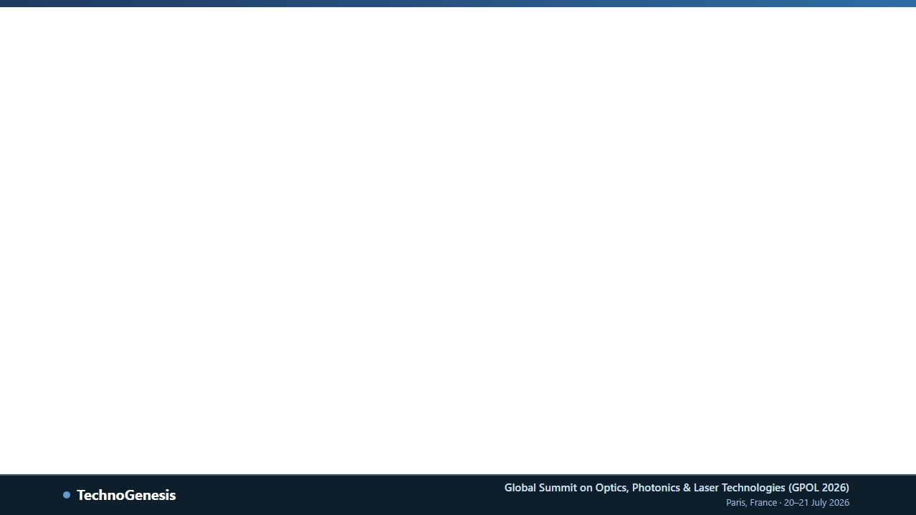
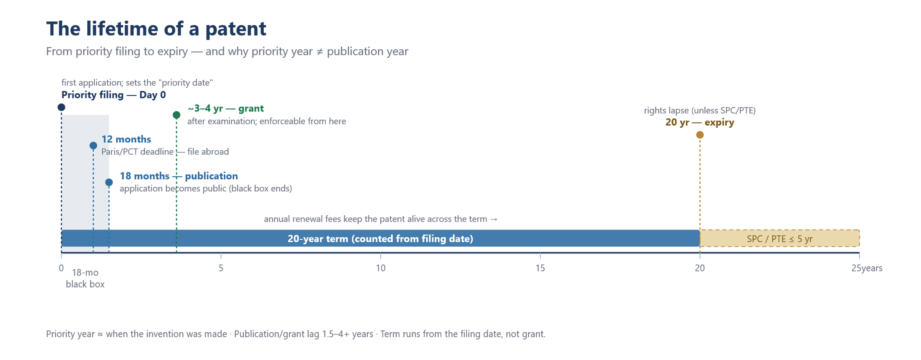
TechnoGenesis •
TechnoGenesis •
TechnoGenesis •
TechnoGenesis •
TechnoGenesis •
TechnoGenesis •
TechnoGenesis •
TechnoGenesis •
TechnoGenesis •
TechnoGenesis •
TechnoGenesis •
TechnoGenesis •
Reading Patents -1
TechnoGenesis •
TechnoGenesis •
TechnoGenesis •
TechnoGenesis •
TechnoGenesis •
TechnoGenesis •
TechnoGenesis •
TechnoGenesis •
TechnoGenesis •
TechnoGenesis •
TechnoGenesis •
Priority year ≈ when the invention was made ·Publication/grant lag 1.5–4+ years · Time runs from the filing date, not grant.
TechnoGenesis •
© 2026 TechnoGenesis. All rights reserved
TechnoGenesis •
TechnoGenesis •
TechnoGenesis •
TechnoGenesis •
TechnoGenesis •
TechnoGenesis •
TechnoGenesis •
TechnoGenesis •

Slide 3
TechnoGenesis •
TechnoGenesis •
TechnoGenesis •
TechnoGenesis •
TechnoGenesis •
TechnoGenesis •
TechnoGenesis •
TechnoGenesis •
TechnoGenesis •
TechnoGenesis •
TechnoGenesis •
TechnoGenesis •
Reading Patents -2
Patent protection & earliest priority year
THREE ROUTEs TO PROTECTION
• National – file office by office (US-USPTO, CN-CNIPA, KR-KIPO).
TechnoGenesis •
TechnoGenesis •
TechnoGenesis •
TechnoGenesis •
• Regional –EPO (EP) ~ covers 39 states, (UP) ~ covers 18 states since 2024 .
• International – PCT (WO); one filing reserves entry to ~ 150 countries for 30/31 months before national entry-> Is a route – no protection until national entry and grant!
PRIORITY YEAR = THE INVENTION MOMENT
• Earliest priority year = when the invention was made
• Publication & Grant lag 1.5-4+years; long procedure which can be longer in some juridictions (e.g. postpone examination in Germany up to 7 years)
TechnoGenesis •
TechnoGenesis •
TechnoGenesis •
TechnoGenesis •
RIGHTS & PROTECTION
• Territorial -> protects only where granted
• Claims define the legal scope -> scope of a granted patent can never be broader than the application as filled.
• publication – when rights (i.e provisional protection) begins.
TechnoGenesis •
TechnoGenesis •
TechnoGenesis •
TechnoGenesis •
• Grant when enforceable protection begins.
© 2026 TechnoGenesis. All rights reserved
TechnoGenesis •
TechnoGenesis •
TechnoGenesis •
TechnoGenesis •
TechnoGenesis •
TechnoGenesis •
TechnoGenesis •
TechnoGenesis •

Slide 4
TechnoGenesis •
TechnoGenesis •
TechnoGenesis •
TechnoGenesis •
TechnoGenesis •
TechnoGenesis •
TechnoGenesis •
TechnoGenesis •
TechnoGenesis •
TechnoGenesis •
TechnoGenesis •
TechnoGenesis •
Reading Patents -3
Methodology & Limitations in patent analysis
TechnoGenesis •
TechnoGenesis •
TechnoGenesis •
TechnoGenesis •
Methodology
The 18-month black box & even more!
• Patent families analysis – Family as a unit, plot versus priority year.
• Black box– Application stay secret ~18 months after earliest priority -> 18
last months can’t be considered for an analysis
• Combination of IPC/CPC classification codes (Technology) & Keywords - (Title/Abstract/claims). Codes bound the domain, keywords refine them and catch emerging technologies that classification misses. (e.g. hollow –core: G02B 6/02328, OCT: A61B5/0066). One patent application can carry several codes
• International routes – EP and WO (30/31 months to know)
TechnoGenesis •
TechnoGenesis •
TechnoGenesis •
TechnoGenesis •
• Volume ≠ value like publication ≠ grant; counts differ by source & scope.
TechnoGenesis •
TechnoGenesis •
TechnoGenesis •
TechnoGenesis •
To take away: a count measures activity, not rights or value.
© 2026 TechnoGenesis. All rights reserved
TechnoGenesis •
TechnoGenesis •
TechnoGenesis •
TechnoGenesis •
TechnoGenesis •
TechnoGenesis •
TechnoGenesis •
TechnoGenesis •

Slide 5
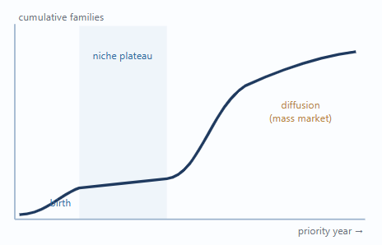
TechnoGenesis •
TechnoGenesis •
TechnoGenesis •
TechnoGenesis •
TechnoGenesis •
TechnoGenesis •
TechnoGenesis •
TechnoGenesis •
TechnoGenesis •
TechnoGenesis •
TechnoGenesis •
TechnoGenesis •
Reading Patents -4
The S-curve & Emergent technologies
TechnoGenesis •
TechnoGenesis •
TechnoGenesis •
TechnoGenesis •
THE LOGISTIC S-CURVE
• Emergence -> steep adoption (invasion) -> saturation (consolidation)
• Natural law of how technology spreads (Bejan & Lorent, 2011)*
*Bejan, A. & Lorente, S. (2011), "The constructal law origin of the logistics S curve," Journal of Applied Physics, 110, 024901.
TechnoGenesis •
TechnoGenesis •
TechnoGenesis •
TechnoGenesis •
THE TRAP
• A long flat middle can be a niche-restricted phase, not maturity.
• Read too early, can’t give safe conclusions.
TechnoGenesis •
TechnoGenesis •
TechnoGenesis •
TechnoGenesis •
An S-curve is a hypothesis about diffusion-not a verdict on maturity.
© 2026 TechnoGenesis. All rights reserved
TechnoGenesis •
TechnoGenesis •
TechnoGenesis •
TechnoGenesis •
TechnoGenesis •
TechnoGenesis •
TechnoGenesis •
TechnoGenesis •

Slide 6
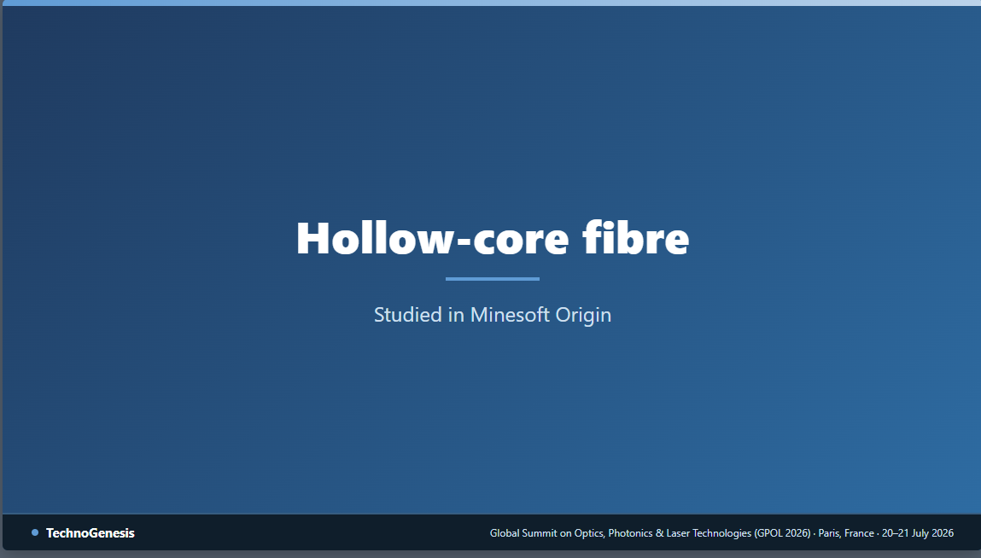
© 2026 TechnoGenesis. All rights reserved

Slide 7
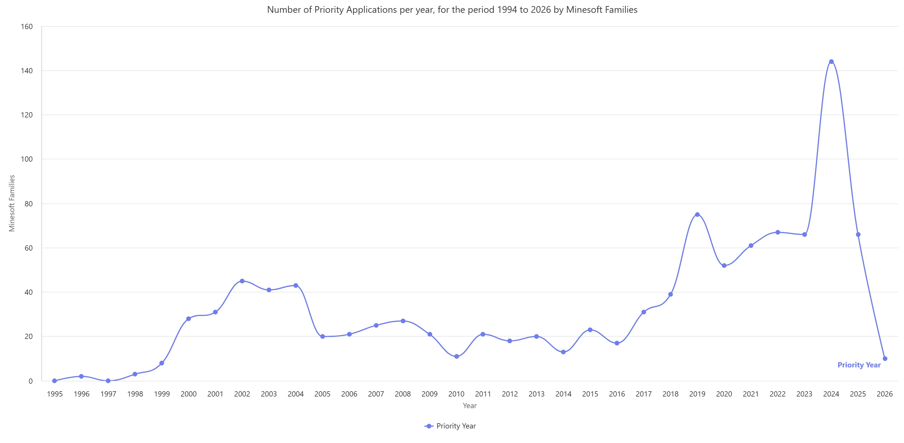
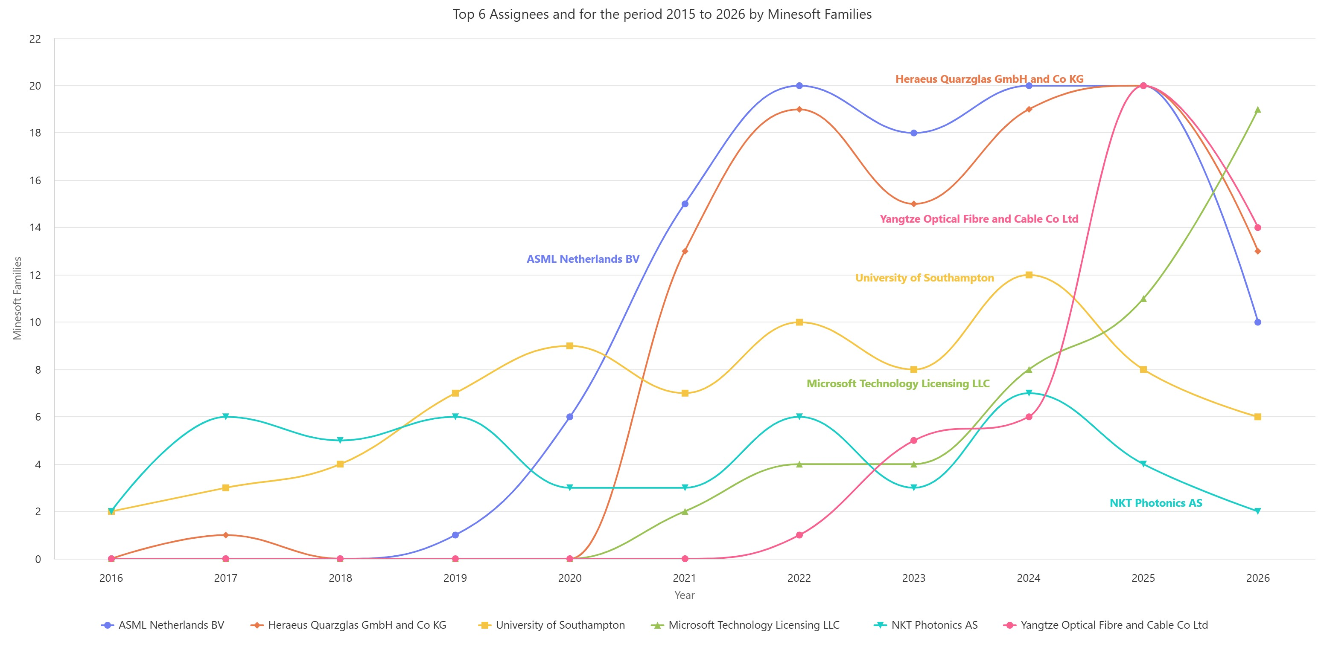
TechnoGenesis •
TechnoGenesis •
TechnoGenesis •
TechnoGenesis •
TechnoGenesis •
TechnoGenesis •
TechnoGenesis •
TechnoGenesis •
TechnoGenesis •
TechnoGenesis •
Hollow-core Fibre
Number of families per priority year & top assignees
TechnoGenesis •
TechnoGenesis •
Number of priority application per priority year for the period 1994 to 2026
ASML: High-power beam delivery
Heraeus Quarzglas: Silica performer supplier
University of Southampton/Luminesity: Academic origin of NANF/DNANF
Microsoft Technology Licensing: Lumenisity acquisition
NKT Photonics: speciality fibre
Yangtze Optical Fibre & Cable: China’s entry
© TechnoGenesis – Minesoft Origin July 2026
TechnoGenesis •
TechnoGenesis •
TechnoGenesis •
TechnoGenesis •
Top 6 Assignees for the period 2015 to 2026
1995
2000
2004
2008
2012
2016
2020
2024
TechnoGenesis •
TechnoGenesis •
TechnoGenesis •
TechnoGenesis •
© TechnoGenesis – Minesoft Origin July 2026
• Not one S-curve but two waves: – Family as a unit, plot versus priority year -> 2000-2004 (Photonic bandgap era), long plateau until 2013 (niche phase), 2014 pulled by AI data-centre latency.
• No plateau reached until now: – The domain is still open and white spaces remains (manufacturing, splicing and cabling process).
TechnoGenesis •
TechnoGenesis •
TechnoGenesis •
TechnoGenesis •
2016
2020
2024
© 2026 TechnoGenesis. All rights reserved
TechnoGenesis •
TechnoGenesis •
TechnoGenesis •
TechnoGenesis •
TechnoGenesis •
TechnoGenesis •
TechnoGenesis •
TechnoGenesis •

Slide 8
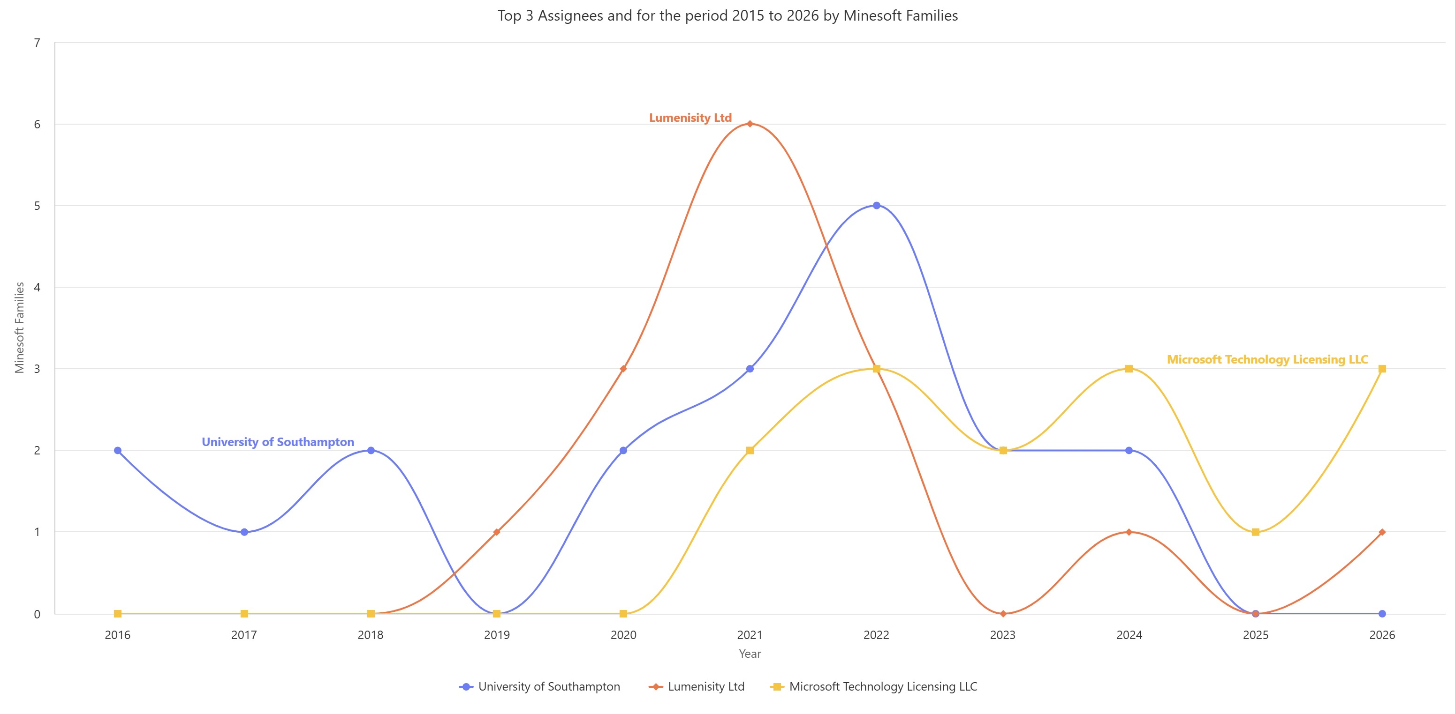
TechnoGenesis •
TechnoGenesis •
TechnoGenesis •
TechnoGenesis •
TechnoGenesis •
TechnoGenesis •
TechnoGenesis •
TechnoGenesis •
TechnoGenesis •
TechnoGenesis •
Hollow-core Fibre
Lumenisity: A Technology transfer story
TechnoGenesis •
TechnoGenesis •
TechnoGenesis •
TechnoGenesis •
TechnoGenesis •
TechnoGenesis •
University of Southampton -> Spin out Lumenisity -> Acquired by Microsoft December 2022
© TechnoGenesis – Minesoft Origin July 2026
TechnoGenesis •
TechnoGenesis •
TechnoGenesis •
TechnoGenesis •
2016
2020
2024
TechnoGenesis •
TechnoGenesis •
TechnoGenesis •
TechnoGenesis •
© 2026 TechnoGenesis. All rights reserved
TechnoGenesis •
TechnoGenesis •
TechnoGenesis •
TechnoGenesis •
TechnoGenesis •
TechnoGenesis •
TechnoGenesis •
TechnoGenesis •

Slide 9
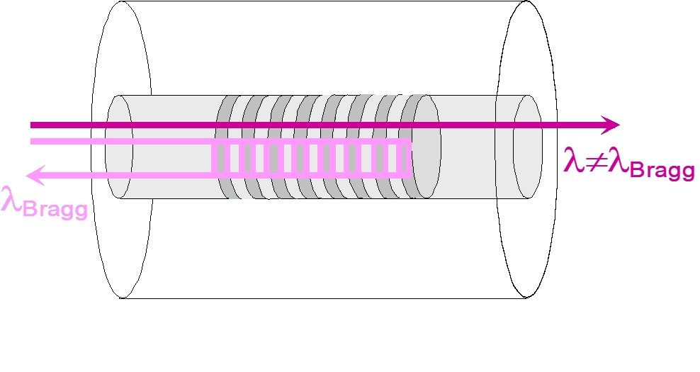
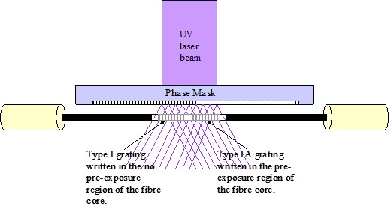
TechnoGenesis •
TechnoGenesis •
TechnoGenesis •
TechnoGenesis •
TechnoGenesis •
TechnoGenesis •
TechnoGenesis •
TechnoGenesis •
TechnoGenesis •
TechnoGenesis •
Study S-curves
When does it matter? – Niche-first, mass-market-later
TechnoGenesis •
TechnoGenesis •
A priority-year S-curve tells you when something was invented — not when, or where, it will matter.
*
TechnoGenesis •
**
TechnoGenesis •
TechnoGenesis •
TechnoGenesis •
***
*
(Accepted Invited talk at 16th Constructal Law Conf, 12-15Oct 2026, Paris) Project collaboration between TechnoGenesis & PSL University, Paris
TechnoGenesis •
TechnoGenesis •
TechnoGenesis •
TechnoGenesis •
(FBG medical application) Ren, H. (2020). Flexible Robotics in Medicine: A Design Journey of Motion Generation Mechanisms and Biorobotic System Development. Academic Press. https://doi.org/10.1016/C2018-0-00607-6
**
***
(image taken from) Mexis, M. (2004). Fiber Bragg Grating Sensing Systems, MSc Thesis, Aston University.
TechnoGenesis •
TechnoGenesis •
TechnoGenesis •
TechnoGenesis •
© 2026 TechnoGenesis. All rights reserved
TechnoGenesis •
TechnoGenesis •
TechnoGenesis •
TechnoGenesis •
TechnoGenesis •
TechnoGenesis •
TechnoGenesis •
TechnoGenesis •

Slide 10
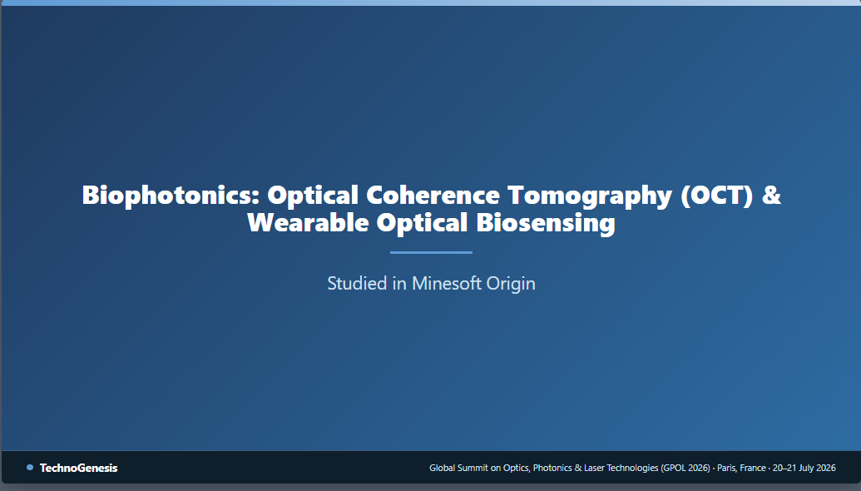
© 2026 TechnoGenesis. All rights reserved

Slide 11
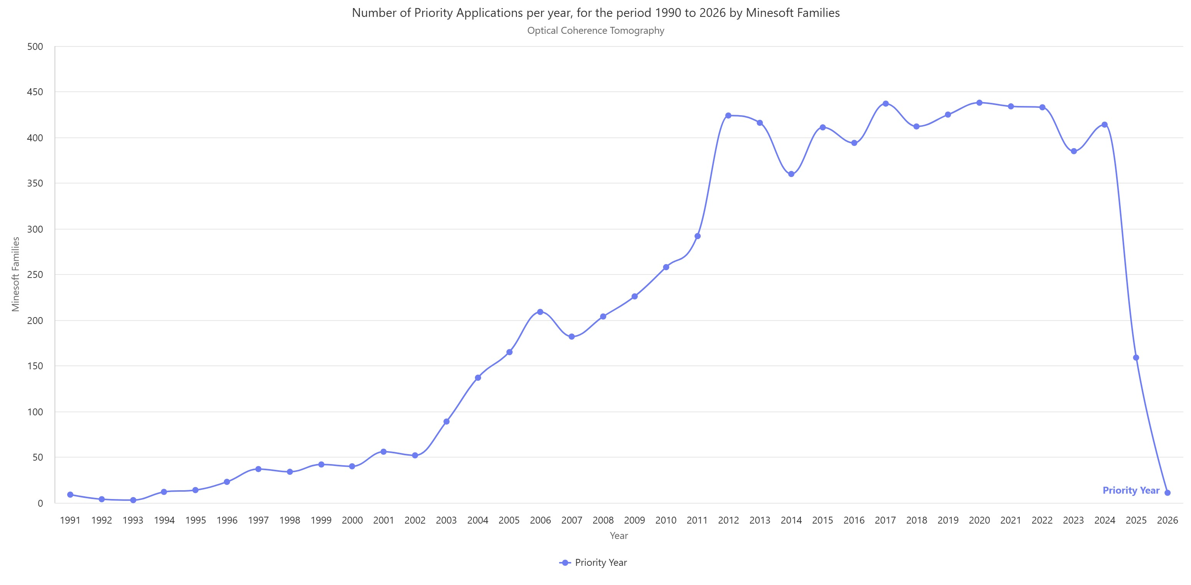
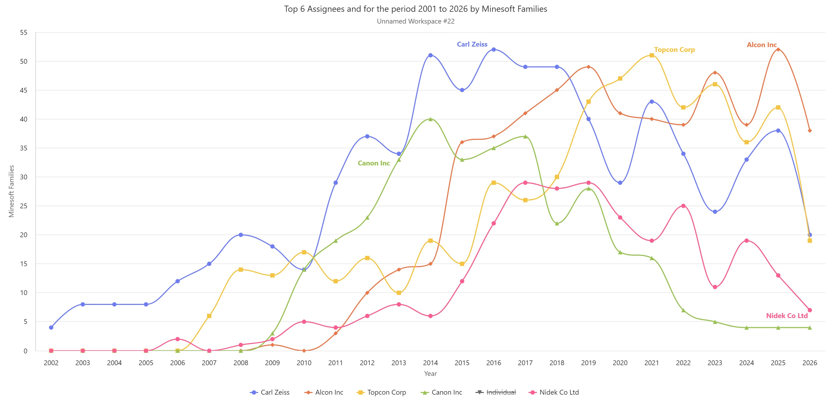
TechnoGenesis •
TechnoGenesis •
TechnoGenesis •
TechnoGenesis •
TechnoGenesis •
TechnoGenesis •
TechnoGenesis •
TechnoGenesis •
TechnoGenesis •
TechnoGenesis •
TechnoGenesis •
TechnoGenesis •
Optical coherence Tomography
Number of families per priority year & top assignees
Number of priority application per priority year for the period 1990 to 2026
Top 5 Assignees for the period 2001 to 2026
© TechnoGenesis – Minesoft Origin July 2026
TechnoGenesis •
TechnoGenesis •
TechnoGenesis •
TechnoGenesis •
© TechnoGenesis – Minesoft Origin July 2026
TechnoGenesis •
TechnoGenesis •
TechnoGenesis •
TechnoGenesis •
1996
2000
2004
2008
2020
2024
2006
2012
2018
2024
2012
2016
2006
2012
2018
2024
Carl Zeiss: Early & sustained leader
Topcon & Alcon : Current front-runners
Canon: Optopol-driven wave (peak 2014, then retreat)
Nidek: Steady ophthalmic specialist
A mature domain: steep growth up to ~2012, then a flat plateau of ~400 families/yr — saturation.
TechnoGenesis •
TechnoGenesis •
TechnoGenesis •
TechnoGenesis •
© 2026 TechnoGenesis. All rights reserved
TechnoGenesis •
TechnoGenesis •
TechnoGenesis •
TechnoGenesis •
TechnoGenesis •
TechnoGenesis •
TechnoGenesis •
TechnoGenesis •

Slide 12
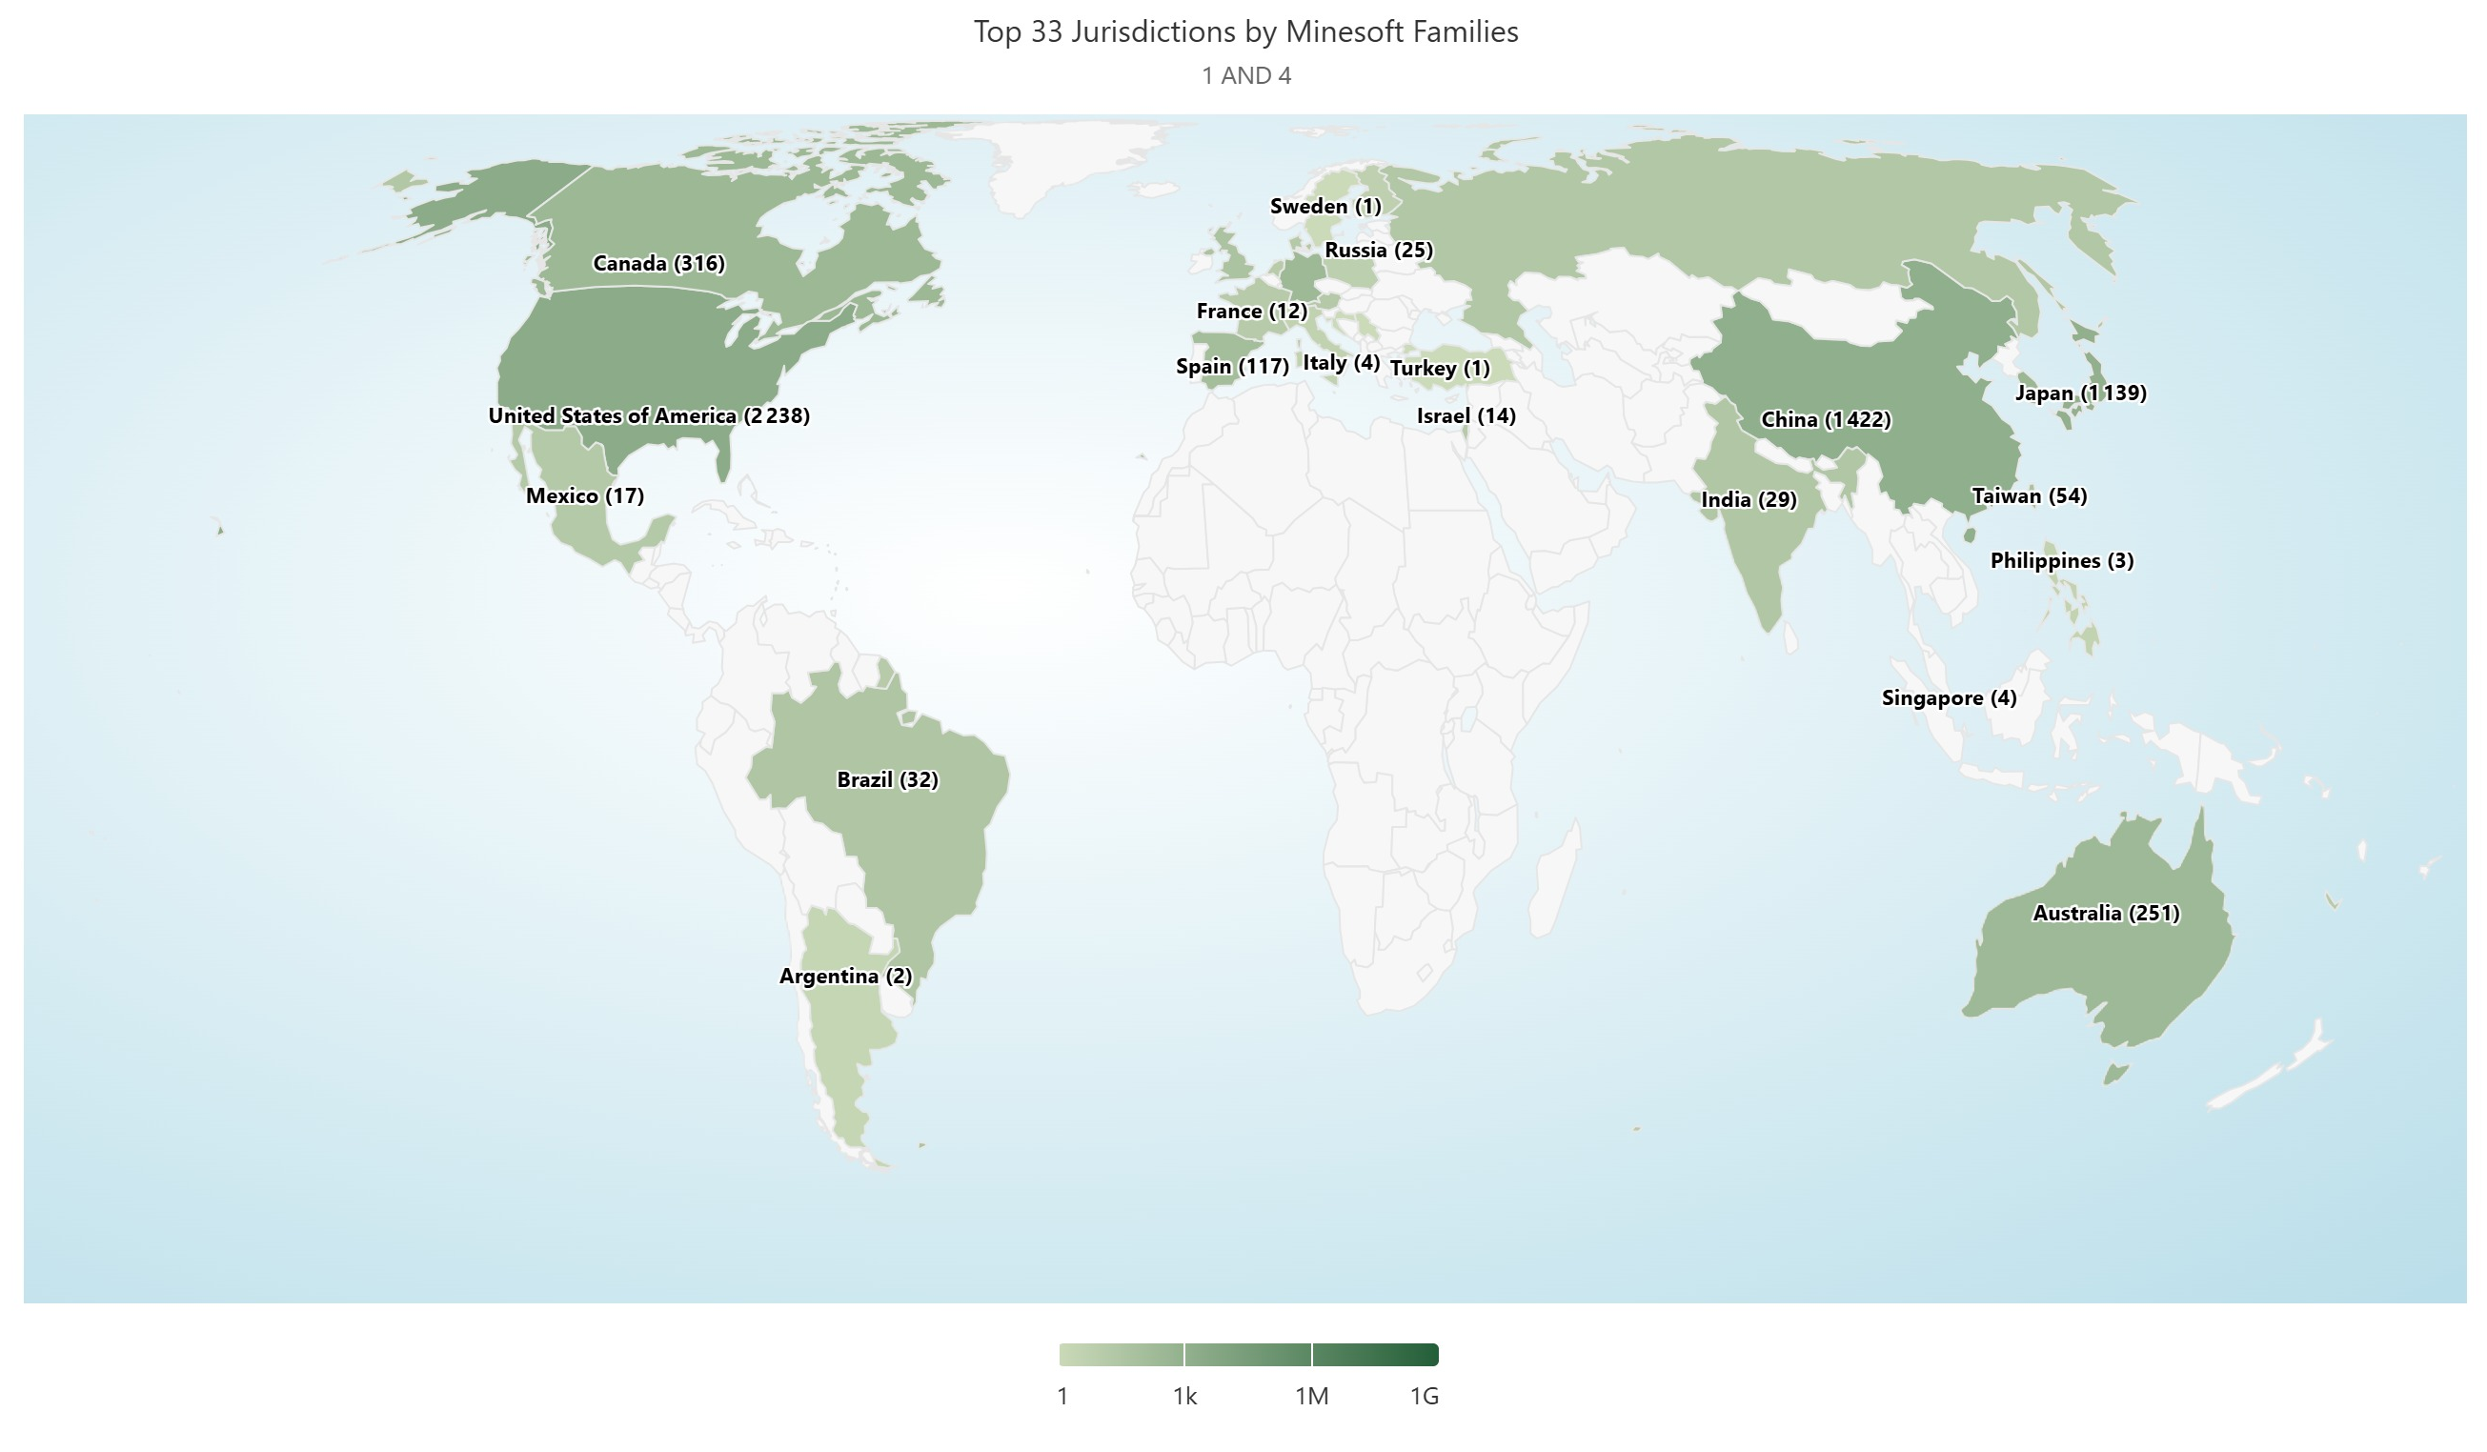
TechnoGenesis •
TechnoGenesis •
TechnoGenesis •
TechnoGenesis •
TechnoGenesis •
TechnoGenesis •
TechnoGenesis •
TechnoGenesis •
TechnoGenesis •
TechnoGenesis •
TechnoGenesis •
TechnoGenesis •
Optical coherence Tomography
Geographical cover (find better)
TechnoGenesis •
The US dominates, over the 2nd China by more than 60%, followed closely by 3rd Japan.
TechnoGenesis •
TechnoGenesis •
TechnoGenesis •
TechnoGenesis •
TechnoGenesis •
TechnoGenesis •
TechnoGenesis •
© TechnoGenesis – Minesoft Origin July 2026
TechnoGenesis •
TechnoGenesis •
TechnoGenesis •
TechnoGenesis •
© 2026 TechnoGenesis. All rights reserved
TechnoGenesis •
TechnoGenesis •
TechnoGenesis •
TechnoGenesis •
TechnoGenesis •
TechnoGenesis •
TechnoGenesis •
TechnoGenesis •

Slide 13
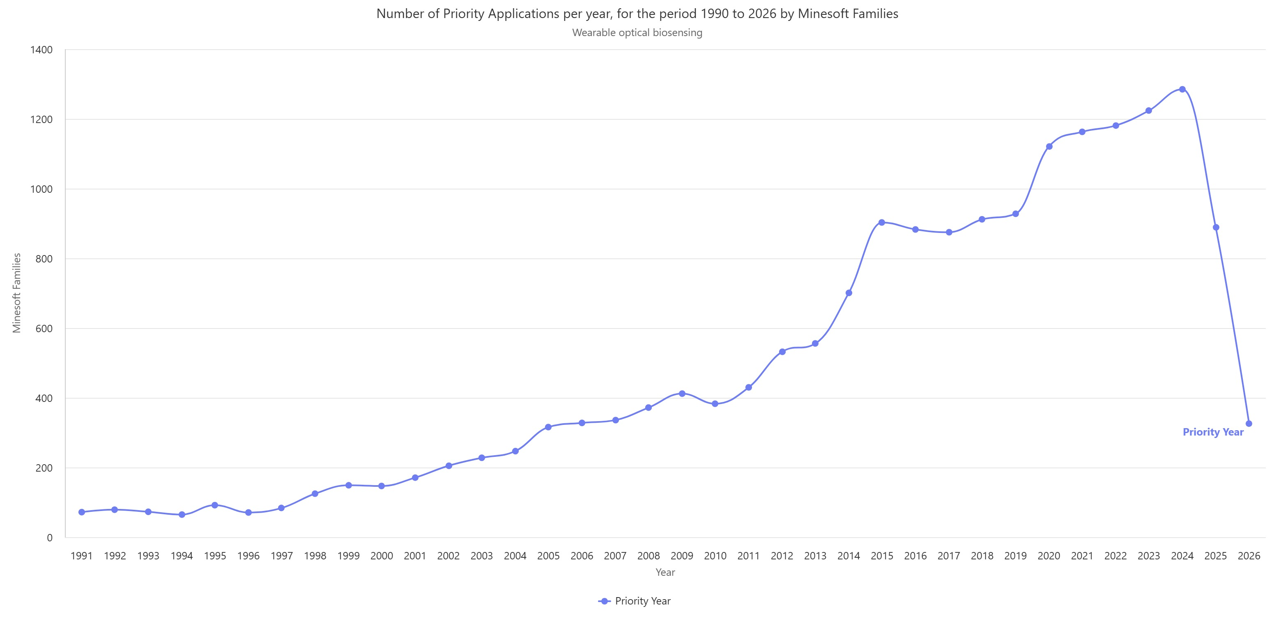
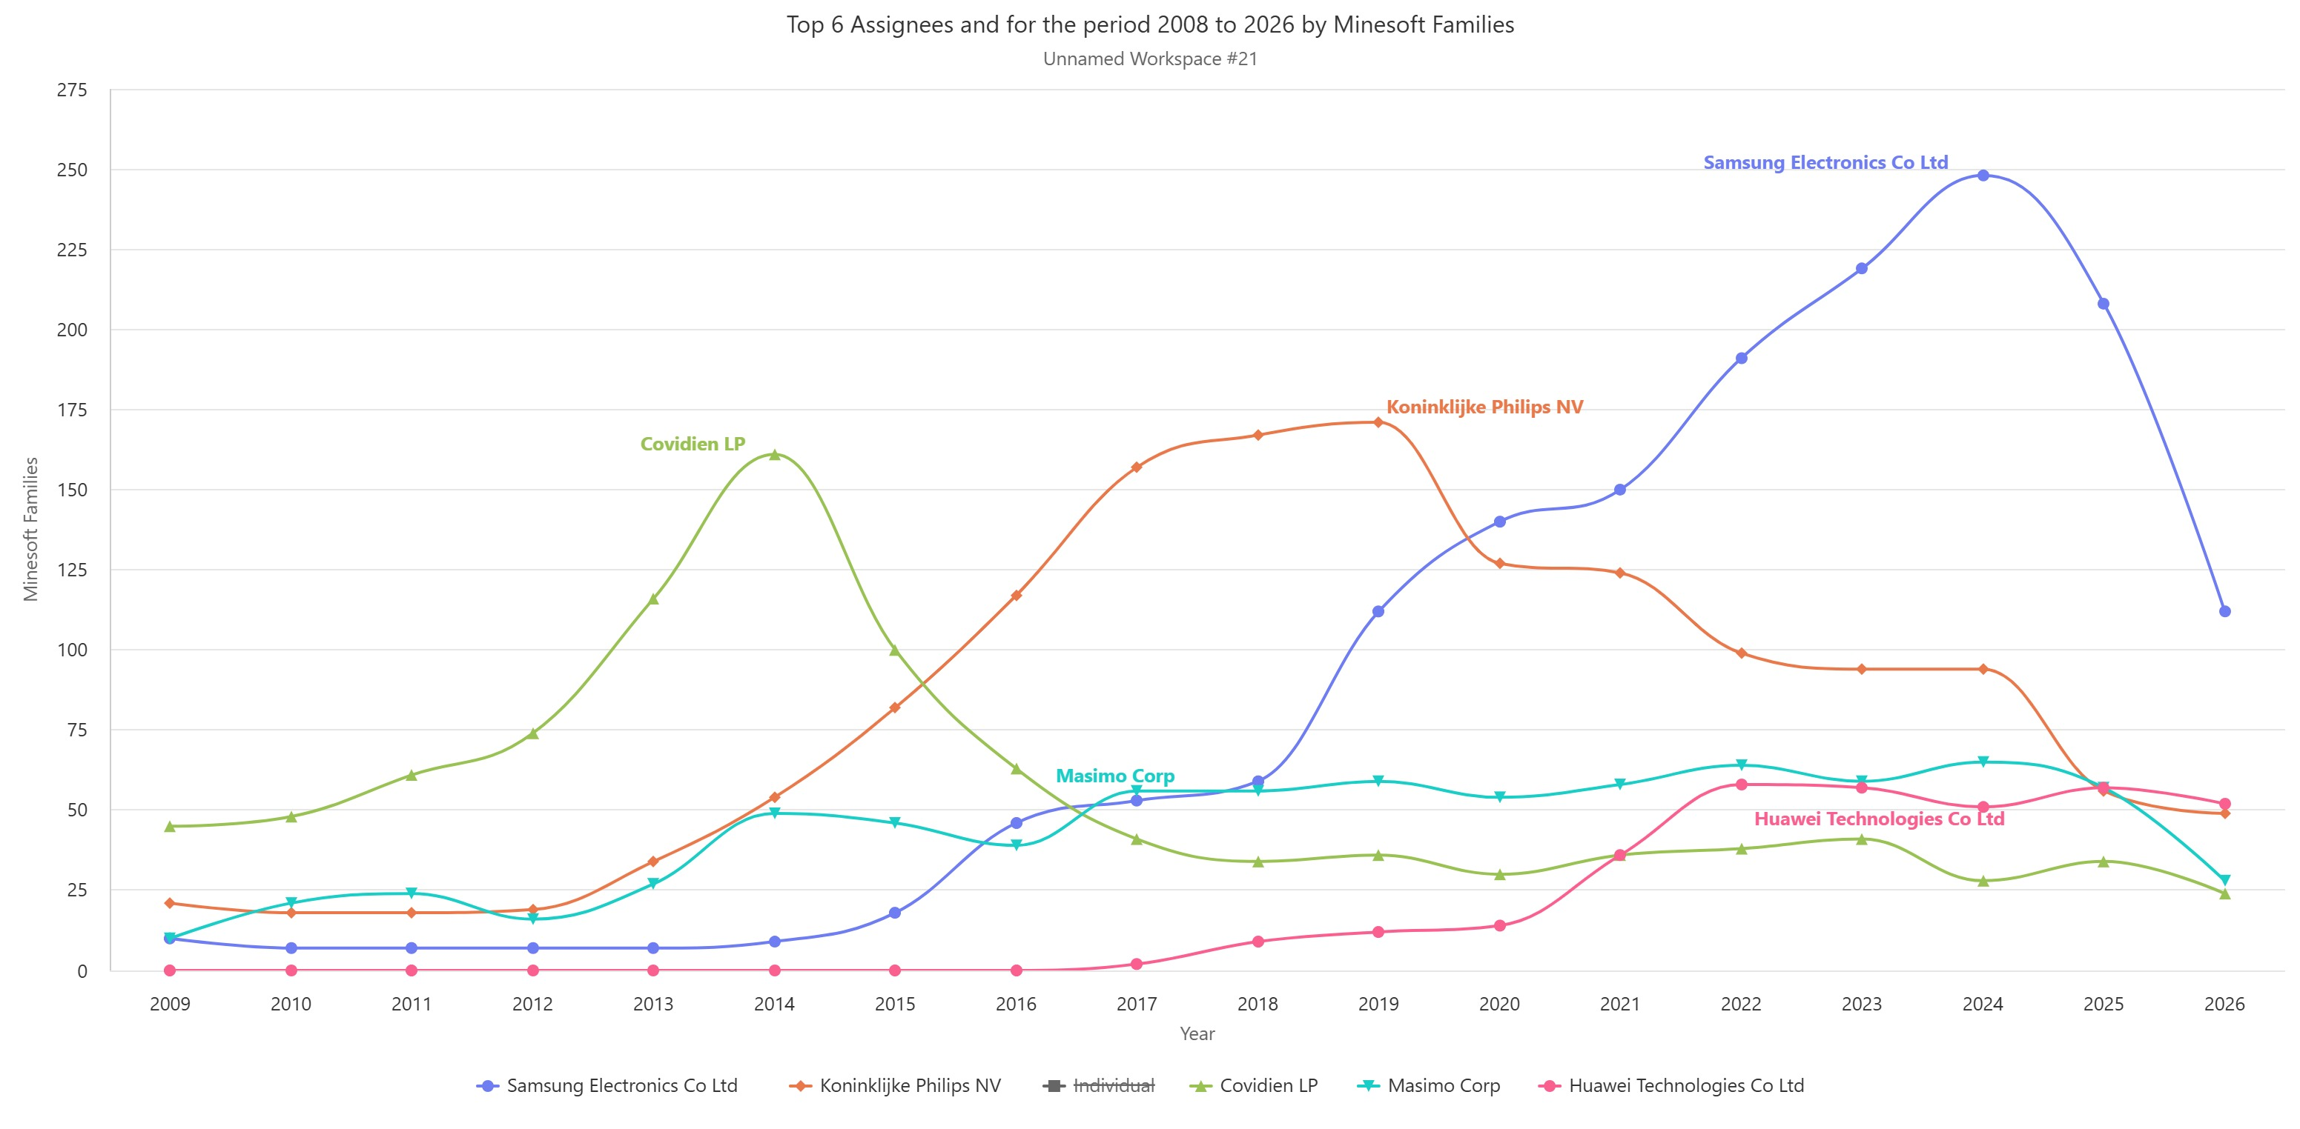
TechnoGenesis •
TechnoGenesis •
TechnoGenesis •
TechnoGenesis •
TechnoGenesis •
TechnoGenesis •
TechnoGenesis •
TechnoGenesis •
TechnoGenesis •
TechnoGenesis •
TechnoGenesis •
TechnoGenesis •
Wearable Optical Biosensing
Number of families per priority year & top assignees
Number of priority application per priority year for the period 1990 to 2026
Top 5 Assignees for the period 2001 to 2026
© TechnoGenesis – Minesoft Origin July 2026
TechnoGenesis •
TechnoGenesis •
TechnoGenesis •
TechnoGenesis •
© TechnoGenesis – Minesoft Origin July 2026
1996
2000
2004
2008
2012
2016
2020
2024
2018
2012
2018
2024
TechnoGenesis •
TechnoGenesis •
2012
2024
TechnoGenesis •
TechnoGenesis •
Samsung Electronics: Dominant ans still rising to ~248 in 2024
Koninklijke Philips: peaked in 2019
Covidien LP: Early leader peaked in 2014
Masimo Corp: Pulse-oximetry pure player
Huawei: China entry in 2016
Double S-curve: a first wave with the smartwatch / fitness-tracker (~2014–15) & then a second acceleration from 2020 (health monitoring) which is attributed to the COVID era.
TechnoGenesis •
TechnoGenesis •
TechnoGenesis •
TechnoGenesis •
© 2026 TechnoGenesis. All rights reserved
TechnoGenesis •
TechnoGenesis •
TechnoGenesis •
TechnoGenesis •
TechnoGenesis •
TechnoGenesis •
TechnoGenesis •
TechnoGenesis •

Slide 14
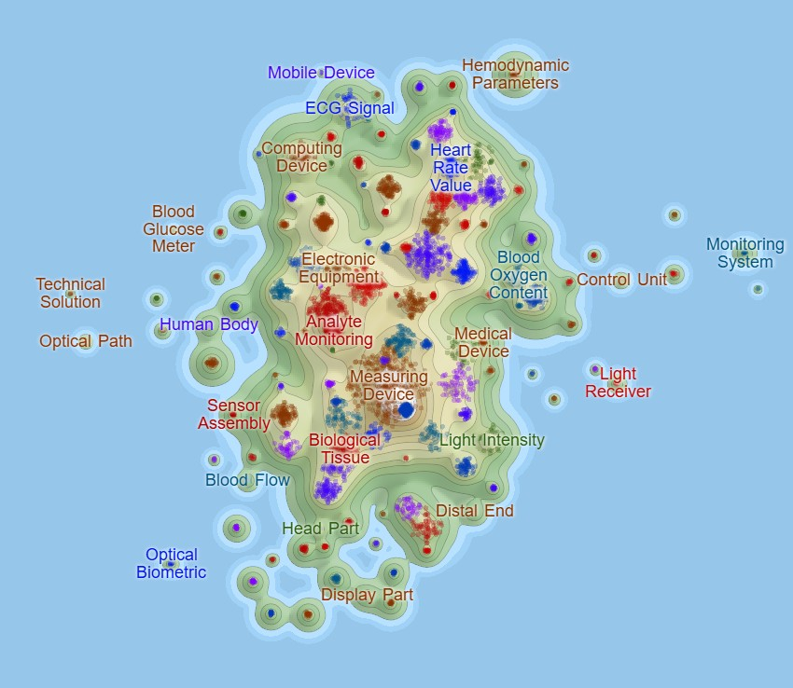
TechnoGenesis •
TechnoGenesis •
TechnoGenesis •
TechnoGenesis •
TechnoGenesis •
TechnoGenesis •
TechnoGenesis •
TechnoGenesis •
TechnoGenesis •
TechnoGenesis •
TechnoGenesis •
TechnoGenesis •
Wearable Optical Biosensing
Technology map for fences & white spaces
Fences (crowded, FTO risk) -> the vital-signs core — heart rate, ECG, blood-oxygen, hemodynamic parameters— plus the generic hardware massif (measuring device, sensor assembly, analyte monitoring).
White spaces (thin, at the edges): the optical-component periphery — optical path, light receiver, light intensity, optical biometric, blood flow — and the valleys between the consumer-device clusters (e.g. mobile/computing device, display part) and the clinical clusters.
Caution: empty doesn’t mean valuable — a blank region can be infeasible rather than open.
TechnoGenesis •
TechnoGenesis •
TechnoGenesis •
TechnoGenesis •
TechnoGenesis •
TechnoGenesis •
TechnoGenesis •
TechnoGenesis •
TechnoGenesis •
TechnoGenesis •
TechnoGenesis •
TechnoGenesis •
© TechnoGenesis – Minesoft Origin July 2026
© 2026 TechnoGenesis. All rights reserved
TechnoGenesis •
TechnoGenesis •
TechnoGenesis •
TechnoGenesis •
TechnoGenesis •
TechnoGenesis •
TechnoGenesis •
TechnoGenesis •

Slide 15
TechnoGenesis •
TechnoGenesis •
TechnoGenesis •
TechnoGenesis •
TechnoGenesis •
TechnoGenesis •
TechnoGenesis •
TechnoGenesis •
TechnoGenesis •
TechnoGenesis •
TechnoGenesis •
TechnoGenesis •
Emerging trends in Photonics
Summary
S-curves, white spaces studies
Results: Three cross-cutting signals
Next
Methodology: Patent families by earliest priority year, bounded by IPC/CPC codes and refined with keywords.
Two domains studied in-house with Minesoft Origin (hollow-core fibre; OCT & wearable biosensing); six read from published landscapes.
S-curves place a technology on its diffusion path —emergence, invasion, saturation — and the theme map locates the fences and the white spaces. Limits kept in view throughout: the 18-month black box, and publication ≠ granted rights.
China leads filing counts; the US and Europe still hold the international families.
What this analysis does not yet tell us: whether the fences are still alive, how broad the claims are, and how the patents cite and litigate.
Building on assignee harmonization already applied here. The next step is adding legal-status filtering and claim-level whitespace mapping which can turn a landscape into a filing strategy.
TechnoGenesis •
TechnoGenesis •
TechnoGenesis •
TechnoGenesis •
AI is the tide. Co-packaged optics, photonic computing and hollow-core fibre are one story — the physical layer of AI compute.
TechnoGenesis •
TechnoGenesis •
TechnoGenesis •
TechnoGenesis •
The domains are converging. Metasurfaces feed LiDAR and AR; silicon photonics underpins quantum and computing. Whitespace is found at the interfaces.
TechnoGenesis •
TechnoGenesis •
TechnoGenesis •
TechnoGenesis •
© 2026 TechnoGenesis. All rights reserved
TechnoGenesis •
TechnoGenesis •
TechnoGenesis •
TechnoGenesis •
TechnoGenesis •
TechnoGenesis •
TechnoGenesis •
TechnoGenesis •

