Slide 1
keycloak audience injection attack

Slide 2
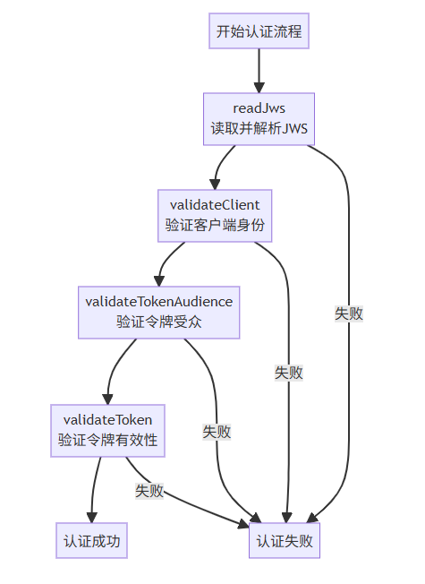
authenticate

Slide 3
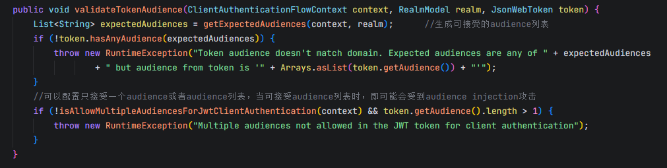
validateTokenAudience

Slide 4
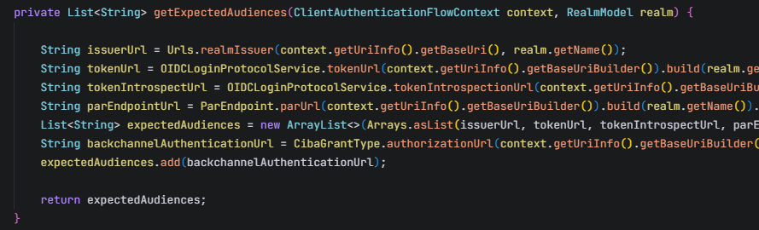
getExpectedAudiences

Slide 5
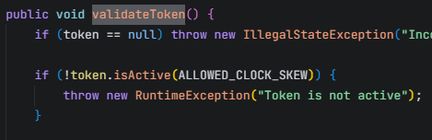

validateToken

