Slide 1
keycloak audience injection attack

Slide 2
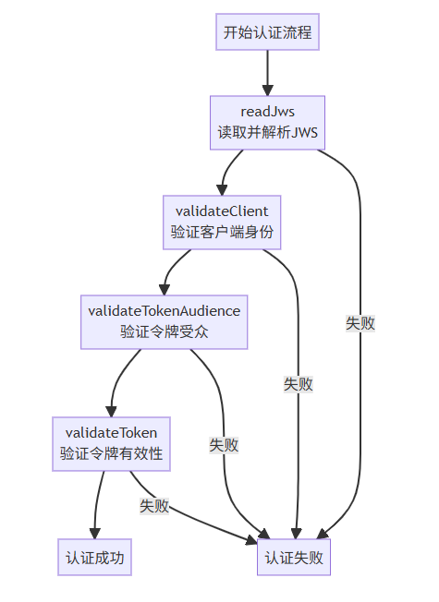
authenticate

Slide 3

validClient

Slide 4


validateTokenAudience

Slide 5

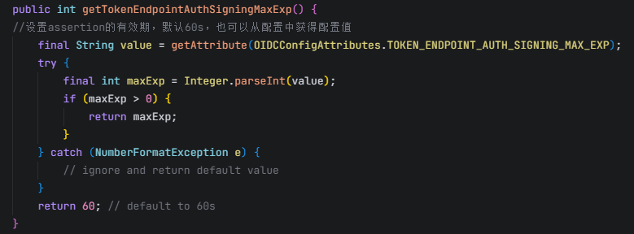
assertion有效期

Slide 6
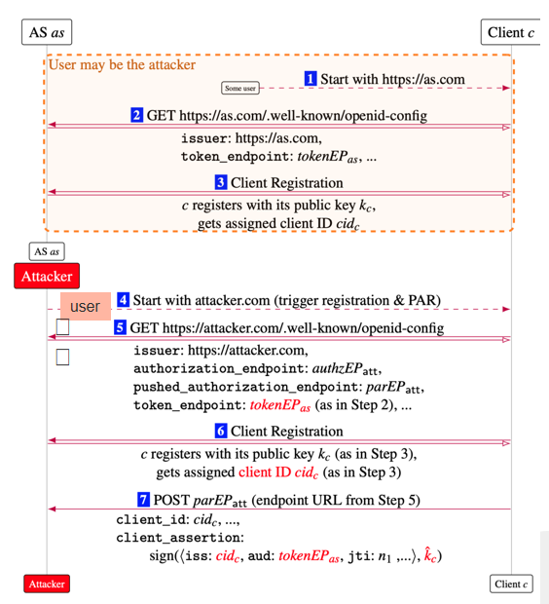
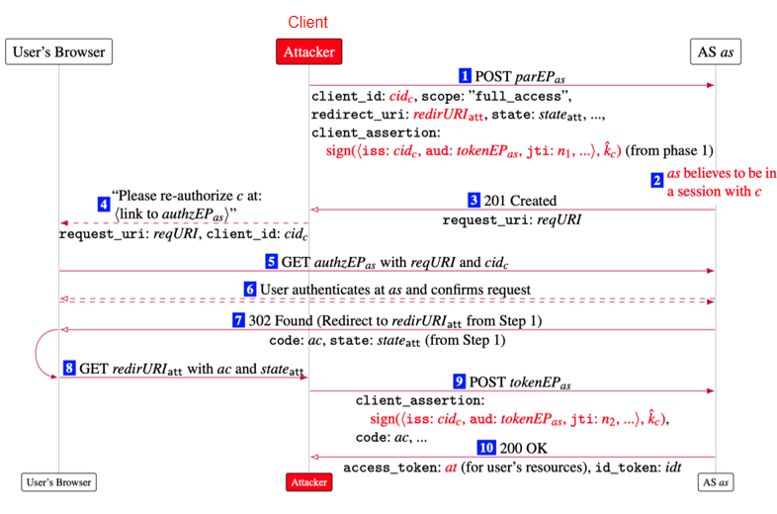
Audience Injection

