Slide 1
Chapter 3. Bad Smells in Code
Deciding when to start refactoring, and when to stop, is just as important to refactoring as knowing how to operate the mechanics of a refactoring
Duplicated Code
If you see the same code structure in more than one place, you can be sure that your program will be better if you find a way to unify them
when you have the same expression in two methods of the same class.
Then all you have to do is Extract Method and invoke the code from both places.
when you have the same expression in two sibling subclasses
Then you can eliminate this duplication by using Extract Method in both classes then Pull Up Field.
If the code is similar but not the same,
you need to use Extract Method to separate the similar bits from the different bits.
You may then find you can use Form Template Method.
If the methods do the same thing with a different algorithm,
you can choose the clearer of the two algorithms and use Substitute Algorithm.
If you have duplicated code in two unrelated classes
consider using Extract Class in one class and then use the new component in the other

Slide 2
Chapter 3. Bad Smells in Code
Long Method
A heuristic we follow is that whenever we feel the need to comment something, we write a method instead
The key here is not method length but the semantic distance between what the method does and how it does it
Ninety-nine percent of the time, all you have to do to shorten a method is Extract Method. Find parts of the method that seem to go nicely together and make a new method.
f you try to use Extract Method, you end up passing so many of the parameters and temporary variables as parameters to the extracted method that the result is scarcely more readable than the original
You can often use Replace Temp with Query to eliminate the temps. Long lists of parameters can be slimmed down with Introduce Parameter Object and Preserve Whole Object.
If you've tried that, and you still have too many temps and parameters, it's time to get out the heavy artillery: Replace Method with Method Object.
Conditionals and loops also give signs for extractions. Use Decompose Conditional to deal
with conditional expressions. With loops, extract the loop and the code within the loop into its own method.

Slide 3
Extract method
void printOwing(double amount) {
  printBanner();
  //print details
  System.out.println ("name:" + _name);
  System.out.println ("amount" + amount);
}
void printOwing(double amount) {
  printBanner();
  printDetails(amount);
  }
void printDetails (double amount) {
  System.out.println ("name:" + _name);
  System.out.println ("amount" + amount);
}
The key is the semantic distance between the method name and the method body. If extracting improves clarity, do it, even if the name is longer than the code you have extracted.
I look at a method that is too long or look at code that needs a comment to understand its purpose. I then turn that fragment of code into its own method.

Slide 4
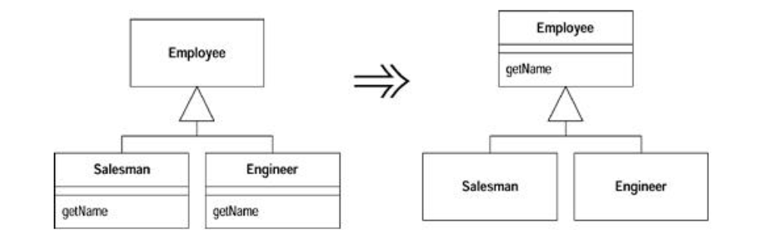
Pull Up Method
  You have methods with identical results on subclasses
Eliminating duplicate behavior is important. Although two duplicate methods work fine as they are, they are nothing more than a breeding ground for bugs in the future. Whenever there is duplication, you face the risk that an alteration to one will not be made to the other. Usually it is difficult to find the duplicates..

Slide 5
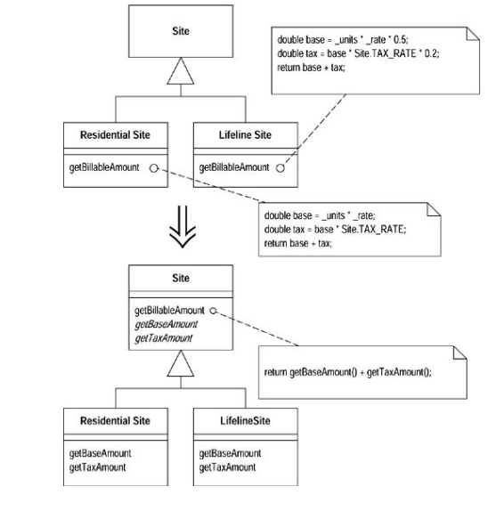
Form Template Method
  You have two methods in subclasses that perform similar steps in the same order, yet the steps are different.
  Get the steps into methods with the same signature, so that the original methods become the same. Then you can pull them up.
A common case is two methods that seem to carry out broadly similar steps in the same sequence, but the steps are not the same. In this case we can move the sequence to the superclass and allow polymorphism to play its role in ensuring the different steps do their things differently. This kind of method is called a template method [Gang of Four].

Slide 6
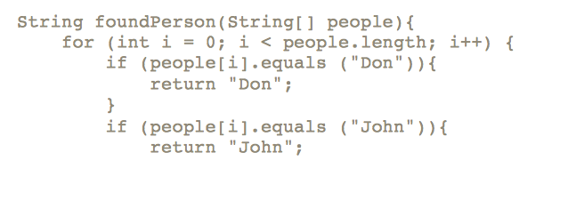
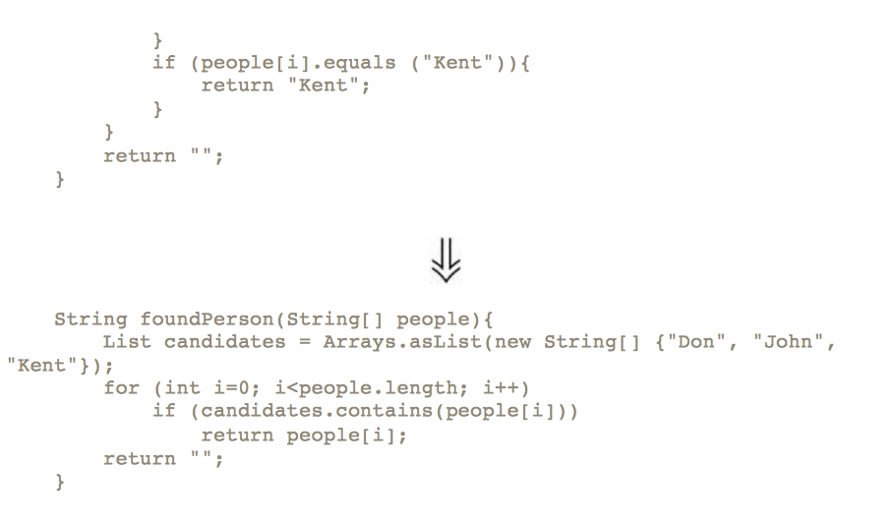
Substitute Algorithm
  You want to replace an algorithm with one that is clearer.
  Replace the body of the method with the new algorithm.
  f you find a clearer way to do something, you should replace the complicated way with the clearer way. Refactoring can break down something complex into simpler pieces, but sometimes you just reach the point at which you have to remove the whole algorithm and replace it with something simpler

Slide 7
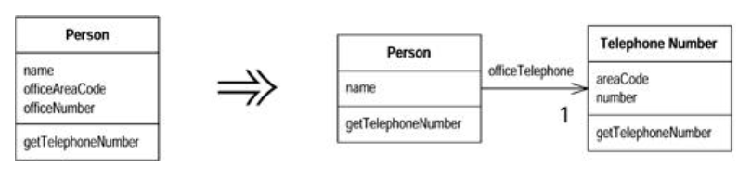
Extract Class
  You have one class doing work that should be done by two.
  Create a new class and move the relevant fields and methods from the old class into the new class
  A class that is too big to understand easily. You need to consider where it can be split, and you split it. A good sign is that a subset of the data and a subset of the methods seem to go together. Other good signs are subsets of data that usually change together or are particularly dependent on each other.

Slide 8
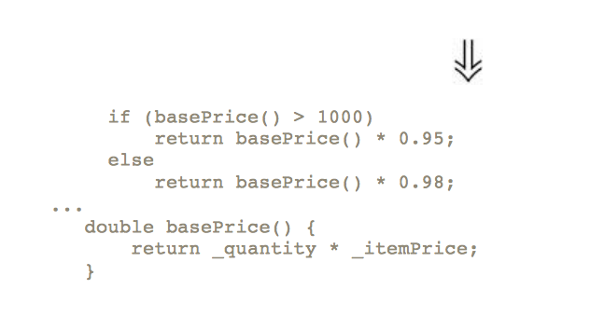
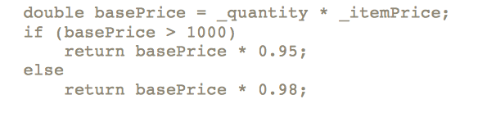
Replace Temp with Query
  You are using a temporary variable to hold the result of an expression.
  Extract the expression into a method. Replace all references to the temp with the expression. The new method can then be used in other methods.
  The problem with temps is that they are temporary and local. Because they can be seen only in the context of the method in which they are used, temps tend to encourage longer methods, because that's the only way you can reach the temp. By replacing the temp with a query method, any method in the class can get at the information.

Slide 9
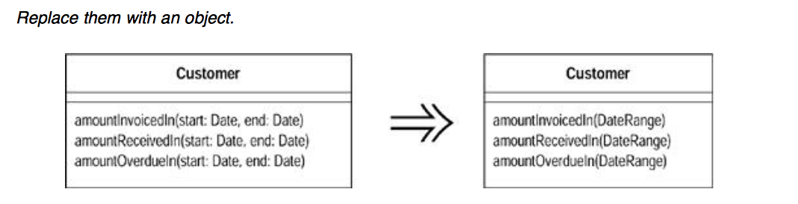
Introduce Parameter Object
  This refactoring is useful because it reduces the size of the parameter lists, and long parameter lists are hard to understand
  You get a deeper benefit, however, because once you have clumped together the parameters, you soon see behavior that you can also move into the new class.

Slide 10
Introduce Parameter Object
  This refactoring is useful because it reduces the size of the parameter lists, and long parameter lists are hard to understand
  You get a deeper benefit, however, because once you have clumped together the parameters, you soon see behavior that you can also move into the new class.

Slide 11
Introduce Parameter Object
  Mechanics
  • Create a new class to represent the group of parameters you are replacing. Make the class immutable.
  • Compile.
  • Use Add Parameter for the new data clump. Use a null for this parameter in all the
  callers.
  • For each parameter in the data clump, remove the parameter from the signature. Modify the callers and method body to use the parameter object for that value.
  • Compile and test after you remove each parameter.
  • When you have removed the parameters, look for behavior that you can move into the
  parameter object with Move Method.

Slide 12
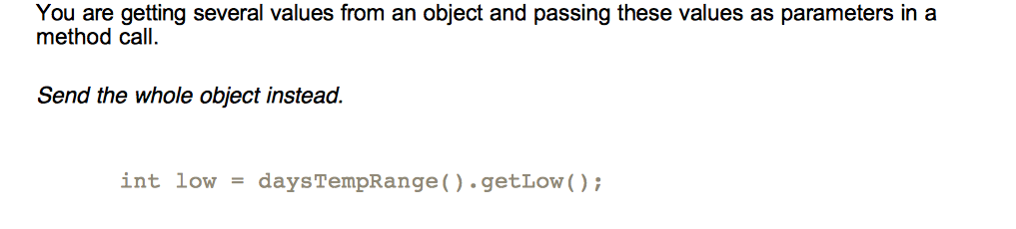
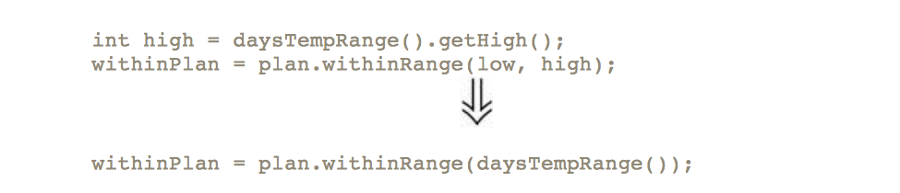
Preserve Whole Object
  This type of situation arises when an object passes several data values from a single object as parameters in a method call. The problem with this is that if the called object needs new data values later, you have to find and change all the calls to this method. You can avoid this by passing in the whole object from which the data came. The called object then can ask for whatever it wants from the whole object
  There is a down side. When you pass in values, the called object has a dependency on the values, but there isn't any dependency to the object from which the values were extracted. Passing in the required object causes a dependency between the required object and the called object. If this is going to mess up your dependency structure, don't use Preserve Whole Object.
  That a called method uses lots of values from another object is a signal that the called method should really be defined on the object from which the values come. When you are considering Preserve Whole Object, consider Move Method as an alternative.
  You may not already have the whole object defined. In this case you need Introduce Parameter Object.

Slide 13
Preserve Whole Object
  Mechanics
  Create a new parameter for the whole object from which the data comes.
  • Compile and test.
  • Determine which parameters should be obtained from the whole object.
  • Take one parameter and replace references to it within the method body by invoking an
  appropriate method on the whole object parameter.
  • Delete the parameter.
  • Compile and test.
  • Repeat for each parameter that can be got from the whole object.
  ￼￼￼￼233
  • Remove the code in the calling method that obtains the deleted parameters. ?rarr; Unless, of course, the code is using these parameters somewhere
  else.
  • Compile and test.

Slide 14
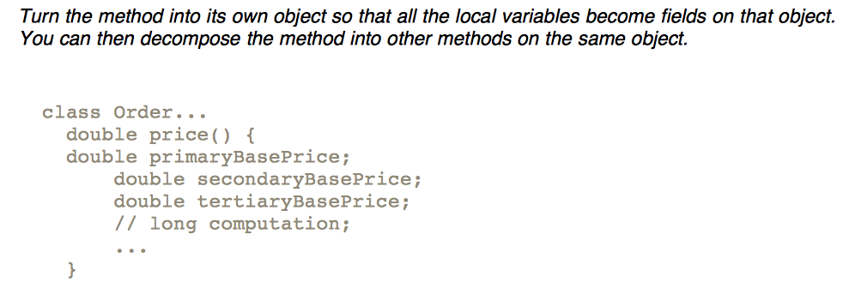
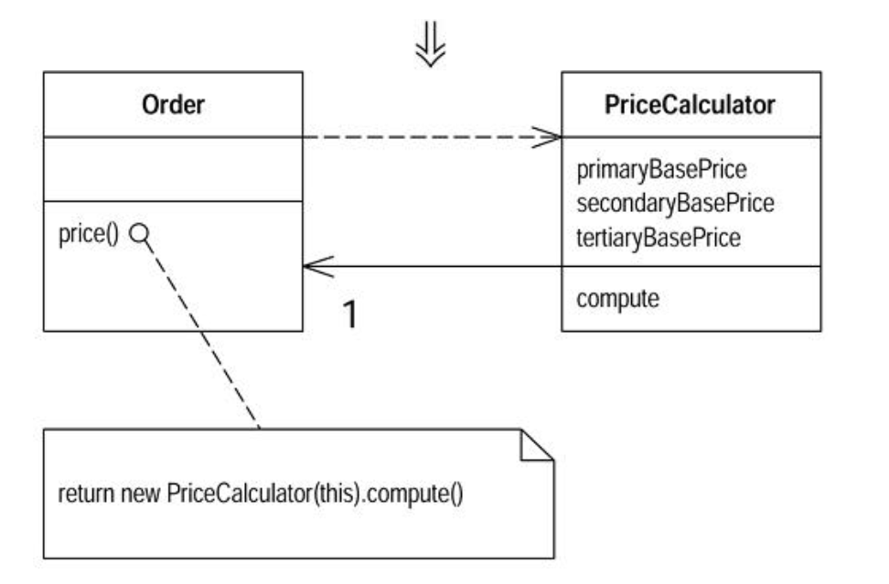
Replace Method with Method Object

Slide 15
Replace Method with Method Object
  The difficulty in decomposing a method lies in local variables. If they are rampant, decomposition can be difficult. Using Replace Temp with Query helps to reduce this burden, but occasionally you may find you cannot break down a method that needs breaking. In this case you reach deep into the tool bag and get out your method object [Beck].
  Applying Replace Method with Method Object turns all these local variables into fields on the method object. You can then use Extract Method on this new object to create additional methods that break down the original method.
  Mechanics
  • Create a new class, name it after the method.
  • Give the new class a final field for the object that hosted the original method (the source
  object) and a field for each temporary variable and each parameter in the method.
  • Give the new class a constructor that takes the source object and each parameter.
  • Give the new class a method named "compute."
  • Copy the body of the original method into compute. Use the source object field for any
  invocations of methods on the original object.
  • Compile.
  • Replace the old method with one that creates the new object and calls compute.
  Now comes the fun part. Because all the local variables are now fields, you can freely decompose the method without having to pass any parameters

Slide 16
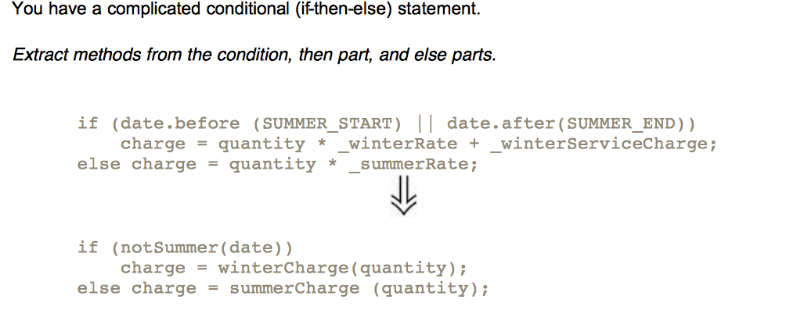
Decompose Conditional
  Motivation
  The problem usually lies in the fact that the code, both in the condition checks and in the actions, tells you what happens but can easily obscure why it happens.
  As with any large block of code, you can make your intention clearer by decomposing it and replacing chunks of code with a method call named after the intention of that block of code
  Many programmers don't extract the condition parts in situations such as this. The conditions often are quite short, so it hardly seems worth it. Although the condition is often short, there often is a big gap between the intention of the code and its body. Even in this little case, reading notSummer(date) conveys a clearer message to me than does the original code. With the original I have to look at the code and figure out what it is doing. It's not difficult to do that here, but even so the extracted method reads more like a comment
  Mechanics
  • Extract the condition into its own method.
  • Extract the then part and the else part into their own methods.

Slide 17
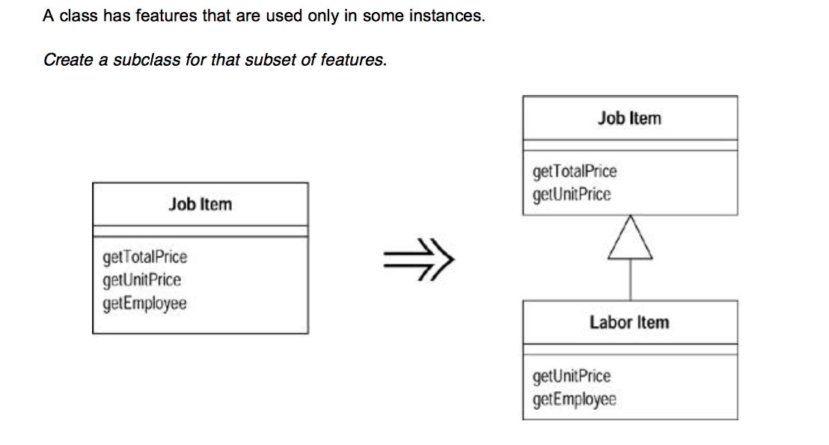
Extract Subclass
  Motivation
  The main trigger for use of Extract Subclass is the realization that a class has behavior used for some instances of the class and not for others. Sometimes this is signaled by a type code, in which case you can use Replace Type Code with Subclasses or Replace Type Code with State/Strategy. But you don't have to have a type code to suggest the use for a subclass.
  The main alternative to Extract Subclass is Extract Class. This is a choice between delegation and inheritance. Extract Subclass is usually simpler to do, but it has limitations. You can't change the class-based behavior of an object once the object is created. You can change the class-based behavior with Extract Class simply by plugging in different components. You can also use only subclasses to represent one set of variations. If you want the class to vary in several different ways, you have to use delegation for all but one of them.

Slide 18
Extract Subclass
  Mechanics
  • Define a new subclass of the source class.
  • Provide constructors for the new subclass.
  ?rarr; In the simple cases, copy the arguments of the superclass and call the superclass constructor with super .
  ?rarr; If you want to hide the use of the subclass from clients, you can use Replace Constructor with Factory Method.
  • Find all calls to constructors of the superclass. If they need the subclass, replace with a call to the new constructor.
  ?rarr; If the subclass constructor needs different arguments, use Rename Method to change it. If some of the constructor parameters of the superclass are no longer needed, use Rename Method on that too.
  ?rarr; If the superclass can no longer be directly instantiated, declare it abstract.
  • One by one use Push Down Method and Push Down Field to move features onto the subclass.
  ?rarr; Unlike Extract Class it usually is easier to work with the methods first and the data last.
  ?rarr; When a public method is pushed, you may need to redefine a caller's variable or parameter type to call the new method. The compiler will catch these cases.
  • Look for any field that designates information now indicated by the hierarchy (usually a boolean or type code). Eliminate it by using Self Encapsulate Field and replacing the getter with polymorphic constant methods. All users of this field should be refactored with Replace Conditional with Polymorphism.
  ?rarr; For any methods outside the class that use an accessor, consider using Move Method to move the method into this class; then use Replace Conditional with Polymorphism.
  • Compile and test after each push down.

Slide 19
Smell: <to be completed>
  Large Class
  When a class is trying to do too much, it often shows up as too many instance variables. When a class has too many instance variables, duplicated code cannot be far behind.
  Long Parameter List
  In our early programming days we were taught to pass in as parameters everything needed by a routine. This was understandable because the alternative was global data, and global data is evil and usually painful. Objects change this situation because if you don't have something you need, you can always ask another object to get it for you. Thus with objects you don't pass in everything the method needs; instead you pass enough so that the method can get to everything it needs. A lot of what a method needs is available on the method's host class. In object-oriented programs parameter lists tend to be much smaller than in traditional programs..
  Divergent Change
  We structure our software to make change easier; after all, software is meant to be soft. When we make a change we want to be able to jump to a single clear point in the system and make the change. When you can't do this you are smelling one of two closely related pungencies.
  Shotgun Surgery
  Shotgun surgery is similar to divergent change but is the opposite. You whiff this when every time you make a kind of change, you have to make a lot of little changes to a lot of different classes. When the changes are all over the place, they are hard to find, and it's easy to miss an important change
  Feature Envy
  The whole point of objects is that they are a technique to package data with the processes used on that data. A classic smell is a method that seems more interested in a class other than the one it actually is in. The most common focus of the envy is the data. We've lost count of the times we've seen a method that invokes half-a-dozen getting methods on another object to calculate some value. Fortunately the cure is obvious, the method clearly wants to be elsewhere, so you
  use Move Method to get it there. Sometimes only part of the method suffers from envy; in that case use Extract Method on the jealous bit and Move Method to give it a dream home..

Slide 20
Smell: <to be completed>
  Data Clumps
  Data items tend to be like children; they enjoy hanging around in groups together. Often you'll see the same three or four data items together in lots of places: fields in a couple of classes, parameters in many method signatures. Bunches of data that hang around together really ought to be made into their own object. The first step is to look for where the clumps appear as fields. Use Extract Class on the fields to turn the clumps into an object. Then turn your attention to method signatures using Introduce Parameter Object or Preserve Whole Object to slim them down. The immediate benefit is that you can shrink a lot of parameter lists and simplify method calling. Don't worry about data clumps that use only some of the fields of the new object. As long as you are replacing two or more fields with the new object, you'll come out ahead.
  Primitive Obsession
  Most programming environments have two kinds of data. Record types allow you to structure data into meaningful groups. Primitive types are your building blocks. Records always carry a certain amount of overhead. They may mean tables in a database, or they may be awkward to create when you want them for only one or two things.
  One of the valuable things about objects is that they blur or even break the line between primitive and larger classes. You can easily write little classes that are indistinguishable from the built-in types of the language. Java does have primitives for numbers, but strings and dates, which are primitives in many other environments, are classes.
  Switch Statements
  One of the most obvious symptoms of object-oriented code is its comparative lack of switch (or case) statements. The problem with switch statements is essentially that of duplication. Often you find the same switch statement scattered about a program in different places. If you add a new clause to the switch, you have to find all these switch, statements and change them. The object- oriented notion of polymorphism gives you an elegant way to deal with this problem.
  Parallel Inheritance Hierarchies
  Parallel inheritance hierarchies is really a special case of shotgun surgery. In this case, every time you make a subclass of one class, you also have to make a subclass of another. You can recognize this smell because the prefixes of the class names in one hierarchy are the same as the prefixes in another hierarchy.

Slide 21
Smell: LAZY CLASS
  Each class you create costs money to maintain and understand.
  A class that isn't doing enough to pay for itself should be eliminated.
  Mio commento: c'é il rischio di creare e cancellare le classi di continuo all'interno di team con criteri di cosa significhi “doing enough to pay for itself”. Stiamo acquisendo una serie di strumenti per smontare e montare il codice, e cercando di creare un spirito critico comune per prendere delle scelte consistenti all'interno di GMTechnologies
  Often this might be a class that used to pay its way but has been downsized with refactoring.
  Or it might be a class that was added because of changes that were planned but not made.
  Either way, you let the class die with dignity.
  If you have subclasses that aren't doing enough, try to use Collapse Hierarchy .
  Nearly useless components should be subjected to Inline Class.
  .

Slide 22
Smell: LAZY CLASS
  Each class you create costs money to maintain and understand.
  A class that isn't doing enough to pay for itself should be eliminated.
  Mio commento: c'é il rischio di creare e cancellare le classi di continuo all'interno di team con criteri di cosa significhi “doing enough to pay for itself”. Stiamo acquisendo una serie di strumenti per smontare e montare il codice, e cercando di creare un spirito critico comune per prendere delle scelte consistenti all'interno di GMTechnologies.
  -> gli esempi di extract class e inline class sono gli stessi, ha senso di esister la classe TelephoneNumber?
  Often this might be a class that used to pay its way but has been downsized with refactoring.
  Or it might be a class that was added because of changes that were planned but not made.
  Either way, you let the class die with dignity.
  If you have subclasses that aren't doing enough, try to use Collapse Hierarchy .
  Nearly useless components should be subjected to Inline Class.
  .

Slide 23
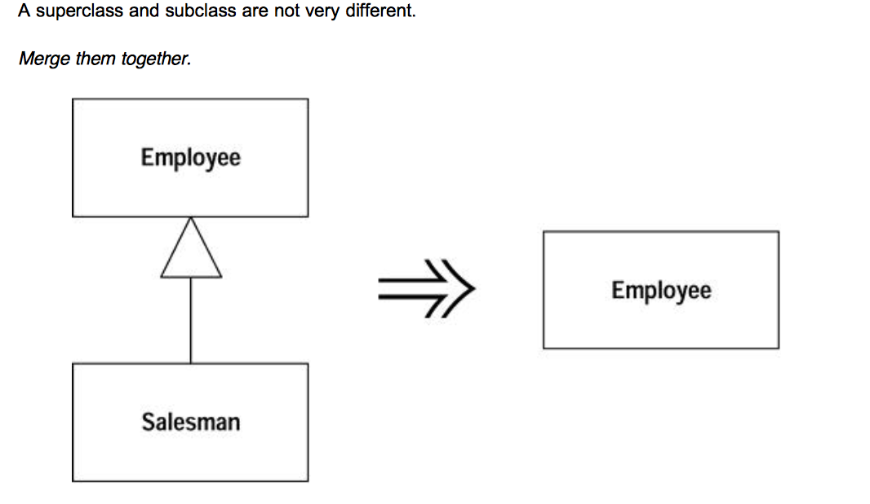
Collapse Hierarchy
  Motivation
  If you have been working for a while with a class hierarchy, it can easily become too tangled for its own good. Refactoring the hierarchy often involves pushing methods and fields up and down the hierarchy. After you've done this you can well find you have a subclass that isn't adding any value, so you need to merge the classes together.

Slide 24
Collapse Hierarchy
  Motivation
  Mechanics
  • Choose which class is going to be removed: the superclass or the subclasses.
  • Use Pull Up Field and
  or Push Down Method and Push Down Field to move all the behavior and data of the removed class to the class with which it is being merged.
  • Compile and test with each move.
  • Adjust references to the class that will be removed to use the merged class. This will
  affect variable declarations, parameter types, and constructors.
  • Remove the empty class.
  • Compile and test.

Slide 25
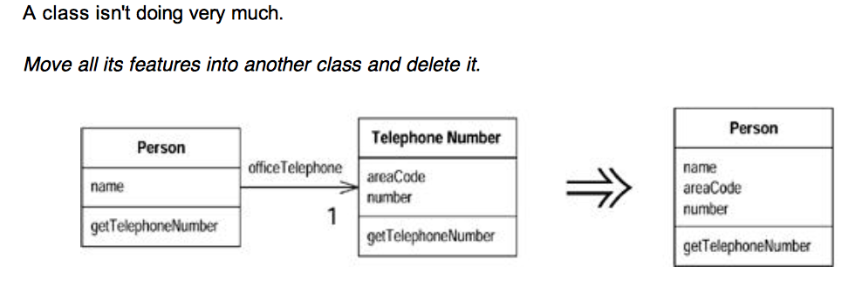
Inline class
  Motivation
  Inline Class is the reverse of Extract Class. I use Inline Class if a class is no longer pulling its weight and shouldn't be around any more. Often this is the result of refactoring that moves other responsibilities out of the class so there is little left. Then I want to fold this class into another class, picking one that seems to use the runt class the most.
  Mechanics
  • Declare the public protocol of the source class onto the absorbing class. Delegate all these methods to the source class.
  -> tia: “public protocol = metodi pubblici , in questo caso di vuole che gli utilizzatori della source class inizino ad utilizzare la classe che la rimpiazzerà
  If a separate interface makes sense for the source class methods, use Extract Interface before inlining.
  • Change all references from the source class to the absorbing class.
  Declare the source class private to remove out-of-package references. Also change the name of the source class so the compiler catches any dangling references to the source class.
  • Compile and test.
  • Use Move Method and Move Field to move features from the source class to the
  absorbing class until there is nothing left.
  • Hold a short, simple funeral service.

Slide 26
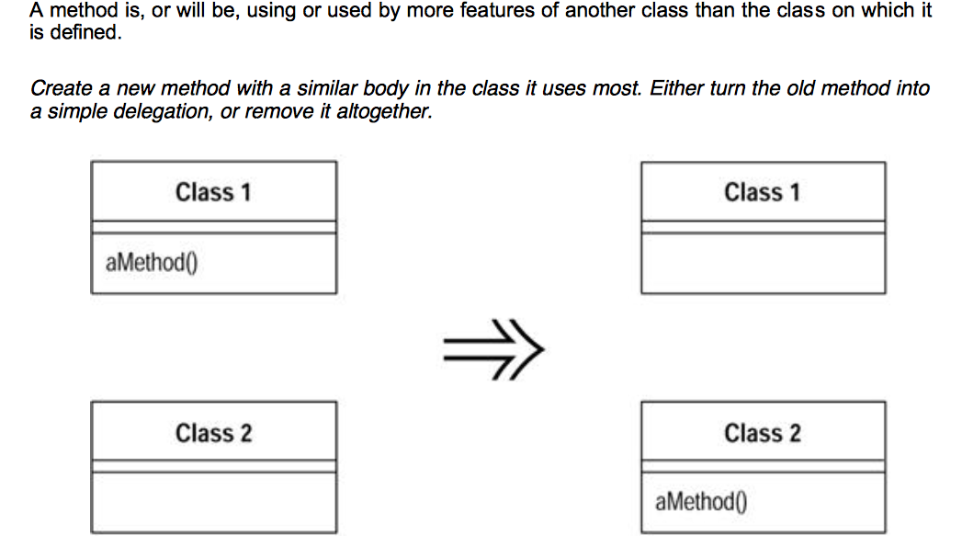
Move Method
Motivation
Moving methods is the bread and butter of refactoring. I move methods when classes have too much behavior or when classes are collaborating too much and are too highly coupled. By moving methods around, I can make the classes simpler and they end up being a more crisp implementation of a set of responsibilities.
I usually look through the methods on a class to find a method that seems to reference another object more than the object it lives on. A good time to do this is after I have moved some fields. Once I see a likely method to move, I take a look at the methods that call it, the methods it calls, and any redefining methods in the hierarchy. I assess whether to go ahead on the basis of the object with which the method seems to have more interaction.
It's not always an easy decision to make. If I am not sure whether to move a method, I go on to look at other methods. Moving other methods often makes the decision easier. Sometimes the decision still is hard to make. Actually it is then no big deal. If it is difficult to make the decision, it probably does not matter that much. Then I choose according to instinct; after all, I can always change it again later.

Slide 27
Mechanics
• Examine all features used by the source method that are defined on the source class. Consider whether they also should be moved.
If a feature is used only by the method you are about to move, you might as well move it, too. If the feature is used by other methods,
consider moving them as well. Sometimes it is easier to move a clutch of methods than to move them one at a time.
• Check the sub- and superclasses of the source class for other declarations of the method.
If there are any other declarations, you may not be able to make the move, unless the polymorphism can also be expressed on the target.
• Declare the method in the target class.
You may choose to use a different name, one that makes more
sense in the target class.
• Copy the code from the source method to the target. Adjust the method to make it work in its new home.
If the method uses its source, you need to determine how to reference the source object from the target method. If there is no
mechanism in the target class, pass the source object reference to the new method as a parameter.
If the method includes exception handlers, decide which class should logically handle the exception. If the source class should be responsible, leave the handlers behind.
• Compile the target class.
• Determine how to reference the correct target object from the source.
There may be an existing field or method that will give you the target. If not, see whether you can easily create a method that will do so. Failing that, you need to create a new field in the source that can store the target. This may be a permanent change, but you can also make it temporarily until you have refactored enough to remove it.
• Turn the source method into a delegating method.
• Compile and test.
• Decide whether to remove the source method or retain it as a delegating method.
Leaving the source as a delegating method is easier if you have many references.
• If you remove the source method, replace all the references with references to the target method.
You can compile and test after changing each reference, although it is usually easier to change all references with one search and replace.
• Compile and test.

Slide 28
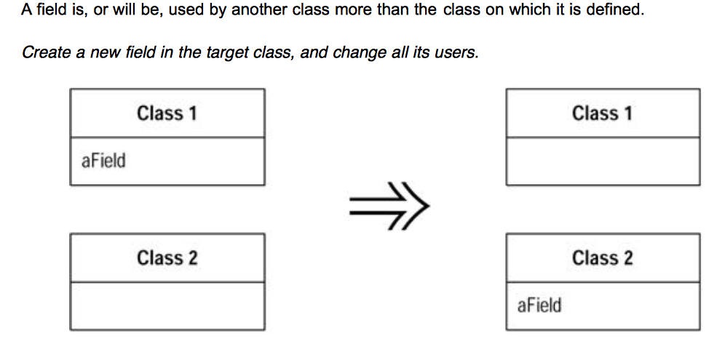
Move Field
Motivation
Moving state and behavior between classes is the very essence of refactoring. As the system develops, you find the need for new classes and the need to shuffle responsibilities around. A design decision that is reasonable and correct one week can become incorrect in another. That is not a problem; the only problem is not to do something about it.
I consider moving a field if I see more methods on another class using the field than the class itself. This usage may be indirect, through getting and setting methods. I may choose to move the methods; this decision based on interface. But if the methods seem sensible where they are, I move the field.
Another reason for field moving is when doing Extract Class. In that case the fields go first and then the methods.

Slide 29
Move Field
Mechanics
• If the field is public, use Encapsulate Field.
If you are likely to be moving the methods that access it frequently or if a lot of methods access the field, you may find it useful to use Self Encapsulate Field
• Compile and test.
• Create a field in the target class with getting and setting methods.
• Compile the target class.
• Determine how to reference the target object from the source.
An existing field or method may give you the target. If not, see whether you can easily create a method that will do so. Failing that, you need to create a new field in the source that can store the target. This may be a permanent change, but you can also do it temporarily until you have refactored enough to remove it.
• Remove the field on the source class.
• Replace all references to the source field with references to the appropriate method on
the target.
For accesses to the variable, replace the reference with a call to the target object's getting method; for assignments, replace the reference with a call to the setting method.
If the field is not private, look in all the subclasses of the source for references.
• Compile and test.

Slide 30
Smell: SPECULATIVE GENERALITY
  Brian Foote suggested this name for a smell to which we are very sensitive. You get it when people say, "Oh, I think we need the ability to this kind of thing someday" and thus want all sorts of hooks and special cases to handle things that aren't required. The result often is harder to
  understand and maintain.
  If all this machinery were being used, it would be worth it. But if it isn't, it isn't. The machinery just gets in the way, so get rid of
  it.
  Tia: credo che in questi casi valga la pena capire il motivo perché sia stata richiesta la funzionalità, per capire in futuro con affrontare richieste simili.
  Capita che davanti a nuove richieste ci si pone la domanda se la nuova funzionalità verrà utilizzata o se avrà l'effetto desiderato.
  Credo che un fattore importante per evitare queste situazione sia la possibilità di poter misurare il grado di riuscita delle funzionalità già implementate per far questo serve conoscere l'aspettativa a medio lungo termine del cliente.
  In questo modo alla prossima funzionalità richiesta il cliente dovrà anche indicare l'aspettativa.
  Probabilmente se l'aspettativa non è chiara ci potremmo trovare nel situazione descritta da questo smell.
  If you have abstract classes that aren't doing much, use Collapse Hierarchy. Unnecessary delegation can be removed with Inline Class. Methods with unused parameters should be subject to Remove Parameter. Methods named with odd abstract names should be brought down to earth with Rename Method.
  Speculative generality can be spotted when the only users of a method or class are test cases.
  If you find such a method or class, delete it and the test case that exercises it.
  If you have a method or class that is a helper for a test case that exercises legitimate functionality, you have to leave it in, of course.

Slide 31
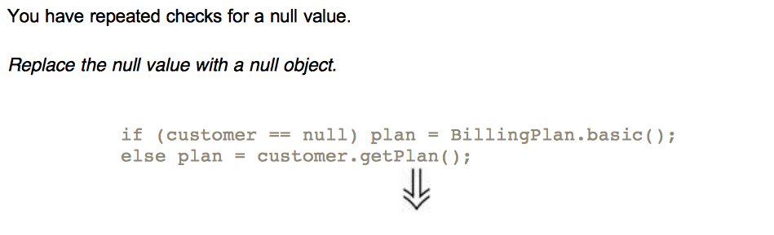
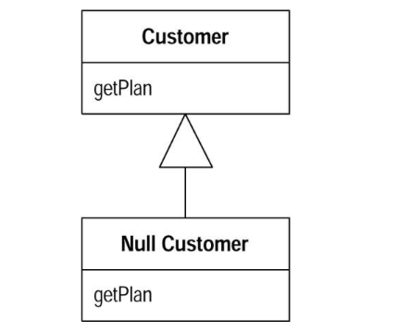
Introduce null object
Motivation
The essence of polymorphism is that instead of asking an object what type it is and then invoking some behavior based on the answer, you just invoke the behavior. The object, depending on its type, does the right thing. One of the less intuitive places to do this is where you have a null value in a field.
?? Remember, null objects are always constant: nothing about them ever changes. Accordingly, we implement them using the Singleton pattern [Gang of Four]. Whenever you ask, for example, for a missing person, you always get the single instance of that class.

Slide 32
Introduce null object
Mechanics
• Create a subclass of the source class to act as a null version of the class. Create an isNull operation on the source class and the null class. For the source class it should return false, for the null class it should return true.
You may find it useful to create an explicitly nullable interface for the isNull method.
As an alternative you can use a testing interface to test for nullness.
• Compile.
• Find all places that can give out a null when asked for a source object. Replace them to
give out a null object instead.
• Find all places that compare a variable of the source type with null and replace them with
a call isNull.
You may be able to do this by replacing one source and its clients
at a time and compiling and testing between working on sources.
A few assertions that check for null in places where you should no longer see it can be useful.
• Compile and test.
• Look for cases in which clients invoke an operation if not null and do some alternative
behavior if null.
• For each of these cases override the operation in the null class with the alternative
behavior.
• Remove the condition check for those that use the overriden behavior, compile, and test.

Slide 33
Smell: TEMPORARY FIELD
  Sometimes you see an object in which an instance variable is set only in certain circumstances.
  Such code is difficult to understand, because you expect an object to need all of its variables.
  Trying to understand why a variable is there when it doesn't seem to be used can drive you nuts.
  Use Extract Class to create a home for the poor orphan variables.
  Put all the code that concerns the variables into the component.
  You may also be able to eliminate conditional code by using Introduce Null Object to create an alternative component for when the variables aren't valid.
  A common case of temporary field occurs when a complicated algorithm needs several variables.
  Because the implementer didn't want to pass around a huge parameter list (who does?), he put them in fields.
  But the fields are valid only during the algorithm; in other contexts they are just plain confusing.
  In this case you can use Extract Class with these variables and the methods that require them. The new object is a method object [Beck].

Slide 34
Smell: MESSAGE CHAINS
  You see message chains when a client asks one object for another object, which the client then asks for yet another object, which the client then asks for yet another another object, and so on.
  You may see these as a long line of getThis methods, or as a sequence of temps.
  Navigating this way means the client is coupled to the structure of the navigation.
  Any change to the intermediate relationships causes the client to have to change.
  The move to use here is Hide Delegate.
  You can do this at various points in the chain. I
  n principle you can do this to every object in the chain, but doing this often turns every intermediate object into a middle man.
  Often a better alternative is to see what the resulting object is used for.
  See whether you can use Extract Method to take a piece of the code that uses it and then Move Method to push it down the chain.
  If several clients of one of the objects in the chain want to navigate the rest of the way, add a method to do that.
  Some people consider any method chain to be a terrible thing. We are known for our calm, reasoned moderation. Well, at least in this case we are.

Slide 35
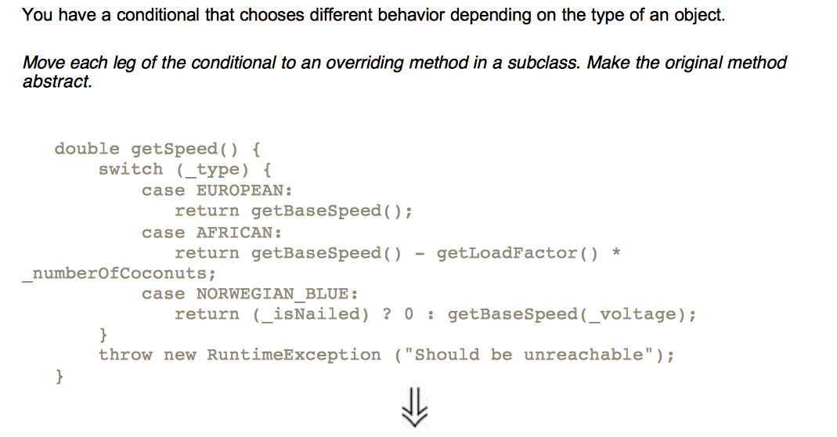
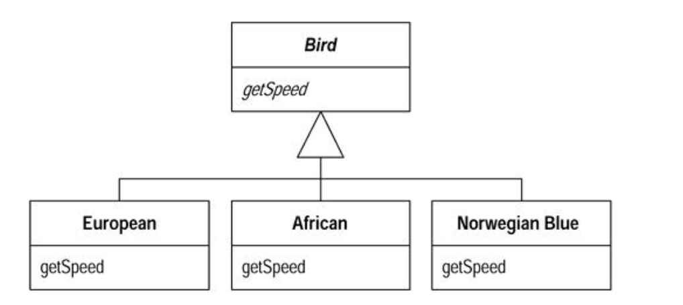
Replace Conditional with Polymorphism

Slide 36
Replace Conditional with Polymorphism
Motivation
One of the grandest sounding words in object jargon is polymorphism. The essence of polymorphsim is that it allows you to avoid writing an explicit conditional when you have objects whose behavior varies depending on their types.
As a result you find that switch statements that switch on type codes or if-then-else statements that switch on type strings are much less common in an object-oriented program.
Polymorphism gives you many advantages. The biggest gain occurs when this same set of conditions appears in many places in the program. If you want to add a new type, you have to find and update all the conditionals. But with subclasses you just create a new subclass and provide the appropriate methods. Clients of the class don't need to know about the subclasses, which reduces the dependencies in your system and makes it easier to update.
Mechanics
Before you can begin with Replace Conditional with Polymorphism you need to have the necessary inheritance structure. You may already have this structure from previous refactorings. If you don't have the structure, you need to create it.
To create the inheritance structure you have two options: Replace Type Code with Subclasses and Replace Type Code with State/Strategy. Subclasses are the simplest option, so you should use them if you can. If you update the type code after the object is created, however, you cannot use subclassing and have to use the state/strategy pattern. You also need to use the state/strategy pattern if you are already subclassing this class for another reason. Remember that if several case statements are switching on the same type code, you only need to create one inheritance structure for that type code.
You can now attack the conditional. The code you target may be a switch (case) statement or an if statement.
If the conditional statement is one part of a larger method, take apart the conditional statement and use Extract Method.
If necessary use Move Method to place the conditional at the top of the inheritance structure.
Pick one of the subclasses. Create a subclass method that overrides the conditional statement method. Copy the body of that leg of the conditional statement into the subclass method and adjust it to fit.
You may need to make some private members of the superclass protected in order to do this.
Compile and test.
Remove the copied leg of the conditional statement.
Compile and test.
Repeat with each leg of the conditional statement until all legs are turned into subclass
methods.
Make the superclass method abstract.

Slide 37
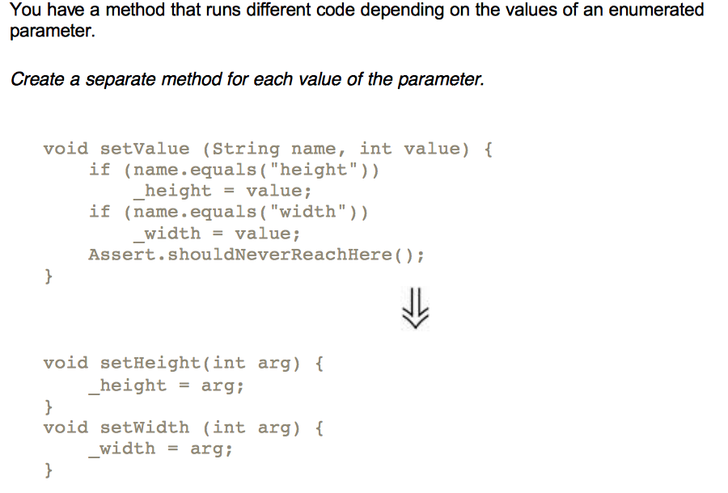
Replace Parameter with Explicit Methods

Slide 38
Replace Parameter with Explicit Methods
Motivation
Replace Parameter with Explicit Methods is the reverse of Parameterize Method. The usual case for the former is that you have discrete values of a parameter, test for those values in a conditional, and do different things. The caller has to decide what it wants to do by setting the parameter, so you might as well provide different methods and avoid the conditional. You not only avoid the conditional behavior but also gain compile time checking. Furthermore your interface also is clearer. With the parameter, any programmer using the method needs not only to look at the methods on the class but also to determine a valid parameter value. The latter is often poorly documented.
The clarity of the explicit interface can be worthwhile even when the compile time checking isn't an advantage. Switch.beOn() is a lot clearer than Switch.setState(true), even when all you are doing is setting an internal boolean field.
You shouldn't use Replace Parameter with Explicit Methods when the parameter values are likely to change a lot. If this happens and you are just setting a field to the passed in parameter, use a simple setter. If you need conditional behavior, you need Replace Conditional with Polymorphism.
Mechanics
Create an explicit method for each value of the parameter.
For each leg of the conditional, call the appropriate new method.
Compile and test after changing each leg.
Replace each caller of the conditional method with a call to the appropriate new method.
Compile and test.
When all callers are changed, remove the conditional method.

