Slide 1
PHASE 2 FINDINGS
Fine-Tuning a Small Language Model
for In-Hospital Mortality Prediction
A QLoRA approach on constrained hardware
Thomas I. Bales · University of Texas at Austin · AI in Healthcare, Summer 2026
llama-3.1-8B · 6.8M trainable params (0.08%) · single Tesla T4 · temperature 0.0

Slide 2
THE RESULT, ON HELD-OUT PATIENTS
Better on both axes at once
200 patients the model never saw in training — the same 200 scored by both models.
2.5×
5×
10 / 22
90%
more deaths caught
more precise
deaths flagged
accuracy
recall 18% → 46%
11% → 56% of flags correct
baseline caught only 4
up from 74.5%
The model catches more deaths and is right more often when it flags — it did not trade one for the other, and it did not hide in the majority class.
Metrics computed directly from the saved held-out confusion matrix (data/phase2_results/validation_results.json).

Slide 3
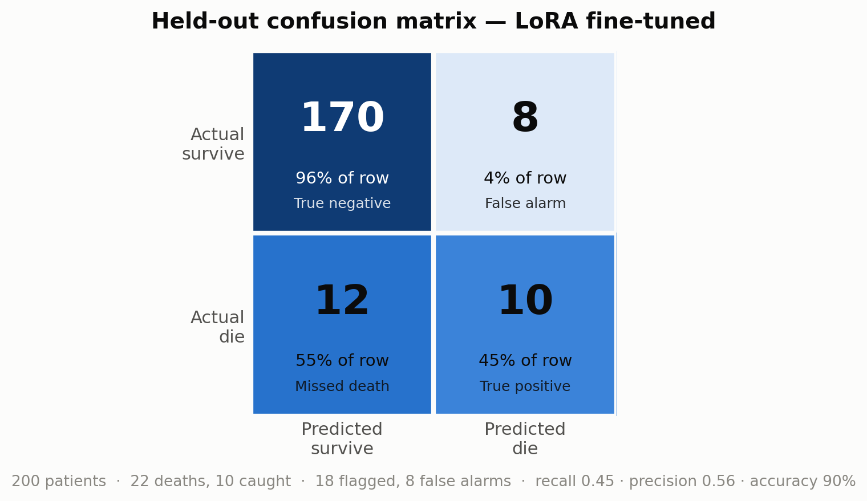
HELD-OUT CONFUSION MATRIX
18 flagged — 10 true, 8 false alarms
10 of 22 deaths caught
True positives — correctly flagged as high-risk.
12 deaths missed
False negatives — the cost that matters most clinically.
8 false alarms of 178 survivors
A calibrated operating point: total flags (18) sit near the true
death count (22) — the model learned the correct scale.
Color encodes each cell's share of its row, so both rows stay legible despite the 170-vs-rest class imbalance.

Slide 4
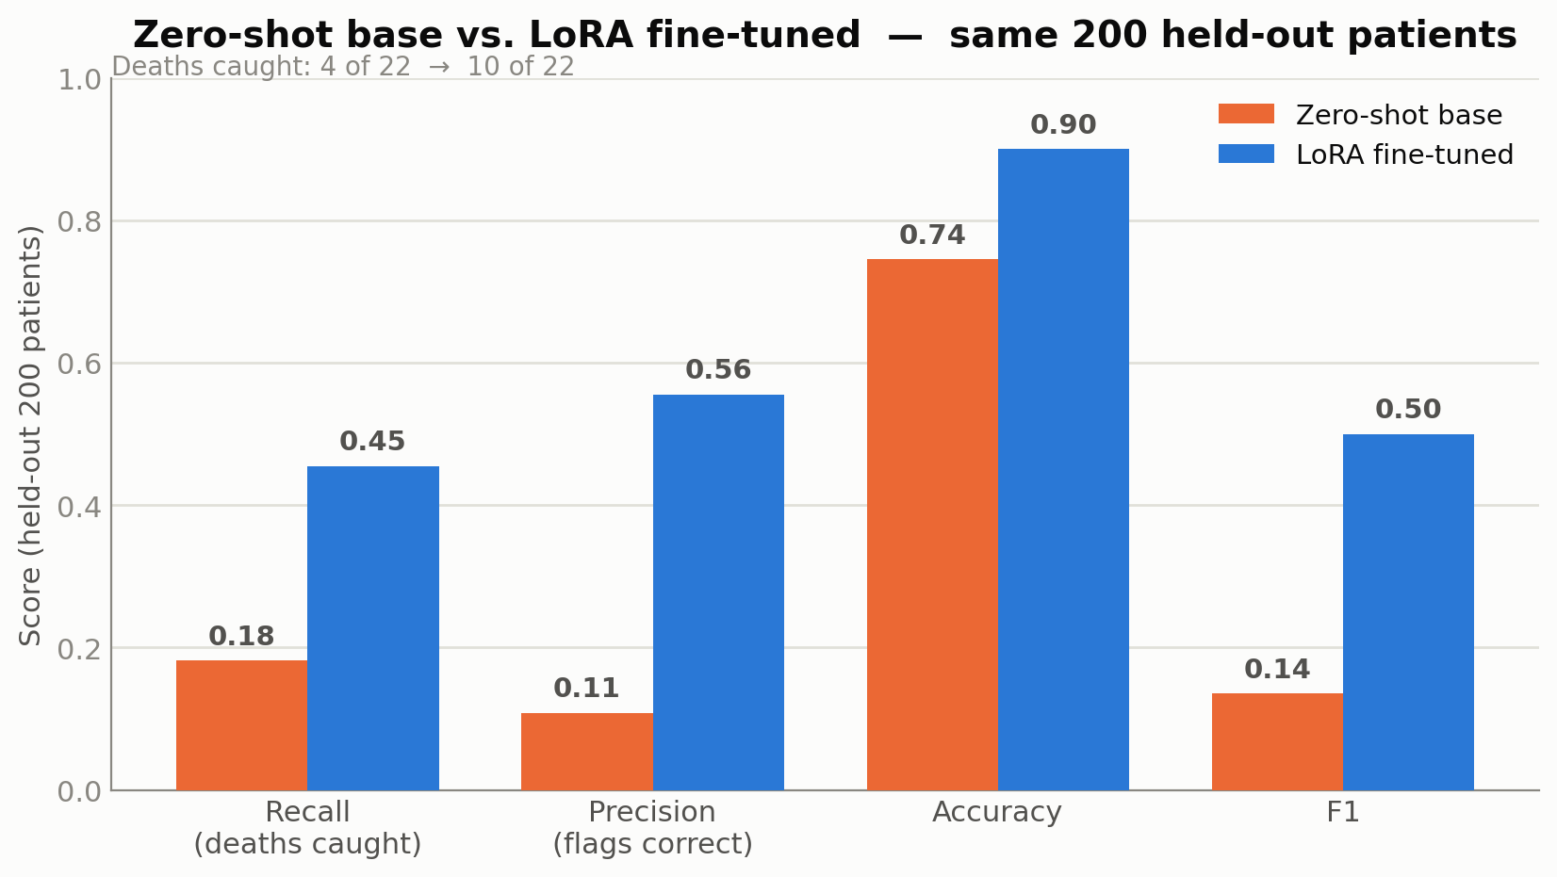
BASELINE VS. FINE-TUNED
Zero-shot llama-3.1-8B vs. a 0.08% adapter
Apples-to-apples: the untuned base at zero-shot vs. the same base with the LoRA adapter, both at temperature 0.0 on the identical 200 held-out patients.

Slide 5
WHY THESE NUMBERS ARE TRUSTWORTHY
The codebase told a different story
What full inspection of the Phase 1 output and the training pipeline surfaced — before any result was believed.
CRITICAL — caught & fixed
IRREDUCIBLE NOISE FLOOR
HONEST EVALUATION
Validation set was inside training
All 200/200 held-out patients also appeared in the training data — “validation” would have measured memorization, not generalization.
Fixed: 213 pairs dropped; 0 of 200 remain.
265 contradictory labels
Identical descriptions carry both Yes and No — 17 coarse features render the same text for patients with different outcomes.
Caps achievable accuracy; no training removes it.
Grouped, prevalence-preserving split
Split by patient description (0 overlap), not at random. Eval keeps the natural 12% death rate; only training is rebalanced.
Recall is the headline — always-“No” scores 89%.
The interactive-chat version of this deck could not see any of this. The single most important fix — removing the validation leak — is what makes the headline comparison a real measurement rather than a memorization score.

Slide 6
MAKING AN 8B MODEL FIT AND RUN ON ONE T4
Three bugs stood between the model and a first step
Wrong GPU
device_map="auto" filled cuda:0 = the 8 GB RTX 2080, not the T4. Fixed by pinning CUDA_VISIBLE_DEVICES to the T4's UUID as the kernel's first action.
Did not fit
llama-3.1-8B is ~16.1 GB in fp16 against the T4's 15.9 GB. 4-bit NF4 QLoRA cut the footprint to 5.6 GB — loadable and trainable on one card.
Kernel crash
transformers 5.13 hardcodes the safetensors mmap backend; mmap reads of the 16 GB checkpoint faulted with an access violation. Fixed by forcing the pread backend.
None of the three was the OOM it first looked like. Each was diagnosed from the actual failure, not guessed — the reason a codebase-grounded account matters.

Slide 7
HOW IT LEARNED
A textbook arc with a noise-floor signature
2,072 optimizer steps, one epoch. Class-balanced training pulled the model off the base rate; the decaying learning rate did the rest.
1
2
3
4
Collapse
Breakout
Damping
Convergence
Steps 0–150
Steps 200–900
Steps 950–1550
Steps 1600–2072
Recall 0.000 — refused to flag anyone, hiding in the 88% base rate.
Class-balancing lifted recall off zero; swings between aggressive and conservative were violent.
Decaying learning rate narrowed the swings; flag count tightened toward a stable band.
F1 peaked (0.41), loss settled ~0.19, flag count matched the true death count.
No overfitting: training and validation loss fell together throughout. Step-level figures per the run's eval log (docs/PHASE2_FINDINGS.md).

Slide 8
THE TRADEOFF IS A VALUES DECISION
Two adjacent steps — same weights, opposite thresholds
Step 850 — aggressive
Step 900 — conservative
Recall 0.51 Precision 0.26
470 patients flagged
Catch half the deaths — accept many false alarms.
Recall 0.15 Precision 0.69
54 patients flagged
Flag almost nobody — but rarely cry wolf.
Which operating point you deploy is not a technical choice — it is a clinical-values decision about how many false alarms are acceptable to catch one more death. That belongs to an accountable institution, not a silent default.

Slide 9
WHAT IT COST TO RUN
One passive datacenter GPU, on the edge of its thermal envelope
97 → 94 °C
5.6 GB
~$30
peak → stable plateau
4-bit NF4 footprint
added hardware cost
2 °C inside hardware shutdown
down from ~16 GB in fp16
one floor fan
Interventions, in order: cardboard air duct → floor fan → 60 W power cap → batch-size cut
The enormous energy cost of this capability was front-loaded into pretraining — absorbed upstream, inherited for free.
Fine-tuning to beat the base cost near-zero marginal energy. That asymmetry — ecological cost socialized upstream, benefit accruing to every free-riding fine-tuner — is itself a governance question.

Slide 10
WHAT WAS PROVEN — AND ITS LIMIT
A small adapter beat its own base; the ceiling is the data
The claim: a small custom adapter on a small, open foundational model can beat that base model on a specialized clinical task — at minimal compute and energy cost, with deterministic, auditable output. The value came from unlocking knowledge already frozen in the weights; only 0.08% of parameters were trained.
The ceiling is the data, not the model
265 descriptions carry contradictory labels — identical text, opposite outcomes. The model learns everything 17 coarse features permit, then oscillates around the residual noise floor.
Highest-value next step
Richer features — raw labs, vitals, diagnosis codes — to separate patients the current descriptions collapse together. The bottleneck is feature resolution, not model capacity or method.
Governance note: feature selection dropped race but kept insurance, which encodes race and class in the MIMIC cohort — a proxy that can look fair on a checklist.

Slide 11
FOR THE RECORD
Configuration, determinism, and next steps
Base model
llama-3.1-8B (frozen)
Determinism as auditability
Temperature 0.0 makes the same patient always yield the same assessment — reproducible, traceable, and reviewable. The bridge between neural inference and the verifiable decision systems safety-critical domains require.
Method
QLoRA — 4-bit NF4 + adapter
Rank / alpha
16 / 32
Trainable params
6,815,744 (0.08%)
NEXT STEPS
Epochs / eff. batch
1 / 8
Phase 3 — RAG + clinical persona (the third model version)
Learning rate
2e-4, decaying
Feature enrichment to lower the conflicting-label noise floor
Inference temp
0.0 (deterministic)
Hardware
Tesla T4 16 GB + $30 fan
Report the full recall–precision frontier across checkpoints
Ensemble check: does the LoRA model miss different patients than the GBM / DNN baselines?

