Slide 1
CE2013 Introduction to CSIE
Exercise 1 Tutorial
Git · GitHub · uv Basics
Git Version Control
GitHub Collaboration
uv Environment Management
Merge Conflict

Slide 2
OVERVIEW
Overview
1
Set Up Project Environment
Initialize the repo, clone it locally, and set up the Python environment
2
Project Version Control
Create a branch, modify code, and push a commit
3
Add Duplicate-Task Prevention
Verify changes, push, and prepare a pull request
4
PR Merge and Sync
Review and merge the PR, then sync the latest progress
5
Delete-Task Feature
Develop the delete-task feature and create a branch conflict
6
Resolve Merge Conflict
Resolve the conflict and complete the merge

Slide 3
PHASE 1 · Set Up Project Environment
Before development begins, complete three setup steps: create your personal repository, clone it locally, and initialize the Python environment with uv.
①
②
③
Create a Personal Repository
Git Clone Locally
Initialize the Dev Environment with uv
Create it from the template and push it to GitHub
Get the project source code
Create a virtual environment and install dependencies

Slide 4
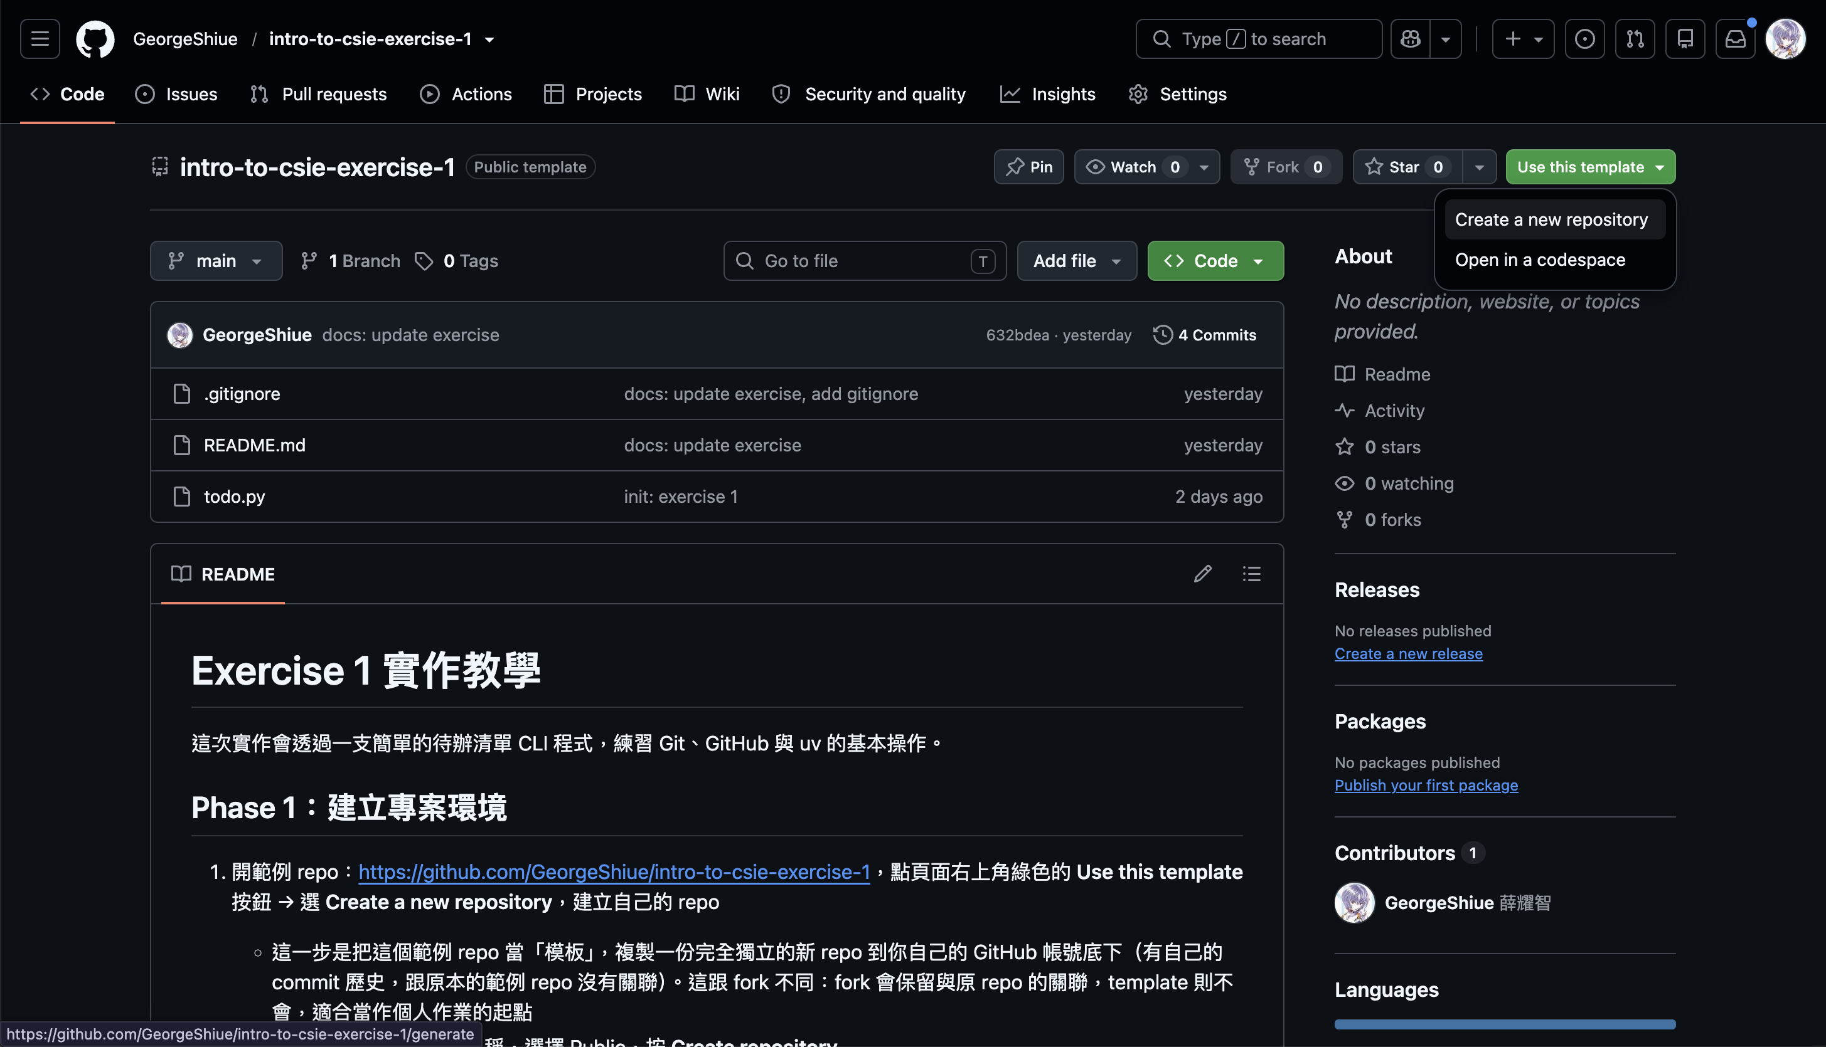
PHASE 1 · Set Up Project Environment
1
Create a Personal Repository from the Template
Log in to GitHub and open the Exercise 1 template
Click "Use this template"
Click "Create a new repository"

Slide 5
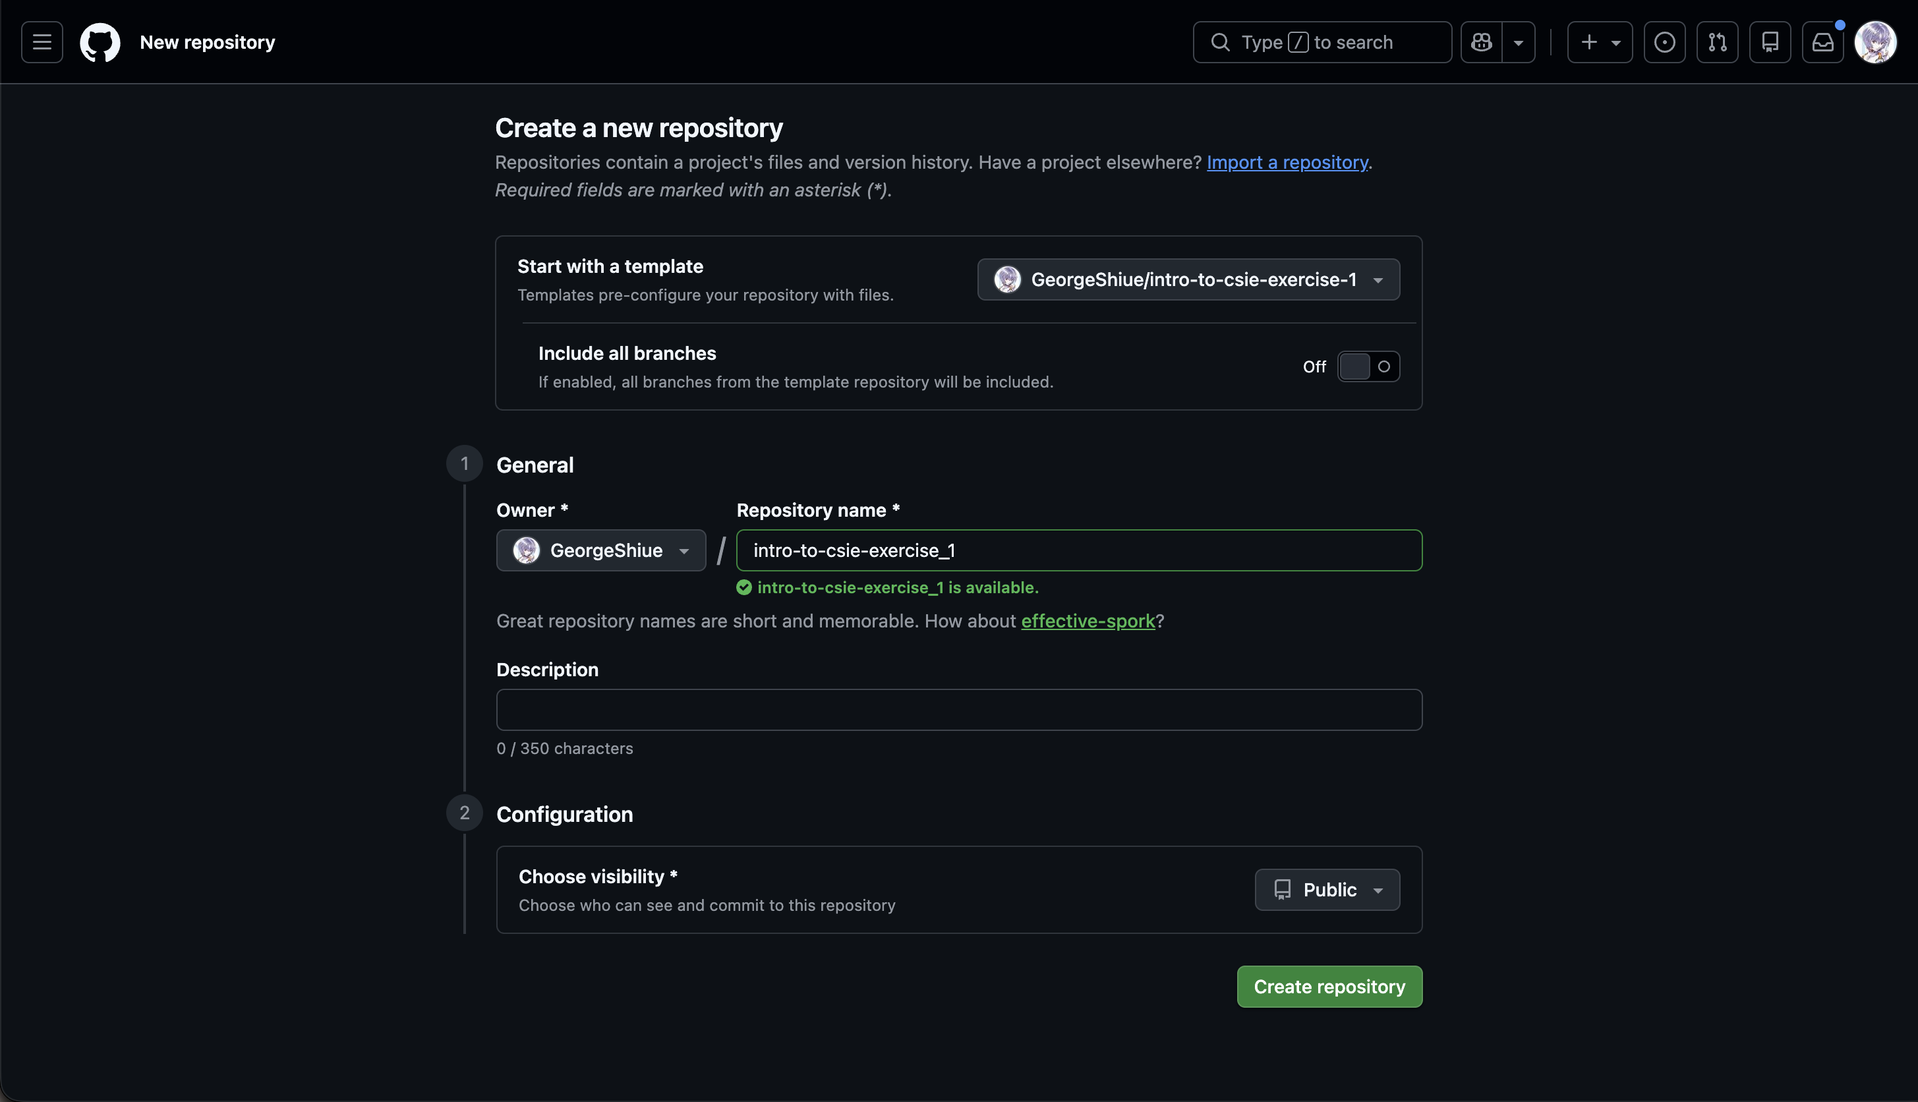
PHASE 1 · Set Up Project Environment
1
Create a Personal Repository from the Template
Enter the repo name
Set Visibility to Public
Click "Create repository"

Slide 6
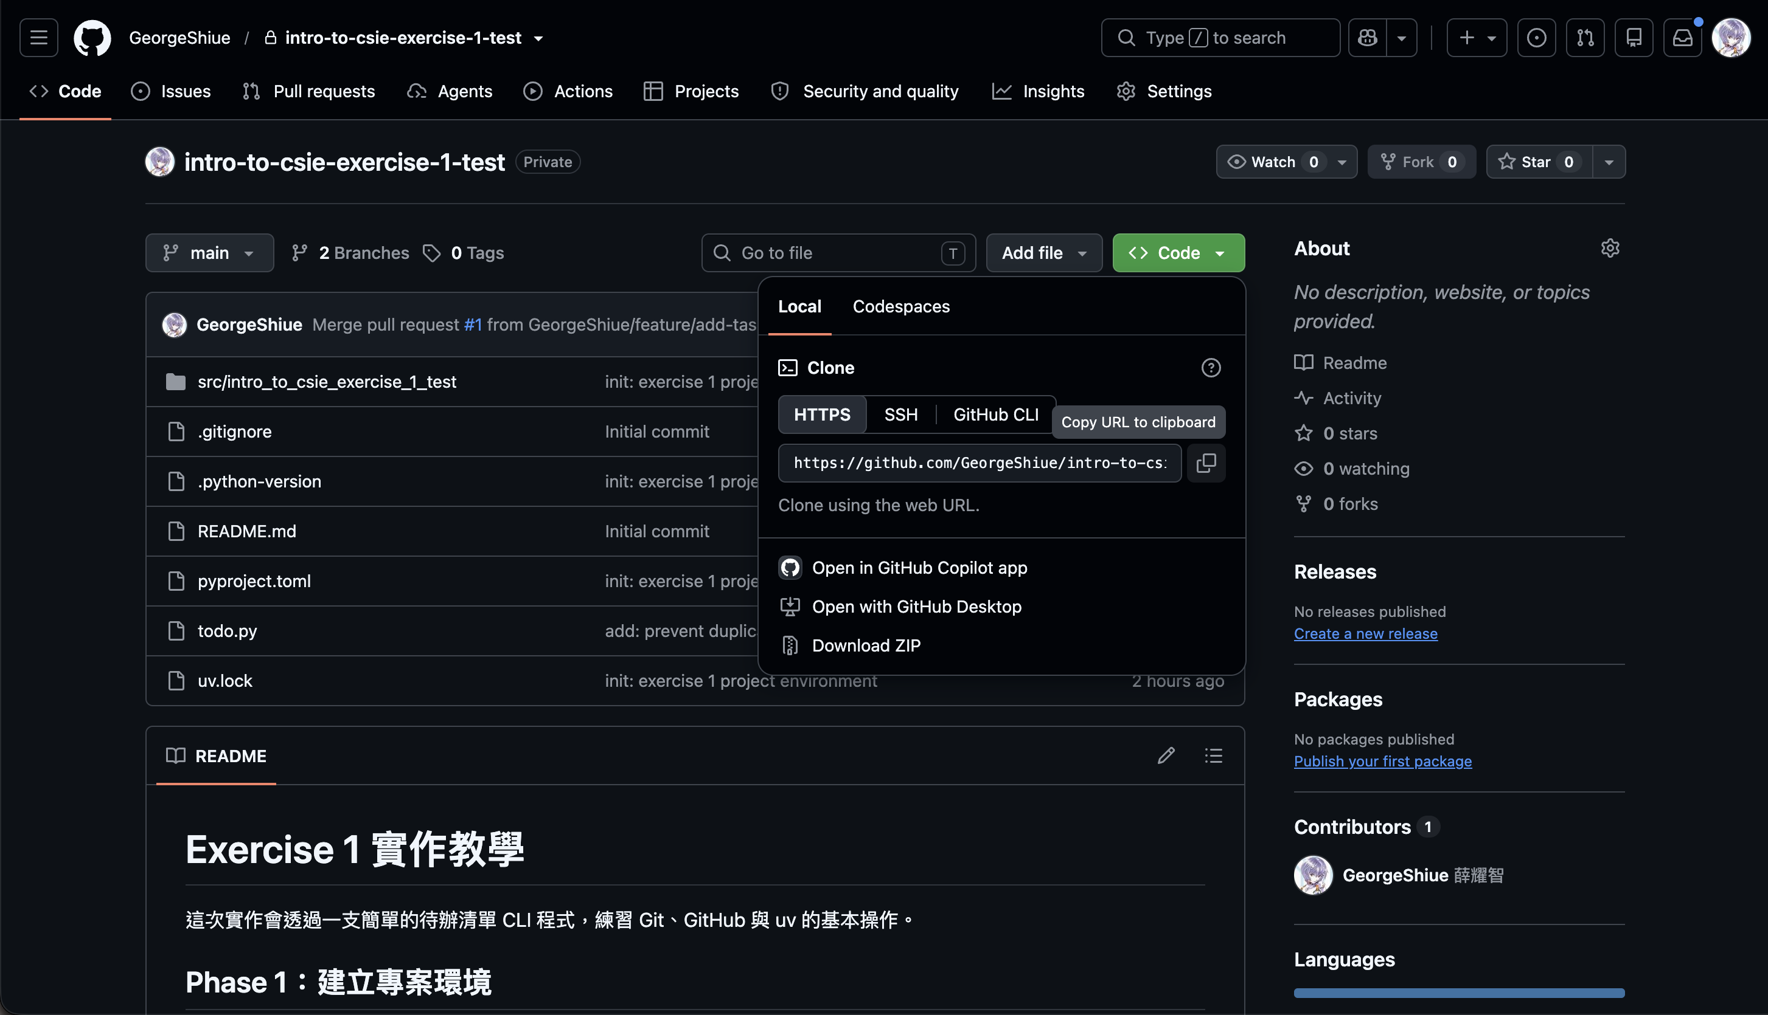
PHASE 1 · Set Up Project Environment
2
Clone the Repository Locally
Repo URL
  Go to the personal exercise 1 repo page you just created
  Click "Code"
  Find the URL under HTTPS, then click the copy button on the right to copy it

Slide 7
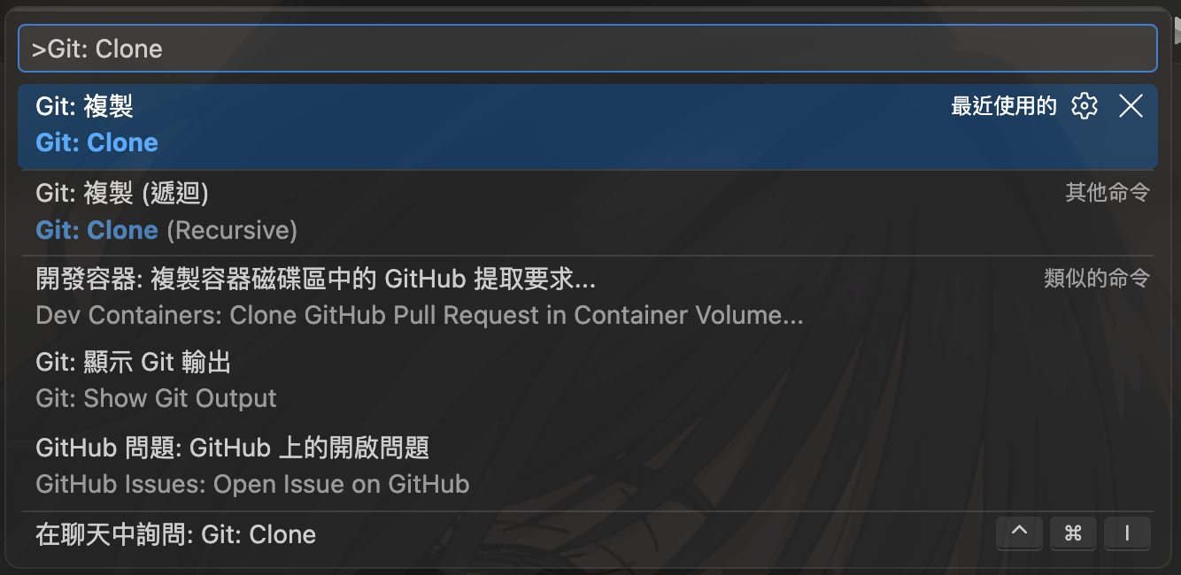
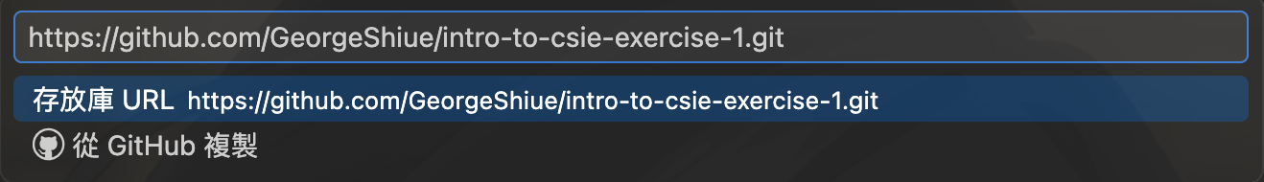
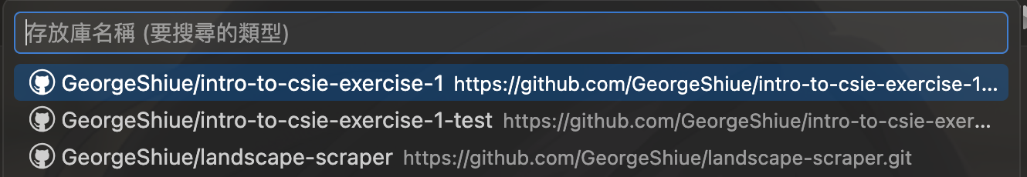
PHASE 1 · Set Up Project Environment
2
Clone the Repository Locally
VS Code:
  Press Cmd/Ctrl+Shift+P, type "Git: Clone", and click it
  Paste the exercise 1 repo URL, or click "Clone from GitHub" below and select the exercise 1 repo
Terminal:
  cd <your code folder path>
  git clone <exercise 1 repo URL>
  Open that folder in VS Code

Slide 8
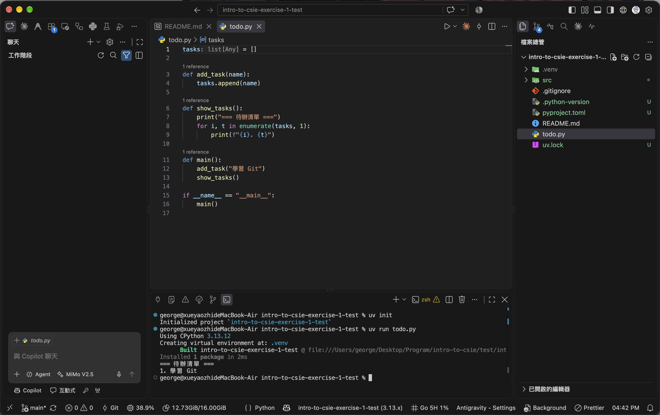
PHASE 1 · Set Up Project Environment
3
Initialize the Python Env with uv
Open the terminal and run uv init
Confirm pyproject.toml, python-version, src, etc. were created
Run uv run todo.py in the terminal
Confirm the .venv environment was created and check the output

Slide 9
PHASE 2 · Project Version Control
Make the first commit on the main branch and push it to GitHub.
feature/delete-task
Create this branch now — Feature 2 will use it later
main
init: exercise 1
project environment
feature/add-task
Next, start developing Feature 1

Slide 10
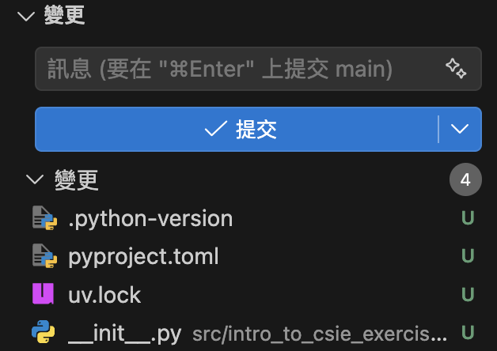
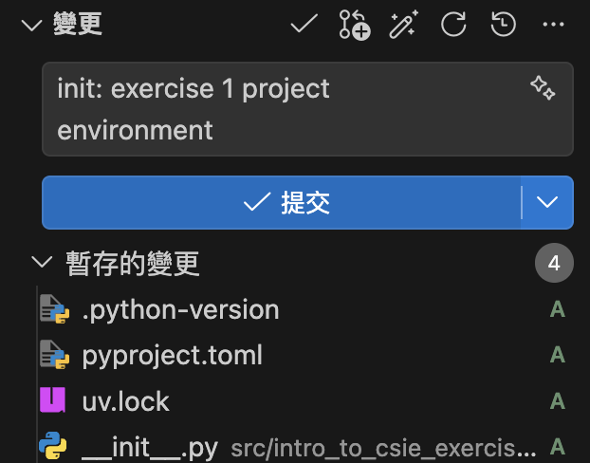
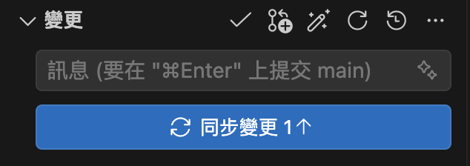
PHASE 2 · Project Version Control
1
Push the First Commit
VS Code
  In the Source Control panel, click the + next to Changes to stage all file changes
  Enter a commit message and click the checkmark to commit the staged changes
  Click Sync Changes to push to GitHub
Terminal
  git add .
  git commit -m "init: exercise 1 project environment"
  git push

Slide 11

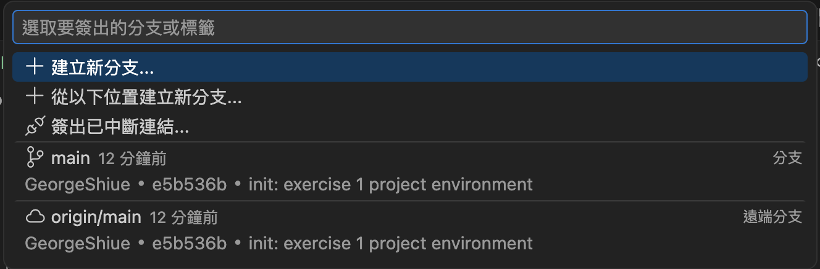
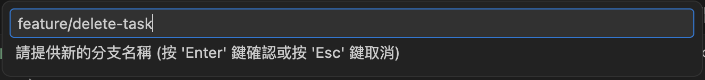
PHASE 2 · Project Version Control
2
Create the feature/delete-task Branch
VS Code
  Click the current branch name (main) in the bottom-left corner
  Select "Create new branch"
  Enter feature/delete-task
Terminal
  git checkout -b feature/delete-task

Slide 12

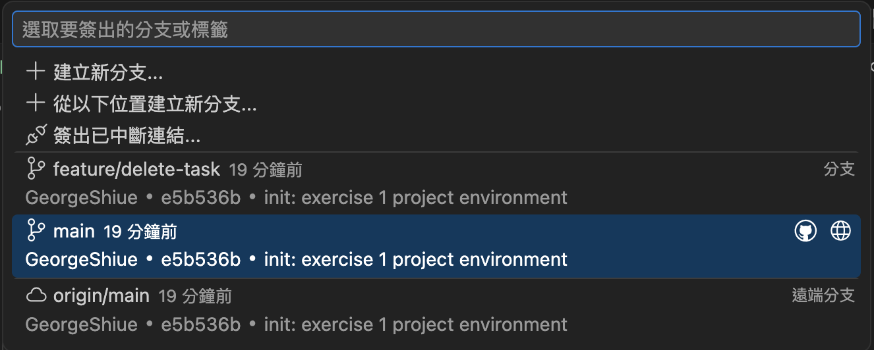
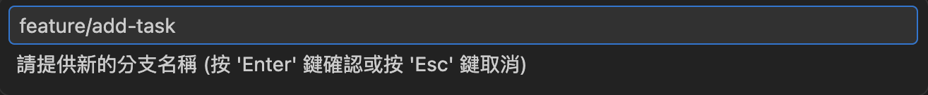
PHASE 2 · Project Version Control
3
Create the feature/add-task Branch
VS Code
  Click the branch name (feature/delete-task) in the bottom-left corner
  Click the local main branch to switch to it
  Repeat the previous step to create the feature/add-task branch
Terminal
  git checkout main
  git checkout -b feature/add-task

Slide 13
PHASE 3 · Add Duplicate-Task Prevention
Continuing on the feature/add-task branch, strengthen the duplicate check before add_task adds a new item, and update the display and verification flow.
①
②
③
Check Whether the Task Is Duplicate
Update the Display Logic Accordingly
Verify and Push the Commit
Compare names before add_task adds an item, and skip the addition if it is a duplicate
show_tasks() displays the current item count; main() adds a duplicate test
Run uv run todo.py to confirm the output, then push the commit

Slide 14
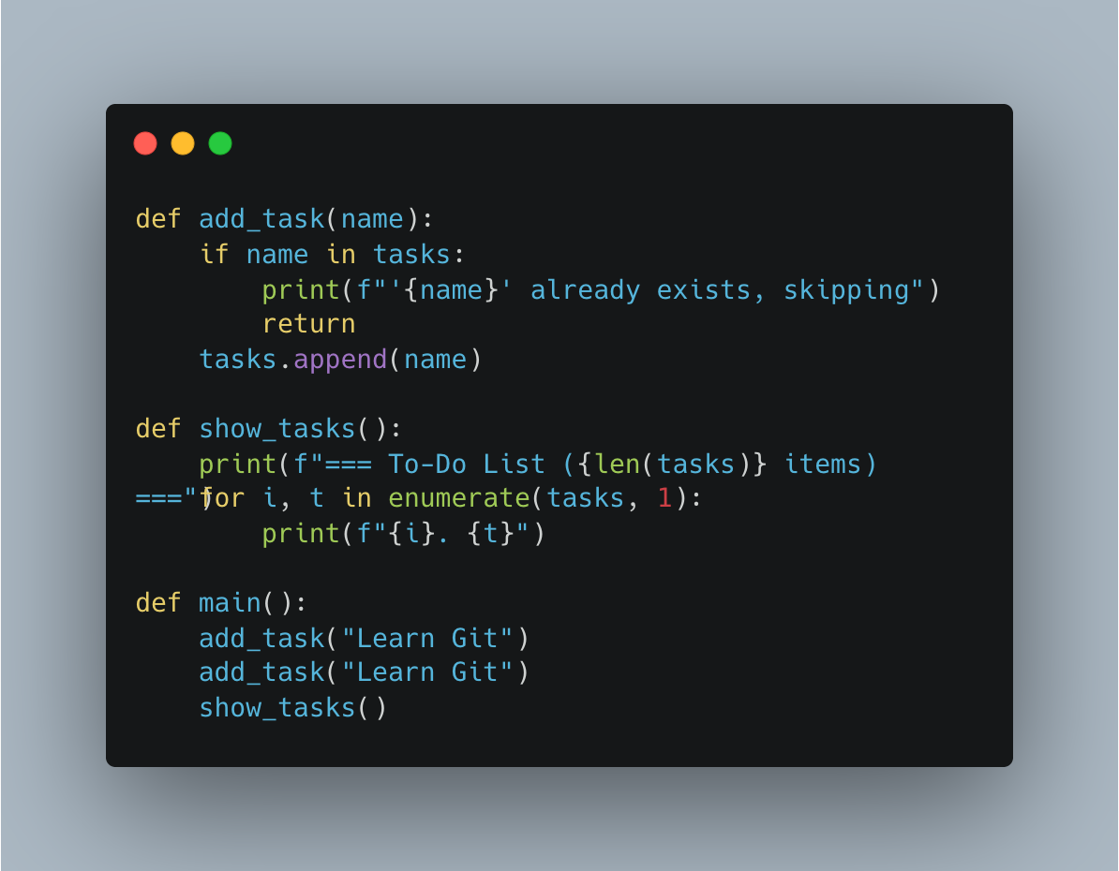
PHASE 3 · Add Duplicate-Task Prevention
1
Modify todo.py to Prevent Duplicate Tasks
add_task(): add a duplicate check
show_tasks(): display the item count
main(): add a duplicate-prevention demo

Slide 15
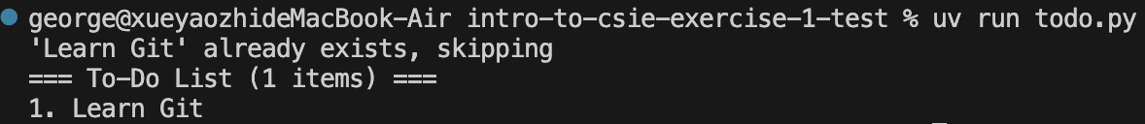
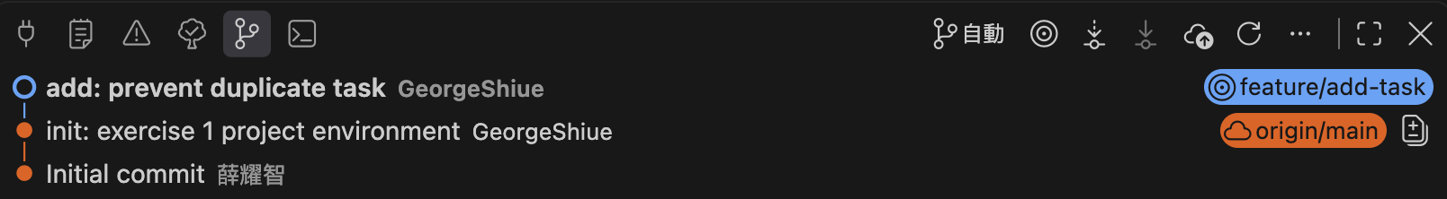
PHASE 3 · Add Duplicate-Task Prevention
2
Verify, Then Push the Commit
Run uv run todo.py in the terminal
  Confirm the duplicate task is blocked and a message is printed
  Confirm the header shows "1 item total"
Repeat the earlier commit steps, commit "add: prevent duplicate task", and push to GitHub

Slide 16
PHASE 4 · PR Merge and Sync
1
2
3
4
Compare & pull request
Check the Diff
Merge pull request
Sync the Local main Branch
base: main ← compare: feature/add-task
In Files changed, confirm only todo.py was modified, write a brief PR description, then click Create pull request
Click Merge pull request → Confirm merge to complete the merge
git checkout main && git pull, then run uv run python todo.py to verify Feature 1

Slide 17
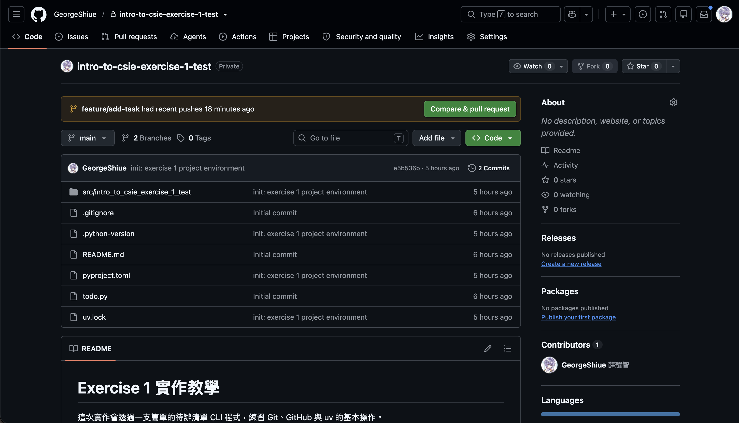
PHASE 4 · PR Merge and Sync
1
Go Back to GitHub to Open a Pull Request
Go to your personal exercise 1 repository page
Click "Compare & pull request"

Slide 18
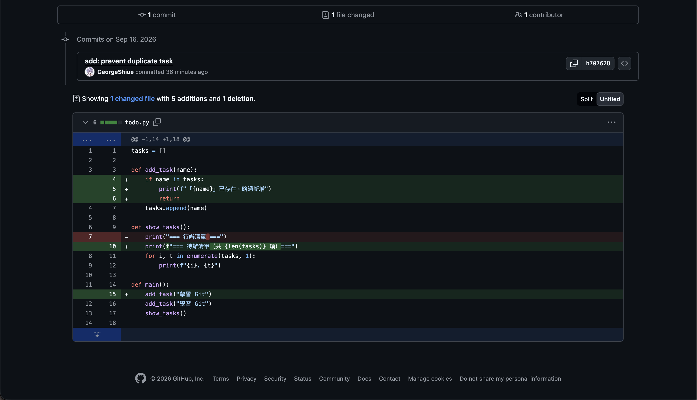
PHASE 4 · PR Merge and Sync
2
Review Changes Before Opening Pull Request
Review the commit history and file changes below
Confirm only todo.py was modified

Slide 19
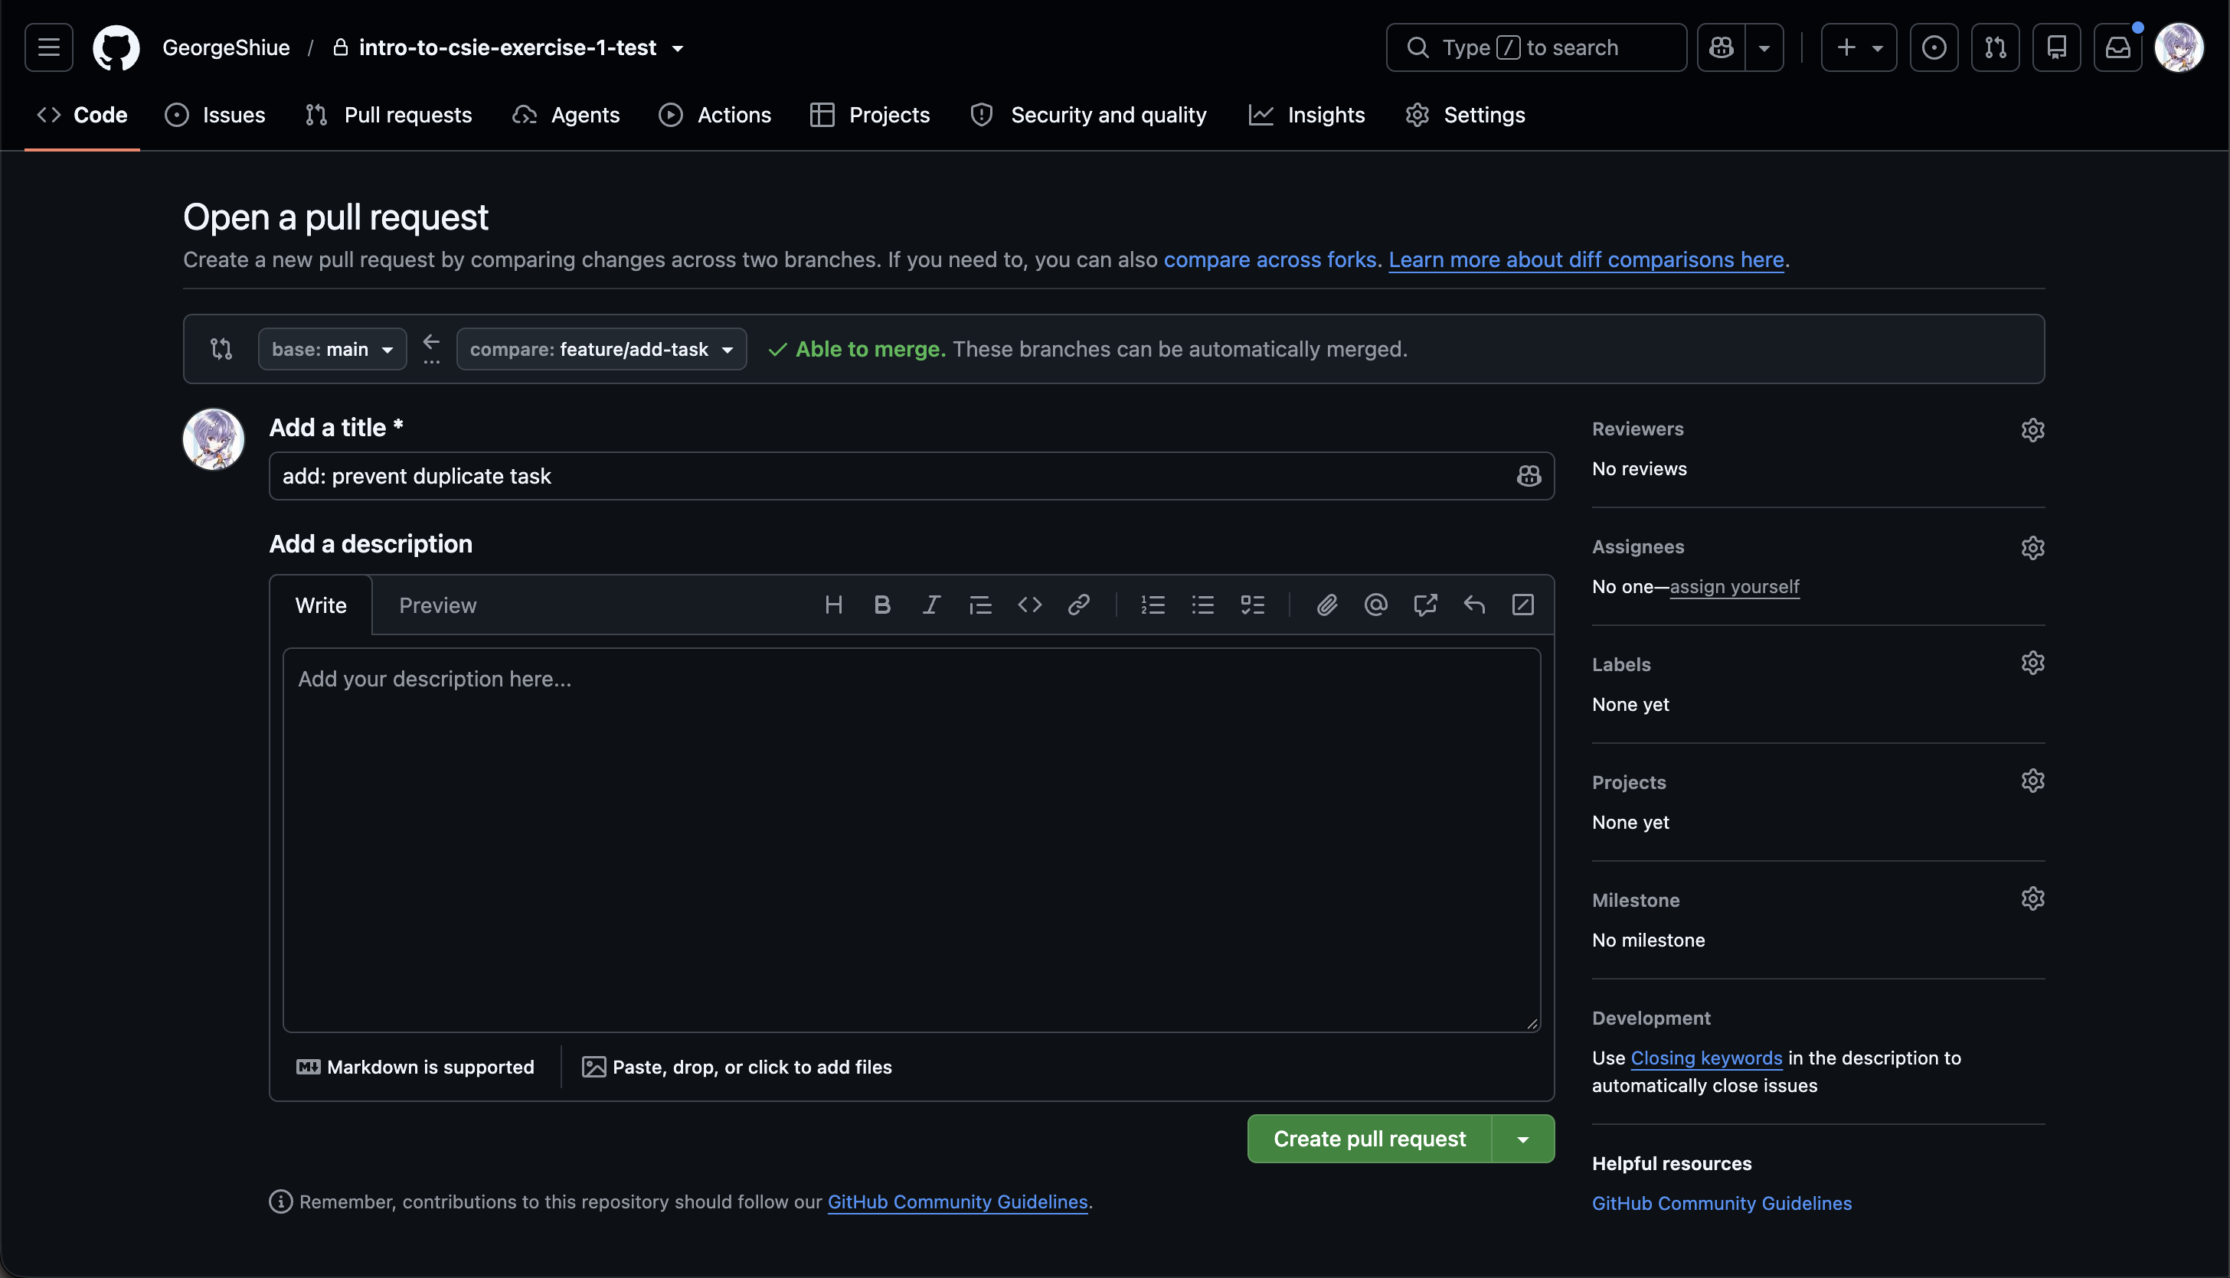
PHASE 4 · PR Merge and Sync
2
Review Changes Before Opening Pull Request
Scroll back up to confirm base: main ← compare: feature/add-task and that the right side shows "Able to merge"
Click "Create Pull Request"

Slide 20
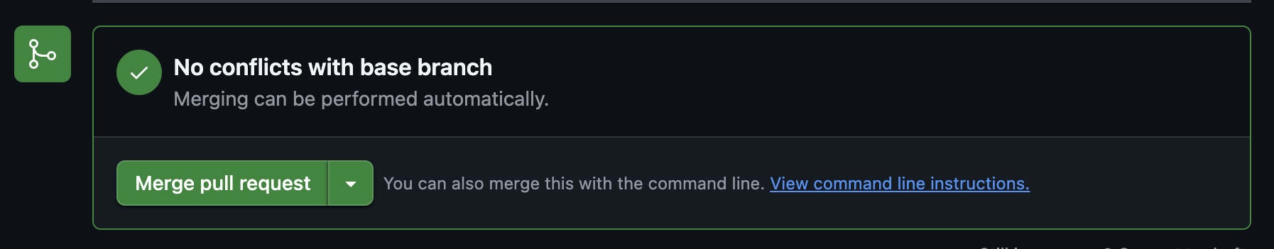
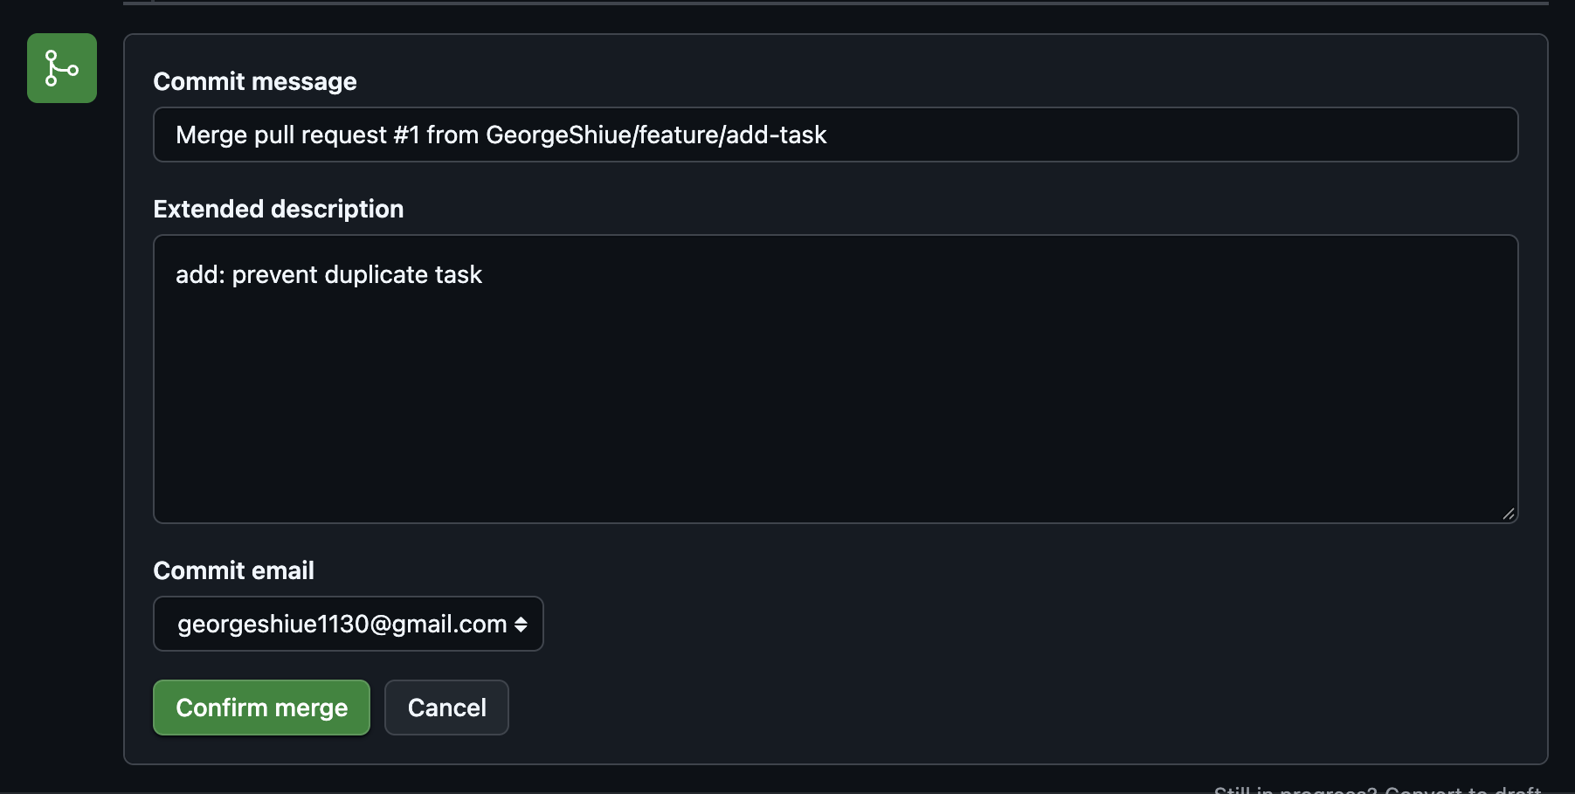
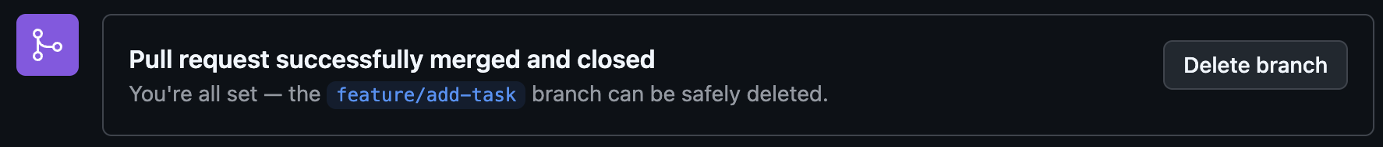
PHASE 4 · PR Merge and Sync
3
Merge the Pull Request
After the PR is created, click "Merge pull request"
Click "Confirm merge" again
"Pull request successfully merged and closed" confirms the merge succeeded

Slide 21
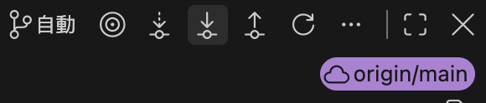
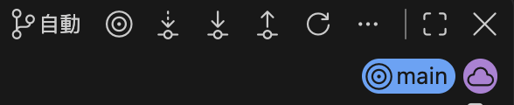
PHASE 4 · PR Merge and Sync
4
Sync and Verify Feature 1
Sync the local main branch to the latest progress
  VS Code:
    Click the branch name (bottom-left) to switch to main
    Open Git Graph and click Pull at the top
  Terminal:
    git checkout main
    git pull
Verify Feature 1:
  Run uv run python todo.py
  Confirm the duplicate task is blocked and the count is shown

Slide 22
Recap: Phases 1–4
1
Phase 1 · Set Up Project Environment
Use the template to create separate repositories, so version history is trackable from the start and everyone works independently.
2
Phase 2 · Project Version Control
Use feature branches to isolate development, keeping main stable and enabling multiple features to be developed in parallel.
3
Phase 3 · Duplicate-Task Prevention
Understand the existing code logic before modifying a feature, and build the habit of considering edge cases at the same time.
4
Phase 4 · PR Merge and Sync
A pull request is the checkpoint for code review and version sync, ensuring changes are reviewed and verified before merging into main.

Slide 23
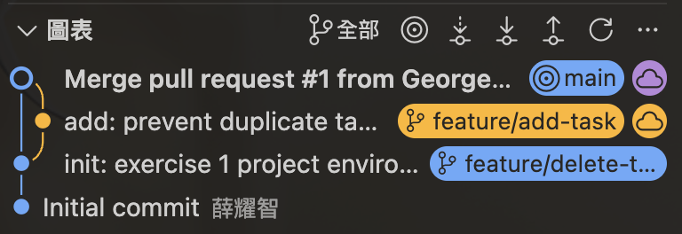
Submission Requirements
Items to Submit
GitHub repo link (including the merge records of both the Feature 1 and Feature 2 PRs)
Git Graph screenshot (from VS Code, clearly showing the branching and merge process)
Assignment Rules
Each assignment is worth 2.5% of the grade
Due by 23:59 on the day of class

Slide 24
PHASE 5 · Delete-Task Feature
Add a delete_task feature on the feature/delete-task branch, allowing users to remove a task from the list by name.
①
②
③
Find and Remove the Task
Handle the Not-Found Case
Update the Display and Push the Commit
delete_task searches the list by name and removes the matching entry if found
Show a message if the name does not exist, without interrupting program execution
show_tasks() re-displays the list; verify it, then push the commit

Slide 25
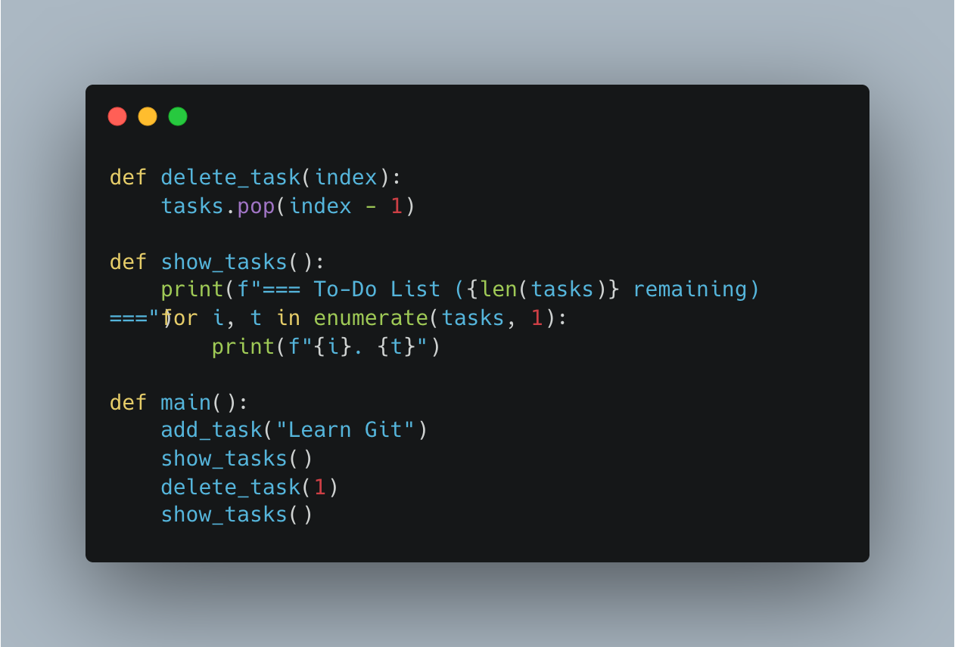
PHASE 5 · Delete-Task Feature
Push the Delete-Task Feature and Open a PR
Switch to the feature/delete-task branch
Modify todo.py
Commit "add: delete task" and push
Open a PR on the GitHub page

Slide 26
PHASE 5 · Delete-Task Feature
A Conflict Appears: Merge Conflicts
After creating the PR, the page shows a red “Can't automatically merge” message — GitHub is telling you in advance that main and feature/delete-task already conflict.
Conflict Markers in todo.py
Why the Conflict Happened
<<<<<<< main
print(f"=== To-Do List ({len(tasks)} items total) ===")
=======
print(f"=== To-Do List ({len(tasks)} items remaining) ===")
>>>>>>> feature/delete-task
Both branches modified the same title line in show_tasks()
But changed it to different content ("total" vs "remaining")
Other parts (duplicate prevention, delete_task) don't conflict — Git will merge them automatically
On the PR page: a red "Merge conflicts" label, the message "This branch has conflicts that must be resolved," and a grayed-out, unclickable "Merge pull request" button

Slide 27
PHASE 6 · Resolve Merge Conflict
1
2
3
4
Edit on the web
Keep One Version
Mark as resolved
Commit merge
Click the dropdown arrow next to "Resolve conflicts" → select "Edit on the web" (do not choose "Fix with Copilot")
Delete the conflict markers (<<<<<<<, =======, >>>>>>>) and the line you don't want, keeping only one version of the title
Once the red "1 conflict" in the top-right disappears and turns into a green checkmark "Resolved," click "Mark as resolved"
Go back to the PR page and click the green "Commit merge" button to complete the merge
Then sync locally: git checkout main && git pull, run uv run todo.py, and confirm the duplicate-prevention and delete features both work correctly and the header displays properly.

