Slide 1








Donate blood, save lives
Free App : friends2support.org
Notes:
Friends2Support is an online Blood Donors Organisation, started on 14 November,2004 with a motive to

Slide 2

Free App : friends2support.org
Notes:
Friends2Support is an online Blood Donors Organisation, started on 14 November,2004 with a motive to

Slide 3



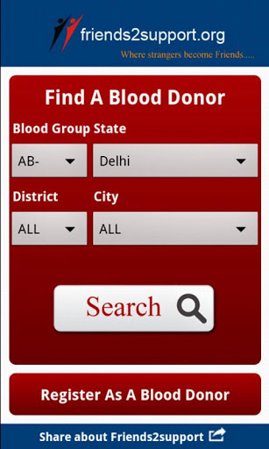
Free App : friends2support.org
Notes:
Friends2Support is an online Blood Donors Organisation, started on 14 November,2004 with a motive to

Slide 4
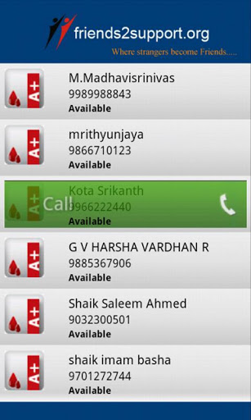
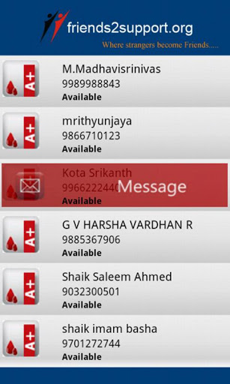
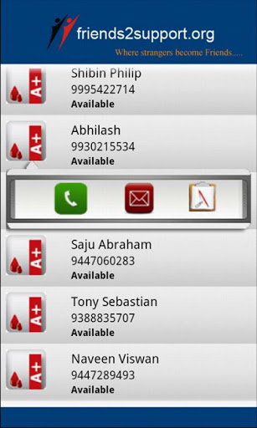
Free App : friends2support.org
Notes:
Friends2Support is an online Blood Donors Organisation, started on 14 November,2004 with a motive to

Slide 5
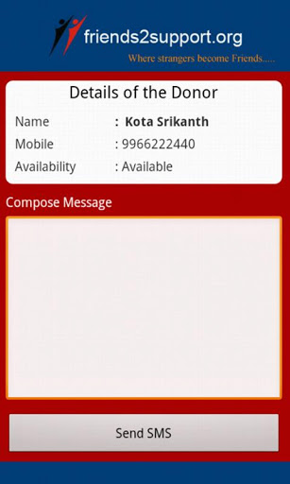
Free App : friends2support.org
Notes:
Friends2Support is an online Blood Donors Organisation, started on 14 November,2004 with a motive to

Slide 6
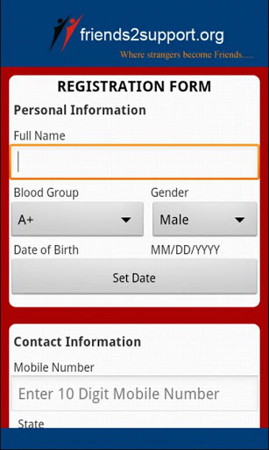
Free App : friends2support.org
Notes:
Friends2Support is an online Blood Donors Organisation, started on 14 November,2004 with a motive to

Slide 7
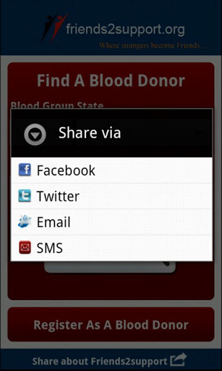
Free App : friends2support.org
Notes:
Friends2Support is an online Blood Donors Organisation, started on 14 November,2004 with a motive to

Slide 8
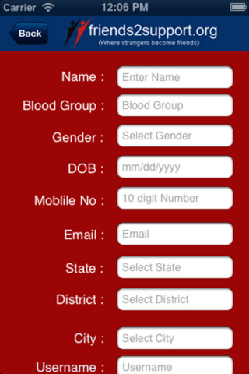

Free App : friends2support.org
Notes:
Friends2Support is an online Blood Donors Organisation, started on 14 November,2004 with a motive to

Slide 9
Smartest solution
Best use of technology
Life is precious
Donate blood, save lives
Free App : friends2support.org
Notes:
Friends2Support is an online Blood Donors Organisation, started on 14 November,2004 with a motive to

Slide 10
Mobile app to reach a large crowd
Help those in frantic need of blood
Donate blood, save lives
Free App : friends2support.org
Notes:
Friends2Support is an online Blood Donors Organisation, started on 14 November,2004 with a motive to

Slide 11
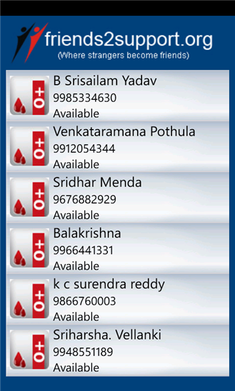
Bringing smiles to millions ☺
Saving life is just a touch away!
Donate blood, save lives
Free App : friends2support.org
Notes:
Friends2Support is an online Blood Donors Organisation, started on 14 November,2004 with a motive to

