Slide 1
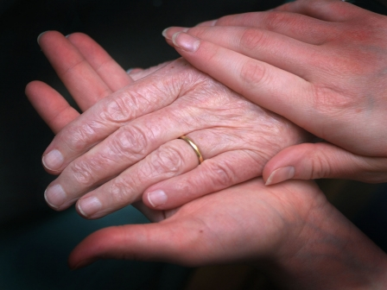
If you care, just share!
If you care for the people who are suffering to get blood to their loved ones, during emergencies… just share the concept! Share the concept of Voluntary Blood Donation

Slide 2
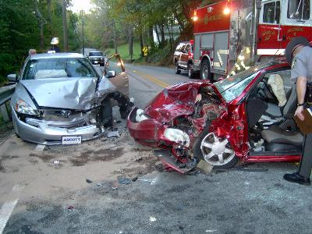
Road Accidents

Slide 3

Strikes

Slide 4
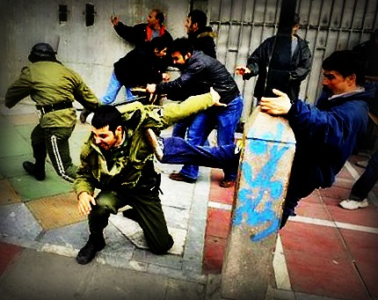
Conflicts

Slide 5

Why lose blood for no reason?

Slide 6
Where do we donate blood?
How do we know there is a requirement?

Slide 7
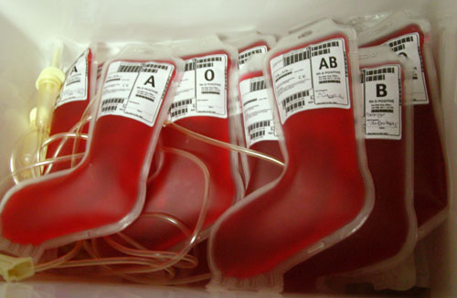
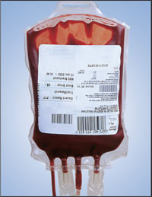
Facing REALITY
India needs 5 crore units of blood every year
India supplies ONLY 50 lakh units every year
A country of over 1 billion fails to fulfill even 10% of its blood requirements.

Slide 8
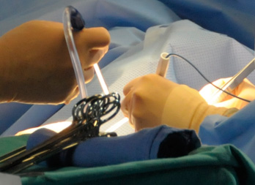
Organ transplantation
Such transplants need about 40-50 units of blood!

Slide 9
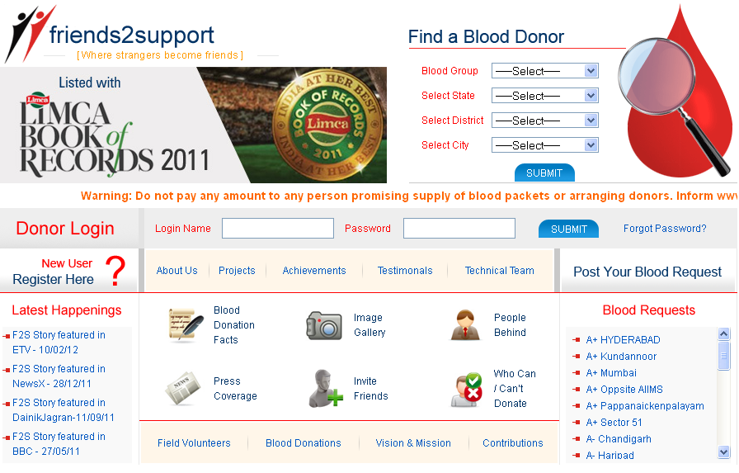
friends2support.org

Slide 10
Role of F2S
Friends 2 Support accepts requests for blood from all over the country via its web portal.
Friends 2 Support brings together individuals who volunteer to donate blood.

Slide 11
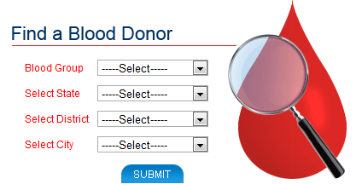
Finding a donor
We provide timely support to those who are in a frantic of blood.

Slide 12

Support via SMS
friends2support.org enables a faster response by supporting an instant messaging service for its users.

Slide 13

Motto and Vision
Motto
Donate blood to save precious lives
Vision
To be the hope of every Indian in search of a voluntary blood donor

Slide 14

Team F2S
The F2S team consists of a group of passionate souls throughout the country who understand the need of blood donation.

Slide 15
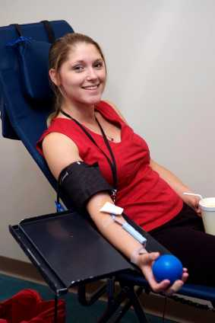
Come forward
Blood Cannot be Manufactured.
It can come only from willing donors.

Slide 16

Come forward
If you hesitate to donate blood even to your loved ones when in need,
how can you expect someone to donate blood to you during emergency?

Slide 17

Where strangers become friends!
Register as a voluntary blood donor with www.friends2support.org

Slide 18


F2S so far!
Team F2S has so far helped save 1,50,000 lives!
All of this has been possible with the undulating support of 1,00,000 volunteers!
Such numbers have got to bring a smile on your face ☺

Slide 19



Recognizations so far!
Listed with LIMCA BOOK of RECORDS as India’s Largest voluntary Blood Donors Website
Listed with INDIA BOOK of RECORDS as India’s Largest voluntary Blood Donors Website
Listed with Asia BOOK of RECORDS as World’s Largest voluntary Blood Donors Website

Slide 20


Recognizations so far!
Winner of Manthan Award
Winner of World Summit Youth Award
Nasscom Social Innovations Nomine

Slide 21
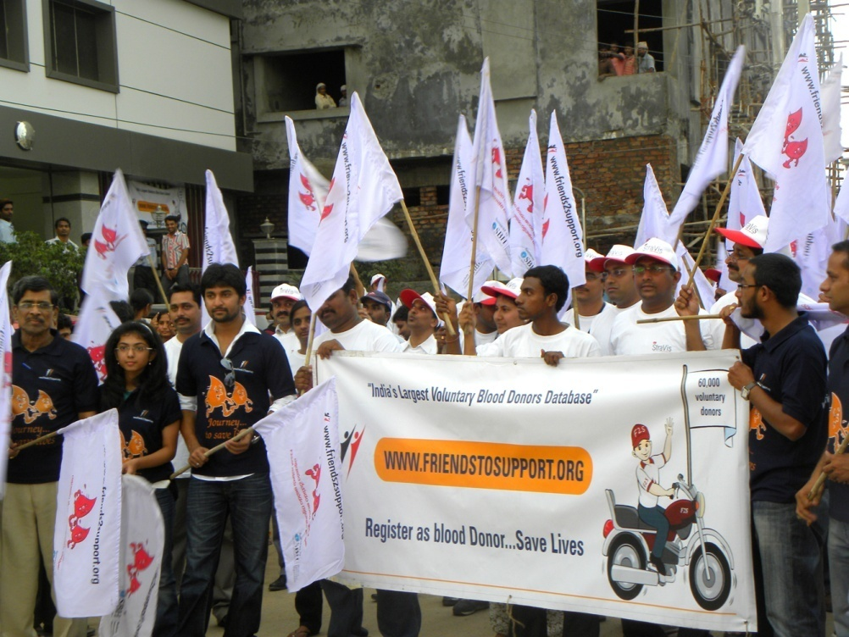
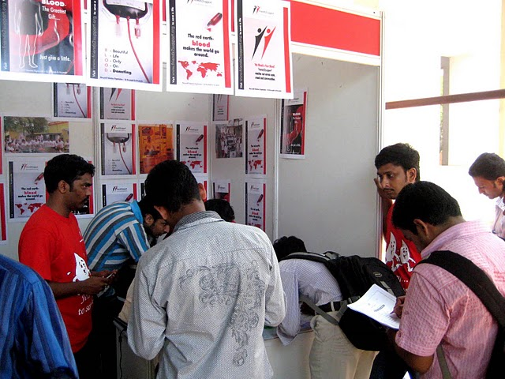
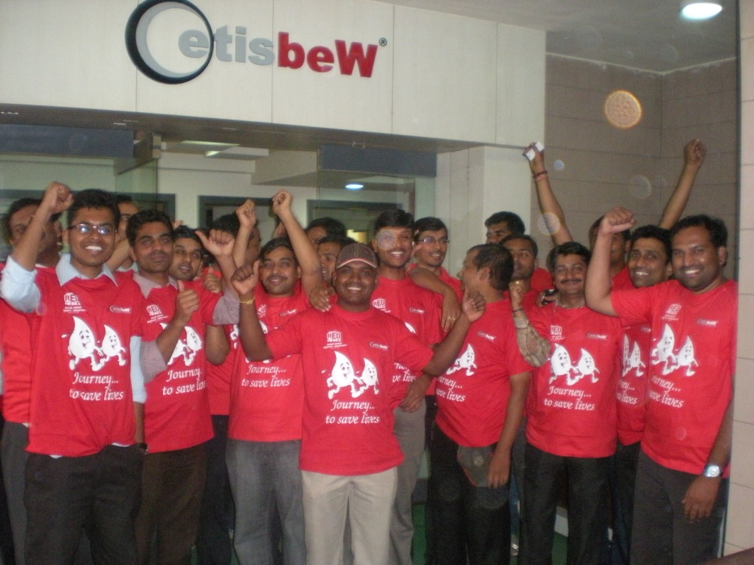
Reaching People to save lives!
Awareness Walks
Awareness Camps
Rallys

Slide 22
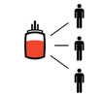
Decide and donate!
Monetary donation would only fulfill a person’s needs.
The donation of a mere 350ml can save the lives of three people!

Slide 23

Pledge your support
Let us all pledge to donate blood and save lives.
Each one, reach one!
www.friends2support.org

