Slide 1
AI-driven Tree Detection in South Florida: Benchmarks and Fine Tuned models for YOLO and Deep Forest.
Tim, Rayan, Ahsan
Frost Institute for Data Science and Computing, University of Miami | Summer 2026
Notes:
(about 20 sec) Hi everyone, I'm Rayan. Our instructor already set up the problem and the data, so I'll focus on what I built this summer, what the results were, and what I learned. After me, Ahsan will walk through his YOLO work.

Slide 2
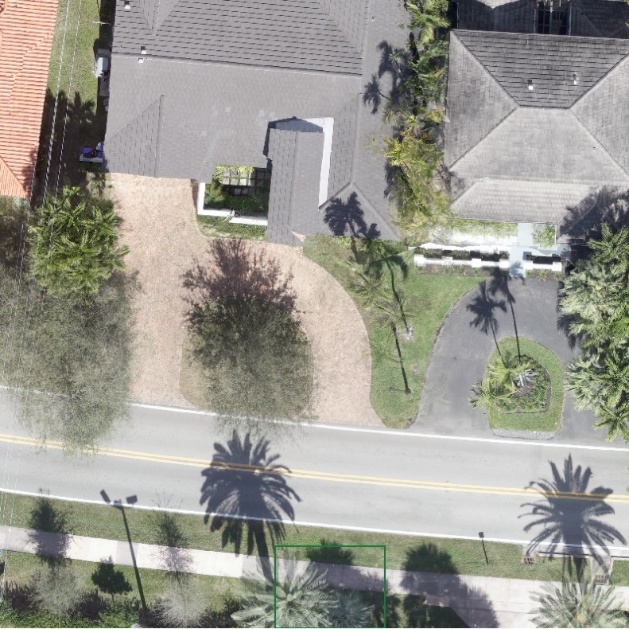
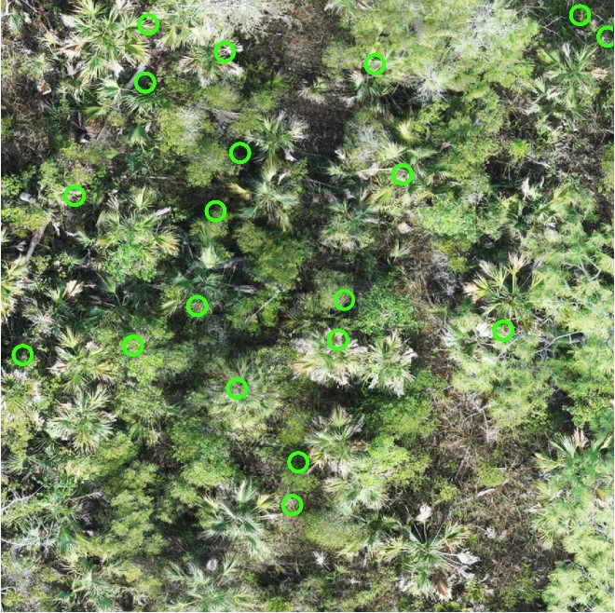
My part: one pipeline, two very different forests
UM Coral Gables campus
40 m x 40 m tile. Sparse, urban, palm-heavy. Inventory of 6,988 confirmed trees.
Big Cypress National Preserve
20 m x 20 m patch. Dense wetland, crowns overlap. About 1,500 to 2,600 trees per hectare. (Circles = surveyed palms.)
The question: can a model find every individual tree in an ordinary color (RGB) photo, and can we trust the score it gets?
Notes:
(about 35 sec) I worked on two sites. On the left is a tile from the Coral Gables campus: trees are mostly separated, lots of palms, and there's a botanical inventory with about seven thousand confirmed trees. On the right is Big Cypress: a 20 by 20 meter patch of wetland forest where trees are packed together and crowns overlap. The question sounds simple: can a model find every individual tree from an ordinary color photo, and can we trust the score it reports? That second half ended up being most of my summer.

Slide 3
Timeline: May to September
May
Jun 1 to 22
Jun 29 to Jul 21
Jul 21 to 23
Jul 28 to Aug 7
Aug to Sep
Setup
Build
Question the score
Big Cypress
Consolidate
Write-up
Repo, imagery, and QGIS maps set up with Tim Norris
Labels, split, tiling, first DeepForest model, region-swap test (s01 to s06)
Species probe, recall tests, manual audit, clean evaluation area (s07 to s12)
Three detectors, species probe, size and alignment checks (s13 to s18)
Fair distance-based scoring, from-scratch CNN, 3-way benchmark (s19, s20)
Synthesis, READMEs, this talk
How it was built
20
25
Every step
1 laptop
numbered scripts, each one answering one question
commits, each a finished experiment with its results
saves a figure and a CSV, so results get checked by eye
all training on a MacBook (M3 Pro, 18 GB, Apple GPU)
Notes:
(about 40 sec) Here's how the summer went. May was setup with Tim. In early June I built the core pipeline and trained a first model. From late June to mid July I spent most of my time questioning the score, and that turned out to be the most important part. In late July I moved the whole approach to Big Cypress and ran a set of diagnostics. Then I consolidated with a fair scoring method and a model I wrote from scratch. How I kept it manageable: every experiment is one numbered script that answers one question, gets one commit, and saves a figure so I can check it visually.

Slide 4
Architecture: from drone photo to tree map
1. Inputs
2. Labels
3. Split + chips
DeepForest
RetinaNet, pretrained on forests
5. Scoring
6. Outputs
Drone orthomosaic (RGB GeoTIFF)
Tree locations as points: campus inventory, Big Cypress plot census
Point-first: one label per real tree
A box (DeepForest, YOLO) or a soft blob on a heatmap (my CNN)
Split by geography: region or whole plot
Cut into small chips, reading one window at a time
Each prediction becomes a point
Matched to nearest real tree (1, 2, 5 m)
Compared to random scatter
Tree points for QGIS
Metrics CSV
Figures
YOLO26s
COCO-pretrained, Ahsan's recipe
TreeNet (mine)
heatmap CNN from scratch, ~2 M params
Diagnostics loop (decides the next script): manual audit in QGIS | false positive / false negative buckets | tree-size re-score | alignment (georeferencing) sweep
config.yaml
every setting in one file
SOFLO_DATA_ROOT
~3.7 GB of imagery stays off GitHub
PyTorch on Apple GPU
windowed reads, peak RAM under 6 GB
Git
one script + one commit per experiment
Notes:
(about 55 sec) This is the whole system on one slide. Inputs are the drone photos plus ground-truth tree locations stored as points. Step two turns each point into a training label: a box, or a soft blob on a heatmap, depending on the model. Step three splits the data by geography, so a model is always tested on ground it never saw, and cuts the huge images into small chips, reading only one window at a time so everything fits on a laptop. I trained three kinds of detectors. All three are scored the same way: every prediction becomes a point, gets matched to the nearest real tree, and is compared against random guessing. The loop at the bottom is the part that mattered most: diagnostics like the manual audit decided what the next script would be. Along the bottom is the plumbing that kept it reproducible.

Slide 5
Step 1: the old labels missed most of the trees
~6 in 10
confirmed trees had no outline from the prior model
640
outlines merged two or more trees into one crown
Design choice: trust the points, not the outlines
Every confirmed tree gets exactly one box: its real crown where a clean outline exists, otherwise a ~7 m box sized from the data. Each box is tagged with where it came from.
Notes:
(about 40 sec) The first real decision came before any model. When I lined up the inventory points with the old model's crown outlines, almost six in ten real trees had no outline at all, and 640 outlines had swallowed two or more trees. So I stopped trusting the outlines. Every confirmed tree gets exactly one box: its real crown shape where a clean outline exists, otherwise a fixed-size box of about 7 meters that I derived from the clean outlines. Every box is tagged with its source, so I can always trace where a label came from.

Slide 6
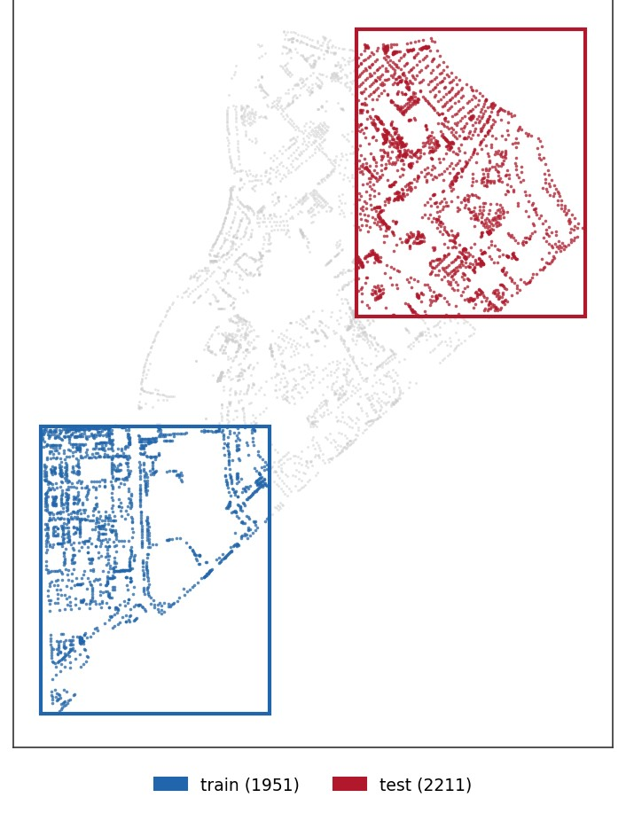
Step 2: a first model, and a score that looked bad
F1 = 0.39
precision 0.40, recall 0.39, scored by box overlap (IoU 0.4)
Model: DeepForest (RetinaNet pretrained on forest canopy), fine-tuned on campus tiles
Design choice: split by geography, not random trees, so the test area is ground the model never saw
Training: early stopped at epoch 13 (best epoch 5), about 28 minutes on the laptop
Swap test: trading the train and test regions moved F1 from 0.39 to 0.32, so the score depends on where you test
Next move: not a bigger model, but checking whether the score itself was right
Blue = train region (1,951 trees), red = test region (2,211 trees)
Notes:
(about 40 sec) Next I fine-tuned DeepForest, a detector pretrained on forest canopy. One design choice here: I split train and test by region, bottom left versus top right, instead of picking trees at random. Random splits leak, because neighboring trees look alike. Training early stopped after about 28 minutes. The first score was an F1 of 0.39, which looks bad. And when I swapped the two regions it dropped to 0.32, so the number also depends on where you test. Instead of reaching for a bigger model, I asked whether the score itself was right.

Slide 7
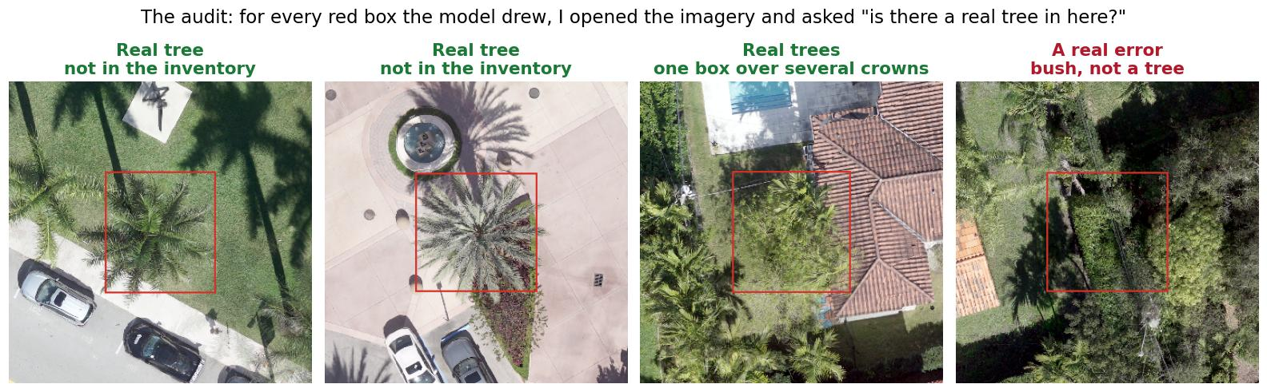
Step 3: was the model wrong, or the answer key?
4 of the 100 random "false positives" I checked one by one in QGIS. Red box = a tree the model found that the inventory has no record of.
94 of 100
5.4%
~0.61, not 0.96
were real trees the inventory never recorded (3 were real errors, 3 unsure)
of misses were truly undetected; the rest had a box on or near the tree, just too loose
only 43 of the 94 were new trees (51 were loose boxes), so extrapolated precision is ~0.61
Notes:
(about 45 sec) So I pulled a random 100 of the model's false positives and opened each one in QGIS. Here are four of them. In the first three there is obviously a tree inside the box, the inventory just never recorded it, and the third one shows a different problem: one box sitting over several crowns at once. The fourth is a real error, a bush. Across the 100: 94 were real trees, 3 were errors, 3 I was unsure about. On the other side, only about 5 percent of the misses were trees the model never found. I also had to catch myself: a quick extrapolation said precision might be 0.96, but only 43 of the 94 were brand-new trees, so the careful number is about 0.61.

Slide 8
Step 4: change the ruler, and always compare to random
Problem: box overlap punished loose boxes and trees missing from the inventory
New ruler: turn each prediction into a point and match it to the nearest real tree within 1, 2, or 5 m, one match per tree
Random floor: scatter the same number of random points and score them the same way. A model only counts if it beats that.
Fair region: score inside a 250 m x 250 m labeled area so unlabeled ground doesn't count against the model
Campus at 5 m: F1 0.57, and the model finds 32 points more of the trees than random does
Notes:
(about 40 sec) That told me box overlap was the wrong ruler, so I changed it. Every prediction becomes a point, and it counts as correct if it's within a set distance of a real tree, one match per tree. The second piece is a random floor: I scatter the same number of random points and score them the exact same way. Every model should have to answer: do you beat darts thrown at a map? On campus the answer is clearly yes. At 5 meters the model finds half the trees and random finds 18 percent. F1 is 0.57.

Slide 9
Campus outcomes: three detectors, one fair comparison
Detection
My from-scratch model finds almost as many trees as DeepForest (recall 0.49 vs 0.50); the gap is false alarms
Read as an experiment: pretraining is worth about 0.15 to 0.24 F1 on this site
Species
Palm vs. not-palm on labeled tree crops: 89.9% accuracy, vs. 54.6% by always guessing the majority (an upper bound)
Pine and cypress couldn't be trained: 55 pine and 22 cypress vs. 3,461 other trees (157 to 1)
TreeNet = mine, from scratch | DeepForest = mine, fine-tuned | YOLO26s = Ahsan
Precision / recall: TreeNet 0.37 / 0.49 | DeepForest 0.67 / 0.50 | YOLO26s 0.65 / 0.67
Notes:
(about 45 sec) With a fair ruler, I could compare three detectors on identical data. My from-scratch CNN, written without any pretrained weights, gets 0.42. DeepForest gets 0.57. Ahsan's YOLO gets 0.66, and he'll explain why. The interesting part: my scratch model finds almost as many trees as DeepForest; it just has more false alarms. So read as an experiment, pretraining is worth roughly 0.15 to 0.24 F1 here. I also tested species. Palm versus not-palm works well, about 90 percent. But pine and cypress barely exist on campus, 22 cypress against 3,461 others, so a four-class model wasn't trainable.

Slide 10
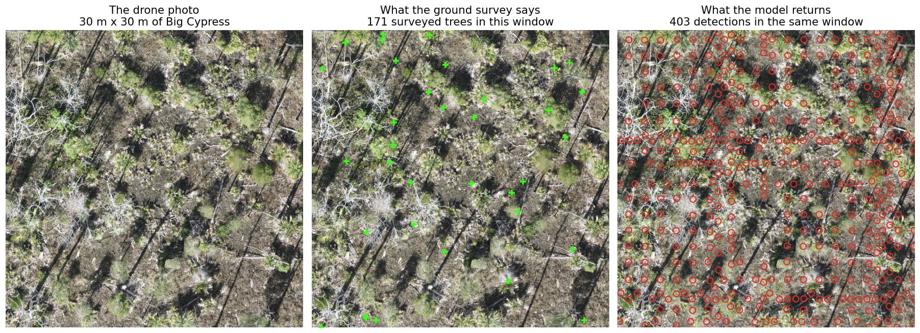
Big Cypress: same playbook, hit a wall
Held-out plot, one 30 m window three ways. Green + = surveyed tree, red circle = model detection.
Whole plot: 2,576 surveyed trees, 4,212 detections. Every detector lands at F1 ~0.11 at a 1 m radius (random scatter gets ~0.10); DeepForest boxes found 3.9% of trees.
Species too: pine / cypress / palm reached 56.9%, worse than always guessing pine (72.1%)
Beating random by recall:
campus +32 points (at 5 m)
Big Cypress +2 points (at 1 m)
Notes:
(about 45 sec) Then I brought the same playbook to Big Cypress. This is the same 30 meter window three ways. On the left is just the drone photo: crowns overlap and the ground is a mess of dead wood. In the middle are the trees the field crew actually surveyed, 171 in this window. On the right is what the model returns, 403 detections in the same window. It is not finding trees, it is carpeting the plot. Over the whole plot that is 4,212 detections against 2,576 real trees. Every detector family lands at an F1 around 11 percent, and random scatter gets about 10. Species classification did worse than just guessing pine. On campus the model beat random by 32 points of recall. Here it is 2.

Slide 11
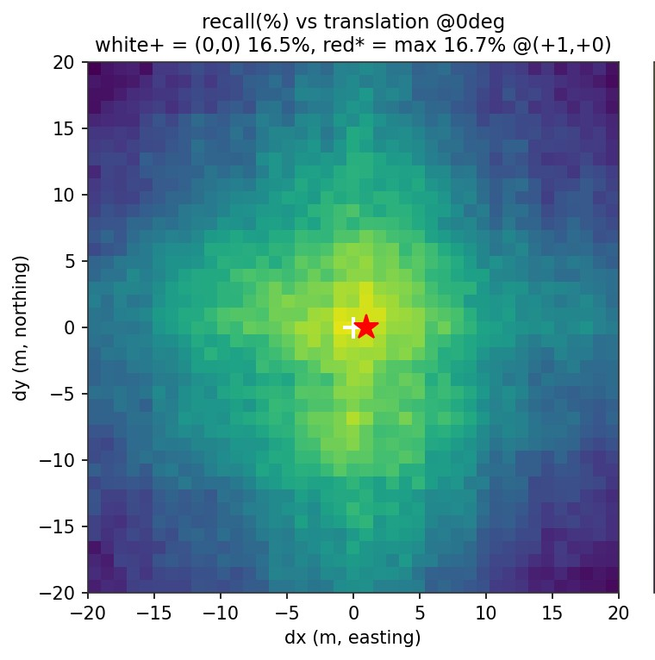
Ruling out the easy excuses
Architecture
Training
Resolution
Three model families (boxes, heatmap, YOLO) all land at F1 ~0.11
Weighted MSE loss collapsed to a blank map; focal loss learned, still ~0.11
Tried 1.6, 3, 5, and 10 cm per pixel; 5 cm best, none fixes it
Box size
Tree visibility
Alignment
Swept 1.5 to 3 m; 2 m best, every size near random
Recall stays ~17% even for the biggest 10% of trees
Palm points sit on palm crowns; shifting or rotating the survey never helps
Recall vs. shifting the survey points up to 20 m: best at no shift
Conclusion: flat RGB can't separate overlapping crowns in dense wetland. Height data is the lever, not a better model.
Notes:
(about 50 sec) A result that bad could just be a bug, so I tried to break my own conclusion. Three different model families land at the same number, so it isn't the architecture. I fixed a loss function that was collapsing, and it still landed there. I tried different resolutions and box sizes. I checked whether it only misses small trees: recall stays flat even for the biggest trees. And I checked whether the survey points were misaligned with the photo: palm points land on palm crowns, and shifting the points in every direction never improves recall. It peaks exactly at no shift, which is what this heatmap shows. So the conclusion is that flat color imagery doesn't carry enough signal in dense, overlapping canopy. Height data is the lever.

Slide 12
Where I used AI, and where I didn't
AI-assisted (Claude, mostly Opus 4.8)
Done myself
Drafting and debugging the pipeline scripts
Plotting and figure code for every step
READMEs, methods notes, and commit write-ups
Writing the Claude Code prompts, with me setting the direction (next slides)
Data inspection: finding the missing-tree problem and choosing point-first labels
Experiment design: what to test next, which excuses to rule out, when to stop
Manual audit: hand-tagging 100 false positives in QGIS, the palm visual check
Interpretation: deciding what's real vs. an artifact, and catching overclaims (0.96 became ~0.61)
AI made the building fast. Every conclusion was checked against the data by me.
Notes:
(about 40 sec) On AI. I used Claude heavily for building, mostly Opus 4.8 in Claude Code: drafting and debugging the scripts, the figure code, the documentation, and even the prompts themselves, which Claude wrote while I steered. What I did myself was the part that decides whether a result is real: inspecting the data, designing the experiments, the manual audit, and interpreting results, including catching my own overclaims like the 0.96. My takeaway: AI makes building fast, and that makes checking against the data more important, not less.

Slide 13
AI reproducibility: how each experiment was run
1. I set the question
2. Claude writes the prompt
3. Claude Code runs it
4. I check the output
5. Commit
Chosen from the last result, e.g. "is the Big Cypress failure an alignment bug?"
In chat, Claude drafts a Claude Code prompt from my direction; I review and correct it
Opus 4.8 writes the script, trains or evaluates on my MacBook, saves figures and CSVs
Open the figures, compare to the data, hand-check where needed, reject overclaims
One commit per experiment, with the numbers and settings in the message
result decides the next question
Models and tools
What makes it reproducible
Claude (chat) wrote every Claude Code prompt, guided by me
Claude Opus 4.8 in Claude Code for most experiments and training runs
The last commit (s20) credits Claude Fable 5 instead
Every run executed locally on my MacBook, not in the cloud
Every setting in config.yaml, fixed random seeds
Exact numbers and run settings written into each commit
Commits from July on link to the Claude session that produced them
Baseline check: s09 re-runs the saved model and stops if scores drift by more than 0.03
Notes:
(about 35 sec) Since AI wrote a lot of this, here's how I kept it reproducible. Every experiment went through the same loop. I picked the question based on the last result. Claude wrote the Claude Code prompt from my direction, and I reviewed it. Claude Code, mostly Opus 4.8, wrote the script and ran it on my laptop. I checked the figures against the data. Then one commit with the exact numbers. On top of that: all settings live in one config file, seeds are fixed, commits link back to the Claude session that produced them, and one script re-runs the saved model and stops if the baseline drifts.

Slide 14
What a prompt looked like
Example: the s18 alignment check (the spec recorded at the top of the script, condensed)
The template every prompt followed
QUESTION
Is the Big Cypress census-to-imagery alignment offset, rotated, or flipped?
CONSTRAINTS
No retraining, no model changes. Pure diagnostics. Reuse the cached s16 predictions.
STEPS
1. Palm test: 20 m crops with only palm points over the imagery
2. Sweep shifts (+/-20 m), rotations (+/-20 deg), and flips; report the best one
3. Check plots and census are axis-aligned 100 m squares
4. Plain verdict: correct / offset / rotated / flipped
OUTPUTS
Write only under outputs/bcnp_georef and reports/bcnp_georef. Figures + CSV.
1
One question: a single thing to find out per script
2
Hard constraints: what not to touch: no retraining, keep the test set out
3
Staged steps: so partial results survive a crash
4
Laptop limits: windowed reads, small batches, 18 GB of memory
5
Named outputs: its own folders, figures, and CSVs
6
A plain verdict: which I then checked against the figures
My part in every prompt: picking the question and the constraints, and pushing back when a verdict overclaimed.
Notes:
(about 30 sec) Here's what one of those prompts looked like, using the alignment check as an example. It has one question, hard constraints like no retraining, staged steps, where outputs go, and it has to end with a plain verdict. Every prompt followed that same template. Claude wrote the wording, but the question and the constraints came from me, and I pushed back whenever a verdict claimed more than the figures showed.

Slide 15
What I learned
1
2
3
Check the answer key first
The metric is a design choice
Always report a random baseline
94 of 100 "mistakes" were real trees the inventory missed.
Same model: F1 0.39 by box overlap, 0.52 by distance on the same test area.
In dense forest it showed a decent-looking 19% recall was chance.
4
5
6
A negative result counts
Data and pretraining beat clever models
Small steps keep it honest
Ruling out six causes turned "it failed" into "RGB alone can't do this."
Pretraining was worth 0.15 to 0.24 F1; no model fixed Big Cypress.
One script, one question, one commit made every result traceable.
Notes:
(about 40 sec) Six things I'm taking away. Check the answer key before blaming the model. Treat the metric as a design choice, because the same model can look very different under two rulers. Always report a random baseline; in dense forest it exposed a decent-looking recall as chance. A negative result counts if you actually rule things out. Pretraining and the right data mattered more than clever architecture. And small steps, one question per script, is what made all of this traceable.

Slide 16
Next steps
Height data for Big Cypress: request the canopy height model from the drone processing (Tim Norris)
Fix the data: re-export three broken plot images (plot_8_3, plot_11_2, plot_12_3)
Finish the clean evaluation area: hand-label every tree in the 250 m square for a fully trustworthy campus score
Better model shape: crown segmentation or height-aware models instead of flat boxes
Cleaner evaluation: a separate validation region so the test set never picks the checkpoint
Write-up: research summary of both sites
Thank you
Up next: Ahsan, on the YOLO26s campus model
Code: soflo-tree-models (rayan branch)
Notes:
(about 30 sec) Next steps. The biggest one is height: I'm requesting a canopy height model for Big Cypress, which should separate overlapping crowns directly. There are also three plot images that need re-exporting, finishing the hand-labeled evaluation area on campus, trying crown segmentation, and keeping a separate validation region. Then the write-up. Thank you, and with that I'll hand it over to Ahsan.

