Slide 1
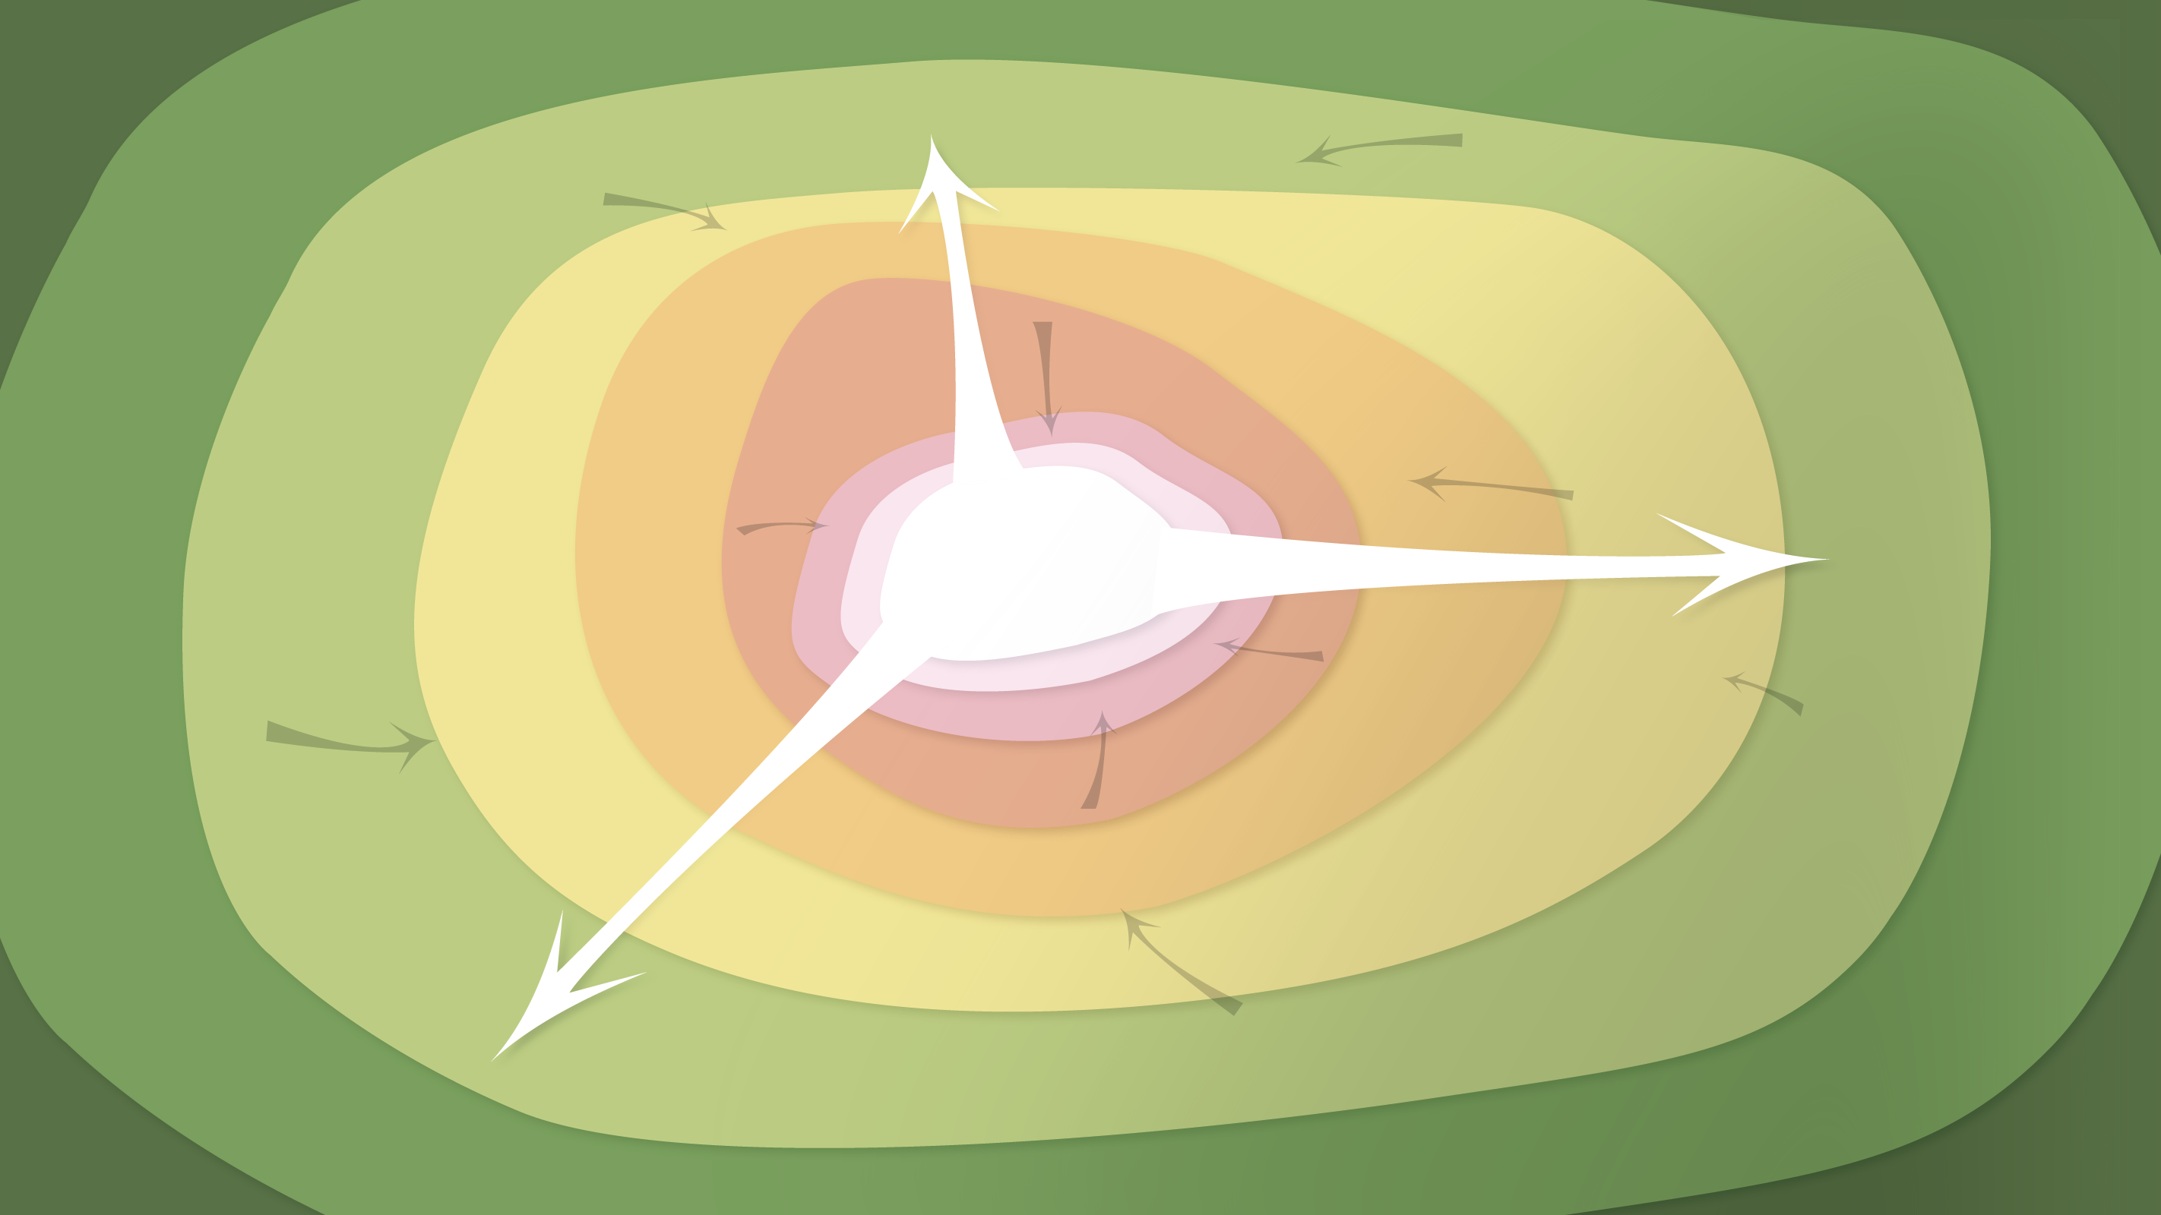
Data Management in the Research Environment
RSM 574/674 Spring 2016
Timothy Norris – tnorris@miami.edu
Angela Clark – aclark@rsmas.miami.edu

Slide 2
Todays Topics Security
B

Slide 3
http://cloudtweaks.com/2015/11/7-common-cloud-security-missteps/

