Slide 1
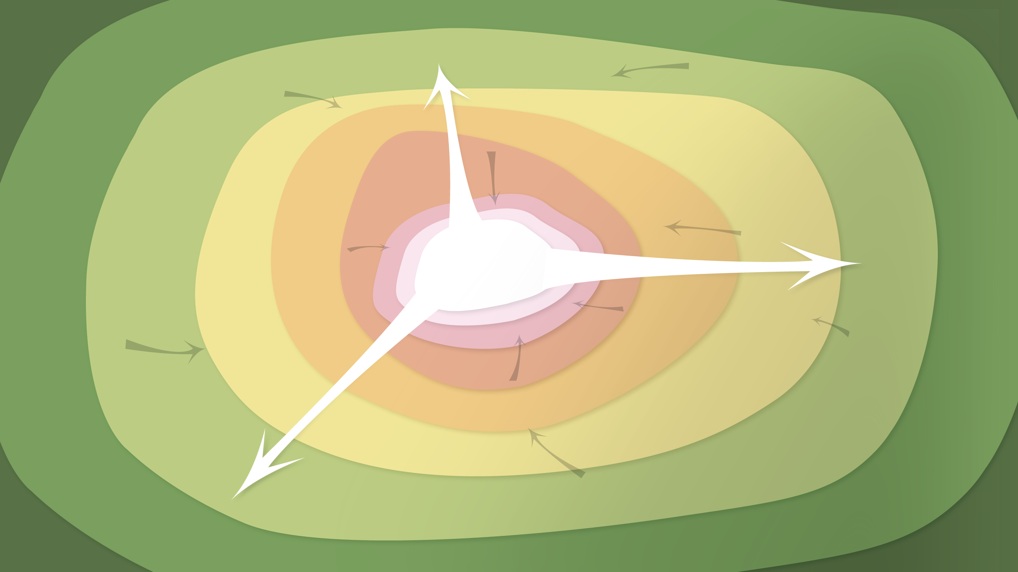
Data Management in the Research Environment
RSM 574/674 Spring 2016
Timothy Norris – tnorris@miami.edu
Angela Clark – aclark@rsmas.miami.edu

Slide 2
Todays Topics Data Curation Profiles
When do you need security
Human Subjects and PII
Best Practices

