Slide 1
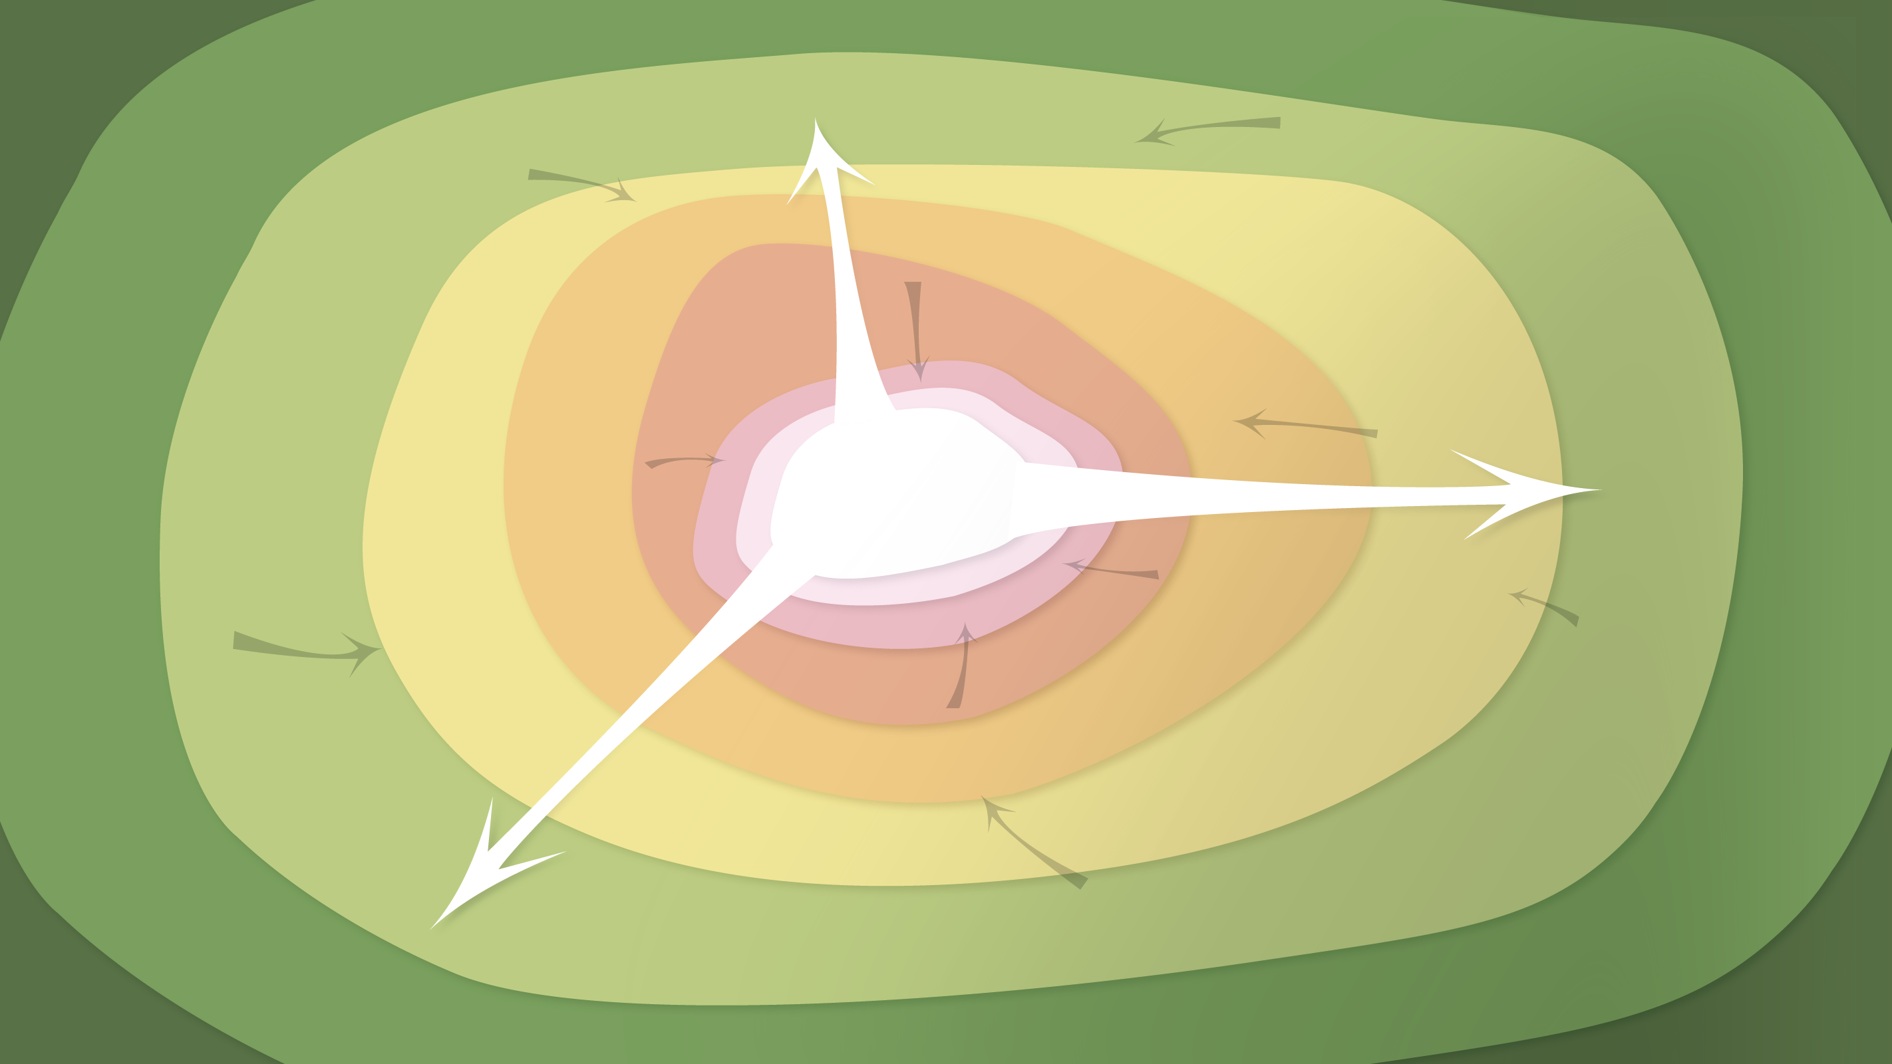
Data Management in the Research Environment
RSM 574/674 Spring 2016
Timothy Norris – tnorris@miami.edu
Angela Clark – aclark@rsmas.miami.edu

Slide 2
Todays Topics Describing Data
Purpose: a quick review
Case: ecological metadata
Case: image metadata
Metadata redux: versioning and git

Slide 3
Find / Identify / Select / Obtain
Locate a list of resources
Check resources in list for validity
Refine search to narrow the list of resources
Obtain the resource
But what happens once the resource is downloaded?
README.txt

Slide 4
Best Practices
Standard terminology (the controlled vocabulary)
Include taxanomic information (scientific names)
Use standards if possible
Make sure data and metadata are consistent
Use consistent file formats (especially with multimedia files)
Maintain consistent data typing (string, date, integer, decimal precision, etc.)
Create data dictionaries (explanations of column headers)
Document your storage systems, naming conventions and file structures
Describe both the spatial and temporal extent and resolution of your dataset
Describe relationships between multiple data files
Include version information
Include process, methods and equipment information

Slide 5
Resources for identifying standards
The Digital Curation Centre
http://www.dcc.ac.uk/resources/metadata-standards
The Library of Congress
https://www.loc.gov/standards/

Slide 6
Assignment #3
Choose one of the following:
(1) Create metadata for your research data using an existing schema
(2) Create a metadata schema (element set) for your data (and project)
DUE: March 18th 2016

