Slide 1
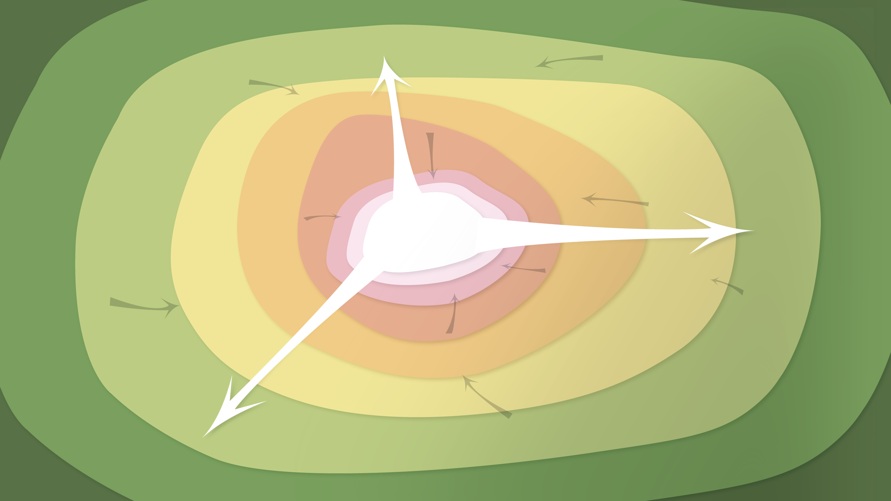
Data Management in the Research Environment
RSM 574/674 Spring 2016
Timothy Norris – tnorris@miami.edu
Angela Clark – aclark@rsmas.miami.edu

Slide 2
Todays Topics Describing Data
Describing Data (who, what, standards, etc.)
Parts of the Whole
A library perspective
Value of descriptions (how much, for whom)
Utility of descriptions (use values)

Slide 3
Metadata
?

Slide 4
A Love Letter to the Future
"Scientific metadata provide the information necessary for investigators separated by time, space, institution or disciplinary norm to establish common ground." - Christine Borgman
Edwards, Mayernik, Betcheller, Bowker, and Borgman (2011). Science friction: Data, metadata, and collaboration.
Social Studies of Science 41(5): 667-690 . http://dx.doi.org/10.1177/0306312711413314

Slide 5
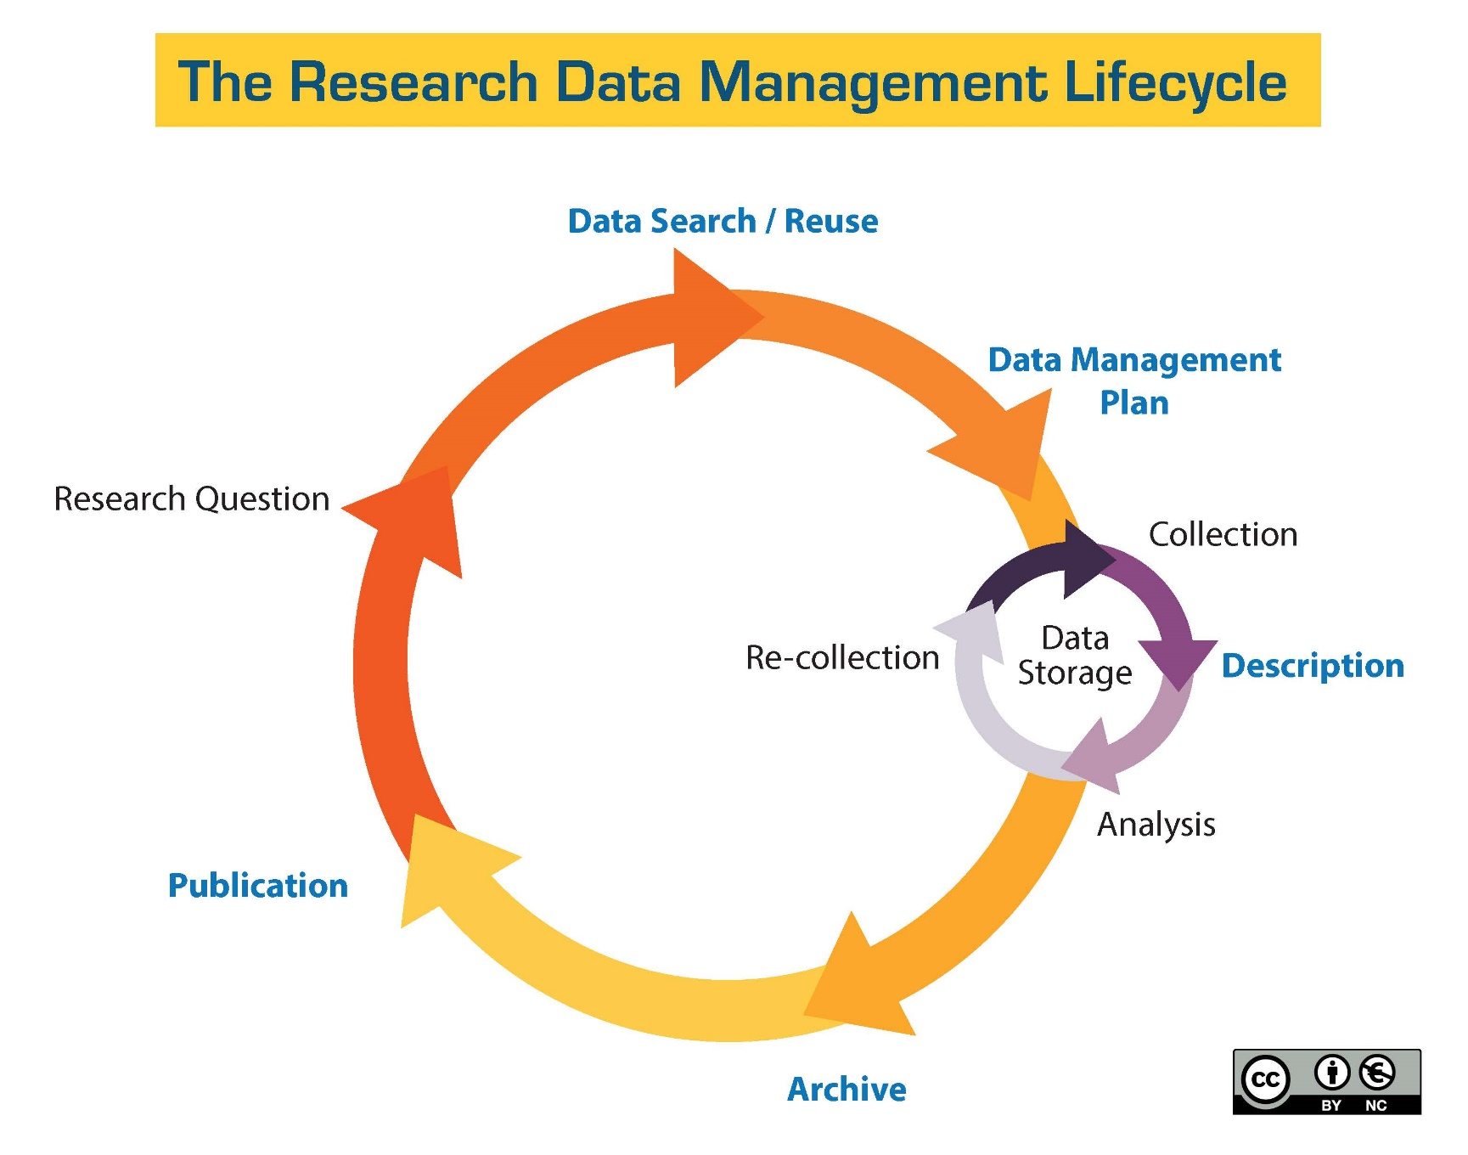
http://guides.library.ucsc.edu/datamanagement/
Notes:
Purpose?? And place?

Slide 6
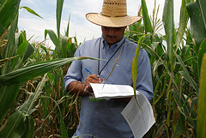
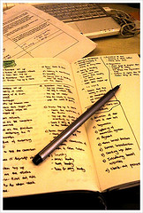
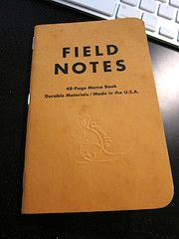
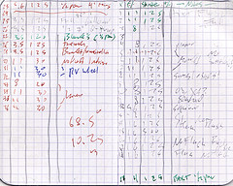
Data Collection
CC image by CIMMYT on Flickr
CC image by SEDAC on Flickr
CC image by Justin See on Flickr
CC image by acordova on Flickr
CC image by ISAS on Flickr
CC image by kukkurovaca on Flickr
DataONE Education Module: Lesson 07: Metadata. DataONE. https://www.dataone.org/sites/all/documents/L07_Metadata.pptx
Notes:
Data collection in the field is recorded in a wide variety of ways, including field notebooks, streaming data from satellites, data created from models, etc

Slide 7
From Field Notes to Datasets
Average Temperature of Observation for Each Species
Species | Average Temperature | Temperature Standard Deviation | Number of Observations | Minimum Temperature | Maximum Temperature
Northern Red-legged Frog | 4.4 | --- | 1 | 4.4 | 4.4
Tailed Frog | 7.0 | 3.0 | 3 | 4 | 10
Arizona Toad | 10.0 | --- | 1 | 10 | 10
Strecker's Chorus Frog | 10.5 | 2.0 | 11 | 9 | 16
Oregon Spotted Frog | 11.0 | 15.5 | 2 | 0 | 22
New Jersey Chorus Frog | 11.5 | 4.5 | 17 | 3 | 22
Wood Frog | 12.5 | 5.5 | 897 | 0 | 28.8
Spring Peeper | 13.2 | 5.6 | 569 | -1 | 32
Red-legged Frog | 13.3 | 5.9 | 16 | 4 | 27
DataONE Education Module: Lesson 07: Metadata. DataONE. https://www.dataone.org/sites/all/documents/L07_Metadata.pptx
Notes:
After returning from the field, scientists will transfer field notes into spreadsheets and other types of databases in preparation for their data analysis. Displayed here is a partial copy of a data set taken from the website “Frog Watch”. Notice there is no indication of Celsius or Fahrenheit in the “temperature” column. This is a simple example of how it is difficult to understand a dataset without all of the information.

Slide 8
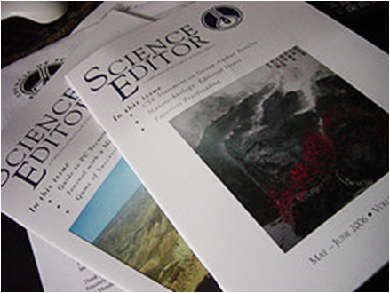
From Datasets to Published Papers
CC image by Heather Kennedy on Flickr
DataONE Education Module: Lesson 07: Metadata. DataONE. https://www.dataone.org/sites/all/documents/L07_Metadata.pptx
Notes:
Once scientists have collected and analyzed data, they publish their conclusions in appropriate science journals.

Slide 9
What is a Dataset?
Definition: A collection of data
Generally datasets can be defined as:
Spatial – a collection of logically related features arranged in a prescribed manner such as GIS map layers, water features, etc
Tabular – a file, spreadsheet, data in a table
Many tabular datasets are inherently “spatial”, e.g. water-quality samples associated with stream collection sites
Elements in a dataset can include:
Values, measures, points, coordinates, conditions, qualities, frequencies, or attributes that are a result of an observational study
DataONE Education Module: Lesson 07: Metadata. DataONE. https://www.dataone.org/sites/all/documents/L07_Metadata.pptx
Notes:
A dataset is a collection of data. Often datasets are considered spatial or tabular. However, many tabular datasets are inherently spatial – they represent spatial information. There are a variety of elements that can be found in a dataset including values, measures, points, conditions, qualities, frequencies or attributes.

Slide 10

Working with Data
When you provide data to someone else, what types of information would you want to include with the data?
When you receive a dataset from an external source, what types of details do you want to know about the data?
DataONE Education Module: Lesson 07: Metadata. DataONE. https://www.dataone.org/sites/all/documents/L07_Metadata.pptx
Notes:
If you were to share your data, what type of information would be most useful to understand the data set?
Alternatively, when receiving data from an external source, what information is needed to understand the data set?
Metadata contains information about the dataset that allows it to be understood when shared amongst scientists.

Slide 11

Working with Data
Providing data:
Why were the data created?
What limitations, if any, do the data have?
What does the data mean?
How should the data be cited if it is re-used in a new study?
Receiving data:
What are the data gaps?
What processes were used for creating the data?
Are there any fees associated with the data?
In what scale were the data created?
What do the values in the tables mean?
What software do I need in order to read the data?
What projection are the data in?
Can I give these data to someone else?
DataONE Education Module: Lesson 07: Metadata. DataONE. https://www.dataone.org/sites/all/documents/L07_Metadata.pptx
Notes:
When sharing data, some considerations include:
- why the data was created;
- what limitations, if any, the data have;.
- what the data means; and who should be cited if someone publishes something that utilized the data.
When receiving data from an alternative source, consider:
What are the data gaps?
What processes were used for creating the current data?
Are there any fees associated with the data?
In what scale were the data created?
What do the values in the tables mean?
What software do I need in order to read the data?
What projection is the data in?
Can I give this data to someone else?
Metadata contain information about a data set, in a standardized format, such that it can be understood and re-used.

Slide 12
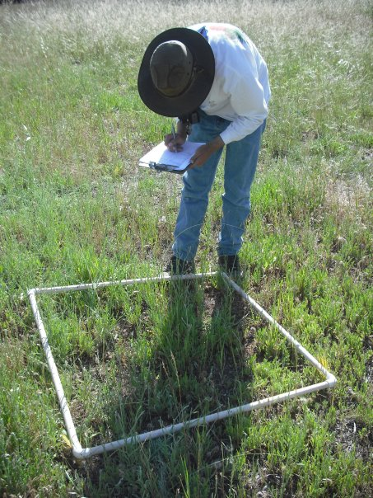
What is Metadata?
Metadata is: Data ‘reporting’
WHO created the data?
WHAT is the content of the data?
WHEN were the data created?
WHERE is it geographically?
HOW were the data developed?
WHY were the data developed?
Photo by Michelle Chang. All Rights Reserved
DataONE Education Module: Lesson 07: Metadata. DataONE. https://www.dataone.org/sites/all/documents/L07_Metadata.pptx
Notes:
Metadata is data about data. It describes the content, quality, condition, and other characteristics of a dataset.
Metadata records answer questions such as:
Why was the data set created?
What processes were used to create the data set?
What projection is the data in?
When was the data last updated?
Who created the data?
What scale was used?
What fields are in the table?
What do the values in those fields mean?
Who do I contact about getting more information about the data?
How do I obtain a copy of the data?
Do the data cost anything?
Are there any limitations to the data?
Metadata is a valuable tool. Metadata records preserve the usefulness of data over time by detailing methods for data collection and data set creation. Metadata greatly minimizes duplication of effort in the collection of expensive digital data and fosters the sharing of digital data resources.

Slide 13
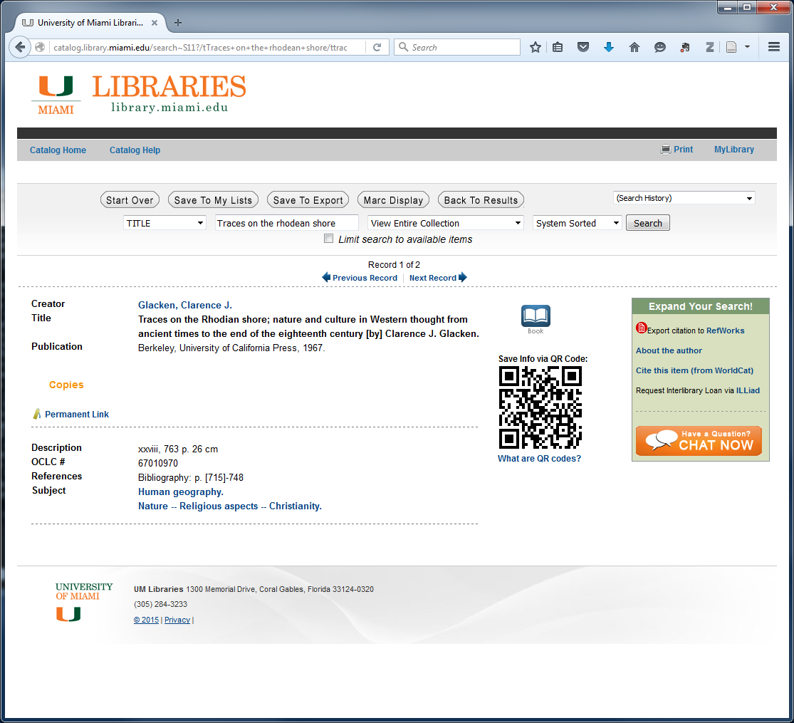
Metadata that you know already human readable

Slide 14
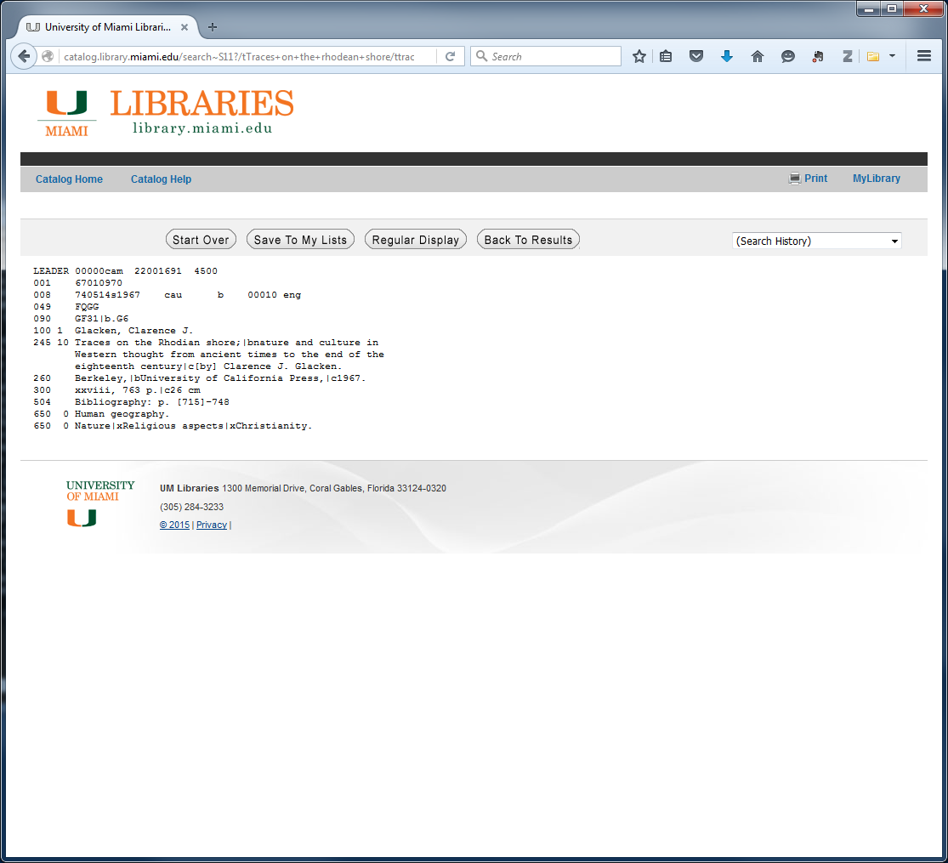
Metadata that you know already machine readable

Slide 15
** pause **

Slide 16
Describing Metadata
Descriptive
Project: Describe the overall project (author, date, place, etc.)
Technical: Describe individual project elements (tables, column headers
Structural
Describe how different elements of the data(set) fit together
Administrative
Rights management
Preservation
National Information Standards Organization (NISO) (2004). Understanding Metadata. http://www.niso.org/publications/press/UnderstandingMetadata.pdf

Slide 17
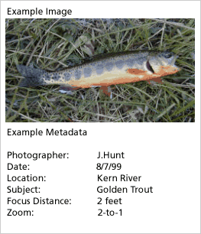


What is a Metadata Standard?
A Standard provides a structure to describe data with:
Common terms to allow consistency between records
Common definitions for easier interpretation
Common language for ease of communication
Common structure to quickly locate information
In search and retrieval, standards provide:
Documentation structure in a reliable and predictable format for computer interpretation
A uniform summary description of the dataset
CC image by ccarlstead on Flickr
DataONE Education Module: Lesson 07: Metadata. DataONE. https://www.dataone.org/sites/all/documents/L07_Metadata.pptx
Notes:
An established standard provides common terms, definitions and structure that allow for consistent communication. The use of standards also support search and retrieval in automated systems.

Slide 18
Standards and Schemas
Idea of standardized set of elements
Minimal to maximal, depends on purpose, audience, domain, and structure
Dublin Core
One of the most common – not Dublin Ireland
Used as a starting point for many other schema
The Dublin Core Metadata Element Set is a vocabulary of fifteen properties for use in resource description. The name "Dublin" is due to its origin at a 1995 invitational workshop in Dublin, Ohio; "core" because its elements are broad and generic, usable for describing a wide range of resources.
http://dublincore.org/documents/dces/

Slide 19
DC DC Example
Title
Creator
Subject
Description
Publisher
Contributor
Date
Type
Format
Identifier
Source
Language
Relation
Coverage
Rights
Title= ”Metadata Demystified”
Creator= ”Brand, Amy”
Creator= ”Daly, Frank”
Creator= ”Meyers, Barbara”
Subject= ”metadata”
Description= ”Presents an overview of metadata conventions in publishing.”
Publisher= ”NISO Press”
Publisher= ”The Sheridan Press”
Date= ”2003-07"
Type= ”Text”
Format= ”application/pdf”
Identifier= ”http://www.niso.org/standards/resources/Metadata_Demystified.pdf”
Language= ”en”
http://dublincore.org/documents/dces/

Slide 20
Schemas

Slide 21
GIS ArcCatalog Example

Slide 22
Standards and structures

Slide 23
Schemas as Walls

Slide 24
Quick Review
metadata is a description of your data for a future user (you perhaps?)
What does this person need to know to use the data properly?
Does this person need discipline specific knowledge? How much?
Two general kinds of descriptive metadata
Project level (contextual)
Technical (data level, units, headers, etc.)
How will the metadata be captured
Notebooks (electronic??)
Device capture
What format (with justification)
Discipline specific standard? Other standard?
Machine or human readable (both?)

Slide 25
** break **

