Slide 1
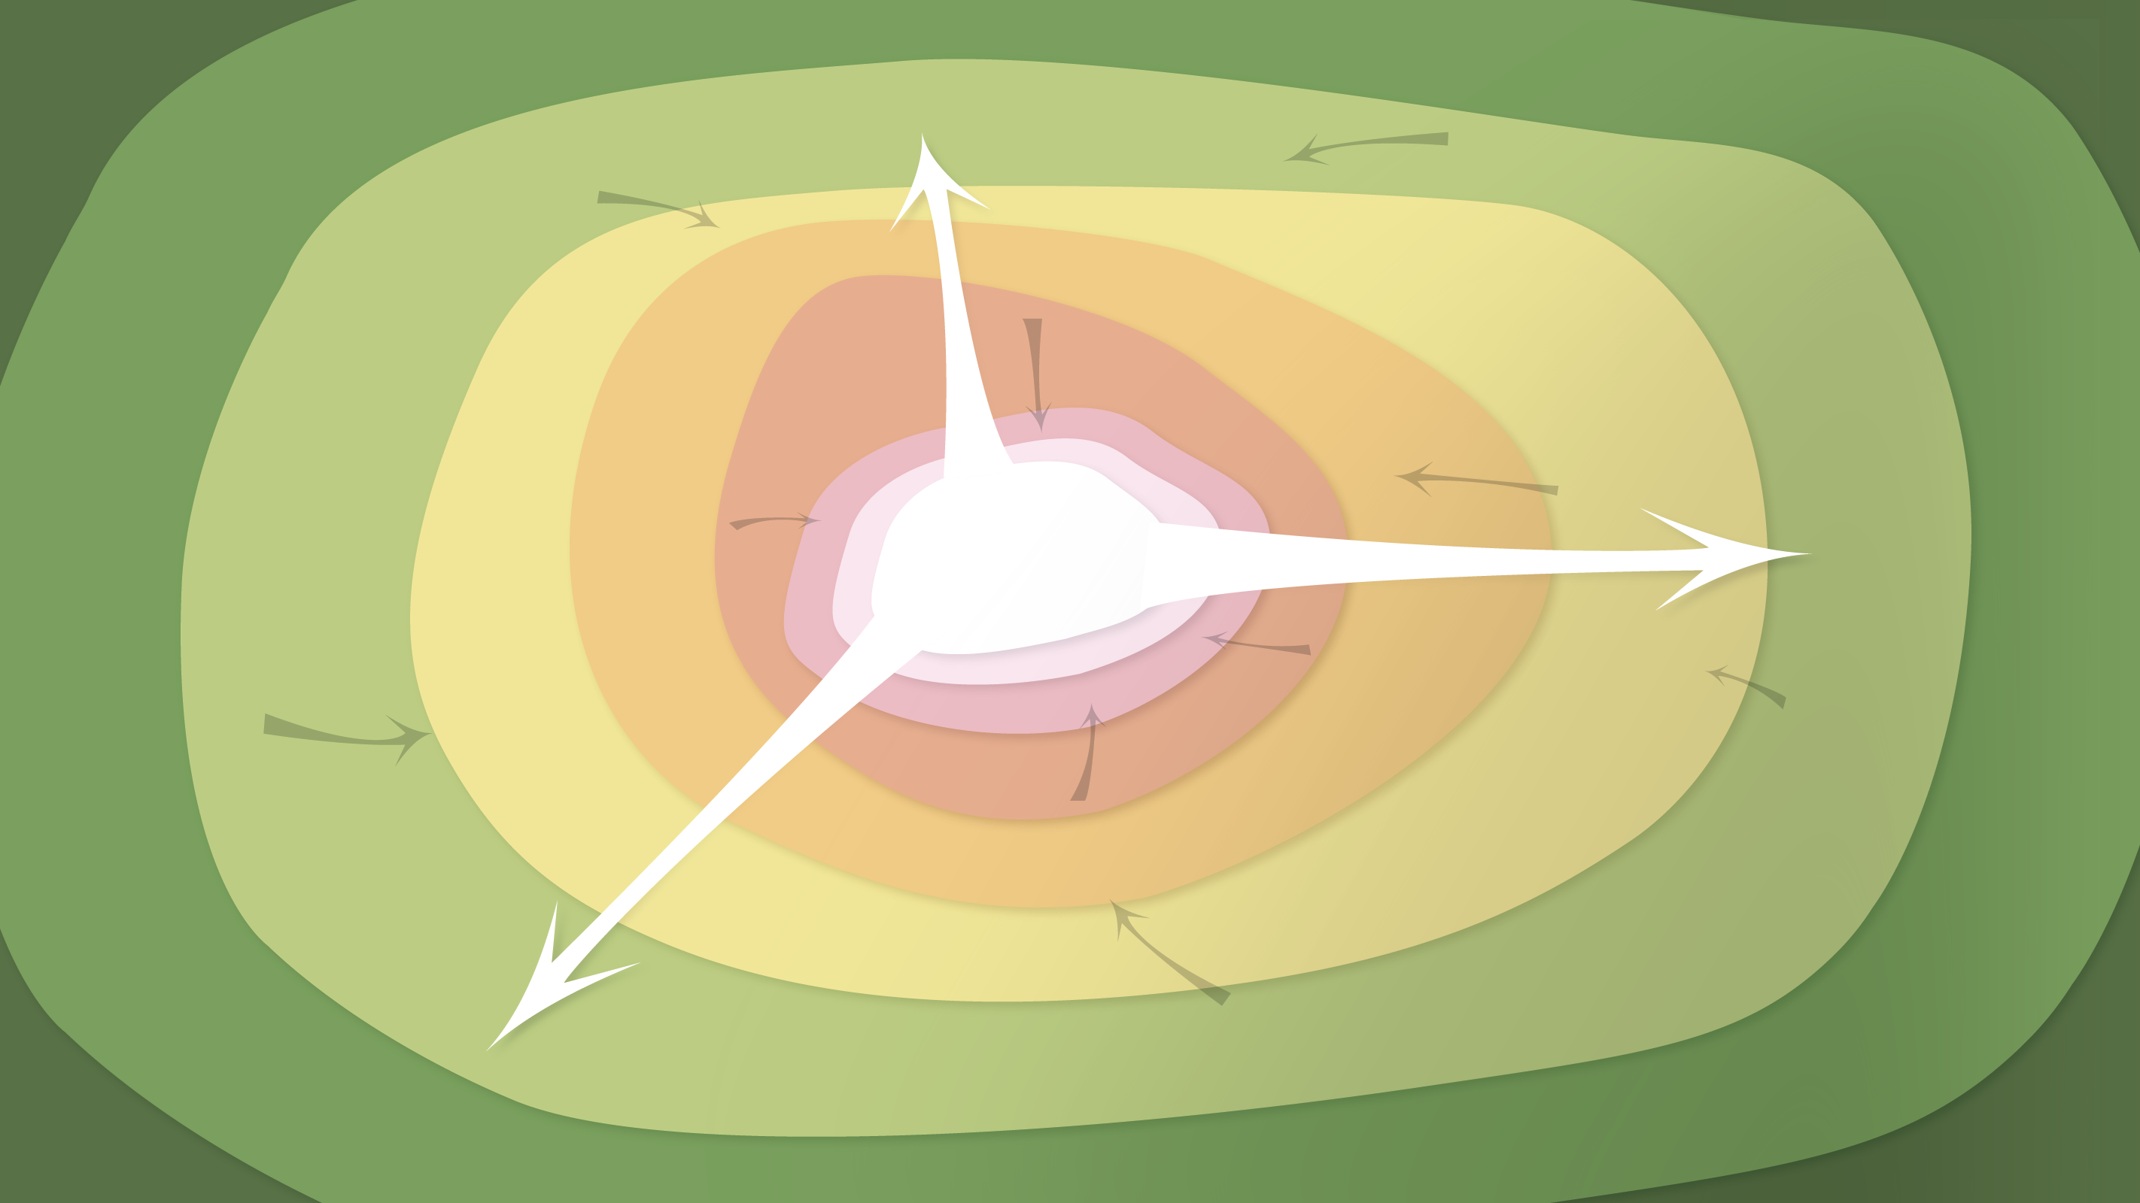
Data Management in the Research Environment
RSM 574/674 Spring 2016
Timothy Norris – tnorris@miami.edu
Angela Clark – aclark@rsmas.miami.edu

Slide 2
Todays Topics
File Formats
Text based “open” formats
Image formats

Slide 3
File Formats
“A file format is a standard way that information is encoded for storage in a computer file. It specifies how bits are used to encode information in a digital storage medium.” - Wikipedia
Data type
Possible formats
Qualitative, tabular
experimental data
Excel spreadsheet (.xlsx)
Comma-delimited text (.csv)
Access database (.mdb/,accdb)
Google Spreadsheet
SPSS portable file (.por)
XML file
Notes:
Whitmire, Amanda L. (2014). Research Data Management Curriculum, Lecture 3: Introduction to Research Data Management. Oregon State University Libraries. Retrieved 11/04/2015 from: http://figshare.com/articles/GRAD521_Research_Data_Management_Lectures/1003835

Slide 4
File Formats
Text: doc, docx, rtf, odt, pages
Tabular: xls, xlsx, numbers, dbf
Stat: spss, sas, jmp, rdata
Images: jpg, tiff, svg, png, gif, bmp
Geographic: shp, geotiff, kml, kmz, gdb
Video: mp4, mov, avi, ogg
Music: mp3, wav, m4a, aiff
Plain text: txt, csv, json, html, xml
Notes:
Joint photographic experts group
Note odt and odf

Slide 5
File Formats
Text: doc, docx, rtf, odt, pages
Tabular: xls, xlsx, numbers, dbf
Stat: spss, sas, jmp, rdata
Images: jpg, tiff, svg, png, gif, bmp
Geographic: shp, geotiff, kml, kmz, gdb
Video: mp4, mov, avi, ogg
Music: mp3, wav, m4a, aiff
Plain text: txt, csv, json, html, xml
General formats
proprietary
mixed
open
Notes:
Joint photographic experts group

Slide 6
File Formats
Text: doc, docx, rtf, odt, pages
Tabular: xls, xlsx, numbers, dbf
Stat: spss, sas, jmp, rdata
Images: jpg, tiff, svg, png, gif, bmp
Geographic: shp, geotiff, kml, kmz, gdb
Video: mp4, mov, avi, ogg
Music: mp3, wav, m4a, aiff
Plain text: txt, csv, json, html, xml
General formats
proprietary
mixed
open
Compression
lossy
depends
lossless
Notes:
Joint photographic experts group

Slide 7
Recommended Formats for Long-term Access and Sharing
Non-proprietary – no software purchase to open the file
Lossless – uncompressed with all of the original data
Indexable – if possible a plain text format that is both human and machine readable
Best file format???
PAPER!

Slide 8
Quick note on statistics files and conversions
Often contain much metadata embedded in the file
For example SPSS and SAS include data types (nominal, ordinal, interval, ration) and data dictionaries (code keys for nominal data, units for interval and ration data, etc.)
How to best share???
Option 1: keep in the proprietary format
Option 2: convert to text based format (csv) and have either
A data dictionary in a text based format so that a user can reconstruct the data-metadata association
Some sort of ‘installer’ that contains the metadata and automatically reconstructs the data-metadata association
This also applies to relational databases, images, and some geographical data

Slide 9
Ok – so what?
First, make sure your operating system lets you see the file formats!!!!
Mac file extensions
finder->preferences: show all filename extensions (check)
PC file extensions:
explorer->organize->folder and search options:
View tab: Hide Extensions for known file types (uncheck)

Slide 10
Some things to remember
hyper text markup language
.html
comma separated values
Text and numbers
Plain text – BUT STRUCTURED
character encoding??? UTF-8
PDF – preferably not!! (hard to index/search UNLESS created with specific care)
Images (bitmap)
TIFF, JPEG2000 (??), PNG, JPEG . . . .
.csv
.txt
.json
.xml
extensible markup language
javascript object notation
portable document format
joint photographic experts group
.jp2
.j2k
.jpg
.tif
.png
tagged image file format
portable network graphic

Slide 11
character encoding??? UTF-8
ASCII – American Standard Code for Information Interchange
[ old school, 128 characters in 7 bits ]
UTF-8 – Universal Coded Character Set + Transformation Format – 8-bit
[ now the new standard, only since about 2007, first 128 characters are ASCII ]
[ encodes 1,112,064 “code points” or characters ]
lowercase “j” would become binary 1101010 and decimal 106

Slide 12
bitmap and vector images
Raster – a “grid” of numeric color values, also known as a bitmap
[ tiff, jpg, png ]
Vector – a collection of points that can be connected to make lines and polygons
[ no standards yet, but common in Adobe Illustrator, AutoCAD, and many GIS applications ]
WATCH for .svg – simple vector graphic

Slide 13
Some things to remember
shapefile
data base format
.shp
Cartographic (maps)
GeoTIFF, shapefile (??!!), AutoCAD, watch for GeoJSON
Shapefile has .shp, .shx, .dbf optional (?!) .prj, .sbx, .sbn
Audio
AIFF, WAVE 44.1 kHz / 16 bit or higher
BUT MP3 with FLAC encoding OK (Free Lossless Audio Codec)
.dbf
prj
projection (for maps)
dxf
shapefile index
drawing interchange format
.shx
audio interchange file format
.aiff
moving pictures expert group
.mp3
wav
wave

Slide 14
Some things to remember
motion pictures expert group
.mp4
Video
MPEG-4
Documentation
Rich Text Format
Open Document Text
HTML
Plain text
.m4a
rtf
rich text format
open document text
.odt

Slide 15
Others?
What do you use in your work?
NetCDF?
network common data form
.nc
.ncf
Actually a collection of tools. NetCDF “is a set of software libraries and self-describing, machine-independent data formats that support the creation, access, and sharing of array-oriented scientific data” – wikipedia
more?

Slide 16
A few links
Dublin Core Metadata
http://dublincore.org/documents/usageguide/elements.shtml

Slide 17

COLOR
Color is entirely a creation of the mind

Slide 18
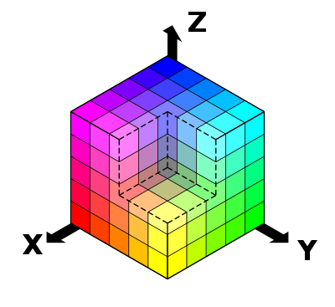
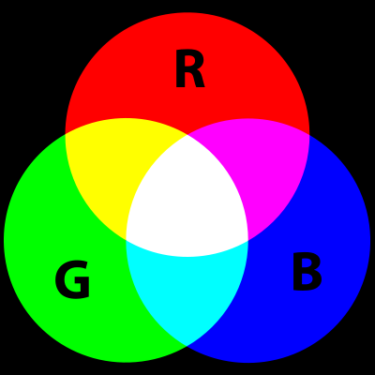
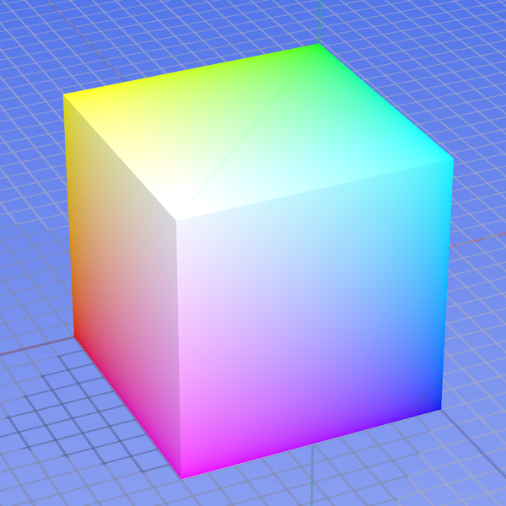
Red Green Blue - RGB
Additive color model based on ‘primary’ colors
Used on all electronic display devices
Primary colors are closely matched to three receptors in eye
The modern computer uses numbers from 0-255 to represent each primary color
8 bits for each color, three colors, 24-bit true color
Approximately 16,777,216 colors – more than we can see

Slide 19


Cyan Magenta Yellow Black - CMYK
The CMYK system is a subtractive color model
Sometimes this is called the process color system or four color system
All printing devices use this system of color
More ink ‘subtracts’ lightness from the white page
‘K’ is for ‘key’ as the black plate in an offset press is the ‘key’ plate
The computer stores 8-bit information for each color ‘channel’
CMYK image files are noticeably larger than RGB image files

Slide 20
Hexidecimal for the Internet
The hex color system is based on the RGB model
Used in HTML for the internet
Is the preferred representation for color by programmers
Hexidecimal is the name for counting in base 16
Good for computers: 2⁴ = 16 and 16 x 16 = 256
Counted from 0-15 like this:
0 1 2 3 4 5 6 7 8 9 A B C D E F
A hex color might look like this: FF00FF
Red: FF = 15*1 + 15*16 = 255
Blue: FF = 15*1 + 15*16 = 255
Green: 00 = 0*1 + 0*16 = 0

Slide 21
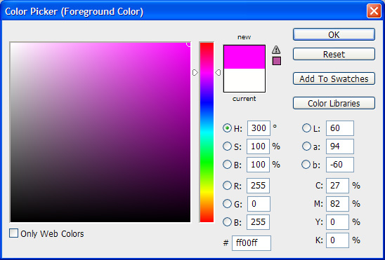
Photoshop’s color picker
Approximate screen color
CMYK
HEX
RGB

Slide 22
A Note on Resolution
“Highest resolution available, not rescaled or interpolated” – LOC recomendation
Resolution is directly related to pixel dimensions
usually expressed as dots per inch (DPI)
can be megapixels (height x width) or simple image dimensions in pixels
SOME NUMBERS TO REMEMBER
1000 DPI – standard number for greyscale reproduction on a printing press
300 DPI – standard minimum for color reproduction on a printing press
72 DPI – standard screen resolution

Slide 23
So what?
How are file size and image quality related to:
Resolution (image dimensions)
Color model
Compression
Vector or Raster
What implications are there for
Short-term workflows
Long-term preservation

Slide 24
Next Week
Frazer, Meghan (2013). An Elevator Pitch for File Naming Conventions. http://acrl.ala.org/techconnect/post/an-elevator-pitch-for-file-naming-conventions.
Alexandra Simperler, Greg Wilson (2015). Software Carpentry get more done in less time. http://arxiv.org/abs/1506.02575.
We will be introducing the command line next week!!
Mac – no install needed – you will use the terminal – applications/utilities/terminal
Windows – you will need to install “git bash”
https://github.com/git-for-windows/git/releases/download/v2.7.0.windows.1/Git-2.7.0-32-bit.exe

