Slide 1
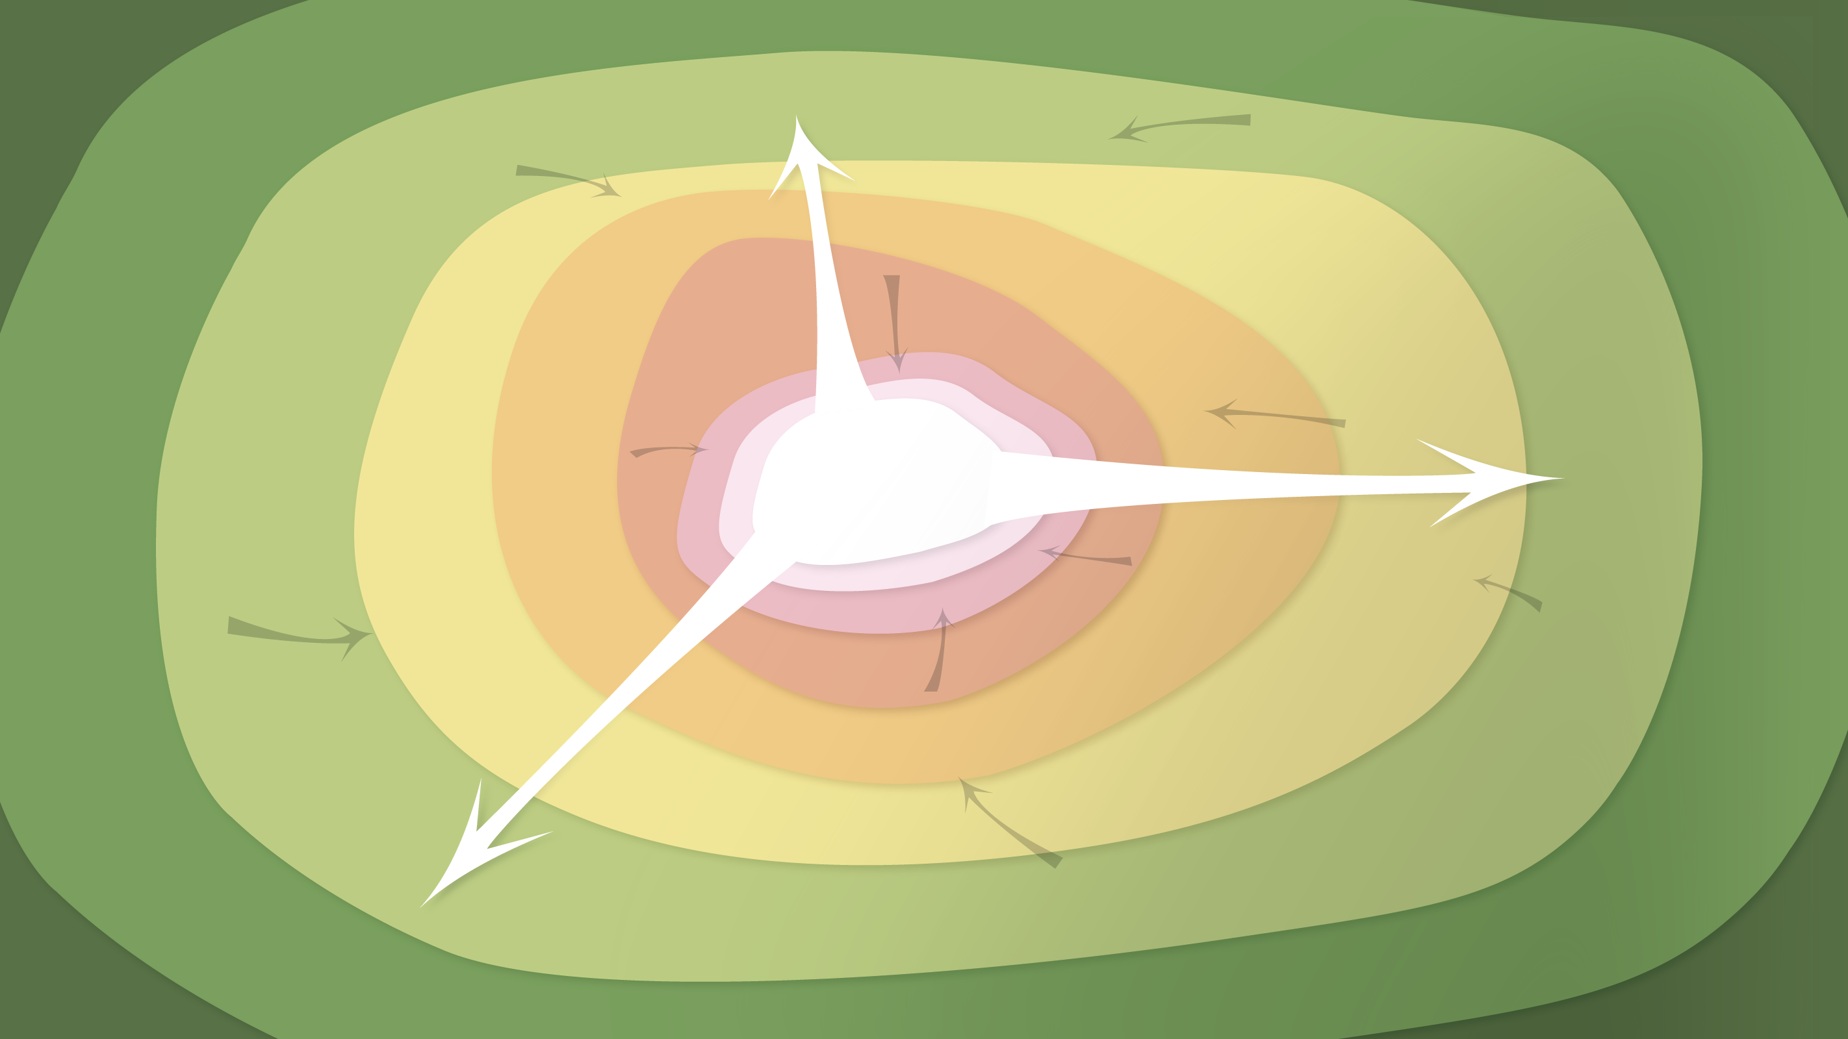
Data Management in the Research Environment
RSM 574/674 Spring 2016
Timothy Norris – tnorris@miami.edu
Angela Clark – aclark@rsmas.miami.edu

Slide 2
Todays Topics Repositories and Archiving
Archiving vs. Backup
Repository Options
Data Citation

Slide 3
Storage
Archives
Preservation
Curation

Slide 4
Backup
Data may change
Archive
Finalized data; static record
Not permanent
“Working” formats
Usually stored locally (individual, department, college, IS/CN)
Kept long-term (5+ years)
Preservation formats
Often stored in official archive
vs.
Next five slides adapted from: Whitmire, Amanda L. (2014). Research Data Management Curriculum, Lecture 15: Data Preservation and DataONE education modules https://www.dataone.org/education-modules.
Notes:
The terms "backup" and "archiving" are often used interchangeably, as they both relate to saving a specific version of a file, but they are actually very different processes. The term “backup” is used specifically when making copies of various files with the knowledge that the files may change. Backups are kept for a certain amount of time, but can be discarded after a specified time has passed. Archiving is used when a file is to be preserved as-is, often at the end of a project and acts as a static (and usually final) record. [source - DataONE education module]
from: http://guides.library.oregonstate.edu/data-management-archive-preserve

Slide 5
To Archive Data
Data selection or appraisal
Format selection
Perform checksums
Select archive location
Periodic file- and bit-level audits

Slide 6
1. Data appraisal
“… the process of distinguishing records of continuing value from those of no further value so that the latter may be eliminated.”
The National Archives (UK)
Notes:
“The UK National Archives (TNA) defines appraisal as: “the process of distinguishing records of continuing value from those of no further value so that the latter may be eliminated”. The similarities are obvious, and the intent is clear: appraisal is the process whereby some records are selected for retention, others (the great majority) are deemed of insufficient value to justify permanent retention. Although these references refer to records the principle of appraisal holds good for any other type of information that needs to be managed over time.” - DCC

Slide 7
Appraisal roles & responsibilities
Researcher (‘data creator’)
Provide enough info. for assessment
Provide info. on audience and access restraints
Data center or repository
Have explicit mission & data selection policy
Ensure legal and contract compliance
Provide data in recommended formats
Provide sufficient metadata
Ensure authenticity & integrity of digital objects & metadata
Assume responsibility for data accessibility
Plan for long-term preservation
Notes:
“A data librarian or archivist will be mainly responsible for setting a selection and appraisal policy, developing criteria with input from other stakeholders. The communities producing and re-using the data need to be consulted, especially local data managers, as they are best placed to judge what makes the data valuable. Researchers will also benefit from knowing in advance how their own data will be assessed, and what they should plan to do in order to increase the chance of their research having an enduring impact.
Researcher (‘data creator’)
Provide enough information for others to assess the research data’s scientific and scholarly quality and compliance with disciplinary or ethical norms.
Provide relevant information for the repository to identify who will use the data and how i.e. the ‘designated community’, and any specific access requirements or constraints.
Provide the research data in formats recommended by the data repository.
Provide the metadata requested by the repository.
Data center or repository
Make explicit its mission in the area of digital archiving, and its selection policy for digital objects.
Ensure compliance with legal regulations and contracts.
Ensure the authenticity and integrity of the digital objects and the metadata.
Assume responsibility from the data producer for ensuring the digital objects are accessible and available to a defined ‘designated community’.
Plan for long-term preservation of the digital assets. “
- from the DCC

Slide 8
Appraisal criteria
Relevance to mission
Historical value
Uniqueness
Potential or redistribution
Non-replicability
Economic case
Full documentation
For more: Whyte, A. & Wilson, A. (2010). "How to Appraise and Select Research Data for Curation". DCC How-to Guides. Edinburgh: Digital Curation Centre. http://www.dcc.ac.uk/resources/how-guides, also http://www.dcc.ac.uk/resources/how-guides/five-steps-decide-what-data-keep
Notes:
While these appraisal criteria were developed from the perspective of data curators and archivists, these same criteria can be used by researchers in considering which datasets and data files to save, and which can be destroyed (or at least relegated to less secure storage). For example, if you are not able to provide adequate metadata and documentation to render your dataset reusable by you or others, there is no reason to archive it regardless of how novel, important or non-replicable it is.
“Appraisal and Selection Policy
A policy needs to ensure consistent, transparent and accountable decision-making, so that commitments can be tracked and accounted for. The policy must fit legal requirements, e.g. relating to privacy and Intellectual Property Rights. It may also need to comply with relevant legislation for the jurisdiction, e.g. Public Records Acts, as well as national data policies and codes of conduct adopted by the host institution or funder, and any information governance policies relating to the discipline.
Relevance to Mission: The resource content fits the centre’s remit and any priorities stated in the research institution or funding body’s current strategy, including any legal requirement to retain the data beyond its immediate use.
Scientific or Historical Value: Is the data scientifically, socially, or culturally significant? Assessing this involves inferring anticipated future use, from evidence of current research and educational value.
Uniqueness: The extent to which the resource is the only or most complete source of the information that can be derived from it, and whether it is at risk of loss if not accepted, or may be preserved elsewhere.
Potential for Redistribution: The reliability, integrity, and usability of the data files may be determined; these are received in formats that meet designated technical criteria; and Intellectual Property13 or human subjects issues are addressed.
Non-Replicability: It would not be feasible to replicate the data/resource or doing so would not be financially viable.
Economic Case: Costs may be estimated for managing and preserving the resource, and are justifiable when assessed against evidence of potential future benefits; funding has been secured where appropriate.
Full Documentation: the information necessary to facilitate future discovery, access, and reuse is comprehensive and correct; including metadata on the resource’s provenance and the context of its creation and use. ” From the DCC

Slide 9
To Archive Data
Data selection or appraisal
Format selection
Perform checksums
Select archive location
Periodic file- and bit-level audits

Slide 10
Checksum Review
bitrot
there is no cloud

Slide 11
Checksum Review
Fastsum
http://www.fastsum.com/
Command line is free, basic GUI interface $15
Md5sum
Built into the bash shell
% md5sum <someFIle.ext>
% man md5sum

Slide 12
File Format Review
Recommended Formats for Long-term Access and Sharing
Non-proprietary – no software purchase to open the file
Lossless – uncompressed with all of the original data
Indexable – if possible a plain text format that is both human and machine readable
Best file format???
PAPER!

Slide 13
character encoding??? UTF-8
File Format Review
ASCII – American Standard Code for Information Interchange
[ old school, 128 characters in 7 bits ]
UTF-8 – Universal Coded Character Set + Transformation Format – 8-bit
[ now the new standard, only since about 2007, first 128 characters are ASCII ]
[ encodes 1,112,064 “code points” or characters ]
lowercase “j” would become binary 1101010 and decimal 106

Slide 14
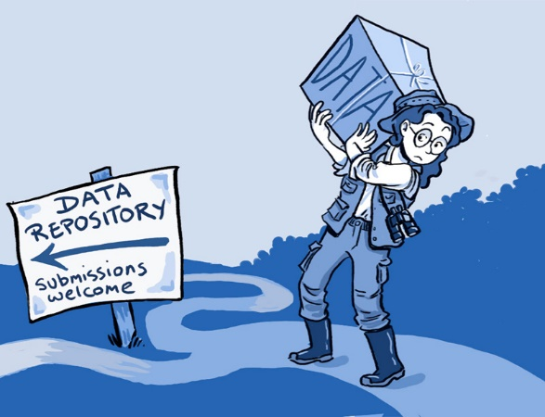
Data Repositories
“Sharing data from one laboratory to another—or even within a laboratory—takes time and effort, but there are also psychological, cultural and technological barriers to doing so.”
http://www.kavlifoundation.org/sites/default/files/image/resources/2014_SL_Neuro_Cartoon.jpg
Ainsley Seago, PLoS Biology
http://www.kavlifoundation.org/science-spotlights/breaking-down-data-barriers-neuroscience

Slide 15
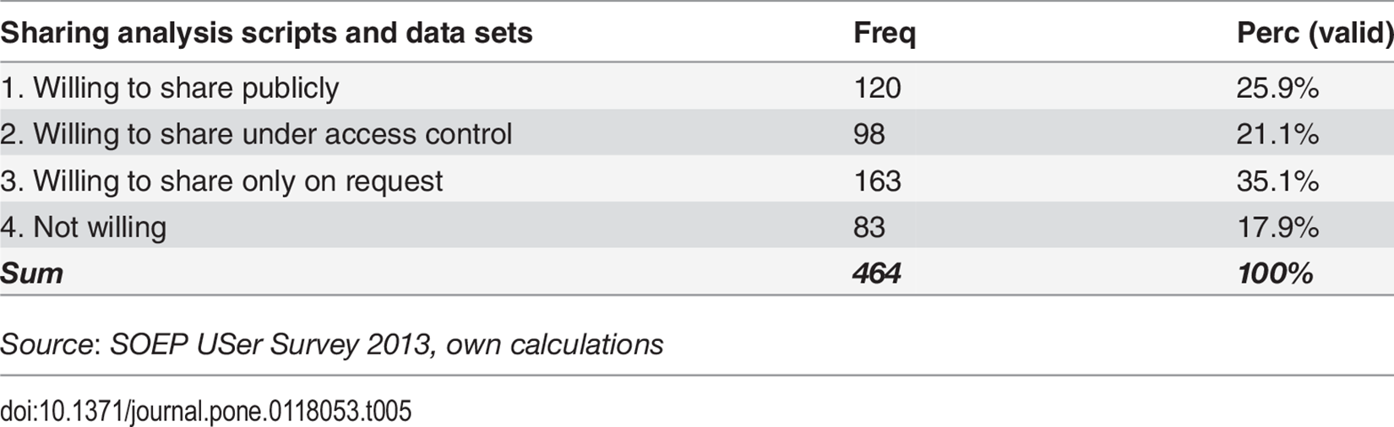
Researcher perspectives on sharing
Age
Control
Resources
Returns

Slide 16
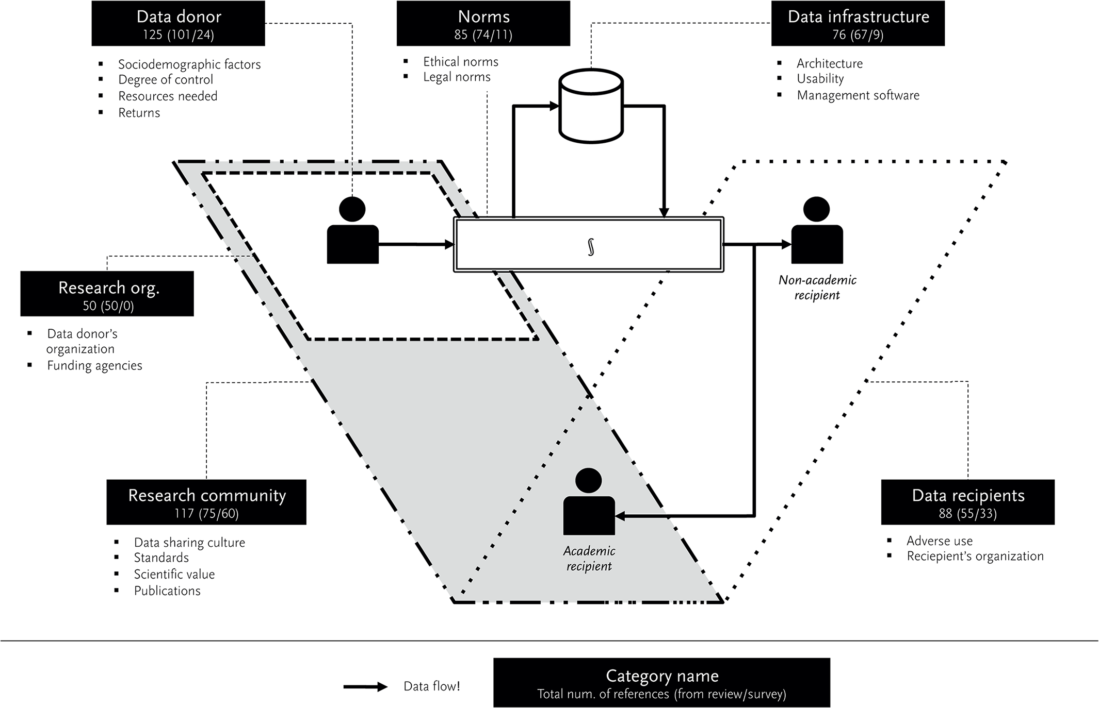
http://dx.doi.org/10.1371/journal.pone.0118053.g004

Slide 17
Select archive location
Considerations
Costs
Size of dataset
Public vs. private access
Length of preservation
Hands-on vs. hands-off
Security of platform
Locations
Individual
Department/College
University-wide
Discipline-specific
3rd-party
Archive vs. sharing mechanism
Next seven slides adapted from: Whitmire, Amanda L. (2014). Research Data Management Curriculum, Lecture 15: Data Preservation. Oregon State University Libraries. Retrieved 11/04/2015 from: http://figshare.com/articles/GRAD521_Research_Data_Management_Lectures/1003835
Notes:
Costs (more on this in a bit)
one-time vs. ongoing
balancing dataset size, storage quality
Size of dataset
fee-based archive services may not take huge files
how much do you want to manage by yourself?
Public vs. private access
A data sharing platform is not the same as a data archive, although some services cover both bases
Length of preservation
Data kept for a shorter time period may be easier to keep locally
Hands-on vs. hands-off
If time is scarce, paying to archive your data will be worth it in the end b/c poorly managed or neglected archives are more likely to fail.
Most repositories and archives take security very seriously, but if you are preserving sensitive data (public or private), choose an archive that has experience in curating such content (e.g. the ICPSR)

Slide 18
Archive on your own
You buy & manage hardware, replication, backups and networking (if applicable, for offsite access)
OK for unrestricted, sensitive (FERPA), and protected data
Costs (100 GB dataset)
Ranges
(but generally cheap)
$
Notes:
All backup functions will have to be established and maintained by you (or your lab group).

Slide 19
Archive w/ department IT
Depends on department IT
Costs (100 GB dataset)
$
Under development???
(check your department)

Slide 20
Archive @ University of Miami Institutional Repository
Storage in Bepress Digital Commons (commercial site that UM subscribes to)
Remotely accessible (restrictions/embargoes possible)
OK for unrestricted data. Not compliant for sensitive (FERPA) and protected data
Costs (100 GB dataset)
$
($0/year * 100 GB) = $0
NOTE: THE COST IS A PLACEHOLDER. THIS IS NOT BINDING

Slide 21


Archive in discipline-specific repository
Replicated, archive-quality storage
Data curation throughout ingest & archive period
Data in context with other datasets
Costs (100 GB dataset)
$
Depends

Slide 22


3rd party storage platforms
Costs (100 GB dataset)
$
depends
Notes:
Are these data archives or data sharing platforms?
Dryad: $80/10GB + $15/1GB + ($15/GB * 89GB) = $1430 for pay once- save forever (POSF)
figshare: Free, unlimited storage, “forever”

Slide 23
Bottom line
No “one-size-fits all” approach
Balance costs, storage quality, access, degree of involvement, security, longevity etc.
Plan ahead so you can budget appropriately
(write into grants)

Slide 24
Repository Directories
Registry of Research Data Repositories
http://www.re3data.org/
The Directory of Open Access Repositories
http://www.opendoar.org/
The Open Access Directory – Disciplinary Repositories
http://oad.simmons.edu/oadwiki/Disciplinary_repositories

Slide 25
Disciplinary Repositories
Biology and Life Sciences - Dryad
http://www.datadryad.org/repo/
Knowledge Network for Biodiversity
https://knb.ecoinformatics.org/
Data Observation Network for Earth
https://www.dataone.org/
Snow and Ice Data Center
https://nsidc.org/
Biological and Chemical Oceanography Data Management Office (BCO-DMO)
http://www.bco-dmo.org/
Inter-University Consortium for Political and Social Research
http://www.icpsr.umich.edu/
FigShare
http://figshare.com/

Slide 26
Data Citation
enabling easy reuse and verification of data
allowing the impact of data to be tracked
creating a scholarly structure that recognizes and rewards data producers
https://www.datacite.org/

Slide 27
Data Citation
DOI – Digital Object Identifier
ARK – Archival Resource Key
PURL – Permanent Uniform Resource Locator

Slide 28
Data Citation
APA Norris, Timothy. (2015). Cordillera Huayhuash Water Quality 2010-2011. UC Santa Cruz. http://doi.org/10.7291/D11592
APA Norris, Timothy. (2015). Cordillera Huayhuash Water Quality 2010-2011 [dataset]. UC Santa Cruz. http://doi.org/10.7291/D11592
Chicago Author-date Norris, Timothy. 2015. “Cordillera Huayhuash Water Quality 2010-2011.” UC Santa Cruz. doi:10.7291/D11592.
http://crosscite.org/citeproc/

Slide 29

ORCID
http://orcid.org/
Open Researcher and Contributor ID

Slide 30
Homework #5 Identify a Repository Solution
Think of the data that you work with (either in another class or for your own work)
Spend some time looking at repositories (from http://www.re3data.org/ or some other source)
Choose a repository solution and then identify
Whether your data fits the stated mission of the repository
Format requirements
Metadata requirements
Ability to control access (accept sensitive data and/or place embargoes on data)
Size limits
Costs (if any) and who funds it
Ability to mint ARK or DOI
Write a brief summary that includes the repository name, an outline of what you found based on the instructions above, a small critique of the repository (its strengths and weaknesses ), and why you choose this particular solution.
The entire assignment cannot exceed 500 words
Email the word document to both Tim and Angela by the end of Monday April 18th

