Slide 1
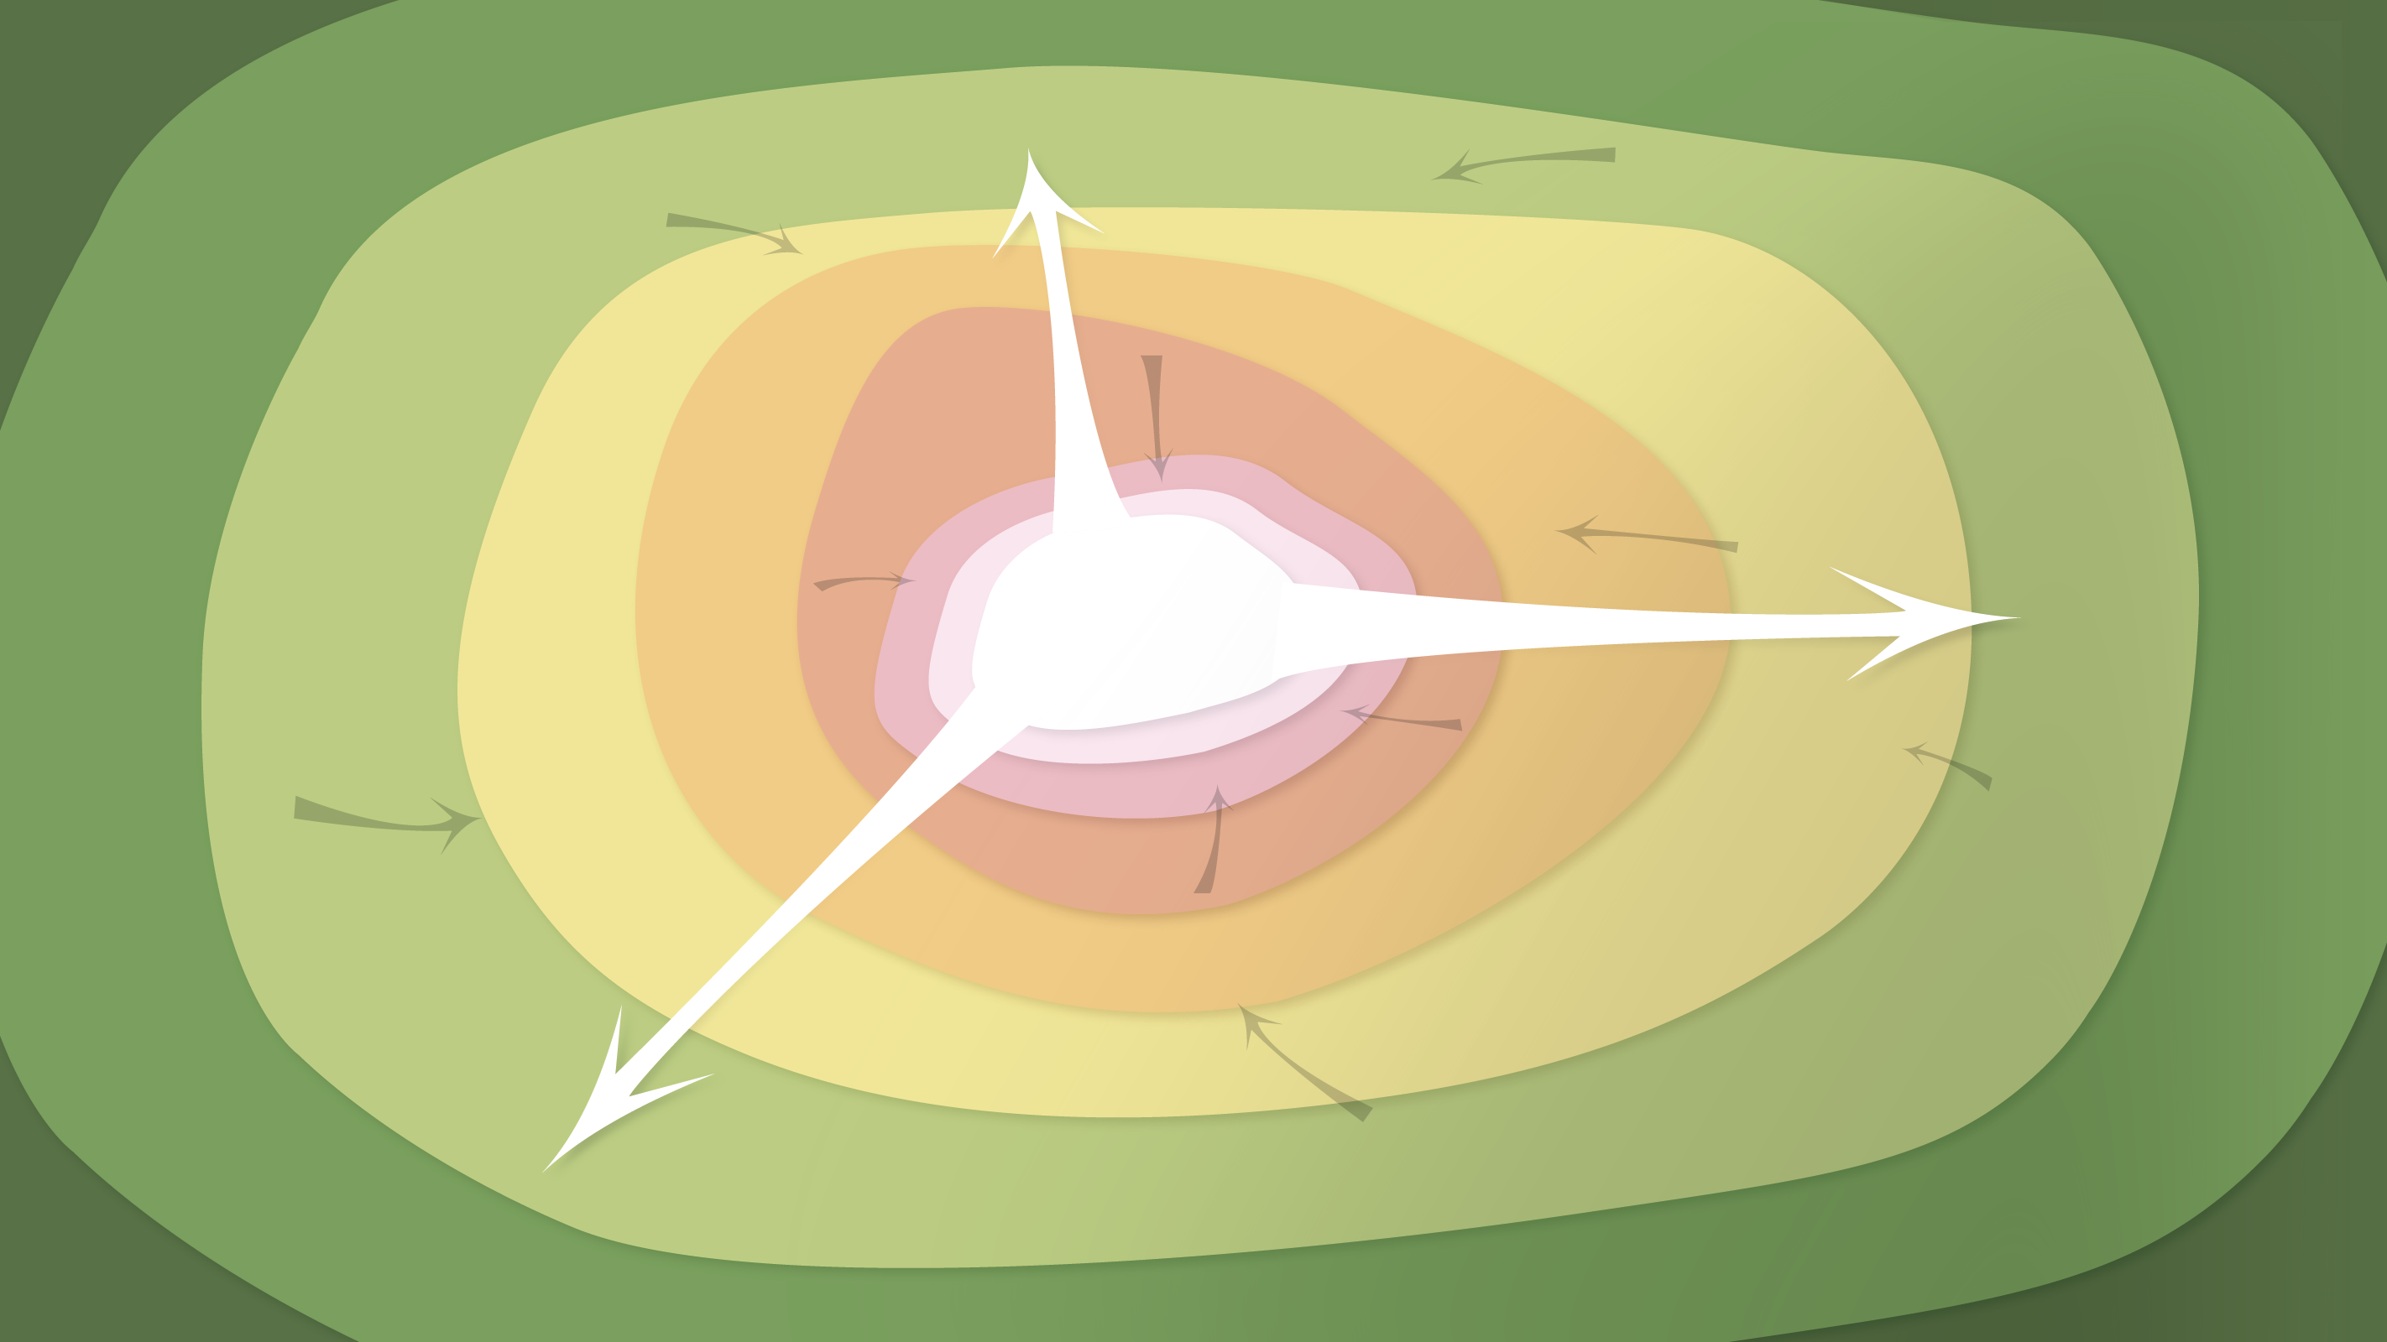
Data Management in the Research Environment
RSM 574/674 Spring 2016
Timothy Norris – tnorris@miami.edu
Angela Clark – aclark@rsmas.miami.edu

Slide 2
Class Outline
Categorizing Data
Data in the Research Lifecycle

Slide 3
On Data
Non-numeric
Text, Image, Sound
Qualitative - Quantitative
Nominal, Ordinal
Interval, Ratio
Kitchin, R (2014). “Conceptualizing Data” in Kitchin, R The Data Revolution. Washington DC: Sage. http://uk.sagepub.com/sites/default/files/upm-binaries/63923_Kitchin_CH1.pdf

Slide 4
What is data?
Measurement level | Definition | Example
Nominal | Categorical in nature, with observations recorded into discrete units. | Unmarried, married, divorced, widowed
Ordinal | Observations that are placed in a rank order, where certain observations are greater than others | Low, medium, high
Interval | Measurements along a scale which possesses a fixed but arbitrary interval and an arbitrary origin. Addition or multiplication by a constant will not alter the interval nature of the observations. Data can either be continuous or discrete in nature. | Temperature along the Celsius scale
Ratio | Similar to interval data except the scale possesses a true zero origin, and multiplication by a constant will not alter the ratio nature of the observations. | Exam marks on a scale of 0–10
Kitchin, R. (2014). The Data Revolution. Washington DC: SAGE.
Kitchin, R (2014). “Conceptualizing Data” in Kitchin, R The Data Revolution. Washington DC: Sage. http://uk.sagepub.com/sites/default/files/upm-binaries/63923_Kitchin_CH1.pdf

Slide 5
On Data
Non-numeric
Text, Image, Sound
Qualitative - Quantitative
Nominal, Ordinal
Interval, Ratio
Observed
Experimental
Modeled
Non-Observed
Captured, Exhaust, Transient, Derived
Modeled,
Technical Metadata
Not “Raw”
Levels (more on this in a moment)
Kitchin, R (2014). “Conceptualizing Data” in Kitchin, R The Data Revolution. Washington DC: Sage. http://uk.sagepub.com/sites/default/files/upm-binaries/63923_Kitchin_CH1.pdf

Slide 6
Data Levels (as described by NASA)
Data level | Description
Level 0 | Reconstructed, unprocessed instrument and payload data at full resolution, with any and all communications artefacts (e.g., synchronisation frames, communications headers, duplicate data) Removed.
Level 1a | Reconstructed, unprocessed instrument data at full resolution, time-referenced, and annotated with ancillary information, including radiometric and geometric calibration coefficients and georeferencing parameters computed and appended but not applied to Level 0 data.
Level 1b | Level 1A data that have been processed to sensor units
Level 2 | Derived geophysical variables at the same resolution and location as Level 1 source data.
Level 3 | Variables mapped on uniform space-time grid scales, usually with some completeness and consistency
Level 4 | Model output or results from analyses of lower-level data (e.g., variables derived from multiple measurements).
https://earthdata.nasa.gov/user-resources/standards-and-references
http://science.nasa.gov/earth-science/earth-science-data/data-processing-levels-for-eosdis-data-products/
Notes:
Do an exercise – the referenced link in the kitchin book is outdated and broken – have them spend one minute trying to find the updated link (search skills)

Slide 7
Sensors and Data Levels
Active vs. Static: | Data Stage: | Example or Focus: | Typical File Formats:
ACTIVE | Raw Data: | Temperature readings over time | Paper? Device-specific? .xlsx, …
 | Processed Data: | “Cleaned,” normalized temperature data compiled in spreadsheet | .xlsx, .sas, …
 | Analyzed Data: | Temperature data with averages computed, graphs charted | .xlsx, .sas, …
STATIC | Finalized, Published Data: | Do the data support hypothesis? | .csv
http://classguides.lib.uconn.edu/content.php?pid=355458&sid=3391384

Slide 8
On Data
Irregular, Flexible
Nested, Trees, Tagged
Non-numeric
Text, Image, Sound
Structured, Semi-structured, Unstructured
Qualitative - Quantitative
Data model, Schema,
Relational Database
Nominal, Ordinal
Interval, Ratio
Observed
Experimental
Modeled
Incorporated
Re-used
Non-Observed
Primary, Secondary, Tertiary
Captured, Exhaust, Transient, Derived
Created, Collected
Released
Truncated
Modeled,
Technical Metadata
Not “Raw”
Levels (more on this in a moment)
Kitchin, R (2014). “Conceptualizing Data” in Kitchin, R The Data Revolution. Washington DC: Sage. http://uk.sagepub.com/sites/default/files/upm-binaries/63923_Kitchin_CH1.pdf

Slide 9
Data: Primary, Secondary and Tertiary
Primary: research generated (from instruments or observations)
Secondary: acquired for research project from another source
Tertiary: derivative of primary or secondary data (anonymized, annotated, bundled, and so on)

Slide 10
On Data
Irregular, Flexible
Nested, Trees, Tagged
Non-numeric
Text, Image, Sound
Structured, Semi-structured, Unstructured
Qualitative - Quantitative
Data model, Schema,
Relational Database
Nominal, Ordinal
Interval, Ratio
Identifiers
Descriptions
Observed
Experimental
Modeled
Indexical, Attribute, Metadata
Incorporated
Re-used
Characteristics
Non-Observed
Primary, Secondary, Tertiary
Captured, Exhaust, Transient, Derived
Created, Collected
Released
Truncated
Modeled,
Technical Metadata
Not “Raw”
Levels (more on this in a moment)
Kitchin, R (2014). “Conceptualizing Data” in Kitchin, R The Data Revolution. Washington DC: Sage. http://uk.sagepub.com/sites/default/files/upm-binaries/63923_Kitchin_CH1.pdf

Slide 11
On Metadata
One persons data is another persons metadata

Slide 12
Useful generalizations
WISDOM
applied knowledge
“Information is not knowledge.
Knowledge is not wisdom.
Wisdom is not truth.
Truth is not beauty.
Beauty is not love.
Love is not music.
Music is THE BEST.”
― Frank Zappa
KNOWLEDGE
organized information
INFORMATION
linked elements
DATA
abstracted elements
WORLD

Slide 13
Another Way of Seeing

Slide 14
What data will you collect / create / wrangle?
Will you use sensors? – OBSERVATIONAL
Captured in situ
Can’t be recreated, recaptured or replaced - VALUE
Includes survey instruments and hired research assistants
But, will you collect data, buy data from a provider, or receive data as a contracted service?
Notes:
Examples: sensor readings (list is long), surveys (both human and non-human)
Part of content from Whitmire

Slide 15
What data will you collect / create / wrangle?
Will you conduct an experiment? - EXPERIMENTAL
In situ or laboratory based (also considered are natural experiments)
Should be reproducible, but can be expensive
May include sensors and observations
Notes:
Examples: biological/chemical assays, spectroscopy, again, list is long

Slide 16
What data will you collect / create / wrangle?
Will you build models? – SIMULATED
Will you write code?
How will you parametrize the model?
Inputs may be more valuable than outputs
What software (or other tools) will you use?
Notes:
Climate models, and so on . .

Slide 17
What data will you collect / create / wrangle?
Will you combine and analyze previously shared data to create new data? – DERIVED or COMPILED
Integration from several sources
Recreation can be very expensive
Again, software and tools?
Are there copyright concerns?
Notes:
Climate science

Slide 18
What data will you collect / create / wrangle?
Will you draw from previously published materials? – REFERENCE or CANONICAL
Peer reviewed
Can be data or textual
This is the most creative, important and valuable aspect of research data
Do you agree? (write a paragraph on why or why not you agree with this statement)
Notes:
The bibliography

Slide 19
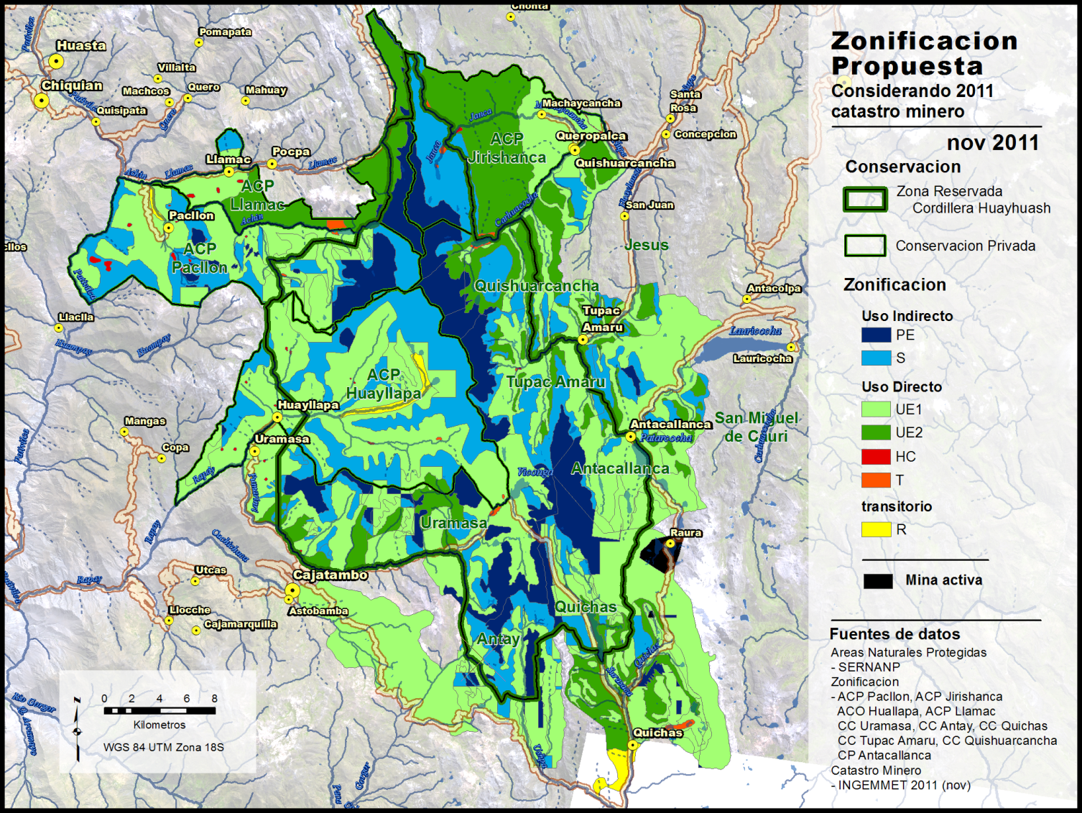
Productivity Model
Conservation Zoning Maps
Topographic Model
Disturbance Model
Land Use Maps
Pasture Transects
Simulated
Compiled
Water Quality Analysis
National Geographic Institute
GPS data collected
Ministry of the Environment
Ministry of the Energy and Mines
Six county governments
Ten communities
SURVEYS
INTERVIEWS
Previous Area Studies
USGS /NASA satellite imagery
Three state governments
Methods
Systemic Theories
SRTM topographic data
Observational
Reference / Canonical
Notes:
Data in a conservation research project (from Tim’s dissertation and previous NGO work)

Slide 20
Productivity Model
Conservation Zoning Maps
Topographic Model
Disturbance Model
Land Use Maps
Pasture Transects
Analyzed
Processed
Water Quality Analysis
National Geographic Institute
GPS data collected
Ministry of the Environment
Ministry of the Energy and Mines
Six county governments
Ten communities
SURVEYS
INTERVIEWS
Previous Area Studies
USGS /NASA satellite imagery
Three state governments
Methods
Systemic Theories
SRTM topographic data
Raw
Finalized / Published
Notes:
Another viewpoint: Raw, Analyzed, Processed, Published
Think about how this also fits well with the data lifecycle
Think about iterations, drafts
Think about primary, secondary, tertiary
Think about qualitative and quatitative

Slide 21
Your Turn
Think about your research project – if you don’t have one, partner with someone who does OR imagine your future internship
DRAW your RESEARCH LIFE CYCLE
Remember: before, during, after
CONSIDER DATA as
qualitative and quantitative
observational, experimental, derived, simulated, reference
raw, processed, analyzed, published
primary, secondary, tertiary
MATCH the STAGES of the research lifecycle with DATA TYPES
Think about management/wrangling at each research stage with each data type

Slide 22
File Formats
“A file format is a standard way that information is encoded for storage in a computer file. It specifies how bits are used to encode information in a digital storage medium.” - Wikipedia
Data type
Possible formats
Qualitative, tabular
experimental data
Excel spreadsheet (.xlsx)
Comma-delimited text (.csv)
Access database (.mdb/,accdb)
Google Spreadsheet
SPSS portable file (.por)
XML file
Notes:
Whitmire, Amanda L. (2014). Research Data Management Curriculum, Lecture 3: Introduction to Research Data Management. Oregon State University Libraries. Retrieved 11/04/2015 from: http://figshare.com/articles/GRAD521_Research_Data_Management_Lectures/1003835

Slide 23
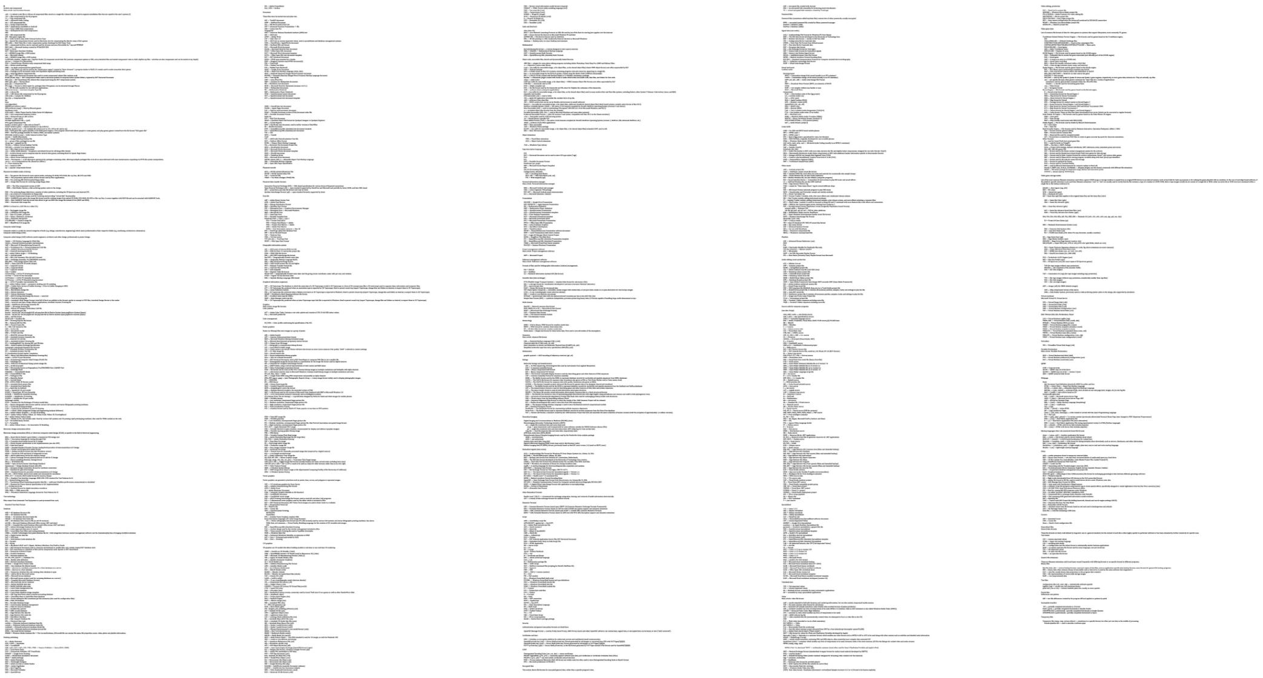
File Formats
http://en.wikipedia.org/wiki/List_of_file_formats - accessed Jan 30 2015

Slide 24
Readings for Wednesday
UK Data Archive (2015). Create and Manage Data: formatting Your Data: File Formats and Software. http://www.data-archive.ac.uk/create-manage/format/formats. (follow “Recommended File Formats” link as well).
Library of Congress (2015). Recommended Formats Statement 2015-2016. https://www.loc.gov/preservation/resources/rfs/RFS%202015-2016.pdf.

