Slide 1
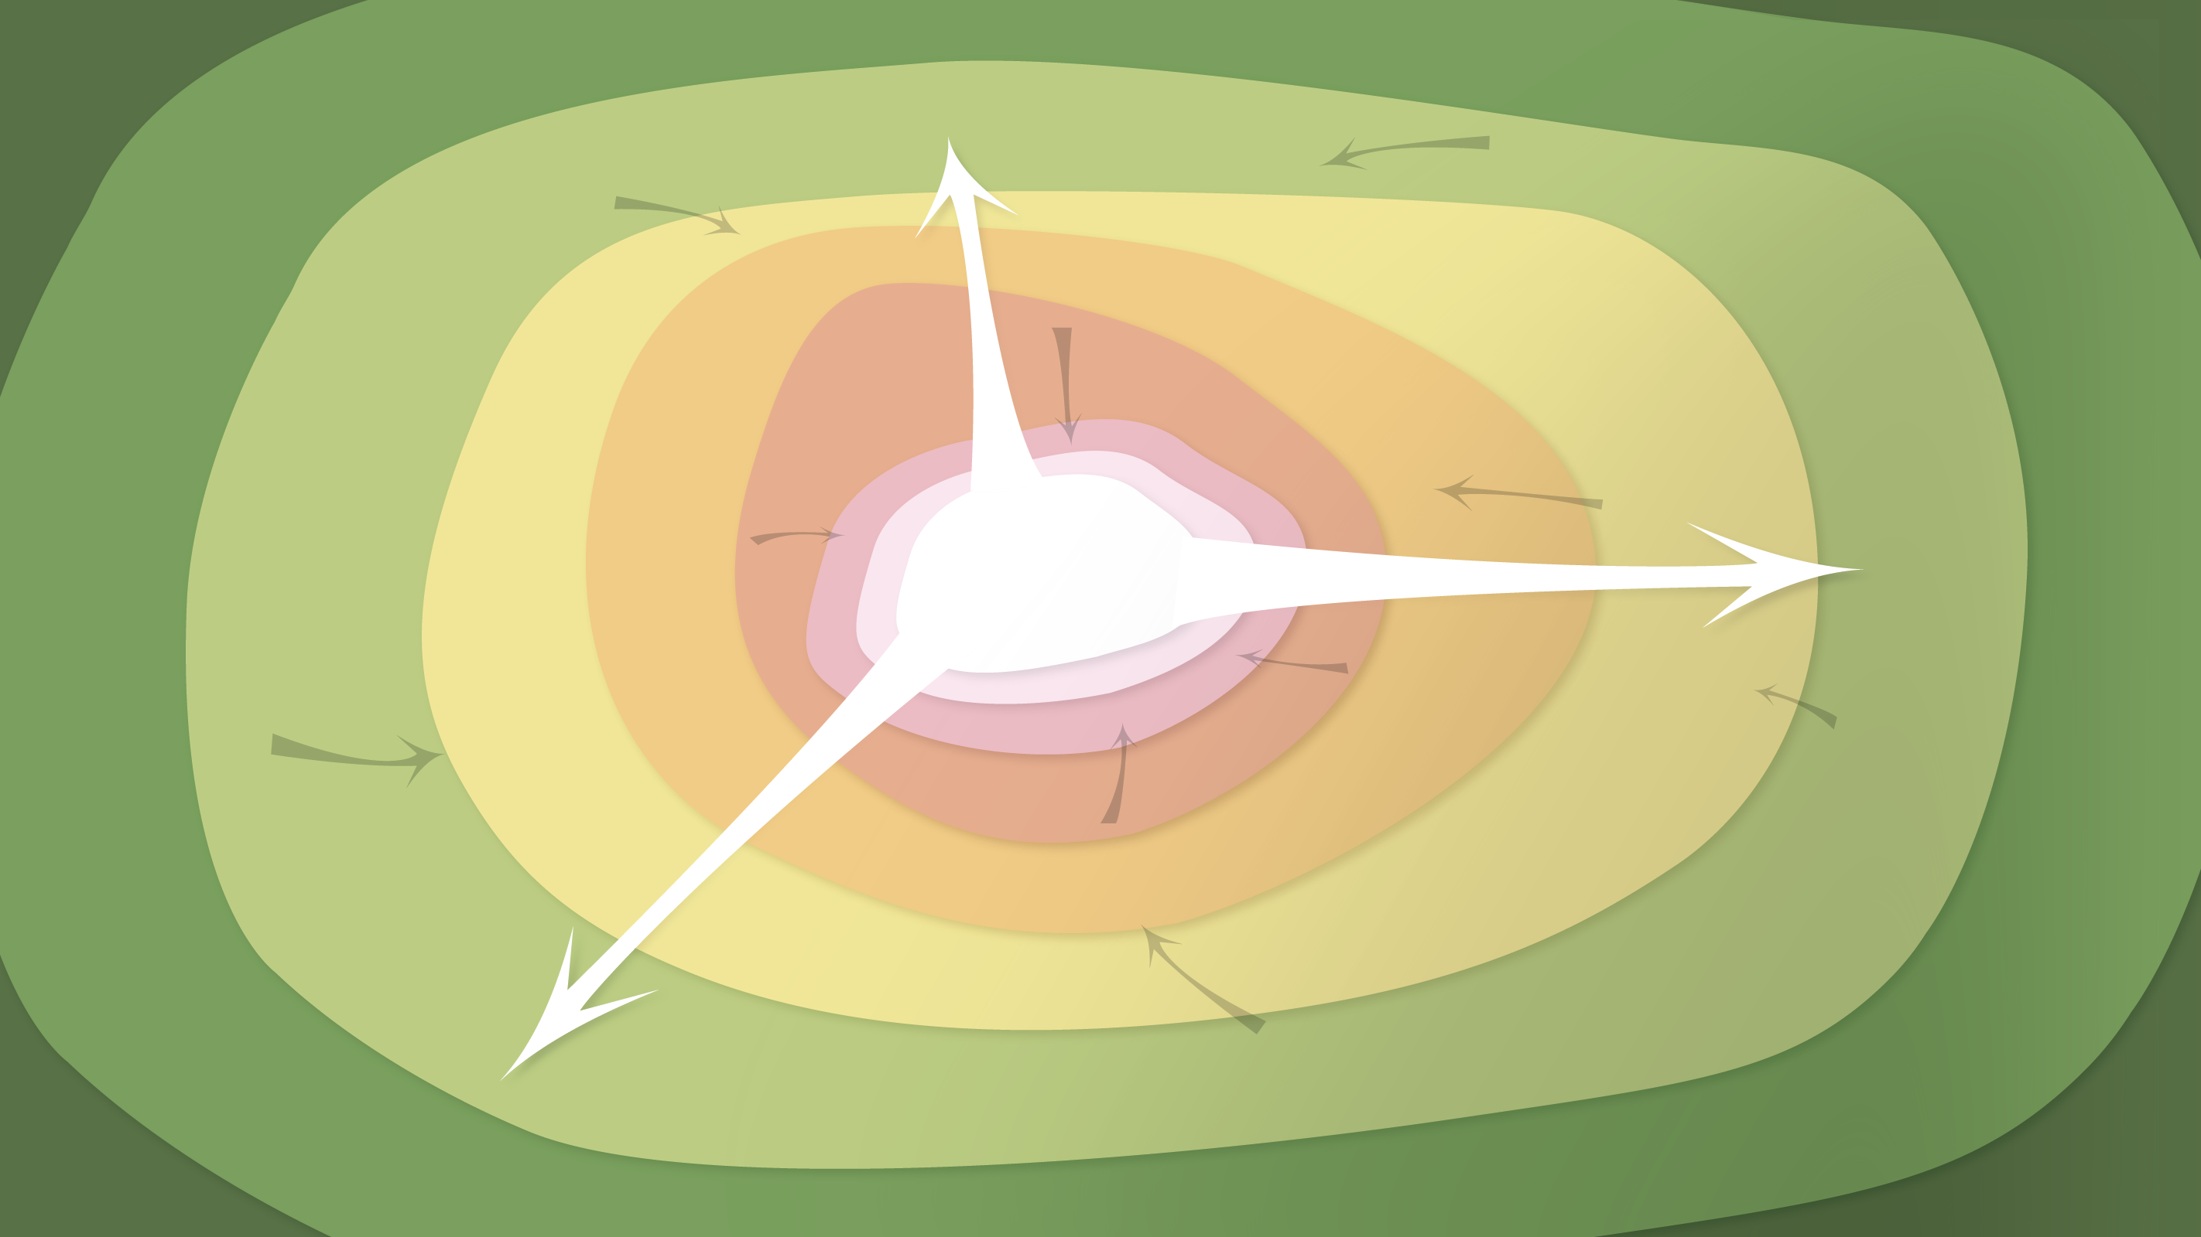
Data Management in the Research Environment
RSM 574/674 Spring 2016
Timothy Norris – tnorris@miami.edu
Angela Clark – aclark@rsmas.miami.edu

Slide 2
Todays Topics
File Formats
Text based “open” formats
Image formats

Slide 3
Data Formats
Text: doc, docx, rtf, odt, pages
Tabular: xls, xlsx, numbers, dbf
Stat: sas, jmp, rdata
Images: jpg, tiff, svg, png, gif, bmp
Geographic: shp, geotiff, kml, kmz, gdb
Video: mp4, mov, avi, ogg
Music: mp3, wav, m4a, aiff
Plain text: txt, csv, json, html, xml
Notes:
Joint photographic experts group
Note odt and odf

Slide 4
Data Formats
Text: doc, docx, rtf, odt, pages
Tabular: xls, xlsx, numbers, dbf
Stat: sas, jmp, rdata
Images: jpg, tiff, svg, png, gif, bmp
Geographic: shp, geotiff, kml, kmz, gdb
Video: mp4, mov, avi, ogg
Music: mp3, wav, m4a, aiff
Plain text: txt, csv, json, html, xml
General formats
proprietary
mixed
open
Notes:
Joint photographic experts group

Slide 5
Data Formats
Text: doc, docx, rtf, odt, pages
Tabular: xls, xlsx, numbers, dbf
Stat: sas, jmp, rdata
Images: jpg, tiff, svg, png, gif, bmp
Geographic: shp, geotiff, kml, kmz, gdb
Video: mp4, mov, avi, ogg
Music: mp3, wav, m4a, aiff
Plain text: txt, csv, json, html, xml
General formats
proprietary
mixed
open
Compression
lossy
depends
lossless
Notes:
Joint photographic experts group

Slide 6
Preferred Formats
Text: doc, docx, rtf, odt, pages
Tabular: xls, xlsx, numbers, dbf
Stat: sas, jmp, rdata
Images: jpg, tiff, svg, png, gif, bmp
Geographic: shp, geotiff, kml, kmz, gdb
Video: mp4, mov, avi, ogg
Music: mp3, wav, m4a, aiff
Plain text: txt, csv, json, html, xml
General formats
proprietary
mixed
open
Compression
lossy
depends
lossless
Notes:
Joint photographic experts group

Slide 7
Recommended Formats for Long-term Access and Sharing
Non-proprietary – no software purchase to open the file
Lossless – uncompressed with all of the original data
Indexable – if possible a plain text format that is both human and machine readable

Slide 8
Ok – so what?
First, make sure your operating system lets you see the file formats!!!!
Mac file extensions
finder->preferences: show all filename extensions (check)
PC file extensions:
explorer->organize->folder and search options:
View tab: Hide Extensions for known file types (uncheck)

Slide 9
Some things to remember
Text and numbers
Plain text – BUT STRUCTURED
character encoding??? UTF-8
PDF – preferably not!! (hard to index UNLESS created with specific care)
Images
TIFF, JPEG2000 (??), PNG, JPEG . . . .

Slide 10
Some things to remember
Cartographic (maps)
GeoTIFF, shapefile (??!!), watch for GeoJSON
Shapefile has .shp, .shx, .dbf optional (?!) .prj, .sbx, .sbn
Audio
AIFF, WAVE 44.1 kHz / 16 bit or higher
BUT MP3 with FLAC encoding OK (Free Lossless Audio Codec)

Slide 11
Some things to remember
Video
MPEG-4
Documentation
Rich Text Format
Open Document Text
HTML
Plain text

Slide 12
http://dublincore.org/documents/usageguide/elements.shtml

