Slide 1
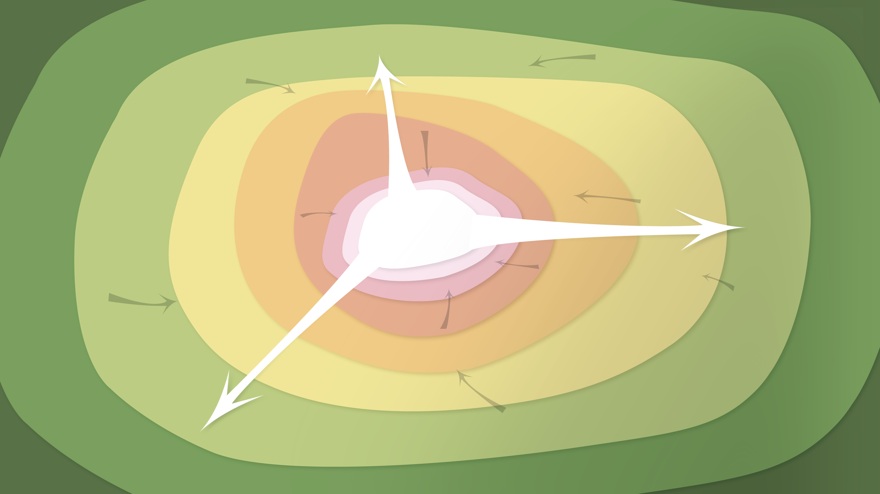
Data Management in the Research Environment
RSM 574/674 Spring 2016
Dr. Timothy Norris – Postdoctoral Fellow Richter Library – tnorris@miami.edu
Angela Clark – Librarian Associate Professor RSMAS – aclark@rsmas.miami.edu

Slide 2
The Data Management Nightmare
Karen Hanson, Alisa Surkis, and Karen Yacobucci, NYU Health Sciences Libraries
https://www.youtube.com/watch?v=N2zK3sAtr-4

Slide 3
Why Manage Data: Researcher Perspective
Manage your data for yourself:
Keep yourself organized – be able to find your files (data inputs, analytic scripts, outputs at various stages of the analytic process, etc)
Track your science processes for reproducibility – be able to match up your outputs with exact inputs and transformations that produced them
Better control versions of data – identify easily versions that can be periodically purged
Quality control your data more efficiently
Notes:
Manage your data for yourself:
Keep yourself organized – be able to find your files (data inputs, analytic scripts, outputs at various stages of the analytic process, etc)
Track your science processes for reproducibility – be able to match up your outputs with exact inputs and transformations that produced them
Better control versions of data – identify easily versions that can be periodically purged
Quality control your data more efficiently

Slide 4
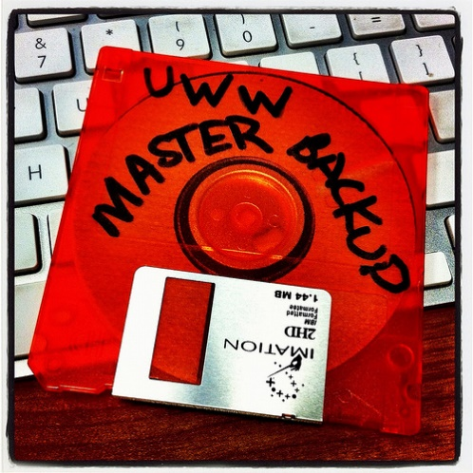
Why Data Management: Researcher Perspective
Make backups to avoid data loss
Format your data for re-use (by yourself or others)
Be prepared: Document your data for your own recollection, accountability, and re-use (by yourself or others)
Prepare it to share it – gain credibility
and recognition for your science efforts!
CC image by UWW ResNet on Flickr
Notes:
Manage your data for yourself:
Make backups to avoid data loss
Format your data for re-use (by yourself or others)
Be prepared: Document your data for your own recollection and re-use (by yourself or others)
Prepare it to share it – gain credibility and recognition for your science efforts

Slide 5
Why Data Management: Foundation to Advance Science
Data is a valuable asset – it is expensive and time consuming to collect
Data should be managed to:
maximize the effective use and value of data and information assets
continually improve the quality including: data accuracy, integrity, integration, timeliness of data capture and presentation, relevance and usefulness
ensure appropriate use of data and information
facilitate data sharing
ensure sustainability and accessibility in long term for re-use in science
Notes:
Data is a valuable asset – it is expensive and time consuming to collect
Data should be managed to:
maximize the effective use and value of data and information assets
continually improve the quality including: data accuracy, integrity, integration, timeliness of data capture and presentation, relevance and usefulness
ensure appropriate use of data and information
facilitate data sharing
ensure sustainability and accessibility in long term for re-use in science

Slide 6
Well managed, publically accessible data is important: why?
Here are a few reasons (from the UK Data Archive):
Increases the impact and visibility of research
Promotes innovation and potential new data uses
Leads to new collaborations between data users and creators
Maximizes transparency and accountability
Enables scrutiny of research findings
Encourages improvement and validation of research methods
Reduces cost of duplicating data collection
Provides important resources for education and training
Notes:
Well-managed, publically accessible data is important for a variety of reasons.
Here are a few (from the UK Data Archive):
Increases the impact and visibility of research
Promotes innovation and potential new data uses
Leads to new collaborations between data users and creators
Maximizes transparency and accountability
Enables scrutiny of research findings
Encourages improvement and validation of research methods
Reduces cost of duplicating data collection
Provides important resources for education and training

Slide 7
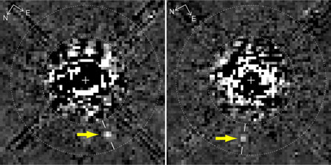
“Planet hidden in Hubble archives” Science News (Feb. 27, 2009)
New Discoveries
A new image processing technique reveals something not before seen in this Hubble Space Telescope image taken 11 years ago: A faint planet (arrows), the outermost of three discovered with ground-based telescopes last year around the young star HR 8799.D. Lafrenière et al., Astrophysical Journal Letters
D. Lafrenière et al., ApJ Letters
“The first thing it tells you is how valuable maintaining long-term archives can be. Here is a major discovery that’s been lurking in the data for about 10 years!” comments Matt Mountain, director of the Space Telescope Science Institute in Baltimore, which operates Hubble.
“The second thing its tells you is having a well calibrated archive is necessary but not sufficient to make breakthroughs — it also takes a very innovative group of people to develop very smart extraction routines that can get rid of all the artifacts to reveal the planet hidden under all that telescope and detector structure.”

Slide 8
Where a majority of data end up now…
Notes:
There is an abundance of data and metadata (if it is done) end up in filing cabinets, on discarded hard drives, in hard-copy journals on the library shelves -- or on the web, but many are subscription only journals.

Slide 9
Imagine if data were more accessible….
Notes:
Data should be properly managed and eventually be placed where they are accessible, understandable, and re-usable.

Slide 10
Quick Review
Lots of data, what to do with it?
Many researcher benefits of data management
Greater exposure of research
Easier workflows, less frustration, more productivity
Many scientific/social benefits of data management
Sharing and re-use
New discoveries
Not managing data is NOT an option
Cost are to high (both personal and professional)

Slide 11
Resources for Reading Review

Slide 12
Agency Response to OSTP 2013 Memo
 |  |  | Policy Coverage
Funder | Link to Response | Timeline to Implement | Published Outputs | Data
AHRQ | http://www.ahrq.gov/funding/policies/publicaccess/index.html | Feb 2015 (A), Oct 2015 (D) | full | full
ASPR | http://www.phe.gov/Preparedness/planning/science/Pages/AccessPlan.aspx | Oct 2015 (A, D) | full | full
CDC | http://www.cdc.gov/od/science/docs/Final-CDC-Public-Access-Plan-Jan-2015_508-Compliant.pdf | Jul 2013 (A), Oct 2015 (D) | full | full
DOD | http://www.dtic.mil/dtic/pdf/DoD_PublicAccessPlan_Feb2015.pdf | estimate fiscal year 2015 | full | full
DOE | http://www.energy.gov/datamanagement/doe-policy-digital-research-data-management | Oct 2014 (A) Oct 2015 (D) | full | full
DOT | https://www.transportation.gov/open/official-dot-public-access-plan | Jan 2016 | full | TBD
FDA | http://www.fda.gov/downloads/ScienceResearch/AboutScienceResearchatFDA/UCM435418.pdf | Oct 2015 (A, D) | full | full
NASA | http://science.nasa.gov/media/medialibrary/2014/12/05/NASA_Plan_for_increasing_access_to_results_of_federally_funded_research.pdf | Oct 2015 (A, D) | full | full
NIH | http://grants.nih.gov/grants/NIH-Public-Access-Plan.pdf | In effect (A, D), Dec 2015 (D) | full | full
NIST | http://www.nist.gov/data/upload/NIST-Plan-for-Public-Access.pdf | Oct. 2015 (A, D) | partial | full
NOAA | http://docs.lib.noaa.gov/noaa_documents/NOAA_Research_Council/NOAA_PARR_Plan_v5.04.pdf | FY2016, Q2 (A, D) (Jan 2016) | full | full
NSF | http://www.nsf.gov/pubs/2015/nsf15052/nsf15052.pdf | Jan 2016 (A, D) | Full | Full
SI | http://public.media.smithsonianmag.com//file_upload_plugin/1f143b54-a9f9-4746-bef5-1c76151e3c7a.pdf | Oct. 2015 (A, D) | full | full
USDA | http://www.usda.gov/documents/USDA-Public-Access-Implementation-Plan.pdf | Jan 2016 (A) | Full | Partial
USAID | http://blog.usaid.gov/2014/10/announcing-usaids-open-data-policy/ | October 1, 2014 (D) | none | Full
USGS | http://www.usgs.gov/usgs-manual/im/IM-OSQI-2015-01.html | Feb 19, 2015 (D) |  | full
VA | http://www.va.gov/ORO/Docs/Guidance/VA_RSCH_DATA_ACCESS_PLAN_07_23_2015.pdf | October 1, 2015 (A, D) | partial | Partial
http://bit.ly/FedOASummary

Slide 13
NSF: the DMP may include
the types of data, samples, physical collections, software, curriculum materials, and other materials to be produced in the course of the project;
the standards to be used for data and metadata format and content (where existing standards are absent or deemed inadequate, this should be documented along with any proposed solutions or remedies);
policies for access and sharing including provisions for appropriate protection of privacy, confidentiality, security, intellectual property, or other rights or requirements;
policies and provisions for re-use, re-distribution, and the production of derivatives; and
plans for archiving data, samples, and other research products, and for preservation of access to them.
http://www.nsf.gov/pubs/policydocs/pappguide/nsf15001/gpg_2.jsp#dmp

Slide 14
My Data Management Plan – a satire
Dear NSF,
I am happy to respond to your request for a 2-page Data Management Plan.
First of all, let me say how enthusiastic I am that you have embraced this new field of "large scale data analysis". Ever since I started working with large Avida data sets in 1993, then with large meteorological data sets in 1995, and then again with large sequence data sets in 1999, I have seen the need for a systematic plan to manage the data. It is nice to see NSF stepping up to the plate in such a timely manner, and I am happy to comply.
Now, as to my actual data management plan, here is how I plan to deal with research data in the future.
Read more . . .
http://ivory.idyll.org/blog/data-management.html

Slide 15
Open Data

Slide 16
Open Data
‘Open Data’ is considered a movement
Open Data is related to, but not the same as, open access (publishing)
Data cannot be copyrighted, but it can be owned
Open Data, like Open Access, is really a misnomer in the global context
While data may be ‘open’, many people still don’t have access to it
Often tools and/or knowledge are not available for access to open data
Open data is different for:
Government: https://www.data.gov/
Research: http://www.opendataresearch.org/
Business: . . . .
Some data cannot be shared due to privacy concerns (human subjects)
Often the term open data refers to ‘open linked data’ (we will discuss this more later in the course)

Slide 17
What is Open?
Access – who can access the data? How?
Redistribution – how is the data redistributed? Who controls?
Reuse – How is the data documented, formatted, and packaged. Is it possible for anyone to reuse?
Absence of technological restriction – Is there proprietary software needed?
Attribution – Who is the author (really)? Where did the data come from (sensor)?
Integrity – just because it is open, does not mean it is good data. Problem?
Discrimination (against groups or beliefs) – remember all data is contextual. Might data be produced from a discriminatory stance or lead to discriminatory conclusions?
License – How is the license distributed? Does this change if a data set grows or is a derived from another data set? Does the license propogate

Slide 18
Levels of open data
Easy to
create
Hard to
Re-use
Non-machine readable
Machine readable but in proprietary format
Machine readable in non-proprietary format
Machine readable in non-proprietary format with URI and RDF
URI – Uniform Resource Identifier
RDF – Resource Description Framework
These are both Internet terms (we will discuss later in the class)
Machine readable in non-proprietary format with URI and RDF – linked to other metadata
this last level is the requisite for the ‘semantic web’ (we will discuss later in class)
Hard to
create
Easy to
Re-use

Slide 19
The Case for Open Data
Transparency (in government, business and research)
Democracy (better informed decisions and debates)
Increased efficiencies in workflows and production
Publicity campaigns and social license (like green business)
More innovation possible

Slide 20
The Case against Open Data
Privatization of public services (kind of like ‘free trade’)
Freely available data benefits big business!!!
Will open data be captured by big business in the guise of ‘transparency’
Empowers the empowered even more
How is data used? For whose interests?
Open Data can be captured (usually by a business interest) and repurposed outside of its original research context
Lacks sustainability, scalability and usability
Often Open Data is promoted by volunteer time (enthusiasts, hackathons, etc)
Who will have the means to support this in the long run?

Slide 21
Intro to thinking about data management

Slide 22
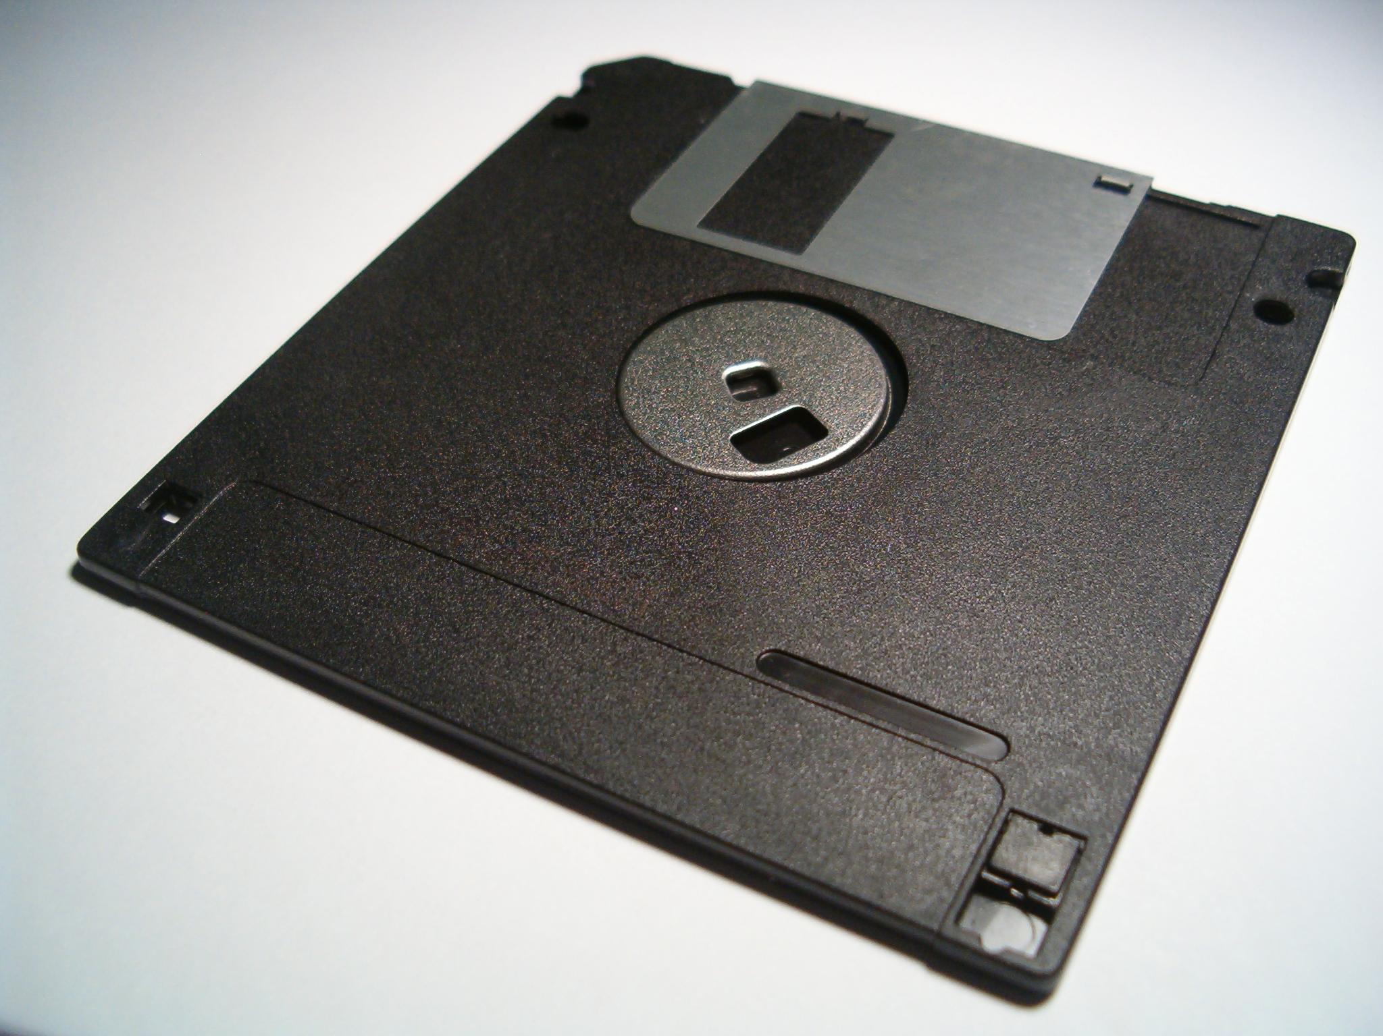
What is data management?
Actions that contribute to effective storage, preservation and reuse of
data and documentation throughout the research lifecycle.
Whitmire, Amanda L. (2014). Research Data Management Curriculum, Lecture 1: Introduction to Research Data Management. Oregon State University Libraries. Retrieved 11/04/2015 from: http://figshare.com/articles/GRAD521_Research_Data_Management_Lectures/1003835
Notes:
Data management is a verb – it involves intentional effort and activity.
The main goals of DM are preservation and reuse, for you and for others.
Covers all aspects of the data lifecycle from planning digital data capture methods, whittling down, ingestion to databases, providing for access and reuse, to transformation.

Slide 23
Data management is not:
Data science
Computational science
Database administration
A research method:
what data to collect
how to collect them
how to design an experiment
Whitmire, Amanda L. (2014). Research Data Management Curriculum, Lecture 1: Introduction to Research Data Management. Oregon State University Libraries. Retrieved 11/04/2015 from: http://figshare.com/articles/GRAD521_Research_Data_Management_Lectures/1003835
Notes:
If this is why you are here, you signed up for the wrong class.

Slide 24

What is DATA Management?
¿Data?
¿Management?
¿ TOOLS ?
File System Organization
File Naming Conventions
Privacy/Security Considerations
File Format Choice
Documentation and metadata
Roles and responsibilities in research environment
Storage and backup strategies
Acquiring and cleaning data
Sharing and collaboration strategies
Ownership of data
Access strategies / Access restrictions
Data publication / Data citation
Numbers
Words
Citations / references
Notebooks / marginalia
Specimens
Field Samples
Images
Videos / sound recording
Relationships
Models
Code
¿ VISUALIZATION?
Notes:
The Matrix - 1999
Big Data . . .
Talk to the data deluge, what are the responses in academia? In the public sector? Perhaps this is why we are here today?
NIH early data sharing requirements from grants over $500,000 – stringent controls for privacy and proprietary data
The 2011 NSF requirement to have data management plans in the grant proposals – there are program specific requirements
Most are simply two page documents with requirements to outline:
Data types to be collected
Standards to be used for metadata and data
Sharing policies (access, privacy, IP, etc.)
Re-use policies (distribution, derivatives
Plans for archival
Note that these requirements caused quite the scramble. No grant money if you could not include a plan.
Note that many foundations now also have data management requirements
Even private sector contracts require data management planning

Slide 25
and Research DATA Management?
Before: Data Management Planning / Grant Process
During: Compliance and Productivity
After: Publication and/or Repository Deposit
Notes:
The Matrix - 1999
Big Data . . .
Talk to the data deluge, what are the responses in academia? In the public sector? Perhaps this is why we are here today?
NIH early data sharing requirements from grants over $500,000 – stringent controls for privacy and proprietary data
The 2011 NSF requirement to have data management plans in the grant proposals – there are program specific requirements
Most are simply two page documents with requirements to outline:
Data types to be collected
Standards to be used for metadata and data
Sharing policies (access, privacy, IP, etc.)
Re-use policies (distribution, derivatives
Plans for archival
Note that these requirements caused quite the scramble. No grant money if you could not include a plan.
Note that many foundations now also have data management requirements
Even private sector contracts require data management planning

Slide 26
and Research DATA Management?
Before: Data Management Planning / Grant Process
Privacy/Security Considerations
Storage and backup strategies
File System Organization
File Naming Conventions
File Format Choice
Documentation and metadata
Roles and responsibilities in research environment
Sharing and collaboration strategies
Ownership of data
Access strategies / Access restrictions
During: Compliance and Productivity
After: Publication and/or Repository Deposit
Notes:
The Matrix - 1999
Big Data . . .
Talk to the data deluge, what are the responses in academia? In the public sector? Perhaps this is why we are here today?
NIH early data sharing requirements from grants over $500,000 – stringent controls for privacy and proprietary data
The 2011 NSF requirement to have data management plans in the grant proposals – there are program specific requirements
Most are simply two page documents with requirements to outline:
Data types to be collected
Standards to be used for metadata and data
Sharing policies (access, privacy, IP, etc.)
Re-use policies (distribution, derivatives
Plans for archival
Note that these requirements caused quite the scramble. No grant money if you could not include a plan.
Note that many foundations now also have data management requirements
Even private sector contracts require data management planning

Slide 27
and Research DATA Management?
Before: Data Management Planning / Grant Process
During: Compliance and Productivity
Follow file naming, organization and format conventions
Documentation and metadata
Acquiring and cleaning data
Regularly backup all data
Be mindful when sharing / version control
Access / privacy policy enforcement
After: Publication and/or Repository Deposit
Notes:
The Matrix - 1999
Big Data . . .
Talk to the data deluge, what are the responses in academia? In the public sector? Perhaps this is why we are here today?
NIH early data sharing requirements from grants over $500,000 – stringent controls for privacy and proprietary data
The 2011 NSF requirement to have data management plans in the grant proposals – there are program specific requirements
Most are simply two page documents with requirements to outline:
Data types to be collected
Standards to be used for metadata and data
Sharing policies (access, privacy, IP, etc.)
Re-use policies (distribution, derivatives
Plans for archival
Note that these requirements caused quite the scramble. No grant money if you could not include a plan.
Note that many foundations now also have data management requirements
Even private sector contracts require data management planning

Slide 28
and Research DATA Management?
Before: Data Management Planning / Grant Process
During: Compliance and Productivity
After: Publication and/or Repository Deposit
Publish
Deposit in a repository
Notes:
The Matrix - 1999
Big Data . . .
Talk to the data deluge, what are the responses in academia? In the public sector? Perhaps this is why we are here today?
NIH early data sharing requirements from grants over $500,000 – stringent controls for privacy and proprietary data
The 2011 NSF requirement to have data management plans in the grant proposals – there are program specific requirements
Most are simply two page documents with requirements to outline:
Data types to be collected
Standards to be used for metadata and data
Sharing policies (access, privacy, IP, etc.)
Re-use policies (distribution, derivatives
Plans for archival
Note that these requirements caused quite the scramble. No grant money if you could not include a plan.
Note that many foundations now also have data management requirements
Even private sector contracts require data management planning

Slide 29
Readings for second week Monday January 18th is a holiday!! (MLK Day)
Open Data Policy—Managing Information as an Asset. https://www.whitehouse.gov/sites/default/files/omb/memoranda/2013/m-13-13.pdf
Committee on Ensuring the Utility and Integrity of Research Data in a Digital Age (2009). “Promoting the Stewardship of Research Data” (Chap 4) in Ensuring the Integrity, Accessibility, and Stewardship of Research Data in the Digital Age. National Academies Press, Washington D.C. http://www.nap.edu/catalog/12615/ensuring-the-integrity-accessibility-and-stewardship-of-research-data-in-the-digital-age
Choose a DMP to read from https://dmptool.org/public_dmps. NOTE: “They are not vetted for quality, completeness, or adherence to funder guidelines.”
If your research lab has an existing DMP bring it to class
Read everything before Wednesday January 20th!!!

