Slide 1
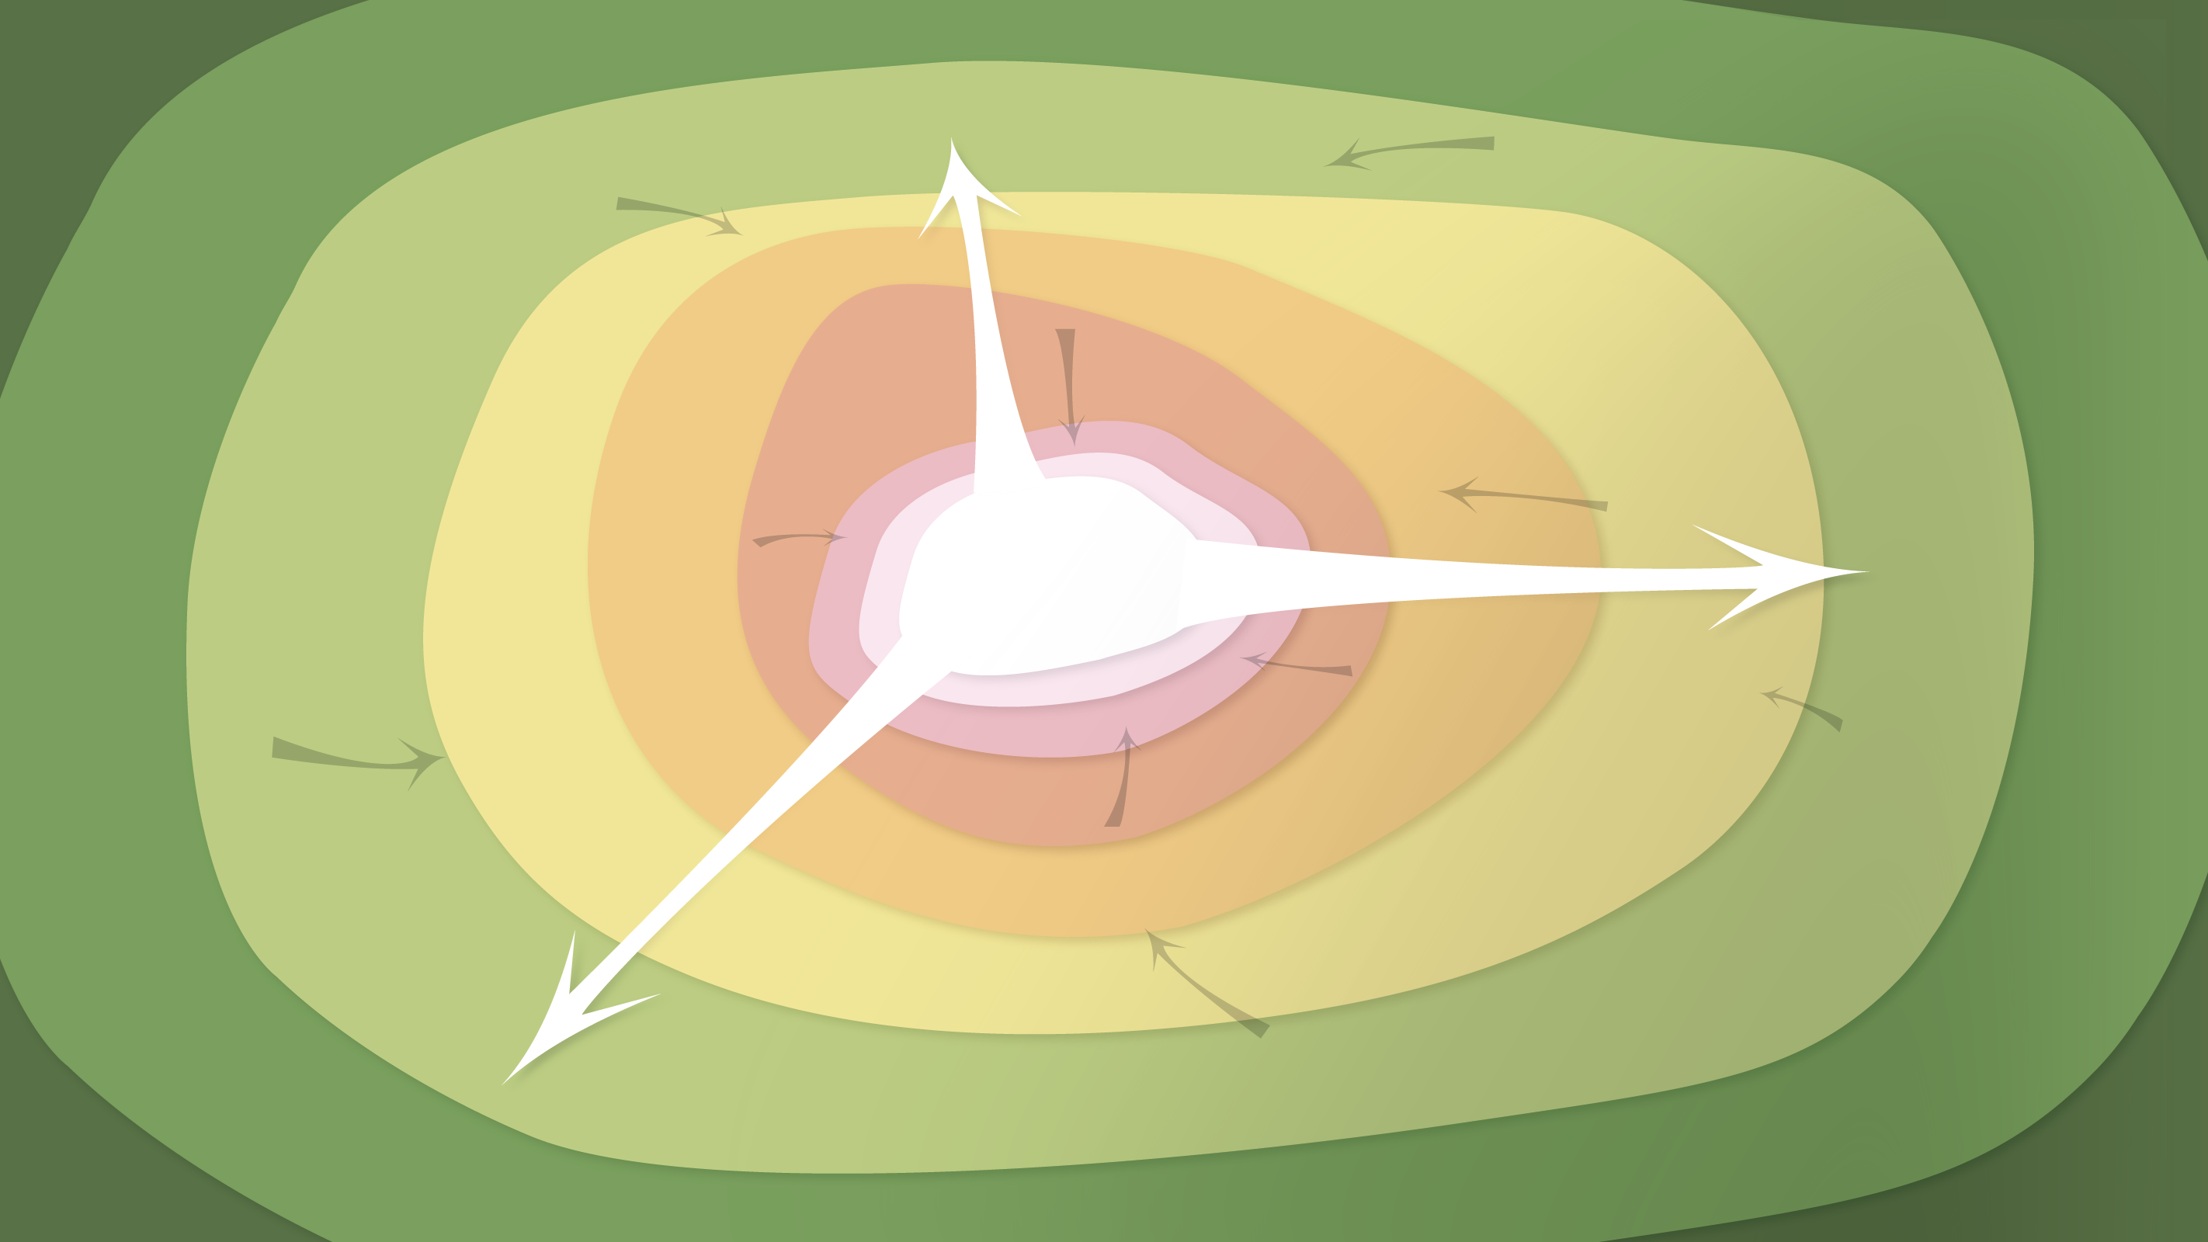
Data Management in the Research Environment
RSM 574/674 Spring 2016
Timothy Norris – tnorris@miami.edu
Angela Clark – aclark@rsmas.miami.edu

Slide 2
Todays Topics Data Curation Profiles
What is a DCP
The toolkit
An example

Slide 3
The data story
Specific data set or research project
Conversation and perhaps a survey form to fill out
Could be done with any discipline (?) or any kind of data (?)
Perhaps choose parts/components to use from the toolkit
this is social science

Slide 4
The original idea
Represents researcher needs and perspectives
Suitable for sharing (inform the library community) (?)

