Slide 1
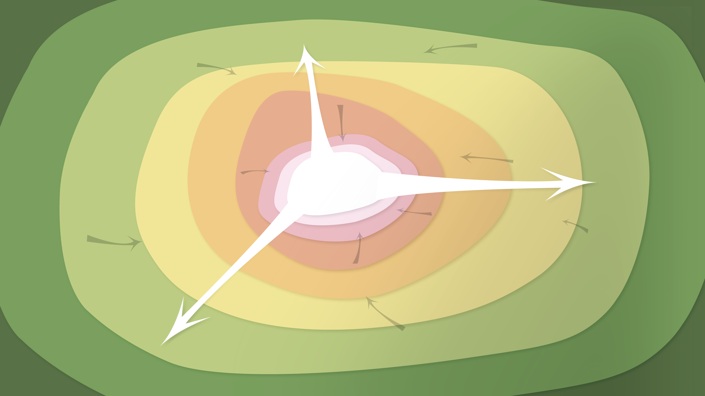
Data Management in the Research Environment
RSM 574/674 Spring 2016
Timothy Norris – tnorris@miami.edu
Angela Clark – aclark@rsmas.miami.edu

Slide 2
Todays Topics Sharing Data
Open Data
Open Software
UM Policies

Slide 3
By Wednesday March 30th 2016
One written paragraph sent by email to both Angela and Tim that describes the content and type of final project that you will do for this class.

Slide 4
Open
?

Slide 5
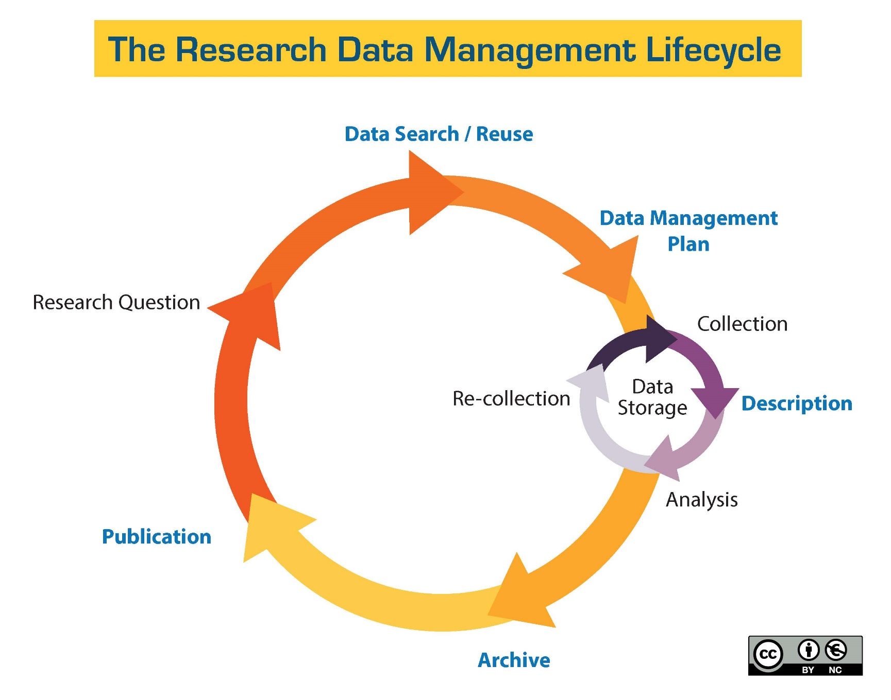
http://guides.library.ucsc.edu/datamanagement/
Notes:
Purpose?? And place?

Slide 6
Open
?

Slide 7
Open Data
“data is open if anyone is free to use, reuse, and redistribute it – subject only, at most, to the requirement to attribute and/or share-alike.”
Pollack, R (2006). ‘The value of the public domain’, Institue for Public Policy Research, http://www.ippr.org/publication/55/1526/the-value-of-the-public-domain, quoted from Kitchin, R (2014). The Data Revolution. Sage, Los Angeles. P. 49-50.

Slide 8
Open Data
opendefinition.org *
www.opengovdata.org °
Accessible
Redistributable (w or w/o license)
Reusable
No Technological restrictions
Attribution
Integrity maintained
Non-discriminatory
License is redistributable, non-specific, and non-restrictive for derivative works
Complete
Primary
Timely
Accessible
Machine processable
Non-discriminatory
Non-proprietary formats
License Free
Open for Compliance Review
° From a 2007 open data workshop. Influenced heavily by Larry Lessig
*As a sub-project of the open knowledge foundation, https://okfn.org/
Adapted from Kitchin, R (2014). The Data Revolution. Sage, Los Angeles. P. 50-51

Slide 9
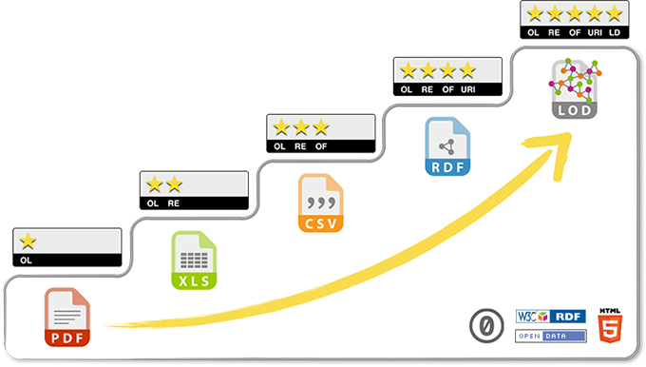
Linked Open Data
Berners-Lee, http://5stardata.info/en/, accessed 03-27-2016

Slide 10
Linked Open Data
★ | make your stuff available on the Web (whatever format) under an open license
★★ | make it available as structured data (e.g., Excel instead of image scan of a table)
★★★ | make it available in a non-proprietary open format (e.g., CSV as well as of Excel)
★★★★ | use URIs to denote things, so that people can point at your stuff
★★★★★ | link your data to other data to provide context5
Adapted from Berners-Lee, http://5stardata.info/en/, accessed 03-27-2016

Slide 11
Open Data Research Environment
Benefits
Barriers
Reproduction
Meta-analyses
Scientific Inquiry Approaches
New Questions
Meet Requirements
Increase Impact/Visibility
Competition
Lack of recognition
Difficult and time consuming
Sensitivity issues

Slide 12
Open Data Research Environment
Competition -> embargos
Lack of recognition -> citations
Difficult and Time Consuming -> data repositories
Sensitivity Issues -> restrict access

Slide 13
Open Data The World Writ Large
Benefits
Barriers
Transparency
Informed choice (democracy)
Improved efficiencies/productivities
Organizational Branding (like “greening” of a business)
Commercial Value
Makes valuable resources selectively accessible
May be co-opted by corporate business for profit
Should businesses “open” their data?

Slide 14
Open Data The World Writ Large
Sustainability (who pays)?
Open Data %LIKE% Free Trade?
Who does it empower (social justice)?
Who does the work for whom?
Data Shadows and Dataveillance?

Slide 15
** Break **

Slide 16
Open Source
1. Free Redistribution
2. Source Code
3. Derived Works
4. Integrity of The Author's Source Code
5. No Discrimination Against Persons or Groups
6. No Discrimination Against Fields of Endeavor
7. Distribution of License
8. License Must Not Be Specific to a Product
9. License Must Not Restrict Other Software
10. License Must Be Technology-Neutral
https://opensource.org/osd

Slide 17
Open Source Example
This set of tools is distributed under the GNU General Public License http://www.gnu.org/licenses/gpl-3.0.en.html
-- or –
/* googleTiles.php is adapted by Tim Norris 07/18/2008 from the perl script googleTiles.pl published under the GNU general public license: http://www.gnu.org/licenses/gpl-3.0.en.html
The original perl script was found here:
http://www.usnaviguide.com/google-tile.htm */

Slide 18
Free Software
The freedom to run the program as you wish, for any purpose (freedom 0).
The freedom to study how the program works, and change it so it does your computing as you wish (freedom 1). Access to the source code is a precondition for this.
The freedom to redistribute copies so you can help your neighbor (freedom 2).
The freedom to distribute copies of your modified versions to others (freedom 3). By doing this you can give the whole community a chance to benefit from your changes. Access to the source code is a precondition for this.
http://www.gnu.org/philosophy/free-sw.html

Slide 19





Licenses to be aware of
Apache License, 2.0 (Apache-2.0)
BSD 3-Clause "New" or "Revised" license (BSD-3-Clause)
BSD 2-Clause "Simplified" or "FreeBSD" license (BSD-2-Clause)
GNU General Public License (GPL)
GNU Library or "Lesser" General Public License (LGPL)
MIT license (MIT)
Mozilla Public License 2.0 (MPL-2.0)
https://opensource.org/licenses/category

Slide 20
Open Source Software
Maps
QGIS
Mapserver
GDAL/OGR
Desktop
Mozilla Firefox
Mozilla Thunderbird
7-zip
KeePass (password manager)
Virtual Box (machine sims)
Graphics
Handbrake (video processor)
VLC (video tools)
InkScape (drawing)
Meshlab (3D model editor)
Blender (3D animation)
Linux
Fedora/Redhat
Debian
Ubuntu
OpenSUSE
Apache
Webserver
Flex
Solr/Lucene
Databases
MySQL
PostgreSQL
MongoDB
SQLite
Languages
Java and javascript
C++ (on linux)
PHP
Python
R
Content Management Systems
Wordpress
Drupal
Joomla
Office
Open Office
Libre Office
Notepad++

Slide 21
** Break **

Slide 22
What About Data? In The Research Environment
What happens if a researcher leaves the institution?
What if someone needs access to my data?
How long do I have to keep them and how should I discard them?
How do I set policy for my team, my lab or myself?
But I’m collaborating: whose policy wins?
What if there isn’t a policy?
What help can I get?
Briney, K., Goben, A., & Zilinski, L. (2015). Do You Have an Institutional Data Policy? A Review of the Current Landscape of Library Data Services and Institutional Data Policies. Journal of Librarianship and Scholarly Communication, 3(2), eP1232. http://dx.doi.org/10.7710/2162-3309.1232

Slide 23
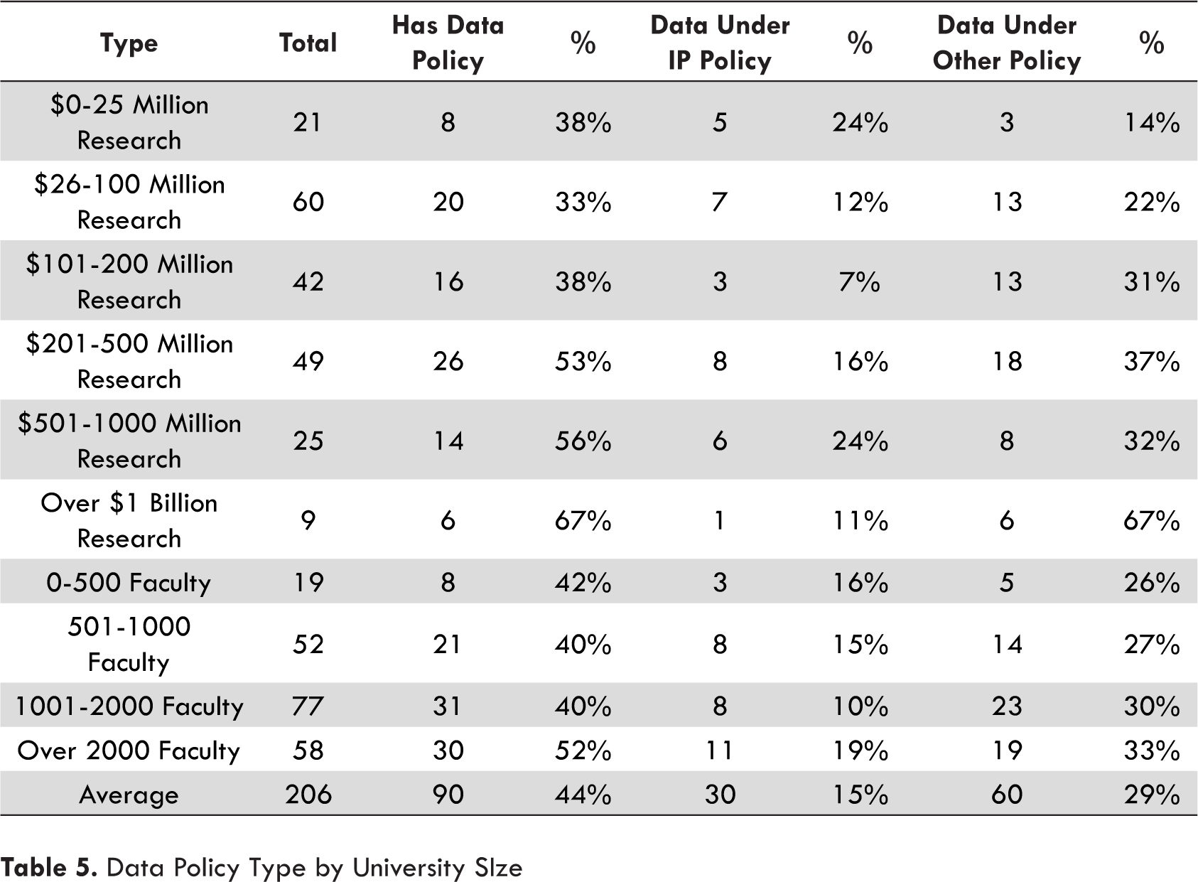

Slide 24
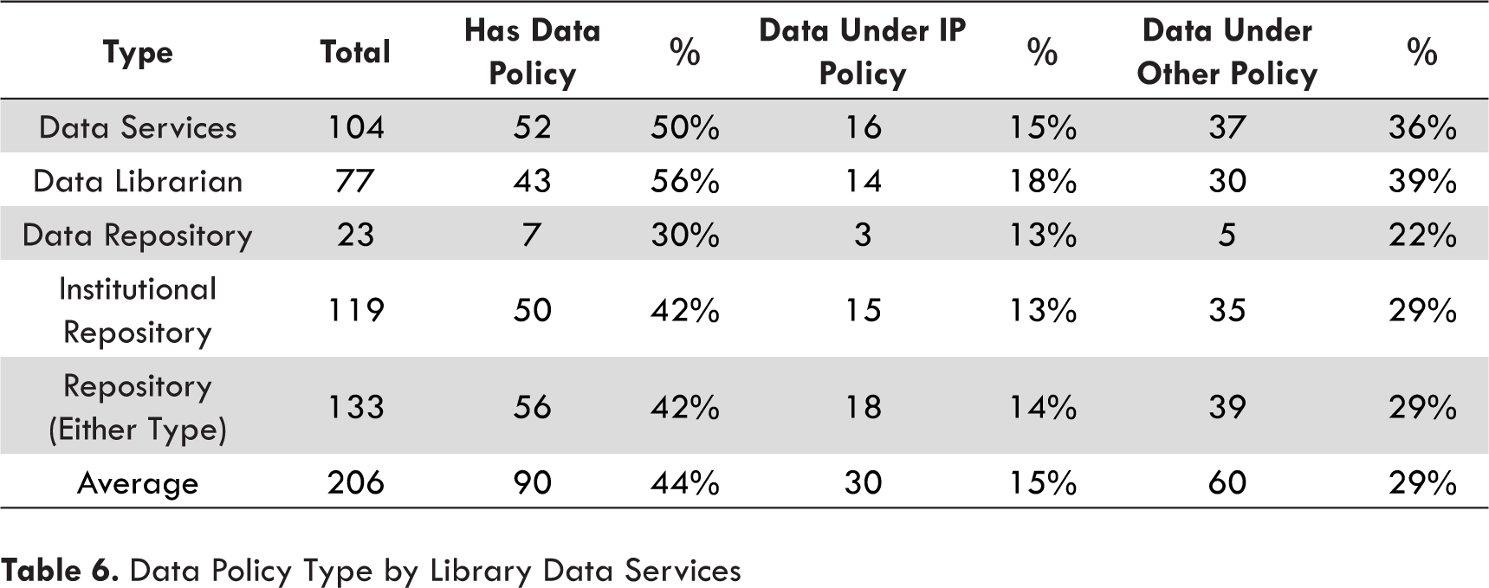

Slide 25
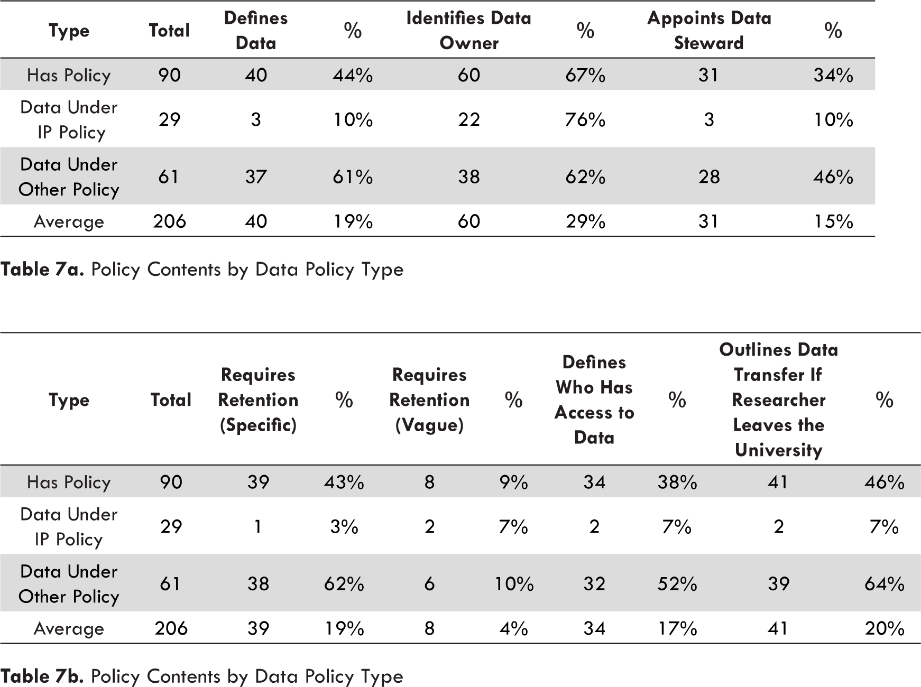

Slide 26
UM Policy – Faculty Manual
Page 123 – Ownership of Discoveries and Inventions.
(a) A discovery or invention, whether or not subject to patent, developed as a direct result of the regular duties of a faculty or staff member, or developed by a faculty member or staff member or student as a result of research done on or in connection with theses or dissertations or problems pertaining thereto, or as a result of a program of research financed wholly or in part by University funds, or by funds under the control of the University, except as otherwise owned for reasons mentioned in the Preamble, is the exclusive property of the University. Any and all right, title and interest in any such discovery or invention, and any patent rights pertaining thereto, are hereby and will be assigned to the University and shall be administered in accordance with the determination of the Committee.

Slide 27
UM Policy – Faculty Manual
Page 123 – Ownership of Discoveries and Inventions.
(a) A discovery or invention, whether or not subject to patent, developed as a direct result of the regular duties of a faculty or staff member, or developed by a faculty member or staff member or student as a result of research done on or in connection with theses or dissertations or problems pertaining thereto, or as a result of a program of research financed wholly or in part by University funds, or by funds under the control of the University, except as otherwise owned for reasons mentioned in the Preamble, is the exclusive property of the University. Any and all right, title and interest in any such discovery or invention, and any patent rights pertaining thereto, are hereby and will be assigned to the University and shall be administered in accordance with the determination of the Committee.

Slide 28
UM Policy – Faculty Manual
Page 138 – Software.
Faculty, students, and research associates or postdoctoral researchers working under faculty guidance on funded research, who develop software will normally be deemed to own the software. Exceptions are ... 1) prior written agreement with University, 2) prior written agreement with funder, 3) work is part of patentable invention, 4) the University made a substantial investment in the work, and 5) works made for hire.

Slide 29

UM Innovation
Concept to commercialization seminars (C2C)
http://www.miami.edu/index.php/u_innovation/resources_for_um/C2C/
Submit an invention
http://www.miami.edu/index.php/u_innovation/submit_an_invention/
http://www.miami.edu/index.php/u_innovation/

Slide 30
UM Policy – Faculty Manual
Page 20 – all data with respect to hiring, promotion, and tenure of faculty
Page 26 – senate appointments and voting
Page 123 – Policies and Procedures of the University of Miami Relating to Allegations of Misconduct in Research
In order to respond to allegations regarding the integrity of any published report, adequate records of the original protocols and research records, including all raw data, must be preserved for at least seven years (or longer if required by the funding agency), so they can be made available for inspection...
... Fabrication is making up data or results and recording or reporting them.

Slide 31
UM Policy – Faculty Manual
Page 124 – Policies and Procedures of the University of Miami Relating to Allegations of Misconduct in Research
Research record means the record of data or results that embody the facts resulting from scientific inquiry, including but not limited to, research proposals, laboratory records, both physical and electronic, progress reports, abstracts, theses, oral presentations, chapters, books, audio or video tapes, CDs, internal reports, journal articles, and any documents and materials provided to the University or to a University official by a respondent in the course of the research misconduct proceeding.
P 128 – The University has the right to obtain custody of all of the research record

Slide 32
UM Policy Grad Handbook
P. 15 – Ethics, Student Rights and Responsibilities
All forms of academic fraud are strictly prohibited. These include, but are not limited to, plagiarism, cheating, collusion, falsification, violation of professional ethics, or misrepresentation of research data. Students certify that all work (whether an examination, dissertation, thesis, research paper, research project, form of creative expression, experimental data, or any other academic undertaking) submitted for evaluation, presentation, or publication meets these standards.

Slide 33
Peer Institutions | last revised | responsible party | ownership stated | "research data" defined | data retention (min.) | data access | PI moves | disputes | take-down | notes
Case Western Reserve University * | 2000 | X |  | X | 3 years | X | X | X | X
New York University * | 2010 | X | X | X | 3 years | X | X |  | X
University of Rochester * | 2014 | X | X | X | 3 years | X | X
University of Miami | 2014 |  |  |  | 7 years |  |  |  |  | in faculty manual
Emory University * | 2007 | X |  |  | 7 years |  | X |  |  | in faculty manual
Brandeis University * | 2003 |  | X |  |  |  |  |  |  | in IP policy
University of Southern California * | 2001 |  | X |  |  |  |  |  |  | in IP policy
Carnegie Mellon University *
Syracuse University *
Tulane University *
Vanderbilt University *
Non-peer Institutions
University of Kentucky | 2011 | X | X | X | 5 years | X | X | X | X
Johns Hopkins University | 2008 | X | X | X | 5 years | X |  |  | X
Duke University | 2007 | X | X | X | 5 Years | X
The University of Edinburgh | 2011 | X |  |  |  | X |  |  | X | not really a policy
University of Pittsburg | 2009 | X | X | X | 7 years | X | X
Pennsylvania State | 2003 | X | X | X | 5 years | X | X |  |  | set of guidelines
Stanford | 1997 | X | X | X | 3 years | X | X

