Slide 1
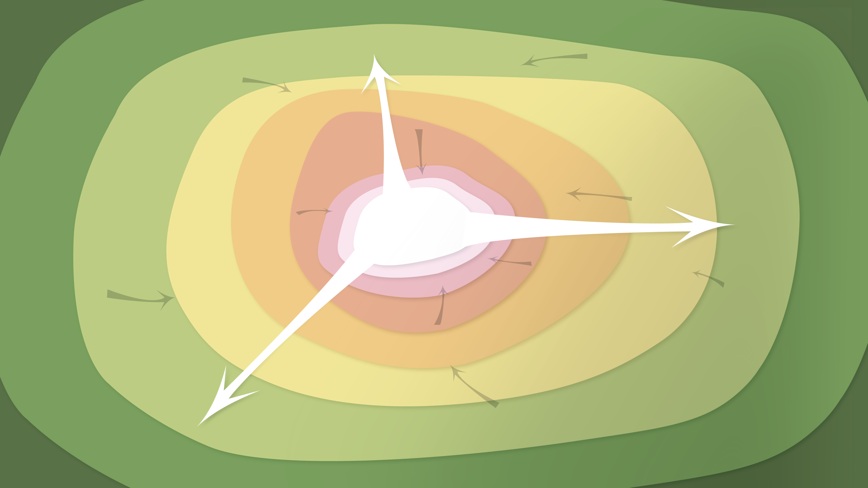
Data Management in the Research Environment
RSM 574/674 Spring 2016
Timothy Norris – tnorris@miami.edu
Angela Clark – aclark@rsmas.miami.edu

Slide 2
Housekeeping
Data Curation Profiles for next week:
please come on Monday February 15th with your interviewee identified - who you are going to talk to about data
Can be advisor, peer, colleague
It should take between 30-60 minutes of their time
New syllabus will be posted by Wednesday February 10th

Slide 3
Todays Topics Backup and Storage
Backups vs. Archiving
Methodological considerations
Local solutions
Online solutions

Slide 4
How important is your data?
take a moment of silence to imagine what would happen if your computer failed today

Slide 5
common data loss scenarios
Hardware failure
Disk drive in the computer
Solid state memory devices (internal drives and external thumb drives)
Unexpected power problem
Power surge/drop
Something touches your computer too much (child/pet)
Catastrophic event
Hurricane
Other
Device accidents
Stolen
Dropped/spilled/etc
Pressed “format” accidentally

Slide 6
again
this will get personal
it CAN happen to you
it is LIKELY that it will happen to you

Slide 7
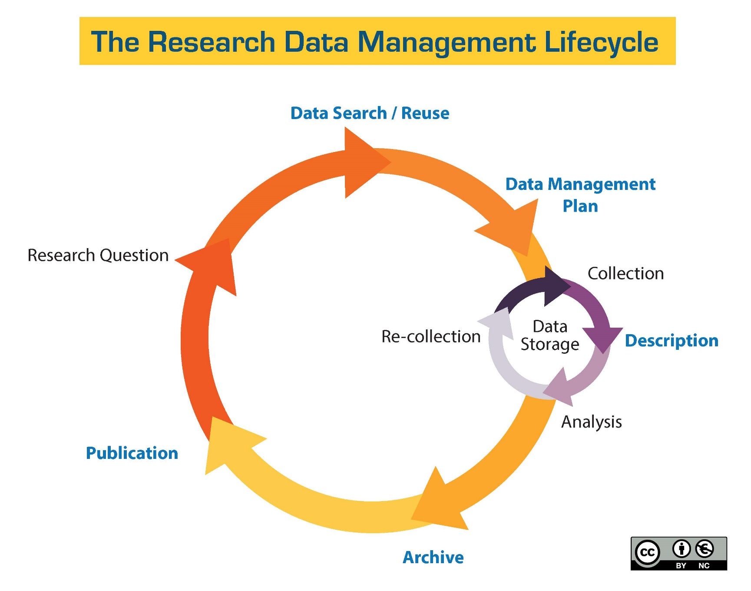
http://guides.library.ucsc.edu/datamanagement/

Slide 8

Data Protection, Backups, Archiving, Preservation Are They the Same Thing? Not Quite…
Data Protection
Includes topics such as backups, archives, and preservation; also includes physical security, encryption, and others not addressed here
We will be talking security on Wednesday
Terms “backups” and “archives” are often used interchangeably, but do have different meanings
Backups: a copy (or copies) of the original file is made before the original is overwritten
Archives: preservation of the file
Data Preservation
Includes archiving in addition to processes such as data rescue, data reformatting, data conversion, metadata
DataONE Education Module: Data Protection Backups. DataONE. Retrieved from http://www.dataone.org/sites/all/documents/L06_DataProtectionBackups.pptx
Notes:
The terms data protection, data backups, data archiving, and data preservation are often used interchangeably but they do have different meanings and purposes. Data protection covers a wide variety of topics including backups, archives, preservation, physical security (such as the use of smart cards), encryption, and others including laws which govern data security. However, these slides will not focus on this broader topic but rather will look specifically at backups, archives, and data preservation.
The terms data backups and data archiving are often used interchangeably as they both relate to saving a specific version of a file, but they do convey different processes. The term “backup” is used specifically when making copies of various files with the knowledge that the files may change. Backups are kept for a certain amount of time, but can be discarded after a specified time has passed. Archiving is used when a file is to be preserved as-is, often at the end of a project and acts as a static (and usually final) record.
Data preservation encompasses many of these same methodologies, but can also include things like data rescue, reformatting of files, converting data, and the creation of metadata. These first three topics will be discuss briefly in this lesson; however, metadata will be covered in another lesson.

Slide 9
Backups vs. Archiving
Backups
Used to take periodic snapshots of data in case the current version is destroyed or lost
Backups are copies of files stored for short or near-long-term
Often performed on a somewhat frequent schedule
Archiving
Used to preserve data for historical reference or potentially during disasters
Archives are usually the final version, stored for long-term, and generally not copied over
Often performed at the end of a project or during major milestones
It is a good idea to have multiple copies of your backups and archives, in case one copy fails.
DataONE Education Module: Data Protection Backups. DataONE. Retrieved from http://www.dataone.org/sites/all/documents/L06_DataProtectionBackups.pptx
Notes:
The main difference between data backups and archiving is that backups deal with data that is copied elsewhere and potentially can be overwritten again as the data changes. Archiving makes a record of data that is usually in its final state.
When a user performs a backup, they are in essence taking a snapshot of the data at that moment in time. This allows the user to restore the file as needed, such as when the current version of the file is corrupted, lost, or somehow destroyed or altered. Backups are often used for short-term storage or near long-term storage, depending upon the user’s backup needs and procedures. Backups are usually scheduled on a frequent basis.
Archiving deals more with records that are no longer in use and is used to create a historical snapshot of the data. This provides for preservation of the data for future needs. Usually, archives are made when a project ends, or when appropriate.
Regardless of whether you are dealing with backups or archives, you should have multiple copies in case one (or many) versions fail.

Slide 10
Backup and Storage Major Considerations
Who is responsible for backup ?
How often do you backup ?
Partial vs. full backups ?
Non-digital backups ?
Where (literally) will the backups be located ?
Do the backups need a description (metadata) ?
Manual vs automatic ?
Recovery procedures ?
Verification – how do you know the backup was successful ?
How long do you keep your backups ?
What happens when the project ends ?

Slide 11
Don’t forget !!
Data conversions and formats
Versioning
File Naming

Slide 12
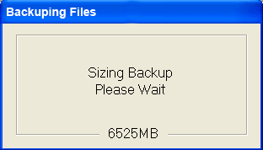



Data in Real Life
A design firm was handling their own backups. The system was working fine and the backup software was reporting that the data was successfully backed up.
Images courtesy of Heather Henkel
DataONE Education Module: Data Protection Backups. DataONE. Retrieved from http://www.dataone.org/sites/all/documents/L06_DataProtectionBackups.pptx
Notes:
DATA IN REAL LIFE: An architecture firm was handling their own backups. The system was working fine – the backup software was reporting that the data was successfully backed up.

Slide 13
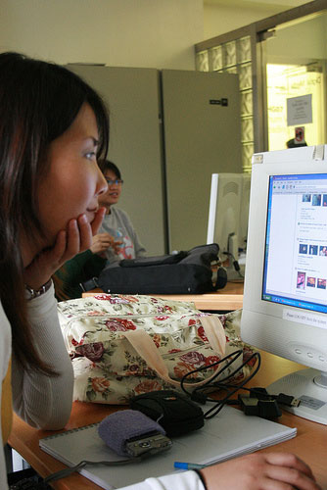
Data in Real Life
The administrator checked the
backups immediately after they were done and confirmed they were good.
CC Image courtesy of angielauw on Flickr
DataONE Education Module: Data Protection Backups. DataONE. Retrieved from http://www.dataone.org/sites/all/documents/L06_DataProtectionBackups.pptx
Notes:
The administrator checked the backups immediately after they were done and confirmed they were good.

Slide 14
Data in Real Life
After a computer virus erased most of their files, they went back to their backups. Unfortunately they found that the backups were all blank and all of the data was gone. Only after some investigation did they discover that the computer tapes (which contained the backups) were placed against a wall that had an elevator on the other side of it. When the elevator went past, the magnets inside erased all of the tapes.
Had they checked their backups properly, they probably would have noticed this before there was an emergency
DataONE Education Module: Data Protection Backups. DataONE. Retrieved from http://www.dataone.org/sites/all/documents/L06_DataProtectionBackups.pptx
Notes:
Unfortunately their computer system became infected with a virus and erased much of their data. They went back to their backups and found that the backups were all blank and all of the data was gone. Only after some investigation did they discover that the computer tapes (which contained the backups) were placed against a wall that had an elevator on the other side of it. When the elevator went past, the magnets inside erased all of the tapes. Had they checked their backups properly, they probably would have noticed this before there was an emergency.

Slide 15
Validation Do you trust your computer?
Always check file sizes after backing up
Or at least check periodically
The MD5 checksum
With this you can monitor the integrity of your data over time
Other checksums are CSC and SHA
Like a fingerprint for a file
Command line: md5sum

Slide 16
Synchronization
Cloud based services (box, dropbox, etc.) are based on Folder Synchronization
Only copies newer files
Thus maintains a “mirror image”
There are commercial and free folder synchronization tools
All have privacy and user data issues
All based on “command line” tools that already exist on your computer
Command line interface (CLI) synching
Mac or Linux: rsync
Windows: xcopy or robocopy

Slide 17
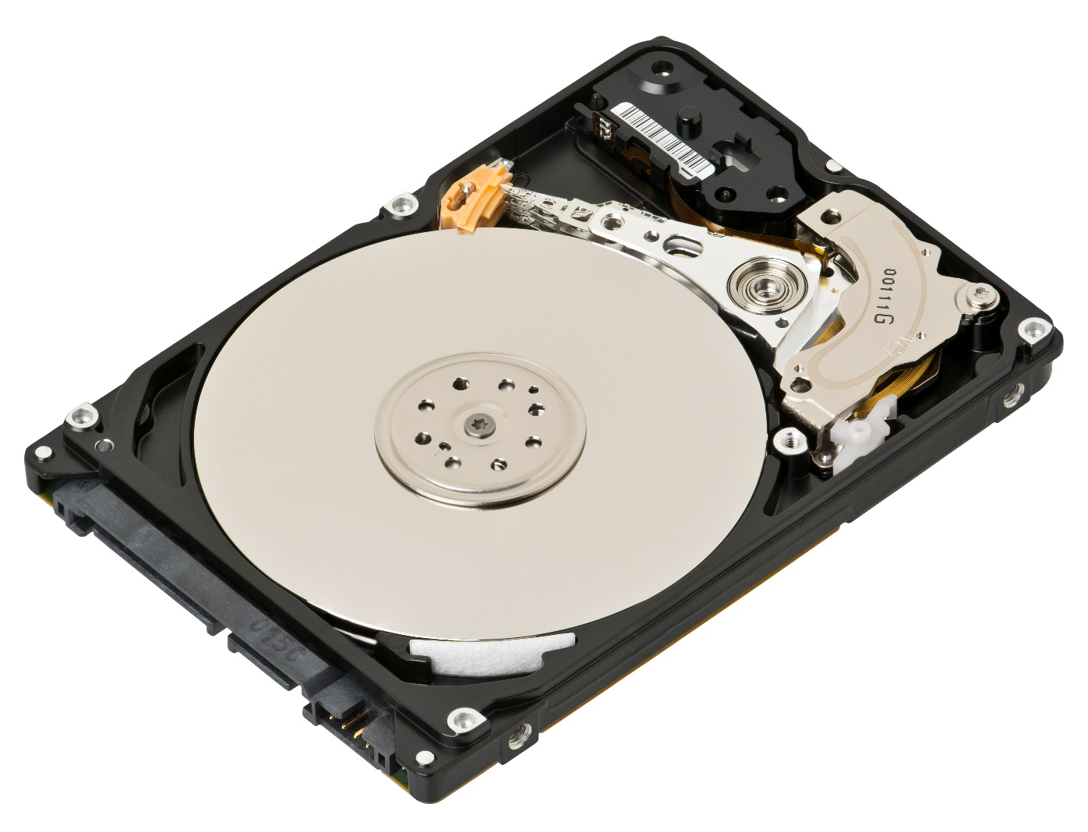

Backup Media Options
Local Machines
Hard disk in computer
External hard drives
Online Solutions
Networked drives (personal cloud)
Repositories
Versioning Tools
The “cloud”
2.5” 500 GB Western Digital SATA
Evan-Amos - CC BY-SA 3.0,

Slide 18
Spinning (metal) disk: Laptop or Desktop
Pros
High level of control over file system, naming, and physical location of disk
Easy to backup
convenient
Cons
Risk of malware (virus)
Risk of theft, damage, loss, etc
System can eventually corrupt the disk (especially pcs)
Finite lifespan
RECOMMENDATIONS:
Never have master copies on your computer
Not for long term storage
Have a backup plan for this storage option

Slide 19
Spinning (metal) disk: Network Server
Pros
High level of control over file system, naming, and physical location of disk
Likely has backup and maintenance schedule
Possible duplicate (mirror) images – RAID systems
Safe physical location
Cons
Expensive to maintain
Migration can be difficult
Susceptible to catastrophic events
Redundant Array of Inexpensive Disks
RECOMMENDATIONS:
Good for master copies
Good for up to 5 year storage

Slide 20
external storage: memory and drives
Pros
Drives are cheap (sort of) and portable
Convenient
Memory is cheap and portable
Cons
Connection technologies change (USB, Firewire, SATA, and so on)
Drive failure (both spinning drives and memory devices)
Easily damaged, stolen or lost
Finite space for large projects multiple drives may be necessary
Malware can be propagated (think unsafe sex)
RECOMMENDATIONS:
Not for master copies
Not for long term storage
Have a backup plan for this storage option
Does anyone use CDs anymore??? ZIP disks??? NOT recommended!!

Slide 21
external storage: magnetic tapes
Pros
Massive amounts of data, cheap
Fast backup
reusable
Cons
Slow retrieval
Degradation over time
Installation and maintenance is expensive
RECOMMENDATIONS:
Excellent for “rolling” backups

Slide 22
Networked drives: personal cloud
Pros
Drives are cheap (sort of) and portable
Convenient access from anywhere
Easy to install and sync
Private: password protected
Cons
Upload/download bottlenecks
Susceptible to acts catastrophic events
Needs permanent power
Needs IP address
RECOMMENDATIONS:
Good “third” option
Western Digital, Seagate . . .
Perhaps buy online, out of state?

Slide 23
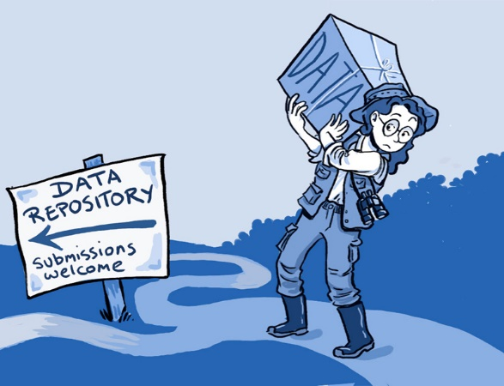
Data Repositories
“Sharing data from one laboratory to another—or even within a laboratory—takes time and effort, but there are also psychological, cultural and technological barriers to doing so.”
http://www.kavlifoundation.org/sites/default/files/image/resources/2014_SL_Neuro_Cartoon.jpg
Ainsley Seago, PLoS Biology
http://www.kavlifoundation.org/science-spotlights/breaking-down-data-barriers-neuroscience

Slide 24
Repository Directories
Registry of Research Data Repositories
http://www.re3data.org/
The Directory of Open Access Repositories
http://www.opendoar.org/
The Open Access Directory – Disciplinary Repositories
http://oad.simmons.edu/oadwiki/Disciplinary_repositories

Slide 25
Disciplinary Repositories
Biology and Life Sciences - Dryad
http://www.datadryad.org/repo/
Knowledge Network for Biodiversity
https://knb.ecoinformatics.org/
Data Observation Network for Earth
https://www.dataone.org/
Snow and Ice Data Center
https://nsidc.org/
Inter-University Consortium for Political and Social Research
http://www.icpsr.umich.edu/
FigShare
http://figshare.com/
These are just some examples, see previous slide for more

Slide 26
Repositories
Pros
Maintained by others
Your data is accessible, visible
Mostly cost free
Cons
Like journals, can be well recognized, but not necessarily
Takes time to format data and metadata correctly
Your data is accessible, visible
RECOMMENDATIONS:
Good preservation option
Not good for working data

Slide 27
Online Versioning and Sharing Services
For programmers only??
Github: http://github.com
Bitbucket: http://bitbucket.org
Project Management (for fee services)
Basecamp: http://basecamp.com
Teamwork: http://teamwork.com
Again, if you start a sequence of versions, add leading zeros
Version0001.docx
20150123_Version_0013.docx

Slide 28
Online Versioning and Sharing
Pros
Maintained by others
Often open text-based formats
Excellent version control and backup
Cons
Steep learning curve
Doesn’t handle proprietary data well
Your data is accessible, visible (sometimes)
RECOMMENDATIONS:
Depending on data type, can be good for working data
Privacy concerns vary

Slide 29
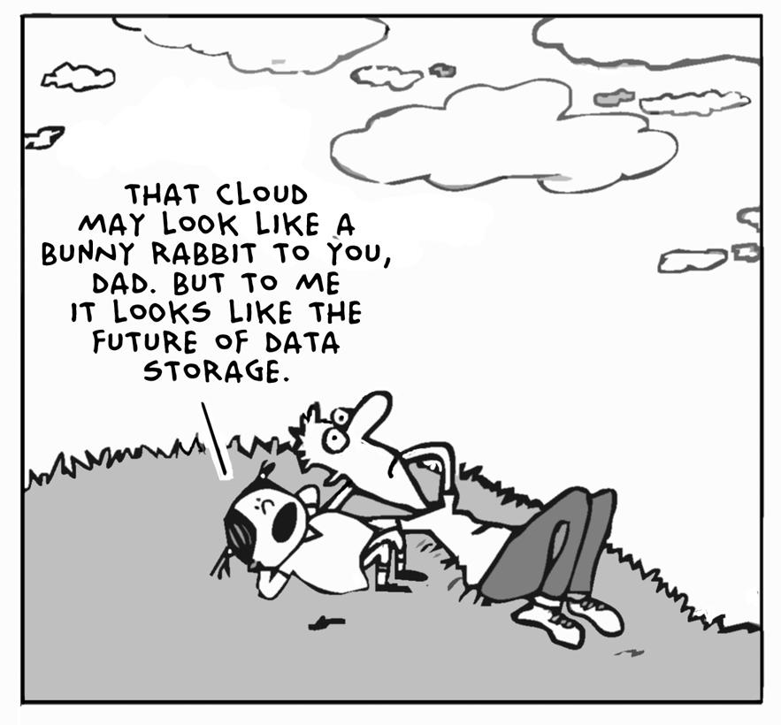
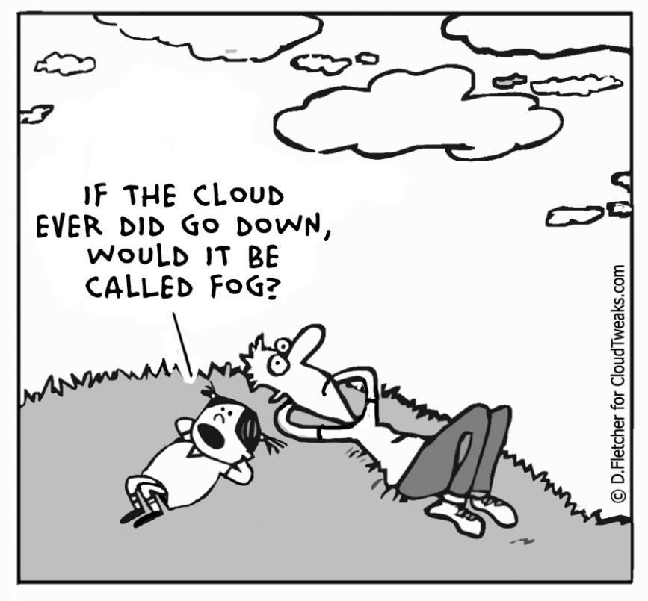
The Cloud
The term “cloud computing” (or just “cloud”, in the context of computing) is a marketing buzzword with no coherent meaning. It is used for a range of different activities whose only common characteristic is that they use the Internet for something beyond transmitting files. Thus, the term spreads confusion. If you base your thinking on it, your thinking will be confused.
Richard Stallman - https://www.gnu.org/philosophy/words-to-avoid.html
http://cloudtweaks.com/2012/02/the-lighter-side-of-the-cloud-future-cloud/ http://cloudtweaks.com/2012/04/the-lighter-side-of-the-cloud-the-fog/

Slide 30
Networked drives: the “Cloud”
Pros
No failure or backup worries (they do it)
Can be secure (depends)
Convenient
Good for catastrophic events
Cons
Upload/download bottlenecks
Fees?
Long-term? No standards?
How to get copies of all your data (try this for google drive)
No control
RECOMMENDATIONS:
Good for quick and dirty collaborations
Perhaps a good “third” option
Not good for large data
Privacy concerns vary

Slide 31
Storage and Backup file-syncing software in the cloud
Google Drive? Drop Box? Sky Drive? iCloud?
Drop Box is good for temporary sharing
Google Drive is good for collaborative work: synchronous file editing with multiple users
What about security?? privacy??
BOX - https://www.box.com/
University of Miami has an affiliation
All content is encrypted
All platforms are supported including smart phones
Recently became “unlimited”
http://www.miami.edu/it/index.php/about_it/aas/ps/documentation/box/
NOTE: make sure to do “Box Login” first. It will not work if you just download.

Slide 32
The Bottom Line: Storage and Backup [ best practices ]
DO
DON’T
RAID storage
External hard drives (XFAT)
Cloud storage and file-syncing
Duplicate computers or hard drives
Write down roles and responsibilities
Verify backups
Organize, file naming conventions, versioning
Have automatic backups
Open formats
USB thumb drives
Email files to yourself
Save files without knowing their location in the computer’s file structure
Backup when you remember
The XFAT format is essential if you ever want to share between a mac and a pc
Mac: Applications:Utilities:Disk Utility
PC: right click in explorer ->Format
Notes:
Save all original files – rename immediately

Slide 33
The Bottom Line: Storage and Backup [ best practices ]
DO
DON’T
Have all your work in at least three places at all times: working version + two backups
Drives fail, computers break, viruses happen, computers get stolen, usb thumb drives ALWAYS fail, you will make a mistake and delete your work on accident, ex-partners seek revenge, and the list goes on . . .
RAID storage
External hard drives (XFAT)
Cloud storage and file-syncing
Duplicate computers or hard drives
USB thumb drives
Email files to yourself
Save files without knowing their location in the computer’s file structure
The XFAT format is essential if you ever want to share between a mac and a pc
Mac: Applications:Utilities:Disk Utility
PC: right click in explorer ->Format
Notes:
Save all original files – rename immediately

Slide 34
Solutions on Campus
Cloud based (all these have collaboration tools)
Box (secure, encrypted) - unlimited
Google Drive (real time editing) - unlimited
OneDrive (email sharing, versioning) – 1 TB
If you need more space at the University of Miami go to the Center for Computational Science (CCS)
They sell space using the condo model
~28 TB for $7,000 (2015) – in perpetuity
Not necessarily backed up (but it is raided)
Talk to Joel Zysman at CCS

Slide 35
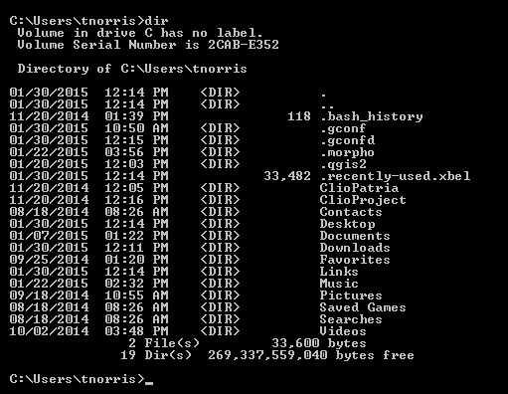
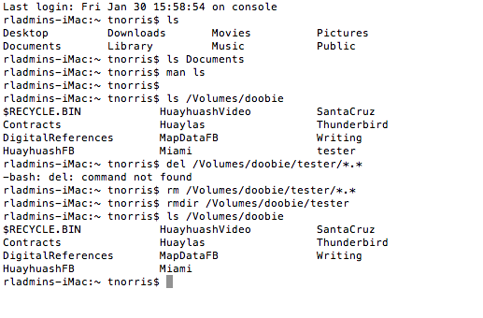
Storage and Backup
File syncing tools that exist on your machine already:
Mac: rsync
PC: xcopy
You will have to understand the command line first:
Mac: Applications/Utilities/Terminal
PC: Start Button->search “cmd”

Slide 36
Storage and Backup
PC: xcopy
-> xcopy <source> <destination> [<options>]
-> xcopy c:\Users\tnorris\Documents\MapData\*.* G:\MapData /D /S /Y
This copies all NEWER files from the MapData directory on the local machine to the backup MapData folder on an external hard drive.
-> xcopy /?
This will show all of the options for the xcopy command. You can see that /D tells xcopy to only copy newer files, /S goes through all sub-directories, and /Y tells xcopy to proceed without asking the user to confirm (be careful!!)
If this interests you, watch for the “Software Carpentry” workshops here at UM.
These are two day introductory programming workshops.

Slide 37
Storage and Backup
Mac: rsync
% rsync [<options>] <source> <destination>
% rsync -arvu /Users/tnorris/Documents/MapData/* /Volumes/MyDrive/MapDataFB
This copies all NEWER files from the MapData directory on the local machine to the backup MapDataFB folder on an external hard drive named “MyDrive”.
% man rsync
This will show all of the options for the rsync command. You can see that -a tells rsync preserve archival information (date stamps, owners, permissions), -r tells rsync to go through all sub-directories, -v tells rsync to tell you what it is doing (which files it copied), and –u will only update newer files and skip older files.
If this interests you, watch for the “Software Carpentry” workshops here at UM.
These are two day introductory programming workshops.

Slide 38
Storage and Backup
If you need space at the University of Miami go to the Center for Computational Science (CCS)
They sell space using the condo model
~28 TB for $7,000 (2015) – in perpetuity
Not necessarily backed up (but it is raided)
Talk to Joel Zysman at CCS

