Slide 1

Practical IP Considerations for Data
Sarah L. Shreeves
University of Miami Libraries

Slide 2
IANAL (I am not a lawyer)

Slide 3
The U.S. Constitution gives Congress the ability
"...to promote the Progress of Science and useful Arts, by securing for a limited Time to Authors and Inventors the exclusive Right to their respective Writings and Discoveries."
US copyright and patent law comes out of this phrase in the Constitution.

Slide 4
Three main IP Areas
A trademark is a word, phrase, symbol, and/or design that identifies and distinguishes the source of the goods of one party from those of others. A service mark is a word, phrase, symbol, and/or design that identifies and distinguishes the source of a service rather than goods.
A patent is a limited duration property right relating to an invention, granted by the United States Patent and Trademark Office in exchange for public disclosure of the invention. Patentable materials include machines, manufactured articles, industrial processes, and chemical compositions.
A copyright protects works of authorship that have been tangibly expressed in a physical form. Think songs, books, movies, and works of art.

Slide 5
So when we talk about IP issues and data what are we really talking about?

Slide 6
We might be talking about: - ownership – who controls the data but also heavily tied to ethics - copyright for compilations and other types of data - reuse rights – how do you determine how data can be reused?

Slide 7
Ownership of Data
Will depend heavily on institutional policy, but ownership of data generated under federal grants is pretty clearly the institutions
See Bayh-Dole Act - https://en.wikipedia.org/wiki/Bayh%E2%80%93Dole_Act
Also, https://ori.hhs.gov/education/products/rcradmin/topics/data/tutorial_2.shtml

Slide 8
Ethical considerations
What are the norms in your lab / researcher group?
Is there clarity and understanding about use of data?

Slide 9
Case studies
UC San Diego – USC: http://chronicle.com/article/Grant-Dispute-Throws-an/231857/
Student retracts paper over data ownership issue: http://retractionwatch.com/2013/02/22/med-student-loses-paper-when-former-boss-claims-right-to-data/
Researchers retracts paper over data ownership/permission issue: https://www.timeshighereducation.com/news/papers-retracted-after-authors-used-unauthorised-data-from-junior-researchers

Slide 10
Copyright protects…
Writing
Choreography
Music
Visual art
Film
Architectural works (as of Dec 1 1990)
Copyright doesn’t protect…
Ideas
Facts
Names, titles, slogans, or short phrases (could be trademarked, however)
Data
Useful articles (i.e. patents)
Notes:
Copyright protects creative works. Patent protects useful articles.

Slide 11
So…… what does copyright cover anyway?
reproduction
distribution
derivatives
performance
Public display
The right to license any of the above to third parties
Notes:
Notice I say rights – plural; copyright is not a single right, but a bundle of rights
Librarians are used to thinking about copyright from a use standpoint, but to help faculty when publishing, we need to think about copyright from an author’s standpoint
Reproduction (i.e., copies)
In print or electronic
For colleagues, students, conference attendees, anyone
Distribution
Sell, rent, lease, or lend publicly
Derivative creation
Adaptations, compilations, other new works based on protected work
Performance & Display
Literary, musical, dramatic, choreographic, pantomimes
Motion pictures and other AV works (performance)
Pictorial, graphic or sculptural works, including individual images from motion pictures and other AV works (display)
Digital audio transmission of sound recordings are considered display

Slide 12
Some more basics….
Protection is automatic once a work is fixed
Very little creative originality is necessary
Registration is not necessary (since 1989)
Works made for hire vest copyright with the institution/organization, not the author
FYI: colleges & universities usually do not claim copyright in faculty works
Joint authors each have equal, full copyright
Notes:
These are basic points about copyright that I hope everyone in this room already knows. If you don’t, you need to.
Many of your faculty won’t know these fundamental points, so you should. I’m going to leave this slide up for a few moments while I get your help on a little project.
Now….who here enjoyed Mad Libs as a kid?

Slide 13
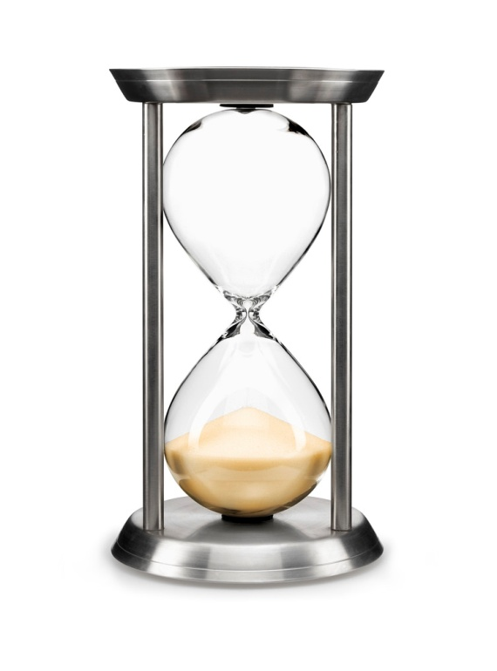
As run the sands of time…
The bundle of copyrights lasts a long time:
Life of the author plus 70 years
For joint works, 70 years after death of last author
For works for hire or anonymous works, 95 years from publication or 120 years from creation, whichever expires first.
But lots of exceptions:
http://copyright.cornell.edu/resources/publicdomain.cfm

Slide 14
Exceptions to Rights of Owners
Public domain
Published before 1923, government works, IDEAS!
Section 107 - Fair use!
Section 108 – Library copying (preservation / ILL)
Section 109(a) – First sale doctrine
Section 109(c) - Exception for public displays
Section 110(1) – Displays and performances in ftf teaching
Teach Act

Slide 15
Fair Use
There is no easy formula for determining fair use, but there are four factors to consider:
The nature of the work (factual, creative)
The purpose of the use (educational, for-profit)
Amount of the work being used
The potential impact of the use on the market for the original.
Notes:
That notice at the beginnings of movies and sporting events: bunk.
In practice, a lot of it will depend on risk. There are uses that are probably fair owned by people who will probably sue, and uses that are maybe less likely to be fair, but there is no known copyright holder and so you’ll probably be okay.
May also depend on your publisher, if you’re working with one. Some will require permission, or proof that something is in the public domain, before they’ll publish. Others will be more open with their interpretation.
Work you do as a student gives you a great deal of leeway as far as Fair Use. Give special thought to things you’re putting online.

Slide 16
What about reuse of data
Norms and expectations of:
Funders
Publishers
Discipline
Lab/PI

Slide 17
If you can share data, how can you communicate about use?
Licenses – restrictive and non-restrictive
http://opendatacommons.org/licenses/
https://creativecommons.org/about/cc0/

Slide 18
Other considerations
Confidentiality and IRB – what did you commit to with your subjects and the IRB?
Contracts – are you getting your data from somewhere else?
Regulations – HIPPA, FERPA, etc

Slide 19
This work is based in part on a presentation by Molly Keener & Kevin Smith for the ACRL Scholarly Communication 101 workshops. Last updated November 6, 2015.
This work is licensed under a Creative Commons Attribution Non-Commercial Share Alike 3.0 United States license: http://creativecommons.org/licenses/by-nc-sa/3.0/.

