Slide 1
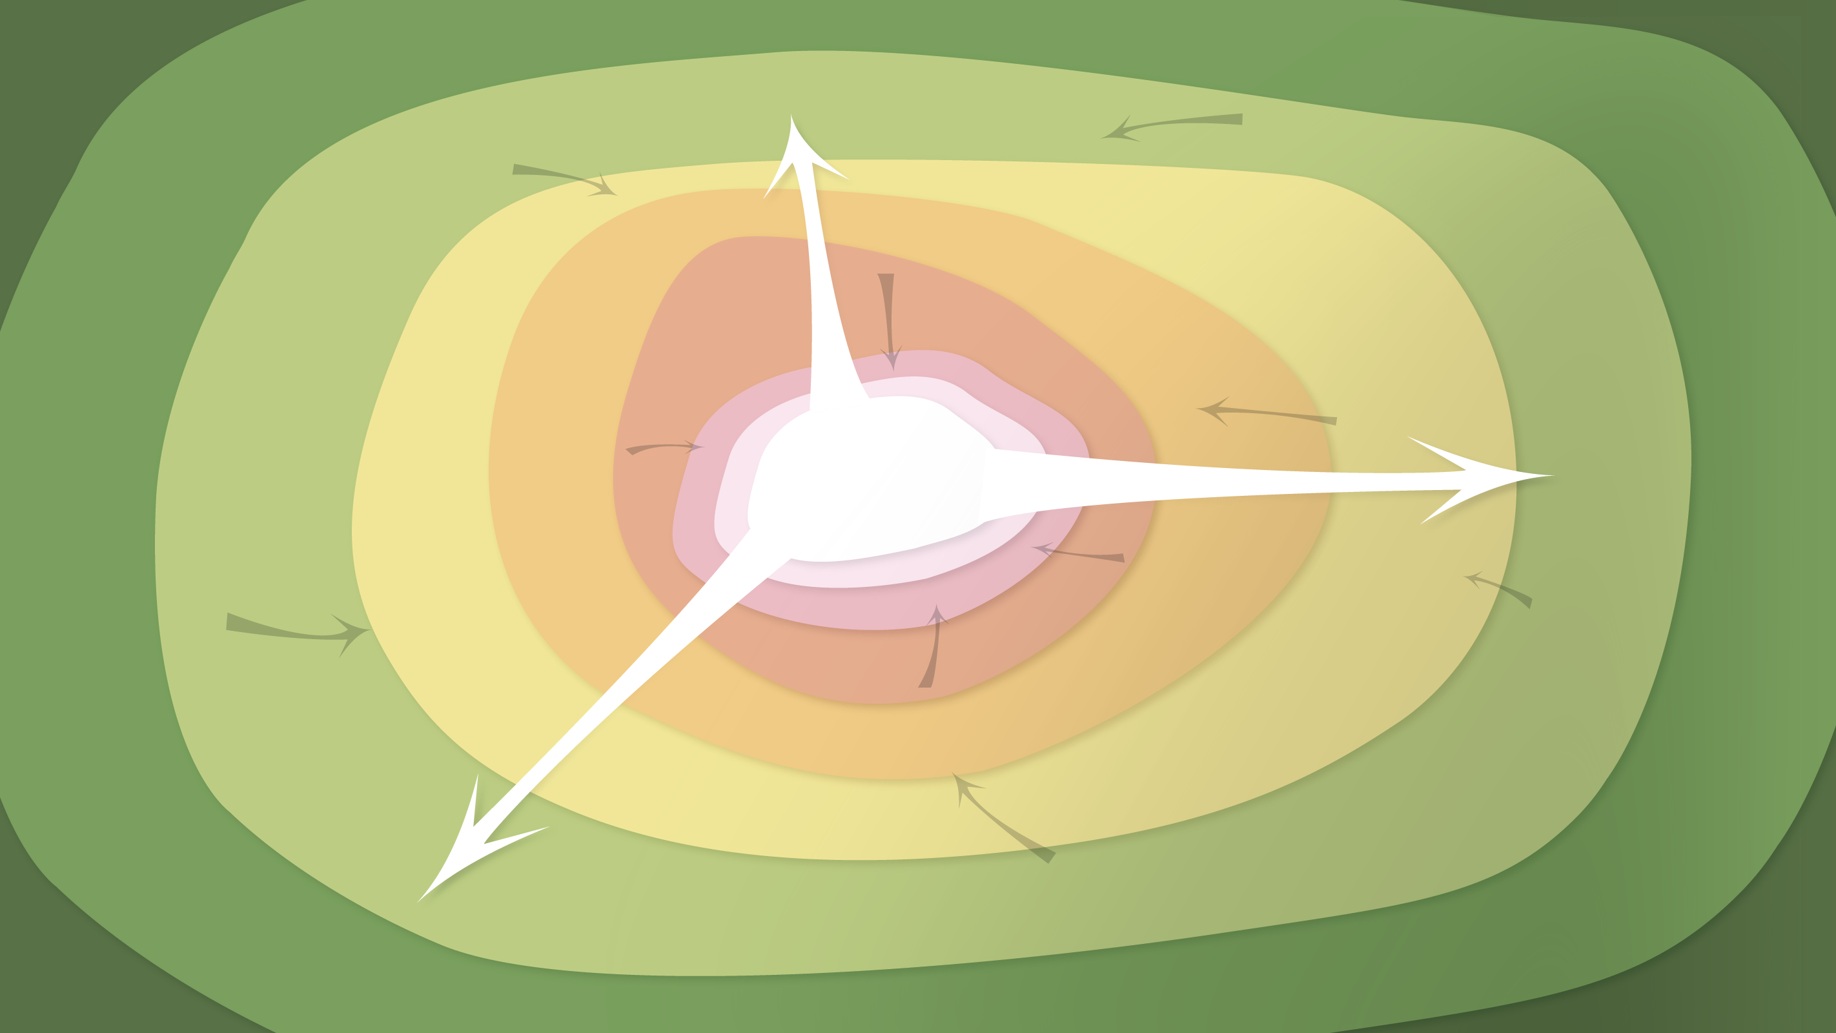
Data Management in the Research Environment
RSM 574/674 Spring 2016
Timothy Norris – tnorris@miami.edu
Angela Clark – aclark@rsmas.miami.edu

Slide 2
Todays Topics Metadata
Describing Data
Parts of the Whole
A library perspective

Slide 3
A Love Letter to the Future

Slide 4
Schemas as Walls

