Slide 1
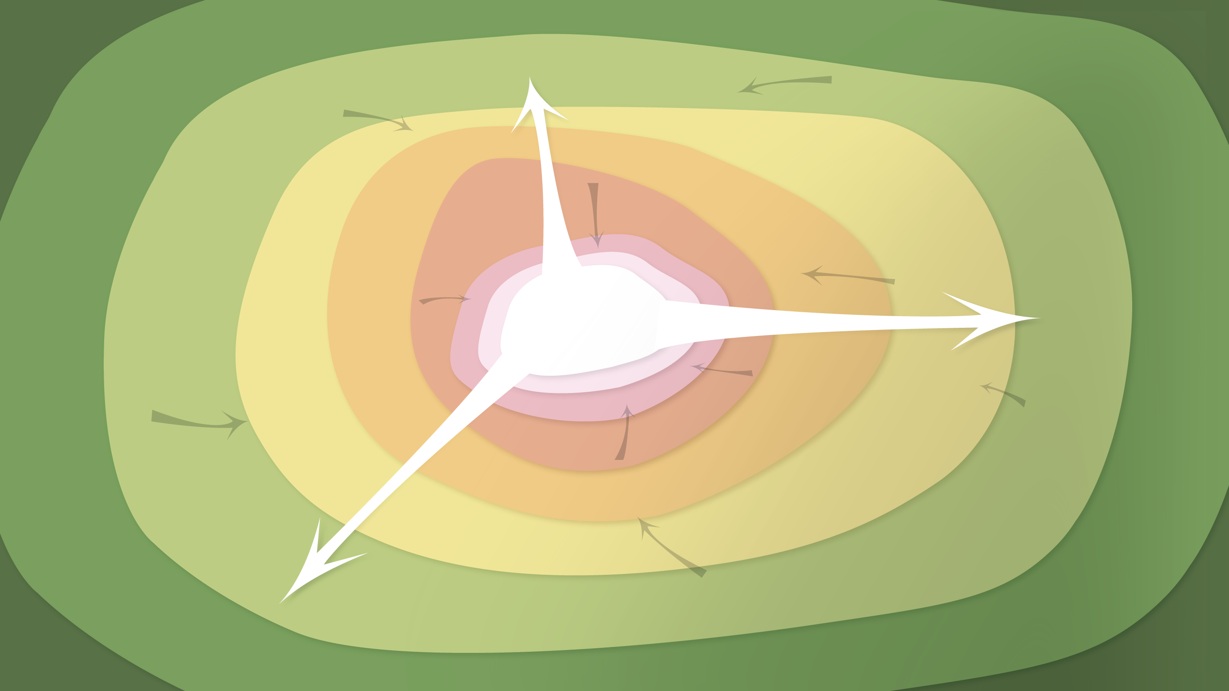
Data Management in the Research Environment
RSM 574/674 Spring 2016
Timothy Norris – tnorris@miami.edu
Angela Clark – aclark@rsmas.miami.edu

Slide 2
Todays Topics Data Curation Profiles
The UM data curation experience
Profile Examples (brief presentations)
Software Carpentry – git – version control

Slide 3
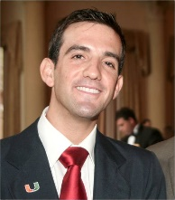
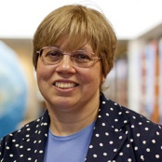

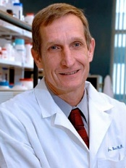

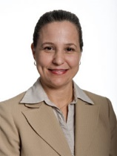
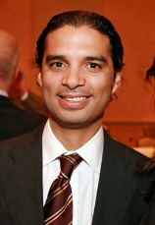
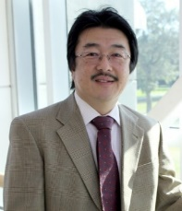


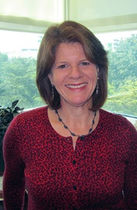

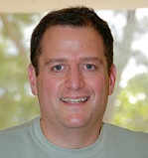

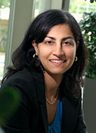
The Work
Field
Dirty
Several presentations
Miller
ACAC
CCS
Data Wrangling Seminars
RSMAS
Engineering
History
Many informal conversations
Department heads
Other identified ‘key informants’
10 different schools
15 different departments
23 formal interviews

Slide 4
The Dirty Work
Several presentations
Miller
ACAC
CCS
informal
conversations
engaged
outreach
Data Wrangling Seminars
RSMAS
Engineering
History
semi-structured
interviews
participant observation
Many informal conversations
Department heads
Other identified ‘key informants’
Thick Description
10 different schools
15 different departments
23 formal interviews
Geertz, C. (1973). Thick description: towards an interpretive theory of culture. In C. Geertz, The interpretation of cultures: selected essays (pp. 3-30). New York: Basic Books.

Slide 5
The Dirty Work
Several presentations
Miller
ACAC
CCS
Informal
conversations
engaged
outreach
method of analysis
Data Wrangling Seminars
RSMAS
Engineering
History
process over product
Many informal conversations
Department heads
Other identified ‘key informants’
Semi-structured
interviews
participant observation
“observing participant”
community building
Thick Description
10 different schools
15 different departments
23 formal interviews

Slide 6


DATA CURATION

Slide 7








most valuable data are the relationships identified in the
literature (and between data) – the bibliography
algorithms
data as research input and output
actual code
Big Data are the exception
raw data
long-term curation for
data is lacking
processed data
human resources are the
limiting factor
Data
analyzed data
good data management
crosses personal and
professional boundaries
model output
there is desire to share, but
NSF is “on the wrong track”
input parameters
media resources
competing researchers mess up
sharing, sometimes competition
encourages sharing
communications
written drafts
rescue the past or capture the future
“Everything you need to know is in the article”
best way forward is in
development of standards and skill sets

Slide 8

Teaching materials
e-journals
professional/gray lit.
[ word press / piazza ]
Personal
servers
blogs
external drives/
personal cloud
versioning (SVN, GIT)
cloud sync
technologies
Google drive
spider-oak [?]
Box
distributed data model
departmental servers
Sharing
Servers/RAID
[ not so good for catastrophic events ]
Backup
[ centralized index ]
repositories
off-campus — on-campus
its mine
USB drives
“The NSF got it all wrong”
metrics/alt metrics
“boxes of CDs”
The stick:
No more grant $$$ [?!]
The carrot:
data as publication [?!]
Identification/privacy issues
NONE!?
its for sharing
“some people don’t share
because they’re jerks”
Notes:
Curation is already taking place on campus, but it is not labeled as such
Several repositories starting on campus: RSMAS – Mapes (atmospheric science) – NSF grant
Miller – Bixby/Lemmon – NIH grant
Departmental Servers:
Engineering – Dr. Zak [???]
UM signing contract with google for drive [?]
There have been problems with permissions on google drive
Sharing cultures: - age is factor (career position and generational)
disciplinary divisions
ecology and earth sciences very open
physics and chemistry tend to have open culture (monetizable?)
social science varies (identity issues, ownership issues)
genetics some (from early 1990s genBANK)
computer science – very little
health/medicine varies (identity issues, monetizable)
De-identification is NOT enough [ people are easy to identify with interview data – this study is perfect example ]
Size is not generally a problem, BUT exceptions are important to locate (atmospheric science, genetics, some imagery and media)

Slide 9
funder
packaged data for mining
university
self-created <> purchased
often not considered
sensor data libraries
Research group
strong sense of
ownership in research
community
public domain
BUT
often license agreements
for base data
Value
inputs
DOI/ARK
Ownership
Metadata standards
Includes duties
(not obligations)
sharing / curation
[ NOT MUCH EXISTS HERE ]
outputs
High future value
MONETIZABLE
banking/
market based
processed and analyzed data
[ well documented ]
patents
co-production / hybrid ownership
knowledge commons
licenses
$$$$ investment for data creation/capture?
raw data and model output
[ little documentation ]
[ problematic versioning ]
[ old proprietary software]
open access
Low future value
NON-MONETIZABLE
Notes:
Data Organization/Management/Curation
“tagging” as data organization
File naming/folder structure as data organization
Metadata
Provenance / process steps [!!]
Consider the semantic web – ontologies – controlled vocabularies
Sensor data
Who maintains libraries? LOCKSS?
Data mining packages
High cost to create
How licensed, owned, shared
Data Ownership based on exclusion and control
Co-production – several researchers face this problem [ myself included ]

Slide 10

Key
Observations
Data curation is already happening
Human resources are the key
Capture the future:
teach good data habits!!
Teaching materials need attention
Nothing new from interviews
– but continued socialization is key
Metadata (but not that word)
Notes:
Data Organization/Management/Curation
“tagging” as data organization
File naming/folder structure as data organization
Metadata
Provenance / process steps [!!]
Consider the semantic web – ontologies – controlled vocabularies
Sensor data
Who maintains libraries? LOCKSS?
Data mining packages
High cost to create
How licensed, owned, shared
Data Ownership based on exclusion and control
Co-production – several researchers face this problem [ myself included ]

Slide 11
Next
steps
Data Management Services
Data Management Plans
Data Publication
Data Preservation
Develop Curricula
For RSMAS grad course – Spring 2016
For library training – Fall 2015
Pilot Projects (see next slides)
Data repository development (Bepress?)
Distributed data / central index
LOCKSS
Amplification Plans
Continue assessment interviews/socialization
Notes:
Data Organization/Management/Curation
“tagging” as data organization
File naming/folder structure as data organization
Metadata
Provenance / process steps [!!]
Consider the semantic web – ontologies – controlled vocabularies
Sensor data
Who maintains libraries? LOCKSS?
Data mining packages
High cost to create
How licensed, owned, shared
Data Ownership based on exclusion and control
Co-production – several researchers face this problem [ myself included ]

Slide 12
**break**

Slide 13
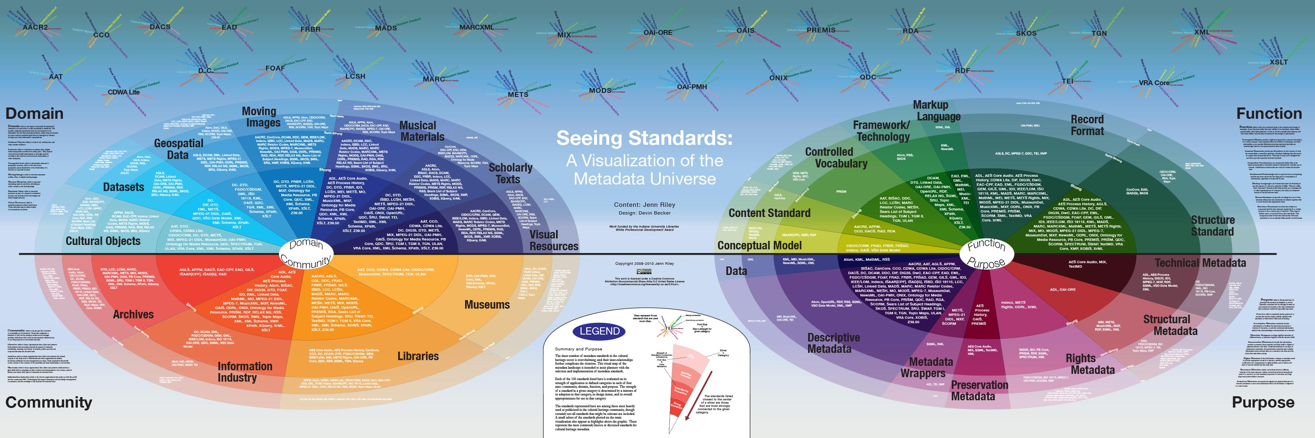
‘Reading’ for February 29th
Riley, “Seeing Standards.” http://www.dlib.indiana.edu/~jenlrile/metadatamap/.
Download and study this poster
We will do a critique of this poster in class on Monday February 29th. Be prepared to discuss strengths and weaknesses. Also, look up at least ten acronyms that you don’t know and be prepared to describe them.

Slide 14
Reading for March 2nd ^{Choose One}
Curdt, Constanze, Dirk Hoffmeister, Guido Waldhoff, Christian Jekel, and Georg Bareth. "Scientific Research Data Management for Soil-Vegetation-Atmosphere Data—The TR32DB." International Journal of Digital Curation 7, no. 2 (2012): 68-80. http://www.ijdc.net/index.php/ijdc/article/view/220/295
[ for ecology: read the introduction through to 2.3.4 ] KNB (no date). “Ecological Metadata Language (EML) Specification.” The Knowledge Network, https://knb.ecoinformatics.org/#external//emlparser/docs/eml-2.1.1/index.html.
[ for marine biology ] Neiswender (2010). "Introduction to Metadata." In The MMI Guides: Navigating the World of Marine Metadata. http://marinemetadata.org/guides/mdataintro.
[ for atmospheric science: read the introduction through 2.6.2 ] Eaton, et al (2011). NetCDF Climate and Forecast (CF) Metadata Conventions. http://cfconventions.org/Data/cf-conventions/cf-conventions-1.6/build/cf-conventions.pdf.
[ for marine geology: read the introduction through chapter 6 ] SEG (2015). SEG Y rev 2 Data Exchange Format. http://www.seg.org/documents/51956/6062543/SEG-Y+rev+2+Draft+Jan+2015
[ for geographic data: read the introduction through page 31 ] FGDC (2000). Content Standard for Digital Geospatial Metadata Workbook, Version 2.0. https://www.fgdc.gov/metadata/documents/workbook_0501_bmk.pdf.

Slide 15
Software Carpentry Workshop in PYTHON and R [ this information is also on Blackboard ]
R WORKSHOP - Monday March 14 and Tuesday March 15, at 8:30AM - 3:00PM
Register: https://umiami.qualtrics.com/SE/?SID=SV_6WMTsZDdZF93KLP
At the Shalala Student Center complex, Senate Room
(1330 Miller Drive, Coral Gables, FL 33146)
PYTHON WORKSHOP - Monday March 28 and Tuesday March 29, at 9:30AM - 4:00PM
Register: https://umiami.qualtrics.com/SE/?SID=SV_0qwpcwD530f9uBf
At the Newman Alumni Center, Executive Conference Room
(6200 San Amaro Drive, Coral Gables, FL 33146)
Please register for one (only)!

